Slide 1
Convex Hull Algorithm
Jarvis March or Gift Wrapping Algorithm

Slide 2
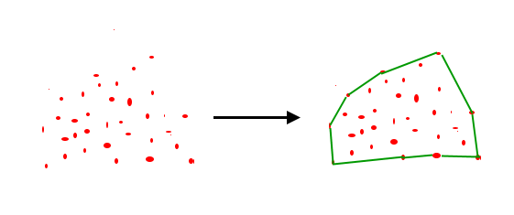
Given a set of points in the plane. the convex hull of the set is the smallest convex polygon that contains all the points of it.

Slide 3
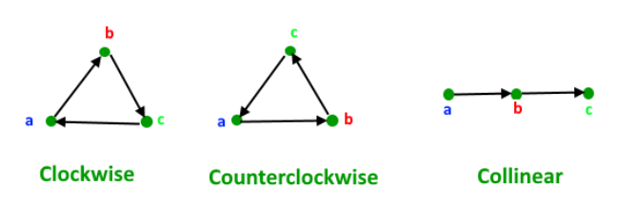
How to check if two given line segments intersect?
Given two line segments (p1, q1) and (p2, q2), find if the given line segments intersect with each other. let us define notion of orientation. Orientation of an ordered triplet of points in the plane can be –counterclockwise –clockwise –collinear
The following diagram shows different possible orientations of (a, b, c)

Slide 4
How is Orientation useful here?
Two segments (p1,q1) and (p2,q2) intersect if and only if one of the following two conditions is verified
1. General Case:
– (p1, q1, p2) and (p1, q1, q2) have different orientations and
– (p2, q2, p1) and (p2, q2, q1) have different orientations.
2. Special Case – (p1, q1, p2), (p1, q1, q2), (p2, q2, p1), and (p2, q2, q1) are all collinear and – the x-projections of (p1, q1) and (p2, q2) intersect – the y-projections of (p1, q1) and (p2, q2) intersect

Slide 5
