Slide 1
Chapter 1
Fundamental Concept
Graph Theory
1.1 What Is a Graph?
1.2 Paths, Cycles, and Trails
1.3 Vertex Degree and Counting
1.4 Directed Graphs
Ch. 1. Fundamental Concept

Slide 2
The KÖnigsberg Bridge Problem
Graph Theory
Königsber is a city on the Pregel river in Prussia
The city occupied two islands plus areas on both banks
Problem:
  Whether they could leave home, cross every bridge exactly once, and return home.
X
W
Y
Z
Ch. 1. Fundamental Concept

Slide 3
A Model
Graph Theory
A vertex: a region
An edge: a path(bridge) between two regions
e₁
X
e₆
X
e₂
W
Y
W
Y
e₅
e₄
e₃
e₇
Z
Z
Ch. 1. Fundamental Concept

Slide 4
What Is a Graph?
Graph Theory
A graph G is a triple consisting of:
  A vertex set V(G)
  An edge set E(G)
  A relation between an edge and a pair of vertices
X
e₁
e₆
e₂
W
e₅
Y
e₄
e₃
e₇
Z
Ch. 1. Fundamental Concept

Slide 5
Loop, Multiple edges
Graph Theory
Loop: An edge whose endpoints are equal
Multiple edges: Edges have the same pair of endpoints
Multiple
edges
loop
Ch. 1. Fundamental Concept

Slide 6
Graph Theory
Simple Graph
Simple graph: A graph has no loops or multiple edges
Multiple
edges
loop
It is not simple.
It is a simple graph.
Ch. 1. Fundamental Concept

Slide 7
Adjacent, neighbors
Graph Theory
Two vertices are adjacent and are neighbors if they are the endpoints of an edge.
Example:
  A and B are adjacent.
  A and D are not adjacent.
A
B
C
D
Ch. 1. Fundamental Concept

Slide 8
Finite Graph, Null Graph
Graph Theory
Finite graph: an graph whose vertex set and edge set are finite.
Null graph: the graph whose vertex set and edges are empty.
Ch. 1. Fundamental Concept

Slide 9
Path and Cycle
Graph Theory
Path: a sequence of distinct vertices such that two consecutive vertices are adjacent.
  Example: (a, d, c, b, e) is a path
  (a, b, e, d, c, b, e, d) is not a path; it is a walk.
Cycle: a closed Path
  Example: (a, d, c, b, e, a) is a cycle
a
b
c
e
d
Ch. 1. Fundamental Concept

Slide 10
Walks, Trails1.2.2
Graph Theory
A walk: a list of vertices and edges v₀, e₁, v₁, …., e_{k}, v_{k} such that, for 1≤i≤k, the edge e_{i} has endpoints v_{i-1} and v_{i}.
A trail : a walk with no repeated edge.
Ch. 1. Fundamental Concept

Slide 11
Paths 1.2.2
Graph Theory
A u,v-walk or u,v-trail has first vertex u and last vertex v; these are its endpoints.
A u,v-path: a u,v-trail with no repeated vertex.
The length of a walk, trail, path, or cycle is its number of edges.
A walk or trail is closed if its endpoints are the same.
Ch. 1. Fundamental Concept

Slide 12
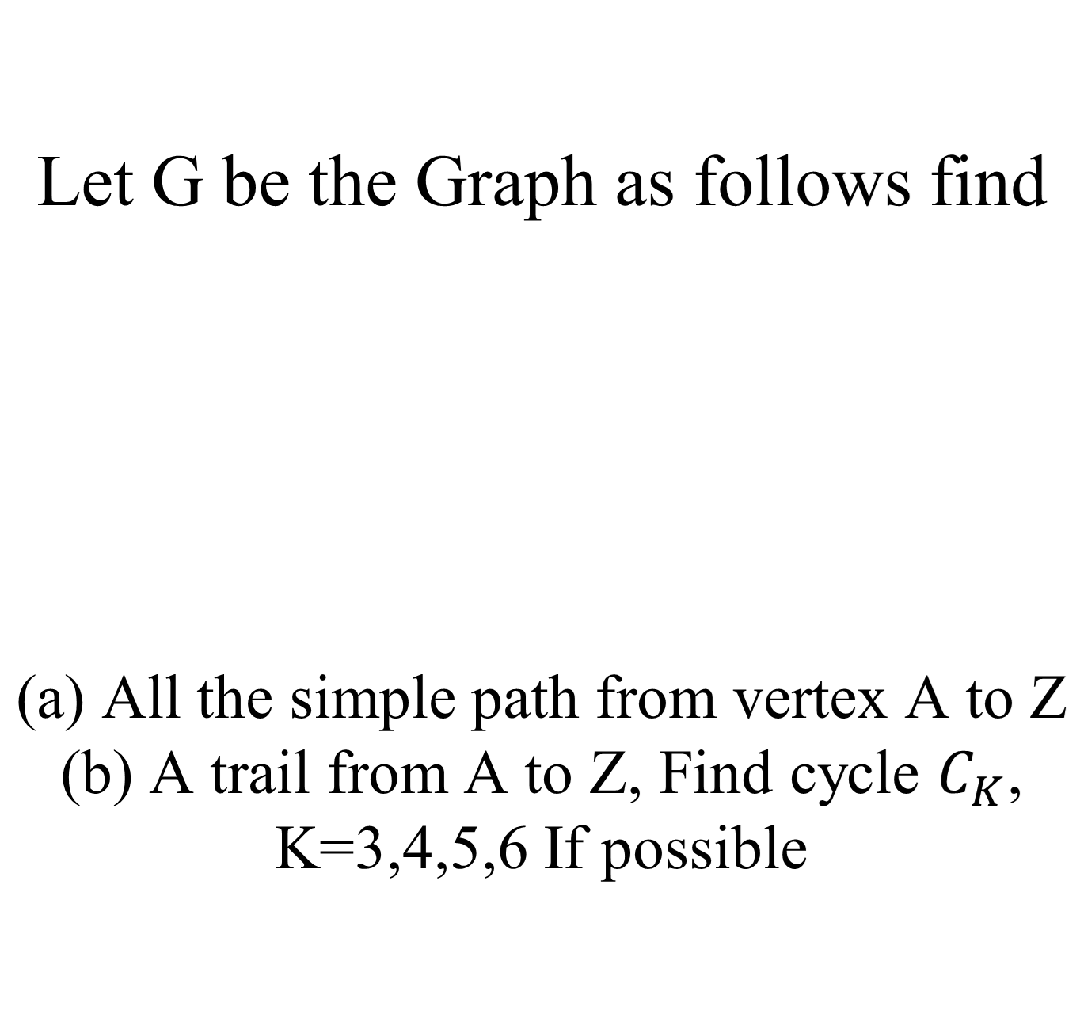
Graph Theory
A
B
A
B
C
X
Y
Z
X
Y
Z
Ch. 1. Fundamental Concept

Slide 13
Ex. Determine whether each of the following is a path, trail or cycle.
Graph Theory
A
C
(B,X,C,B)
(X,A,B,Y)
(B,X,Y,B)
(B,A,X,C,B,Y)
(X,C,A,B,Y)
(X,B,A,X,C)
(X,B,A,X,B)
(A,B,C,X,B,A)
(X,C,B,A)
B
Y
X
Ch. 1. Fundamental Concept

Slide 14
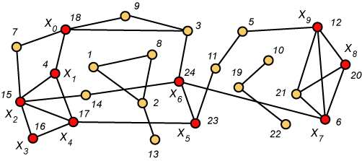
A Path from 18 to 12
Graph Theory
Ch. 1. Fundamental Concept

Slide 15
Subgraphs
Graph Theory
A subgraph of a graph G is a graph H such that:
  V(H) ⊆ V(G) and E(H) ⊆ E(G) and
  The assignment of endpoints to edges in H is the same as in G.
Ch. 1. Fundamental Concept

Slide 16
Subgraphs
Graph Theory
Example: H₁, H₂, and H₃ are subgraphs of G
a
b
G
c
e
d
a
b
a
b
c
H₃
c
H₁
H₂
d
e
d
e
d
Ch. 1. Fundamental Concept

Slide 17
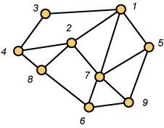
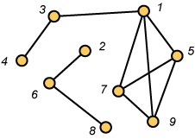
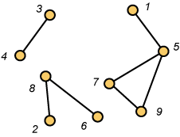
Graph Theory
NO YES
Ch. 1. Fundamental Concept

Slide 18
Connected and Disconnected
Graph Theory
Connected: There exists at least one path between two vertices.
Disconnected: Otherwise
Example:
  H₁ and H₂ are connected.
  H₃ is disconnected.
a
b
a
b
H₁
c
H₂
H₃
c
d
e
d
e
d
Ch. 1. Fundamental Concept

Slide 19
Complement
Graph Theory
Complement of G: The complement G’ of a simple graph G :
  A simple graph
  V(G’) = V(G)
  E(G’) = { uv | uv ∉E(G) }
u
u
v
y
v
G
y
G’
w
x
w
x
Ch. 1. Fundamental Concept

Slide 20
Clique and Independent set
Graph Theory
A Clique in a graph: a set of pairwise adjacent vertices (a complete subgraph)
An independent set in a graph: a set of pairwise nonadjacent vertices.
Example:
  {x, y, u} is a clique in G.
  {u, w} is an independent set.
u
G
y
v
x
w
Ch. 1. Fundamental Concept

Slide 21
Bipartite Graphs
Graph Theory
A graph G is bipartite if V(G) is the union of two disjoint independent sets called partite sets of G
Also: The vertices can be partitioned into two sets such that each set is independent
Matching Problem
Job Assignment Problem
Workers
Boys
Girls
Jobs
Ch. 1. Fundamental Concept

Slide 22
Theorem: A graph is bipartite if and only if it has no odd cycle.
Graph Theory
Examples:
_{A}
_{B}
_{A}
_{B}
_{F}
_{C}
_{E}
_{D}
_{D}
_{C}
_{A}
_{B}
_{A}
_{B}
_{C}
_{D}
_{C}
_{D}
_{E}
_{F}
Ch. 1. Fundamental Concept

Slide 23
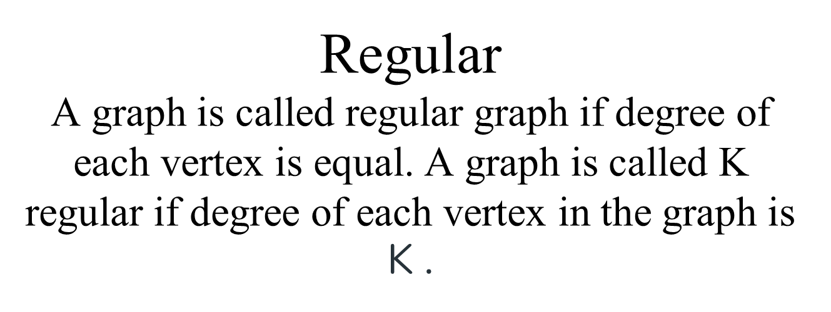
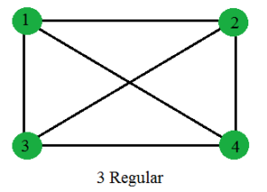
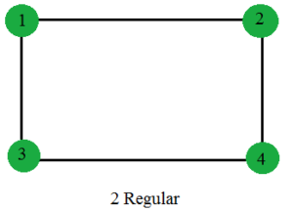
Graph Theory
3-regular
Ch. 1. Fundamental Concept

Slide 24
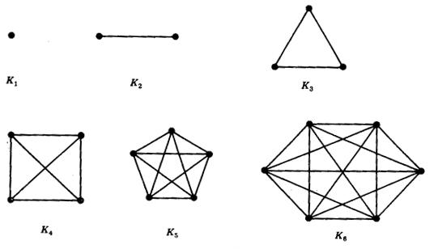
Complete Graph
Graph Theory
Complete Graph: A complete graph is a graph in which each vertex is connected to every other vertex.
Ch. 1. Fundamental Concept

Slide 25
Complete Bipartite Graph or Biclique
Graph Theory
Complete bipartite graph (biclique) is a simple bipartite graph such that two vertices are adjacent if and only if they are in different partite sets.
Complete Graph
Complete Bipartite Graph
Ch. 1. Fundamental Concept

Slide 26
Adjacency, Incidence, and Degree
Graph Theory
Assume e_{i} is an edge whose endpoints are (v_{j},v_{k})
The vertices v_{j} and v_{k} are said to be adjacent.
The edge e_{i} is said to be incident upon v_{j}
Degree of a vertex v_{k} is the number of edges incident upon v_{k} . It is denoted as d(v_{k})
e_{i}
v_{j}
v_{k}
Ch. 1. Fundamental Concept

Slide 27
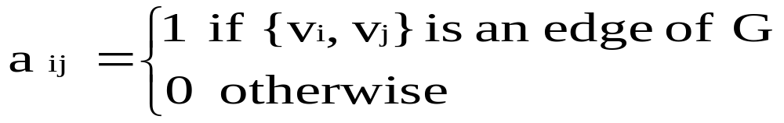
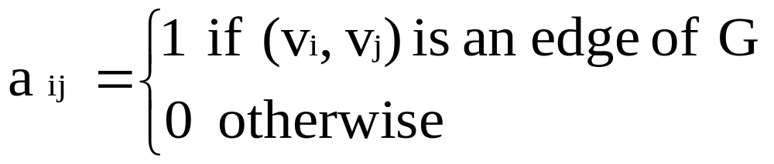
Adjacency matrix
Graph Theory
There is an N x N matrix, where |V| = N , the Adjacenct Matrix (NxN) A = [a_{ij}]
For undirected graph
For directed graph
Ch. 1. Fundamental Concept

Slide 28
Adjacency matrix
Graph Theory
Example: Undirected Graph G (V, E)
u
 | v | u | w
v | 0 | 1 | 1
u | 1 | 0 | 1
w | 1 | 1 | 0
e1
e2
v
w
e3
Ch. 1. Fundamental Concept

Slide 29
Adjacency matrix
Graph Theory
Example: Undirected Graph G (V, E)
w
w x y z
0 1 1 0
1 0 2 0
1 2 0 1
0 0 1 0
wxyz
b
y
z
a
c
e
x
d
Ch. 1. Fundamental Concept

Slide 30
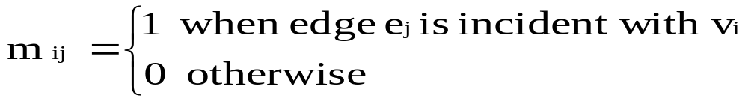
Incidence Matrix
Graph Theory
G = (V, E) be an undirected graph. Suppose that v₁, v₂, v₃, …, v_{n} are the vertices and e₁, e₂, …, e_{m} are the edges of G. Then the incidence matrix with respect to this ordering of V and E is the nx m matrix M = [m _{ij}], where
Can also be used to represent :
Multiple edges: by using columns with identical entries, since these edges are incident with the same pair of vertices
Loops: by using a column with exactly one entry equal to 1, corresponding to the vertex that is incident with the loop
Ch. 1. Fundamental Concept

Slide 31
Graph Theory
Incidence Matrix
u
 | e₁ | e₂ | e₃
v | 1 | 0 | 1
u | 1 | 1 | 0
w | 0 | 1 | 1
e1
e2
v
w
e3
Ch. 1. Fundamental Concept

Slide 32
Incidence Matrix
Graph Theory
w
b
a b c d e
1 1 0 0 0
1 0 1 1 0
0 1 1 1 1
0 0 0 0 1
wxyz
y
a
c
z
e
x
d
Ch. 1. Fundamental Concept

Slide 33
Adjacency matrix
Graph Theory
Example: directed Graph G (V, E)
u
 | v | u | w
v | 0 | 1 | 0
u | 0 | 0 | 1
w | 1 | 0 | 0
v
w
Ch. 1. Fundamental Concept

Slide 34
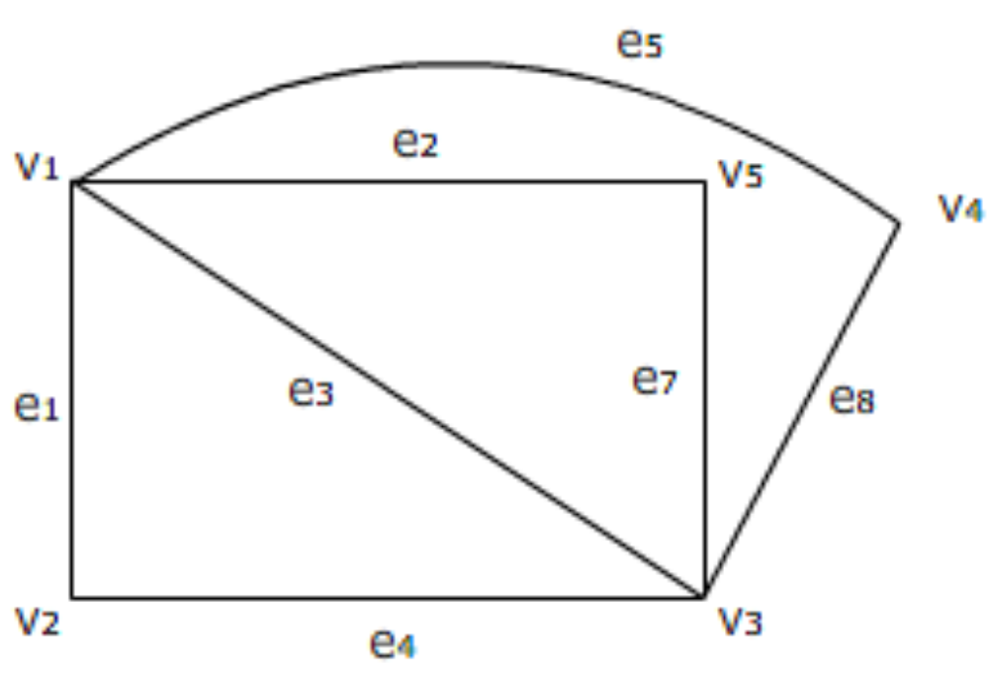
Adjacency matrix
Graph Theory
Ch. 1. Fundamental Concept

Slide 35
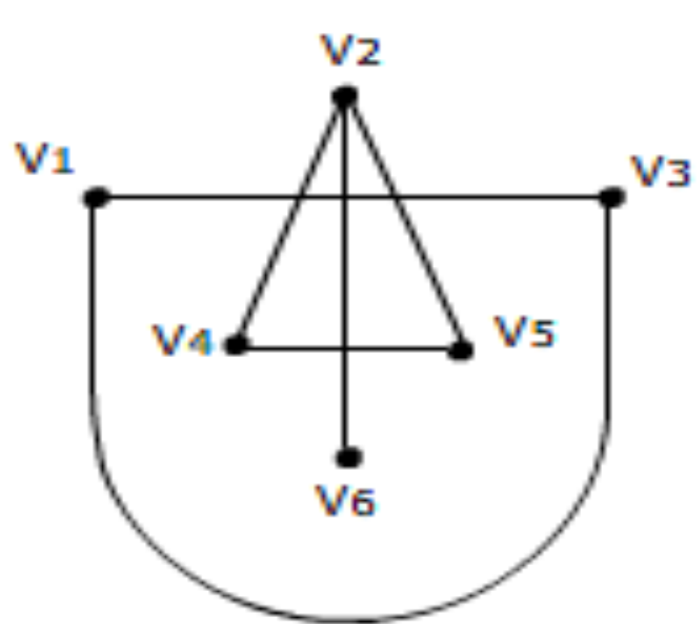
Adjacency matrix
Graph Theory
Ch. 1. Fundamental Concept

Slide 36
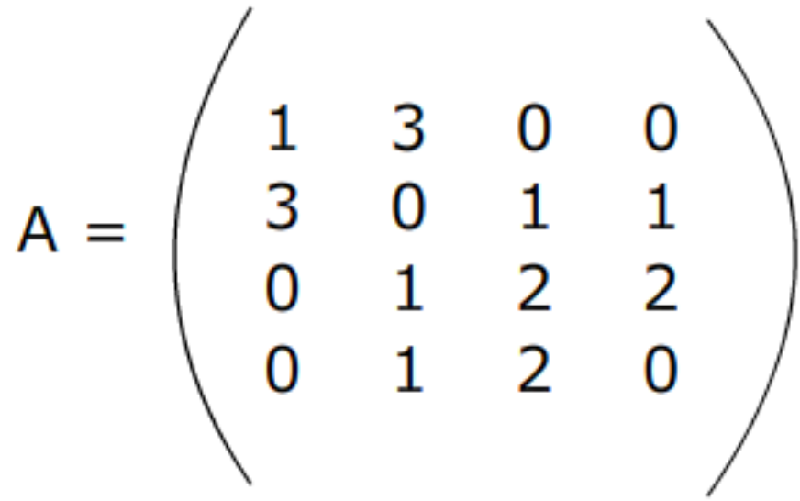
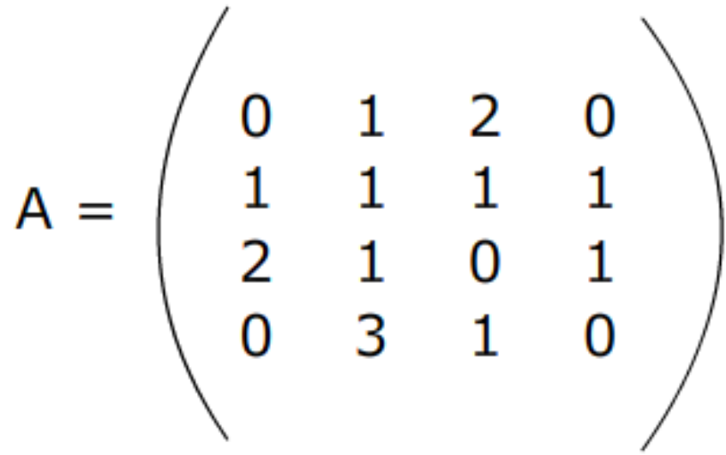
Draw the multigraph whose adjacency matrix is as follows:
Graph Theory
Ch. 1. Fundamental Concept

Slide 37
Chromatic Number
Graph Theory
The chromatic number of a graph G, written x(G), is the minimum number of colors needed to label the vertices so that adjacent vertices receive different colors
Blue
Green
x(G) = 3
Blue
Red
Ch. 1. Fundamental Concept

Slide 38
Maps and coloring
Graph Theory
A map is a partition of the plane into connected regions
Can we color the regions of every map using at most four colors so that neighboring regions have different colors?
Map Coloring → graph coloring
  A region → A vertex
  Adjacency → An edge
Ch. 1. Fundamental Concept

Slide 39
Scheduling and graph Coloring 1
Graph Theory
Model:
  One committee being represented by a vertex
  An edge between two vertices if two corresponding committees have common member
  Two adjacent vertices can not receive the same color
_{Committee 1}
_{Committee 2}
_{common member}
Ch. 1. Fundamental Concept

Slide 40
Scheduling and graph Coloring 2
Graph Theory
Scheduling problem is equivalent to graph coloring problem.
_{Committee 2}
_{common member}
_{Common Member}
_{Different Color}
_{Committee 1}
_{Committee 3}
_{No Common Member}
_{Same Color OK}
_{Same time slot OK}
Ch. 1. Fundamental Concept

Slide 41











Components 1.2.8
Graph Theory
The components of a graph G are its maximal connected subgraphs.
A component (or graph) is trivial if it has no edges; otherwise it is nontrivial.
An isolated vertex is a vertex of degree 0.
Ch. 1. Fundamental Concept

Slide 42
Theorem: Every graph with n vertices and k edges has at least n-k components 1.2.11
Graph Theory
Proof:
  An n-vertex graph with no edges has n components
  Each edge added reduces this by at most 1
  If k edges are added, then the number of components is at least n-k
Ch. 1. Fundamental Concept

Slide 43
Theorem: Every graph with n vertices and k edges has at least n-k components 1.2.11
Graph Theory
Examples:
n=2, k=1,
1 component
n=3, k=2,
1 component
n=6, k=3,
3 components
n=6, k=3,
4 components
Ch. 1. Fundamental Concept

Slide 44
Cut-edge, Cut-vertex 1.2.12
Graph Theory
A cut-edge or cut-vertex of a graph is an edge or vertex whose deletion increases the number of components.
Cut-edge
Not a Cut-vertex
Cut-edge
Cut-vertex
Ch. 1. Fundamental Concept

Slide 45
Cut-edge, Cut-vertex 1.2.12
Graph Theory
G-e or G-M : The subgraph obtained by deleting an edge e or set of edges M.
G-v or G-S : The subgraph obtained by deleting a vertex v or set of vertices S.
G
G-e
e
Ch. 1. Fundamental Concept

Slide 46
Induced subgraph 1.2.12
Graph Theory
An induced subgraph:
  A subgraph obtained by deleting a set of vertices.
  We write G[T] for G- T’, where T’ =V(G)-T;
  G[T] is the subgraph of G induced by T.
Example:
  Assume T:{A, B, C, D}
A
B
A
B
E
C
D
C
D
G[T]
G
Ch. 1. Fundamental Concept

Slide 47
Induced subgraph 1.2.12
Graph Theory
More Examples:
  G₂ is the subgraph of G₁ induced by (A, B, C, D)
  G₃ is the subgraph of G₁ induced by (B, C)
  G₄ is not the subgraph induced by (A, B, C, D)
B
A
B
B
A
B
A
E
C
C
D
C
D
C
D
G₁
G₂
G3
G₄
Ch. 1. Fundamental Concept

Slide 48
Induced subgraph 1.2.12
Graph Theory
A set S of vertices is an independent set if and only if the subgraph induced by it has no edges.
  G₃ is an example.
A
B
B
C
E
C
D
G₁
G3
Ch. 1. Fundamental Concept

Slide 49
Eulerian Circuits 1.2.24
Graph Theory
A graph is Eulerian if it has a closed trail containing all edges.
We call a closed trail a circuit when we do not specify the first vertex but keep the list in cyclic order.
An Eulerian circuit or Eulerian trail in a graph is a circuit or trail containing all the edges.
Ch. 1. Fundamental Concept

Slide 50
Even Graph, Even Vertex, and Maximal Path1.2.24
Graph Theory
An even graph is a graph with vertex degrees all even.
A vertex is odd [even] when its degree is odd [even].
Ch. 1. Fundamental Concept

Slide 51
Theorem: A graph G is Eulerian if and only if it has at most one nontrivial component and its vertices all have even degree. 1.2.26
Graph Theory
Ch. 1. Fundamental Concept

Slide 52
Adjacency Matrix and Incidence Matrix of a Digraph 1.4.10
Graph Theory
In the adjacency matrix A(G) of a digraph G, the entry in position i, j is the number of edges from v_{i} to v_{j}.
In the incidence matrix M(G) of a loopless digraph G, we set m_{i,j}=+1 if v_{i} is the tail of e_{j} and m_{i,j}= -1 if v_{i} is the head of e_{j}.
Ch. 1. Fundamental Concept

Slide 53
Connected Digraph 1.4.12
Graph Theory
To define connected digraphs, two options come to mind. We could require only that the underlying graph be connected.
However, this does not capture the most useful sense of connection for digraphs.
Ch. 1. Fundamental Concept

Slide 54
Weakly and strongly connected digraphs 1.4.12
Graph Theory
A graph is weakly connected if its underlying graph is connected.
A digraph is strongly connected or strong if for each ordered pair u,v of vertices, there is a path from u to v.
Ch. 1. Fundamental Concept

