Slide 1
DAA Project:
ART GALLERY PROBLEM
Submitted by:
Jaidev Chittoria (18IT119)
Ayush Bhandari (18IT209)
Abhishek Kaswan(18IT201)
Siddharth Pokharna(18IT146)

Slide 2
Introduction
The art gallery problem or museum problem is a well-studied visibility problem in computational geometry. It originates from a real-world problem of guarding an art gallery with the minimum number of guards who together can observe the whole gallery.
Mathematically, the layout of the art gallery is represented by a simple polygon and each guard is represented by a point in the polygon.

Slide 3
Problem Statement
Art Gallery
camera
Guarding an art gallery with the minimum number of guards who can keep a check on the whole gallery.
Notes:
‹#›

Slide 4
Applications
Generally used in motion and visibility
Placement of radio antennas
Architecture
Robotics
Ultrasonography
Sensors
Gaming applications

Slide 5
Triangulation
To make things easier, first we decompose a polygon into pieces that are easy to guard.
Draw diagonals between pair of vertices.
Triangulation: decomposition of a polygon into triangles by
a maximal set of non-intersecting diagonals.
Notes:
‹#›

Slide 6

3-Coloring
Idea: Select a set of vertices, such that any triangle has at least one
selected vertex.
Assign each vertex a color:
pink, green, or yellow.
Any two vertices connected by
an edge or a diagonal must be
assigned different colors.
Thus the vertices of every triangle
will be in three different colors.
Notes:
‹#›

Slide 7





A 3-Coloring Algorithm
A 3-coloring can be found through a graph traversal (such as DFS).
During DFS, maintain the invariant:
All polygon vertices of encountered
triangles have been colored such that
no adjacent two have the same color.
⇒ Its color is uniquely determined.
Notes:
‹#›

Slide 8
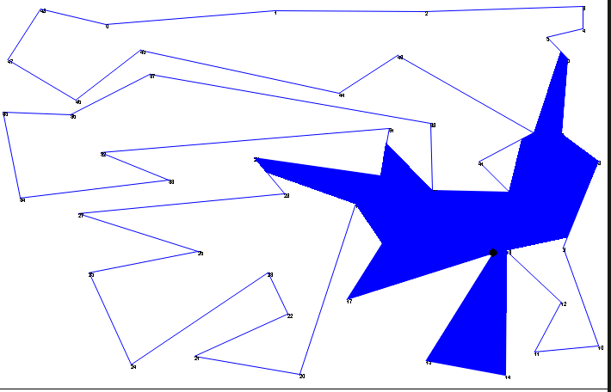
POLYGON VISIBILITY
It refers to the area one guard can cover without moving from its place

Slide 9
Algorithm
polygon and a vertex
invisible_edges = []
For every other vertex V:
if V is visible:
if no invisible edges:
Add V to solution
else:
Find closest intersection point
if the 2 edges that meet are on same sides of line:
if the line in polygon:
Add closest intersection point to solution
Add V to solution
else
if V is not visible:
add V to invisible_edges

Slide 10

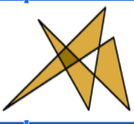
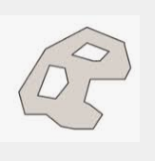
Polygon
A polygon is a plane figure that is described by a finite number of straight line segments connected to form a closed polygonal chain.
Fig 1: Simple Fig 2: Intersecting Fig 3: With holes
How to make the polygon such that it is non intersecting and with no holes i.e Fig1 .
f(x,y) = ax+by+c i.e equation of line
Points: P(x1,y1),Q(x2,y2)
If on putting P,Q on the f(x,y) the sign comes out to be same then they are on the same side w.r.t line
P Q
Q P

Slide 11
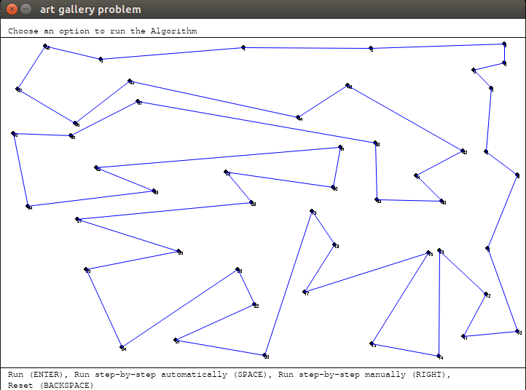
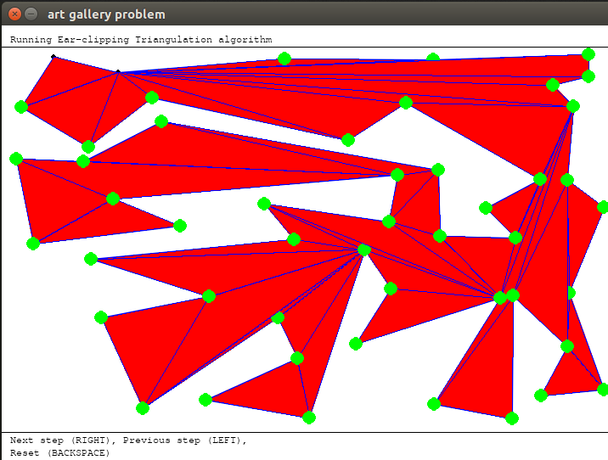
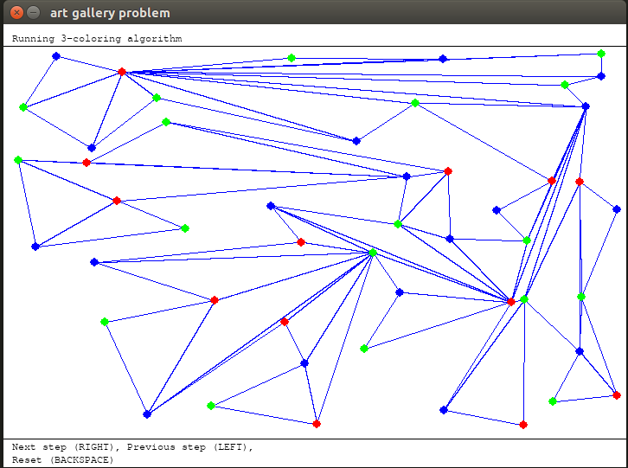
RESULT
Fig1. Polygon creation
Fig 2 . Triangulation
Fig 3. 3 -coloring

Slide 12
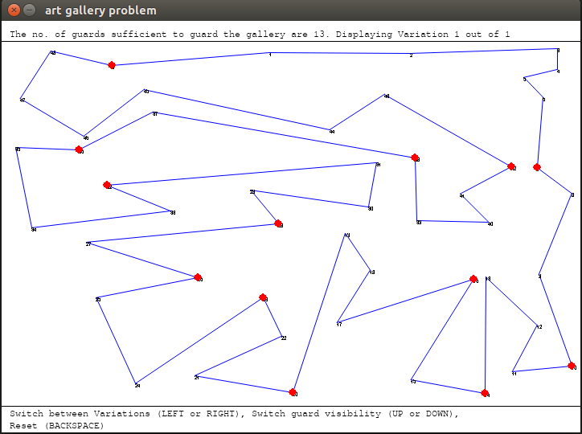
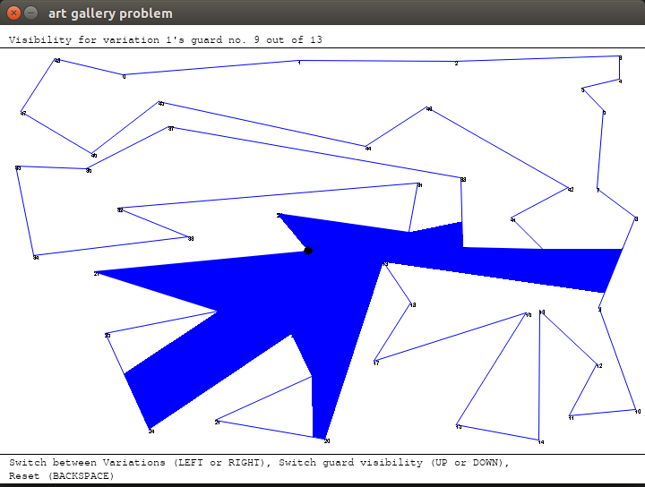
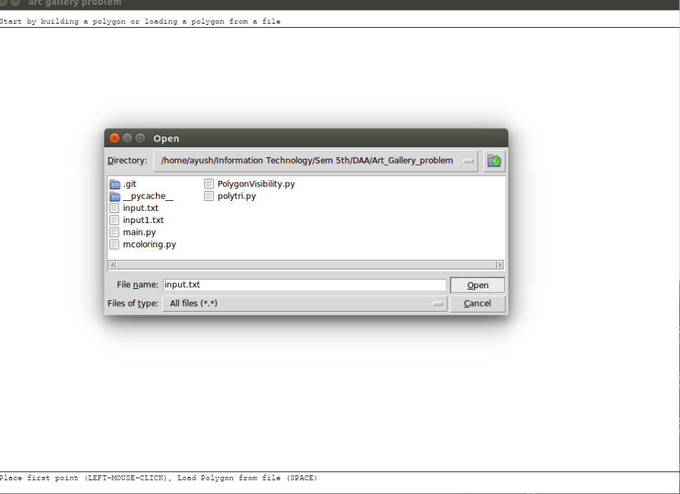
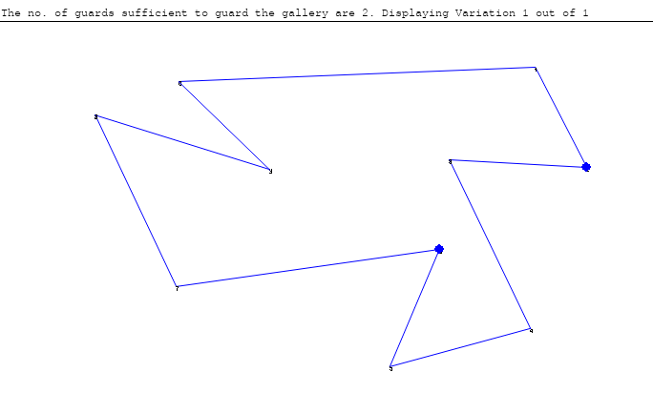
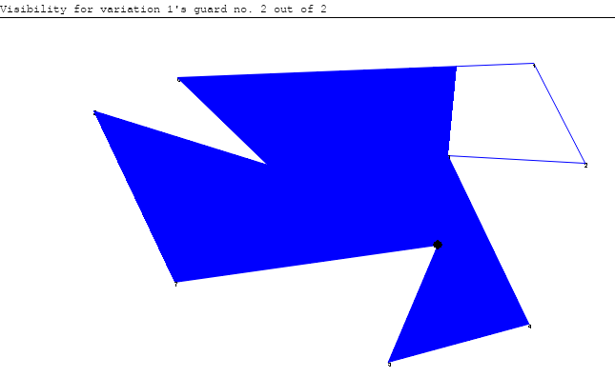
Using input File:
Fig 4. Solution
Fig 5. Visibility of guard
Fig 6. input.txt Fig 7. Solution Fig 8. Visibility of guard

Slide 13
Future Work
• Efficient Vertex guard visibility algorithm
• Editing polygon during run time (by drag and drop of edges and vertices)
• Ability to pause the visualization of the algorithm
• More appealing visual effects

Slide 14
Individual Contribution
Abhishek Kaswan(18IT201): Triangulation and File input in code
Ayush Bhandari (18IT209) : Polygon creation and GUI
Jaidev Chittoria (18IT119): 3-Coloring and debugging
Siddharth Pokharna(181IT146): Polygon Visibility and different
variation of solution

Slide 15
References
https://ieeexplore.ieee.org/document/4368172
https://ieeexplore.ieee.org/document/7850164
O'Rourke, J. Art Gallery Theorems and Algorithms. New York: Oxford University Press.
DIMACS Research and Education Institute. "Art Gallery Problems."

