Slide 1
Seasonal Demand Prediction
"Seasonal Insights, Real-Time Impact."

Slide 2
Table of contents
01
02
03
04
05
06
Introduction
Workflow and methodology
Caveats and Limitations
References
Acknowledgement
Conclusion

Slide 3

What We Are Presenting?
We are presenting a project that uses data analytics and machine learning to address supply chain inefficiencies in an e-commerce fashion business. By combining sales data, inventory levels, and expense records, the system develops a predictive model to forecast Effective Demand—defined not just by orders placed, but by orders that are successfully delivered. This approach enables more accurate demand planning and improved operational efficiency.

Slide 4

01
Introduction

Slide 5
Introduction
our project introduces an AI-powered Seasonal Demand Prediction system. By combining sales data, inventory records, delivery outcomes, and operational expenses, the model forecasts Effective Demand—the true measure of demand based on orders that are successfully delivered.
Solution
Problem
Overstocking or stockouts during peak seasons
Poor inventory allocation across warehouses
Inaccurate supplier ordering
Increased operating costs due to rushed logistics
Lost revenue from unmet effective demand
Precise seasonal demand forecasting
Reduced stockouts and overstock situations
Optimized warehouse inventory distribution
Better supplier planning and cost reduction
Improved customer experience through higher fulfillment rates

Slide 6
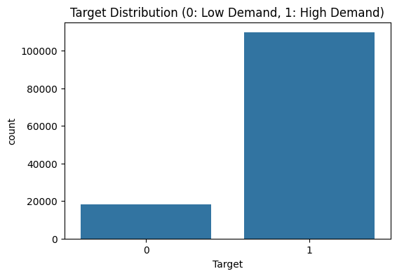
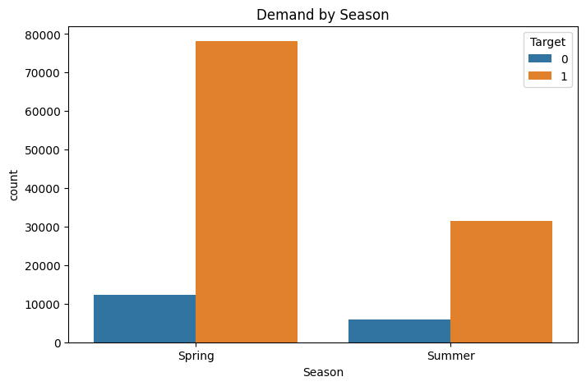
Workflow and Methodology
1. Data Collection
Gather sales data, inventory levels, expenses, delivery status, and seasonal factors.
2. Data Cleaning & Preprocessing
Handle missing values, remove noise, normalize data, and engineer features like seasonality,
trends, and delivery success rates.
3. Exploratory Data Analysis (EDA)
Identify demand patterns, seasonal spikes, cancellation trends, and supply chain bottlenecks.
4. Model Development
Train machine learning models (e.g., Random Forest, XGBoost, Time-series models) to predict Effective Demand.
5. Model Evaluation
Validate accuracy using metrics such as RMSE, MAE, and compare performance across models.
6. Prediction & Visualization
Generate seasonal demand forecasts and visualize insights through charts and dashboards

Slide 7
Caveats & Limitations
1. Data Quality Issues
Predictions depend heavily on accurate sales, inventory, and delivery data; missing or inconsistent data can reduce model reliability.
2. Limited Historical Seasonal Data
Insufficient past seasonal records may weaken the model’s ability to detect long-term patterns.
3. External Factors Not Fully Captured
Sudden events like supply disruptions, new fashion trends, weather anomalies, or policy changes may not be reflected in the model.
4. Model Assumptions
Machine learning models assume historical patterns repeat; unexpected behavior may cause prediction deviations.
5. Delivery & Logistics Variability
Changes in courier performance, delays, or cancellations can significantly affect “Effective Demand” accuracy.
6. Inventory Dependency
Incorrect or delayed inventory updates can lead to inaccurate forecast outcomes.
7. Overfitting Risk
Model may perform well on training data but poorly on unseen future data if not properly tuned.

Slide 8
Reference
Chase, C. W. (2013). Demand-Driven Forecasting: A Structured Approach to Forecasting. Wiley.
Hyndman, R. J., & Athanasopoulos, G. (2021). Forecasting: Principles and Practice (3rd ed.). OTexts.
Fildes, R., & Goodwin, P. (2020). "Forecasting Decision Support Systems: Past, Present, and Future." International Journal of Forecasting.
Kumar, S. & Chatterjee, A. (2020). "Demand Forecasting in E-commerce Using Machine Learning Techniques." Journal of Retail Analytics.
Kaggle Datasets – Public retail and seasonal demand datasets used for benchmark comparisons.

Slide 9
Acknowledgement
We would like to express our sincere gratitude to everyone who contributed to the successful completion of this project. We extend our thanks to our mentors and faculty for their valuable guidance, insightful feedback, and continuous support. We also acknowledge the resources, datasets, and tools that enabled us to apply advanced data analytics and machine learning techniques effectively.
Finally, we are grateful to our team members for their collaboration, dedication, and commitment throughout the development of the Seasonal Demand Prediction system.

Slide 10
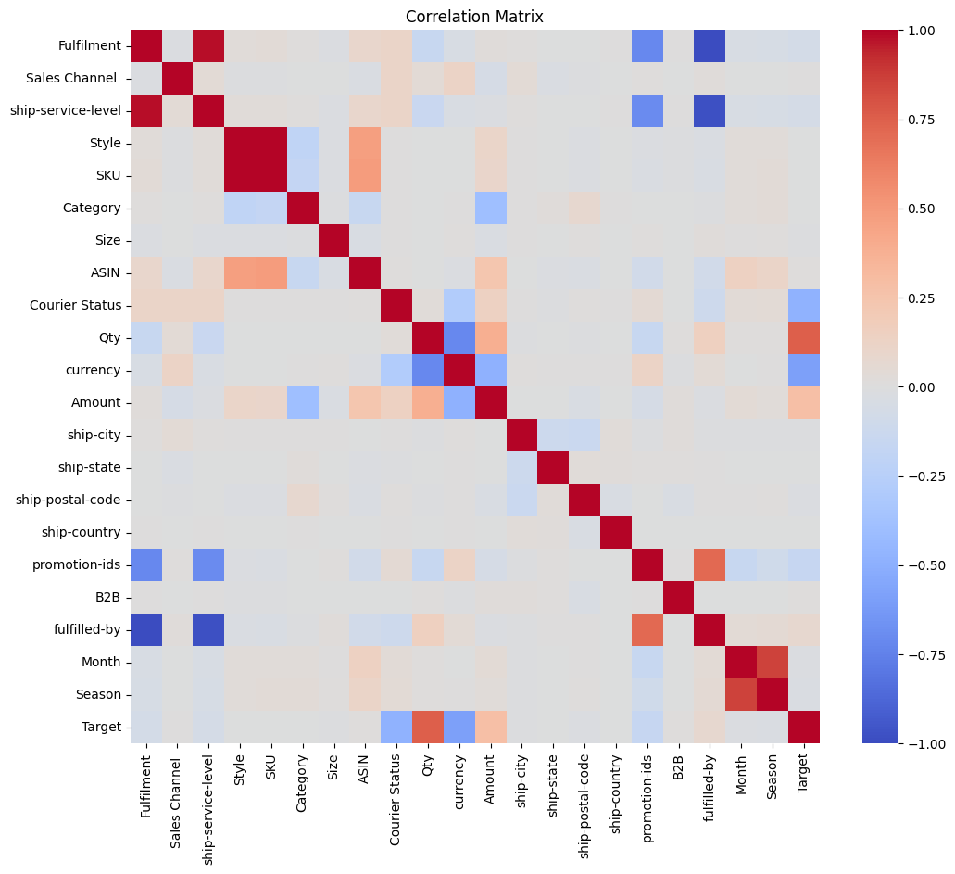
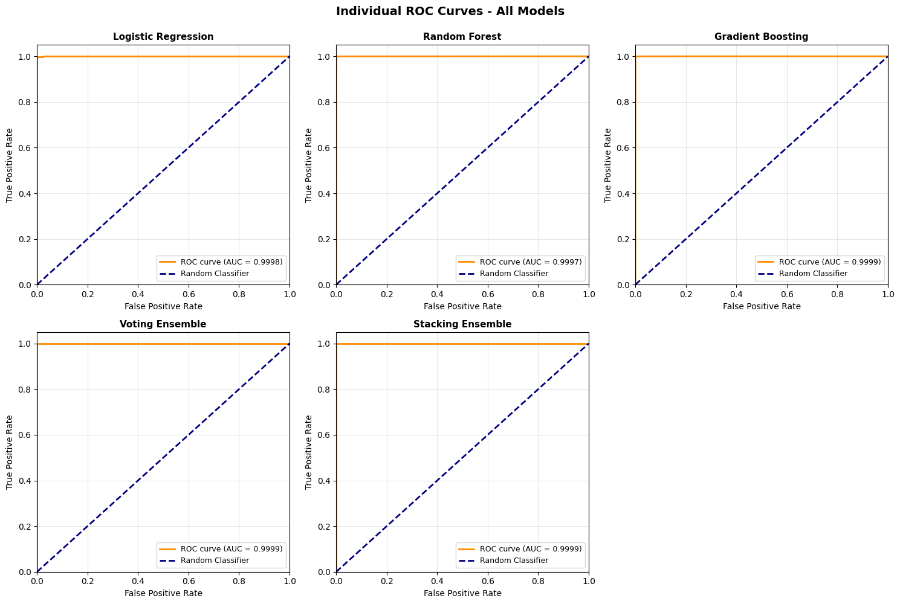
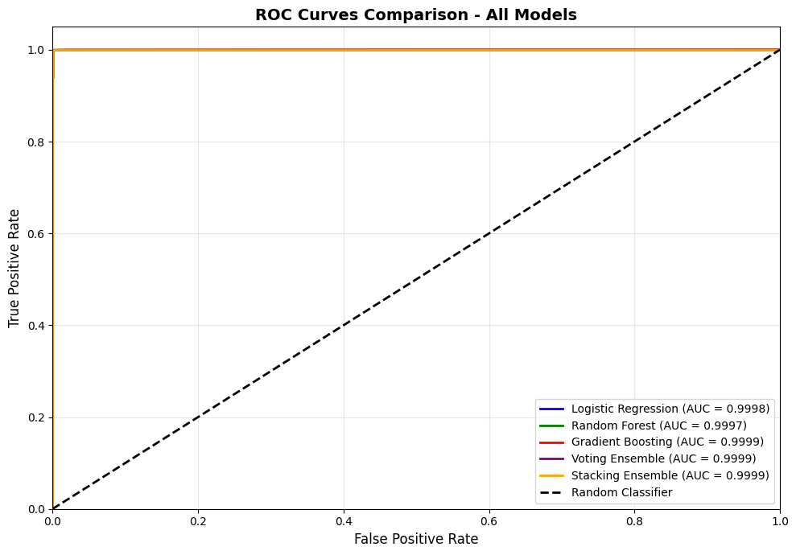
Conclusion
This project moves the business from reactive (restocking after running out) to proactive (stocking based on predicted effective demand). The target accuracy of 88% ensures that the supply chain is resilient enough to handle seasonal fluctuations without overstocking dead inventory.

Slide 11
THANKS

