Slide 1

FORGOTTEN KNOWLEDGE TRACKER
Presented by:
Soham Gawas
Mahesh Gawali
Bhargav Ghawali
Ayush Devadiga
T.E(COMPUTER SCIENCE AND ENGINEERING (AI&ML)
SEM - V
Guided by : Prof. Yamuna Vasanth

Slide 2
Contents
ABSTRACT
AIM OF THE PROJECT
INTRODUCTION
LITERATURE SURVEY
EXISTING SYSTEM (Next slide will be Disadvantage of existing system)
PROPOSED SYSTEM (Next slide will be Advantage of proposed system)
HARDWARE & SOFTWARE REQUIREMENTS
MODULES ( Mention how many modules)
MODULES DESCRIPTION
METHODOLOGY(What are all the algorithms used, concepts implemented)
SYSTEM ARCHITECTURE
FIGURES( UML diagrams, diagrams related to your project)
CONCLUSION
FUTURE ENHANCEMENTS
REFERENCES

Slide 3
Abstract
Many people spend hours learning new things, but much of that knowledge fades with time. This is a natural process known as the forgetting curve. Our project, Forgotten Knowledge Tracker (FKT), is designed to help users retain what they’ve learned by automatically detecting learning activity and estimating when it’s likely to be forgotten.
The system quietly runs in the background, identifying learning patterns from apps, screen content, and activity. It then uses a memory model to predict when a topic needs review and reminds the user at the right time—without requiring manual input.
FKT brings together memory science, AI, and user behavior tracking to make sure that important knowledge isn’t lost over time. It’s lightweight, offline-capable, privacy-friendly, and built to support long-term learning in a simple, effortless way.

Slide 4
Aim of the Project
To build an AI-powered system that helps users retain the knowledge they gain over time
To automatically detect when a user is involved in learning activities using apps, screen content, or audio
To estimate when a learned topic is likely to be forgotten based on memory science
To provide timely and intelligent reminders for revision, without needing manual input
To support long-term knowledge retention through a system that is lightweight, offline-compatible, and privacy-focused
To make the learning process more effective by turning passive study sessions into lasting memory

Slide 5
Introduction
Forgotten Knowledge Tracker (FKT)
Retain What You Learn, Effortlessly:
Learning from videos, articles, PDFs, and coding is often forgotten over time.
FKT tracks learning in the background—no manual input needed.
Detects what you’re studying through screen activity and app usage.
Uses a memory model to predict when you’ll forget something.
Sends simple reminders at the right time to help you review.
Lightweight, works offline, and keeps your data private.
Combines AI and brain science to boost long-term memory—effortlessly.

Slide 6
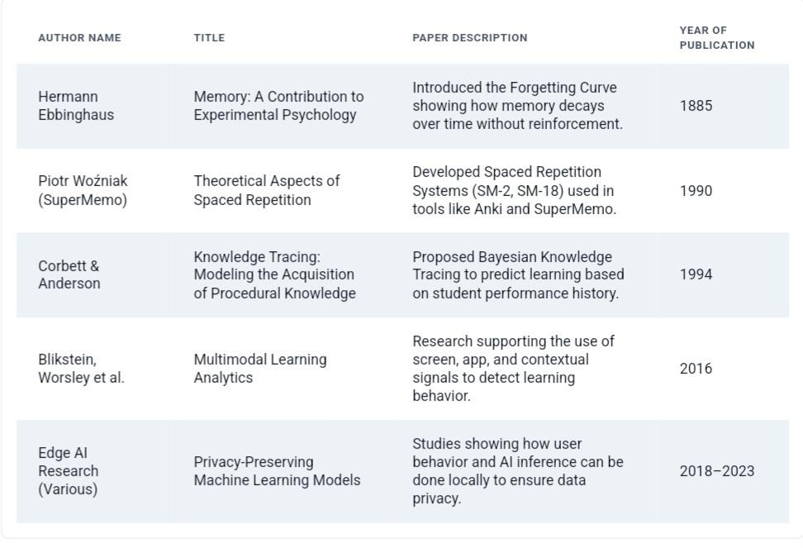
Literature Survey

Slide 7
Existing System
Flashcard apps (e.g., Anki, RemNote) use spaced repetition but require manual input and organization.
Productivity tools (e.g., Forest, Notion, Pomodoro timers) help with focus and time but don’t track what you're learning.
Platforms like Coursera and Khan Academy personalize content but can’t track learning outside their own systems.
Most tools work only within their own apps and don’t monitor learning across different platforms.
No existing system predicts forgetting or gives reminders based on memory decay.

Slide 8
Proposed System
Runs silently in the background to detect learning activities automatically.
Tracks app usage, screen content, and behavior to identify educational activity.
Uses a basic memory model to estimate when forgetting might occur.
Sends timely reminders or review prompts before memory fades—no manual input needed.
Works fully offline and keeps all personal data on the device.
Supports all types of learning, including videos, PDFs, and more.
Makes revision feel effortless and natural.

Slide 9
Comparison of Previous and Proposed System
Existing tools need manual input, while FKT works automatically in the background.
Most systems don’t detect real learning, but FKT recognizes learning as it happens.
They can’t identify topics, whereas FKT understands what you’re studying.
Memory decay is ignored by others, but FKT predicts forgetting and reminds you in time.
Cloud-based tools risk privacy, but FKT keeps all data safely offline.
Traditional tools don’t support self-paced learning, while FKT works with any format or style

Slide 10
Hardware & Software Requirements
Hardware Requirements:
RAM: 4 GB minimum, 8–16 GB recommended for heavier processing
CPU: Dual-core processor (basic), Quad-core or higher for faster performance
Storage: 500 MB to 2 GB depending on usage and model size
Operating System: Windows, Linux, or macOS
Optional: Microphone for capturing audio contex
Software Requirements
Python 3.10 or above
Key Libraries: Flask, scikit-learn, transformers, sentence-transformers, matplotlib, sqlite3
Frontend: Basic HTML, CSS, and JavaScript for dashboard interface
Optional Libraries: speech\_recognition (for voice input)

Slide 11
Modules
1. Activity Monitoring Module
Tracks user interactions with apps and screens to detect learning behavior.
2. Intent & Content Analysis Module
Determines whether the activity is educational and identifies the topic.
3. Forgetfulness Estimation Module
Uses memory decay logic to predict when a topic is likely to be forgotten.
4. Reminder System Module
Triggers timely notifications or review prompts based on memory strength.
5. Dashboard Module
Provides a simple interface to review learning history, upcoming reminders, and topic trends.

Slide 12
Module Description
1. Activity Monitoring: Tracks app usage and screen data.
2. Content & Intent Detection: Identifies learning activities.
3. Forgetfulness Estimator: Uses cognitive models to estimate memory decay.
4. Reminder Engine: Notifies user for revision based on priority.
5. Dashboard: Presents review history and learning stats visually.

Slide 13
Methodology
How FKT Works:
Combines simple machine learning with proven memory science.
Monitors user activity (like app usage, screen text, and optional ambient audio) to detect learning moments.
Classifies whether the activity is educational and identifies the topic.
Uses a memory decay model based on the Ebbinghaus Forgetting Curve to estimate when knowledge will fade.
Schedules timely reminders or review prompts before forgetting happens.
Runs entirely on the device—keeping your data private and the system lightweight.
Delivers smart, just-in-time support to help learning stick.

Slide 14
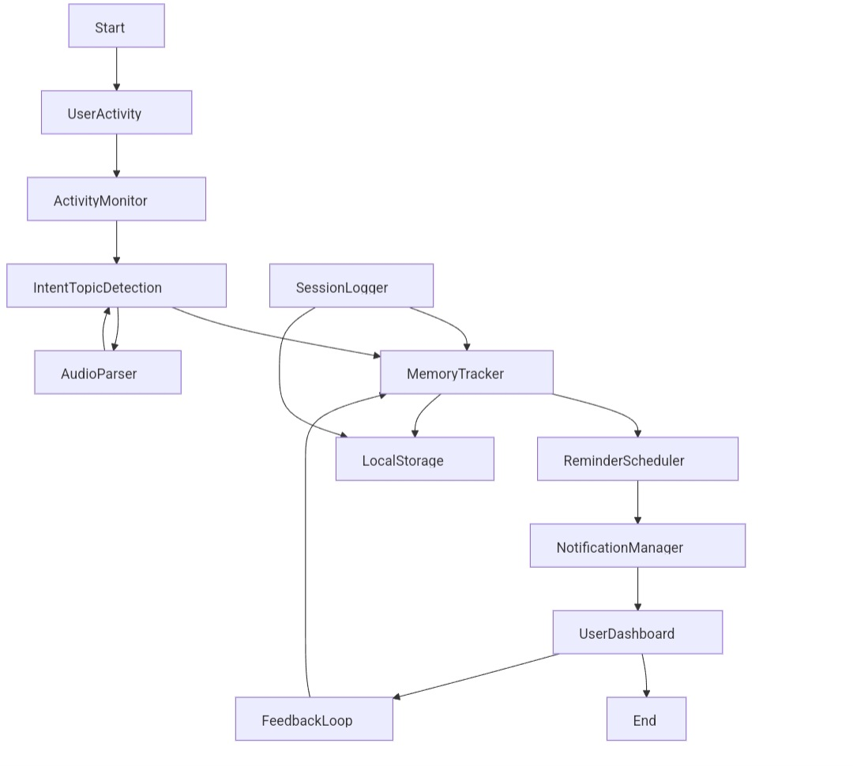

Slide 15
System Architecture
Workflow overview:
The system monitors activity, detects learning, predicts forgetfulness, sends reminders, and shows progress through a dashboard.
Activity monitoring: tracks app usage, screen content, and optional audio
Intent detection: checks if the activity is educational and extracts topic
Forgetfulness estimation: predicts when topics may be forgotten
Reminder system: triggers review alerts at the right time
Local storage: saves all data privately on the device
Dashboard: shows learning history and upcoming

Slide 16
Conclusion
The Forgotten Knowledge Tracker helps users retain valuable knowledge effortlessly.
It uses AI to detect what is learned and predicts when it may be forgotten.
This ensures that important topics are revised at the right time.
It bridges the gap between human memory and machine intelligence.
Lightweight, offline, and privacy-focused.

Slide 17
Future Enhancements
Develop a mobile version to support on-the-go learning and reminders
Add voice command support for hands-free interaction and topic tagging
Implement adaptive memory modeling based on user performance
Integrate visual summarization for quicker topic refresh
Allow syncing across devices with end-to-end encryption
Improve audio context detection for better intent recognition
Introduce streaks or light gamification to increase engagement
Support for language-based topic detection for regional learning content

Slide 18
References
Ebbinghaus, H. (1885). Memory: A contribution to experimental psychology
Research on spaced repetition systems (Anki, SuperMemo, SM-2 and SM-18 models)
Bayesian Knowledge Tracing and Deep Knowledge Tracing in intelligent tutoring systems
Multi-modal learning analytics for screen, app, and audio-based intent detection
Local and privacy-focused AI model design in modern edge computing
Python libraries used: scikit-learn, transformers, sentence-transformers, Flask, sqlite3
Related studies on memory retention, cognitive load, and human forgetting behavior

