Slide 1

BHARAT COLLEGE OF ENGINEERING, BADLAPUR (W.)
LecGap – Lecture Based Gap Prediction
Team Members name: Soham Gawas, Bhargav Ghawali, Mahesh Gawali, Ayush Devadiga
Name of the Guide: Prof Shital Gujar
Project Domain: AIML
Project Group Number: Group Number 8
Year: BE
Semester: VII

Slide 2
Abstract
Recorded lectures are everywhere — comprehension gaps are not tracked
LecGap transcribes lectures, extracts concepts, builds a course concept graph
Students take a capped quiz; wrong answers trace prerequisites into ordered remediation
Faculty get a confusion heatmap and taught-vs-learned order divergence
Streamlit + FastAPI baseline built, with durable jobs and live progress

Slide 3
Problem Statement
Video ≠ understanding — students finish a lecture video without knowing what they missed
Wrong answers stay isolated — AI quiz tools never ask which earlier concept is the real gap
No learning order — students see their mistakes, not what to learn first
No class-level view — instructors cannot see where the whole class is confused
Taught order ≠ learned order — teaching sequence is never checked against prerequisites

Slide 4
Brief Literature Review
AI study tools (YouLearn, Knowt, NotebookLM) — generate quizzes but do not model prerequisites
LectureBank (2019) — benchmark dataset for concept-prerequisite chain learning
Cross-domain graph learning (2021) — transfers prerequisite knowledge across subjects
Deep Knowledge Tracing — predicts student mastery from quiz history only

Slide 5
Research Gap
No end-to-end system combines extraction, prerequisite mapping, remediation and instructor analytics
Static prerequisite models are trained once and never self-correct from student data
Quiz tools are concept-blind — they grade answers but cannot trace a failure to its root cause
Instructors get no feedback on whether teaching order matches concept dependencies
No tool understands a classroom — LecGap does

Slide 6
Project Objectives
Extract concepts from lecture audio and visuals, with timestamps
Classify prerequisite relationships and benchmark accuracy on LectureBank
Personalize remediation in dependency order using short video clips
Refine the prerequisite graph continuously from student performance
Give instructors a confusion heatmap and teaching-order divergence insight

Slide 7
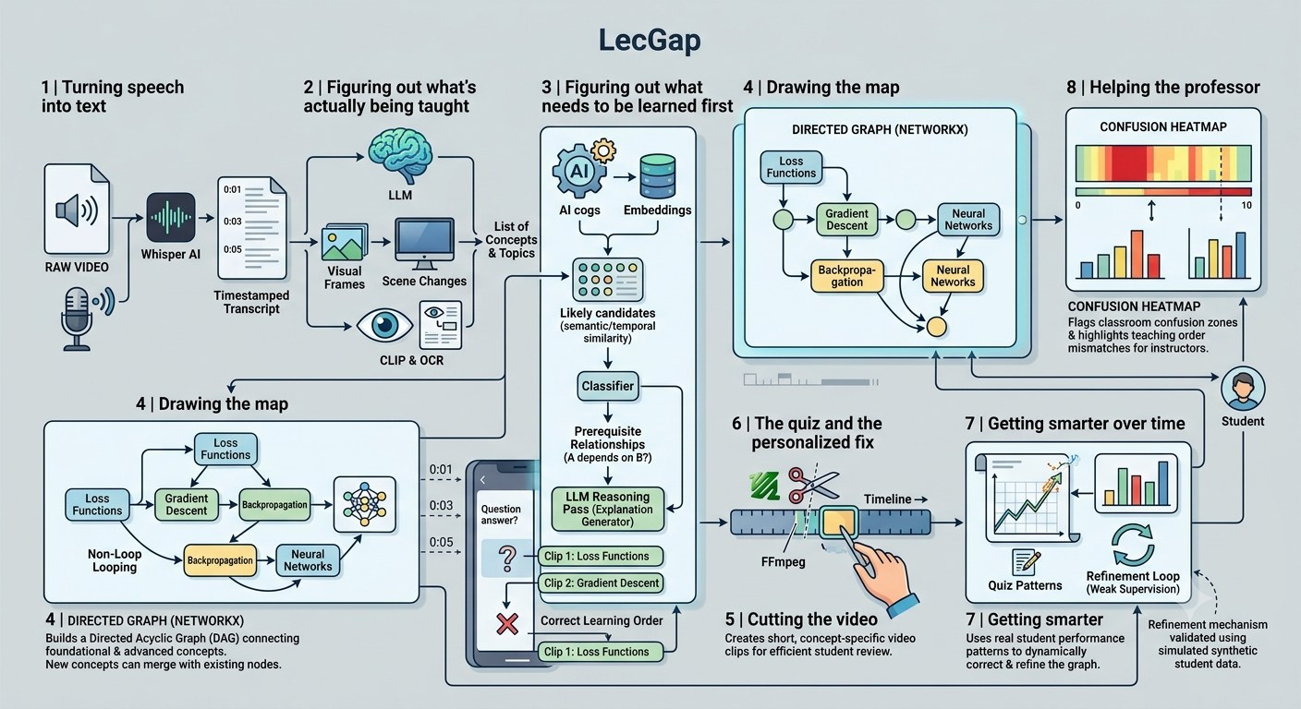
Proposed Methodology
Transcribe lecture audio (Whisper)
Extract concepts — speech (LLM), slides (CLIP/OCR)
Classify prerequisites — fine-tuned model, benchmarked
Build a per-course concept graph (DAG)
Cut clips, generate quizzes
Remediate in dependency order, refine over time

Slide 8
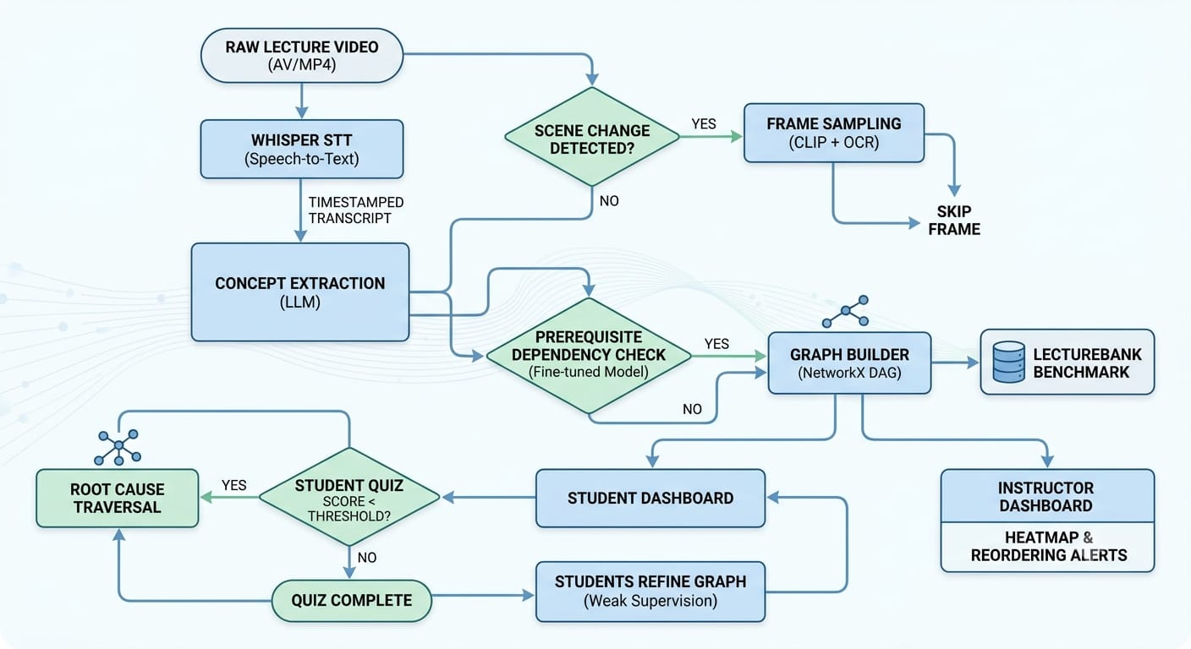
System Architecture / Flowchart
Streamlit frontend — student and faculty dashboards
FastAPI backend — REST API, durable background jobs
Live progress — server-sent events
Two-tier state — TTL cache + session state
Graph feedback — quiz results refine the DAG

Slide 9
Dataset Description
Lecture recordings — NPTEL and YouTube lectures on ML, DL and NLP, 21 to 86 minutes long
LectureBank — 208 labeled concepts, 921 positive prerequisite edges, 42,749 concept pairs
Synthetic students — LLM personas that attempt quizzes, used for controlled refinement tests
Pipeline data — timestamped transcripts, extracted concepts, graph edges, clips, quiz responses

Slide 10
AI/ML Techniques and Algorithms
Whisper — timestamped speech-to-text (hosted on Groq)
LLM + CLIP + OCR — concept extraction from speech and slides
MiniLM + classifier — frozen-encoder prerequisite model, F1 0.569
Cross-encoder fine-tuning — tried on Kaggle GPU, did not beat the baseline
NetworkX DAG — deduplication, cycle breaking, topological order
Weak supervision — co-failure rule refines edges from student data

Slide 11
Implementation and Experimental Setup
Stack: Python, Streamlit, FastAPI, Whisper, NetworkX
Run: uvicorn backend + student and faculty Streamlit apps
Upload: row created, media streamed in 1 MiB chunks, job queued
Config: env vars for API URL, API key, quiz cap (15)
Tests: pytest — client, state, theme (WCAG AA), render, API contract

Slide 12
Expected / Preliminary Results
Working baseline: upload → quiz → remediation plan with clips
Student view: quiz, feedback, dependency-ordered remediation
Faculty view: confusion heatmap, order divergence, DAG
Gaps found: untyped snapshot/stats, blocking quiz generation, silent 401s
Expected: benchmarked prerequisite accuracy and refinement gains

Slide 13
Project Timeline and Semester VIII Plan
Aug 2026 — repo setup, LLM layer, concept extraction, LectureBank labels
Aug 2026 — classifier benchmarked; frozen-encoder baseline locked in (F1 0.569)
Sep 2026 — quiz loop, refinement experiment (F1 0.571 → 0.857), faculty dashboard
Sep 2026 — full 21–86 min lecture runs, server-graded MCQs, interactive DAG
Sep 2026 — job registry with live SSE progress, dark theme, 700+ tests passing
Sem VIII — React frontend, job-queue hardening, wider evaluation, final report

Slide 14
References
Li et al., AAAI 2019 — LectureBank: prerequisite chain learning benchmark
Li et al., ACL 2021 — cross-domain prerequisite learning via graph autoencoders
Piech et al., NeurIPS 2015 — Deep Knowledge Tracing
Radford et al., ICML 2023 — Whisper: robust speech recognition via weak supervision
Hagberg et al., SciPy 2008 — NetworkX graph analysis library
YouLearn, Knowt, NotebookLM — referenced for comparative positioning

