Slide 1
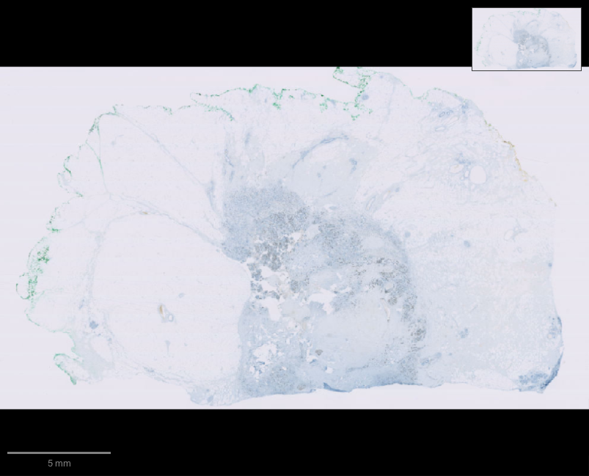
luma
Scientific software,
in conversation
A voice-native companion for QuPath
Notes:
Luma makes the interface to established scientific applications conversational. The current prototype targets QuPath. The visual is an actual QuPath viewer capture of public OpenSlide OS-2.ndpi, not a generated scientific result. Source: https://openslide.cs.cmu.edu/download/openslide-testdata/Hamamatsu/ . Interaction reference: https://github.com/farzaa/clicky .

Slide 2
The learning gap
Researchers know the question.
The software still demands
its own language.
Menus, parameters and scripts stand between a scientific question and an action.
Notes:
The problem statement comes from the project brief and hackathon scope. We have not yet measured time savings or validated usability with researchers. Source: https://luma.com/vdq0qw9u .

Slide 3
The interaction
“Find the cells in this region.”
“Only highlight the positive ones.”
“Compare that with the earlier result.”
The researcher keeps working in the original application.
Notes:
The proposed product experience combines continuous voice with an application adapter. Current verified capabilities include semantic context, MCP, native companion, approvals, actual cell analysis and hierarchy recovery. The separate Realtime and GPT-Live transports have local protocol tests. Actual AWS-credit OpenAI text has also focused the real viewer through companion conversation routing. Production voice remains disabled because AWS-credit coverage is unverified. The phrases on this slide are intended demo requests, not evidence of a completed funded voice session.

Slide 4
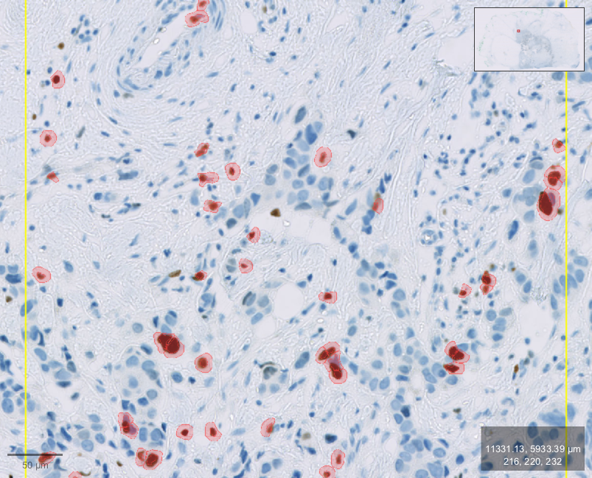
Real operations in QuPath
899
detected cells
49
above the chosen
DAB threshold
Notes:
Actual integration fixture, 17 October 2026. OS-2.ndpi is the freely distributable Ki-67 sample used in QuPath tutorials. ROI x=50000 y=26000 width=2200 height=2200 pixels. QuPath WatershedCellDetection created 899 cells. Threshold classification used Nucleus: DAB OD mean >= 0.2, yielding 49 Positive and 850 Negative. This is a test of software operation, not a validated tumor-cell Ki67 labelling index or a clinical result. Source: docs/pitch/integration-evidence.json and https://qupath.readthedocs.io/en/0.7/docs/tutorials/cell_detection.html .

Slide 5
Researcher control
Exact actions for review
Changes to the image or selection invalidate stale approval.
Measured results and recoverable object state
The test restored the original empty hierarchy.
File and external effects remain outside that recovery boundary.
Notes:
The gateway and application adapter enforce approvals. An approval binds exact arguments and the observed image/selection/hierarchy state. Native control approvals also bind reviewed dialog state. An interrupted or rejected proposal does not automatically execute. The authorized integration test compared counts and restored the empty baseline. Hierarchy checkpoints do not undo file writes, image settings, arbitrary scripts or external plugin effects.

Slide 6
A reusable application layer
32
MCP tools for QuPath
879 pinned source files and searchable task knowledge
help an agent verify unfamiliar operations.
Notes:
Current repository exposes 32 MCP tools, a live menu catalog, visible JavaFX dialog inspection, an approval-gated Groovy escape hatch, a qupath://guide resource and a prompt. The current pinned local documentation corpus contains 67 authored/upstream documents. Read-only API lookup also indexes 879 Java files directly from the pinned Git commit; it does not execute the reference source. Seven newer import/navigation/summary tools pass actual-library synthetic contracts and gateway approval tests, while their new native application flows await manual unlock and disposable-instance authorization. These give discoverable breadth but do not prove every command or third-party plugin works end to end. Other application adapters remain future work.

Slide 7
The prototype today
OpenAI text now controls
the real QuPath viewer.
Actual requests pass fresh AWS credit checks.
Live voice still needs a credit-covered endpoint.
Next: try it with a researcher.
Notes:
Prototype status at 17 October 2026, 04:52 BST: native companion foundation, QuPath extension, MCP and public-slide analysis/recovery are verified locally. The new companion text/Stop controls compile and are loaded, but foreground inspection awaits manual unlock. Authenticated companion conversation routing through actual AWS-credit OpenAI GPT-OSS-120B focused the public viewer at the exact requested coordinates without changing scientific objects. Across three real text/reference fixtures: ten model requests, $0.0059721 estimated token usage, $10 conservative reserves; AWS billing settlement unreconciled. A further actual model fixture searched/read the exact pinned QP.loadPixelClassifier declaration and returned correct structured type assignments without application actions. Evidence: docs/pitch/text-model-evidence.json, docs/pitch/companion-text-evidence.json and docs/pitch/api-model-evidence.json. GPT-Live voice remains disabled because a credit-covered endpoint is unverified. No cloud infrastructure or new model agreement was created. Next validation should use researcher-selected tasks and measure completion, errors and interaction latency. Repo: https://github.com/AyushGupta05/Voice .

