Slide 1
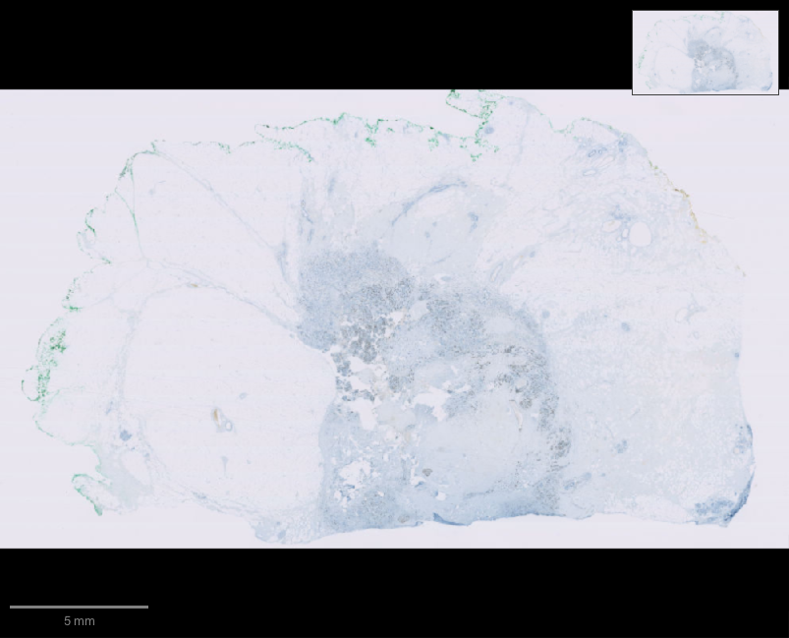
luma
Scientific software,
in conversation
A voice-native companion for QuPath
Notes:
Luma makes the interface to established scientific applications conversational. The current prototype targets QuPath. The visual is an actual QuPath viewer capture of public OpenSlide OS-2.ndpi, not a generated scientific result. Source: https://openslide.cs.cmu.edu/download/openslide-testdata/Hamamatsu/ . Interaction reference: https://github.com/farzaa/clicky .

Slide 2
The learning gap
Researchers know the question.
The software still demands
its own language.
Menus, parameters and scripts stand between a scientific question and an action.
Notes:
The problem statement comes from the project brief and hackathon scope. We have not yet measured time savings or validated usability with researchers. Source: https://luma.com/vdq0qw9u .

Slide 3
The interaction
“Find the cells in this region.”
“Only highlight the positive ones.”
“Compare that with the earlier result.”
The researcher keeps working in the original application.
Notes:
The proposed product experience combines continuous voice with an application adapter. Current verified capabilities include semantic context, MCP, native companion, approvals, actual cell analysis and hierarchy recovery. The separate Realtime and GPT-Live transports have local protocol tests. Actual AWS-credit OpenAI text has focused the real viewer through companion routing and completed the fixed scientific analysis through the shared backend/Runtime. The proposed continuous spoken interaction remains separate from those text results. Production voice remains disabled because AWS-credit coverage is unverified. The phrases on this slide are intended demo requests, not evidence of a completed funded voice session.

Slide 4
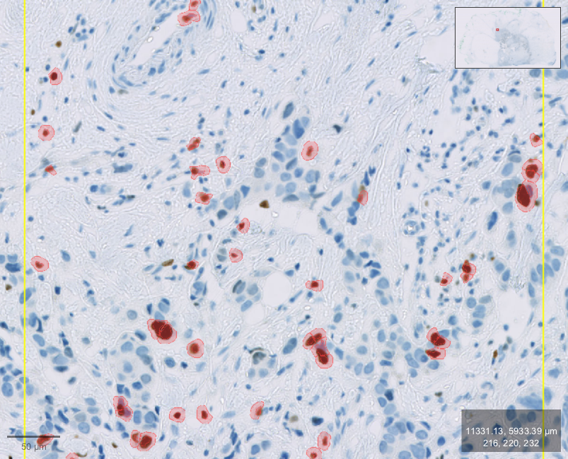
Real OpenAI analysis in QuPath
899
detected cells
49
above the chosen
DAB threshold
21.5 s
Fixed public sample. Segmentation validity unverified.
with test-only simulated approvals
Notes:
Actual OpenAI scientific-agent test, 17 October 2026, 05:53 BST. The credit-checked GPT-OSS-120B backend executed H-DAB, the fixed ROI x=50000 y=26000 w=2200 h=2200, watershed cell detection, Nucleus: DAB OD mean >=0.2 classification, comparison and empty-baseline restoration. Independent actual QuPath observations: 899 cells, 49 Positive, 850 Negative. The structured model answer matched. This single predefined workflow took 21,471 ms and eight model requests with five test-only simulated decisions under explicit user authorization. Ordinary production changes still require human approval. The image is the earlier real public-slide capture for this same ROI and algorithm/threshold, not a new screenshot of the model run. Counts verify software execution; segmentation/biology/clinical validity is unestablished. Sources: docs/pitch/analysis-model-evidence.json, docs/pitch/integration-evidence.json, docs/SCIENTIFIC-AGENT-TEST.md and https://openslide.cs.cmu.edu/download/openslide-testdata/Hamamatsu/ .

Slide 5
Researcher control
Exact actions and candidate counts for review
Changes to the image or selection invalidate stale approval.
Measured results and recoverable object state
The test restored the original empty hierarchy.
File and external effects remain outside that recovery boundary.
Notes:
The gateway and application adapter enforce approvals. An approval binds exact arguments and the observed image/selection/hierarchy state. Native control approvals also bind reviewed dialog state. An interrupted or rejected proposal does not automatically execute. The actual OpenAI test compared counts and restored the empty baseline. Its five automatic decisions were confined to the explicitly preauthorized disposable fixture. The first real attempt stopped on invalid later arguments after detection and trusted cleanup restored its known baseline; the corrected run completed all steps. Production candidate-count previews now distinguish existing-class filters from assigned Positive/Negative labels, with contract and actual empty-scope refusal checks. Foreground layout of new review content is not yet checked. Hierarchy checkpoints do not undo file writes, image settings, arbitrary scripts or external plugin effects.

Slide 6
A reusable application layer
32
MCP tools for QuPath
879 pinned source files and searchable task knowledge
help an agent verify unfamiliar operations.
Notes:
Current repository exposes 32 MCP tools, a live menu catalog, visible JavaFX dialog inspection, an approval-gated Groovy escape hatch, a qupath://guide resource and a prompt. The current pinned local documentation corpus contains 67 authored/upstream documents. Read-only API lookup also indexes 879 Java files directly from the pinned Git commit; it does not execute the reference source. Seven newer import/navigation/summary tools pass actual-library synthetic contracts and gateway approval tests, while their new native application flows await manual unlock and disposable-instance authorization. These give discoverable breadth but do not prove every command or third-party plugin works end to end. Other application adapters remain future work.

Slide 7
The prototype today
An OpenAI text agent runs
a complete QuPath workflow.
The original application and its algorithms stay intact.
Live voice still needs a credit-covered endpoint.
Next: researcher tasks and live voice.
Notes:
Prototype status at 17 October 2026, 06:20 BST: the real credit-checked OpenAI backend completed the fixed public QuPath analysis/classification/comparison/restoration sequence with independent 899/49/850 counts and a restored empty hierarchy. It took eight requests/21,471 ms with five preauthorized test-only simulated approvals; this is not a live-voice or researcher-completion benchmark. An earlier six-request attempt stopped at argument validation and restored safely; both attempts are included. Cumulative 26 completed model requests estimate $0.02179905 token usage, with all $26 conservative attempt reserves retained under the unchanged $200 cap. Invoice/credit settlement is unreconciled. No new project cloud resource/model agreement or direct cash fallback. Actual companion WebSocket text focus and pinned API declaration retrieval are separately verified. Original stock QuPath bundle matches the verified package and retains its signature; Luma uses a separate extension/launcher/companion. New native/import flows still need normal reload, manual unlock and scoped test approval. GPT-Live remains disabled because no AWS-credit-covered frontend endpoint is verified. Native microphone/playback hardware and production voice wiring remain. Sources: docs/pitch/analysis-model-evidence.json, docs/pitch/analysis-model-initial-failure.json, docs/pitch/qupath-preservation-evidence.json, docs/FUNDING.md and docs/CAPABILITIES.md. Repo: https://github.com/AyushGupta05/Voice .

