Slide 1

SRM Institute of Science and Technology
18CSC204J

Slide 2
OBSTACLE AND RANGE DETECTION IN AUTOMATED CARS
Design and Analysis of Algorithms

Slide 3
Problem Definition
Because most automobiles are becoming autonomous at a quick rate, this autonomous system leads to driver carelessness. If the driving system fails to function properly, accidents and a great deal of damage might occur with the help of convex hull algorithm and LIDAR sensor we can decrease the error of the driving system
Problem Explanation
We are aiming to limit the amount of accidents as well as any barriers that may collide with the user's car while driving in order to solve this problem.
Using the Convex Hull problem, we can successfully reduce the possibilities risks can be avoided if drivers remain alert at all times.as with the help of cameras we can detect the shape of the other vehicle but our vehicle distance and shape cannot be predicted

Slide 4
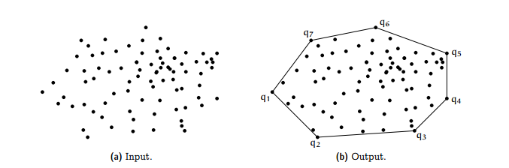
Design Techniques Used
Convex Hull

Slide 5
Divide and Conquer Algorithm
Given the set of points for which we have to find the convex hull. Suppose we know the convex hull of the left half points and the right half points, then the problem now is to merge these two convex hulls and determine the convex hull for the complete set. This can be done by finding the upper and lower tangent to the right and left convex hulls. This is illustrated above Tangents between two convex polygon
Let the left convex hull be a and the right convex hull be b. Then the lower and upper tangents are named as 1 and 2 respectively, as shown in the figure. Then the red outline shows the final convex hull.
Now the problem remains, how to find the convex hull for the left and right half. Now recursion comes into the picture, we divide the set of points until the number of points in the set is very small, say 5, and we can find the convex hull for these points by the brute algorithm. The merging of these halves would result in the convex hull for the complete set of points.

Slide 6
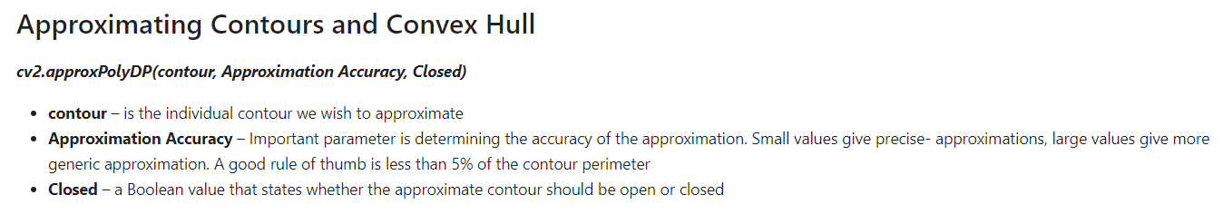
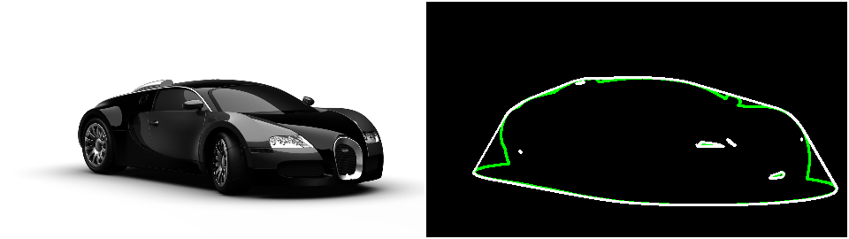

Slide 7
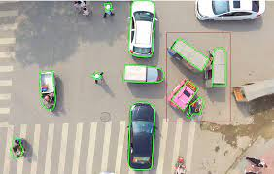
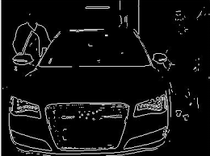
IN REAL LIFE

Slide 8
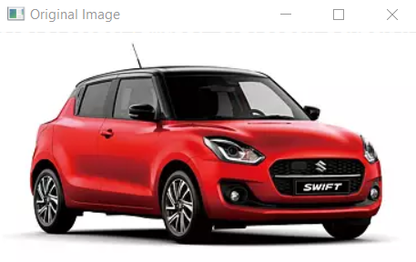
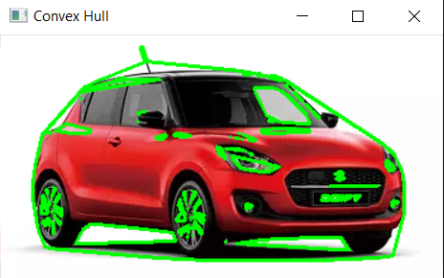
Input
Output

Slide 9
Our approach to solve the problem
While driving, the convex hull algorithm is used to avoid the collision. It considers all other cars in a given range as points. These points are then used to make a contour.
We use the divide and conquer algorithm, where these points are divided and the point is found which are at the maximum distance from the centre. Using this way the maximum contour graph is found and this helps the driver to find the range to where the cars are present and avoid the collision we use convex hull to define and shape or our vehicle and other vehicle also so to take the points we use Light Detecting and Ranging Sensor (LIDAR) and draw a shape of the object (car).

Slide 10
Other existing solution
1. Ultrasonic sensors are used to avoid collision where sound is sent and received by a receiver. Using the Doppler Effect it calculates the change in wavelength and determines if a car is moving toward us
2. Using Machine learning and computer vision. Where a camera is used which takes the videos of the cars on the road in real-time. Using machine learning algorithms, it then determines how far or near the car is and avoids collision

Slide 11
Thank You

