Slide 1
A Computational Comparison of Sorting Algorithms
Group 13
GUPTA, Ayush
BSc in MATH-CS track at HKUST

Slide 2
Brief outline
Introduction
Methods used
Findings
Conclusion
Takeaway
Q & A

Slide 3
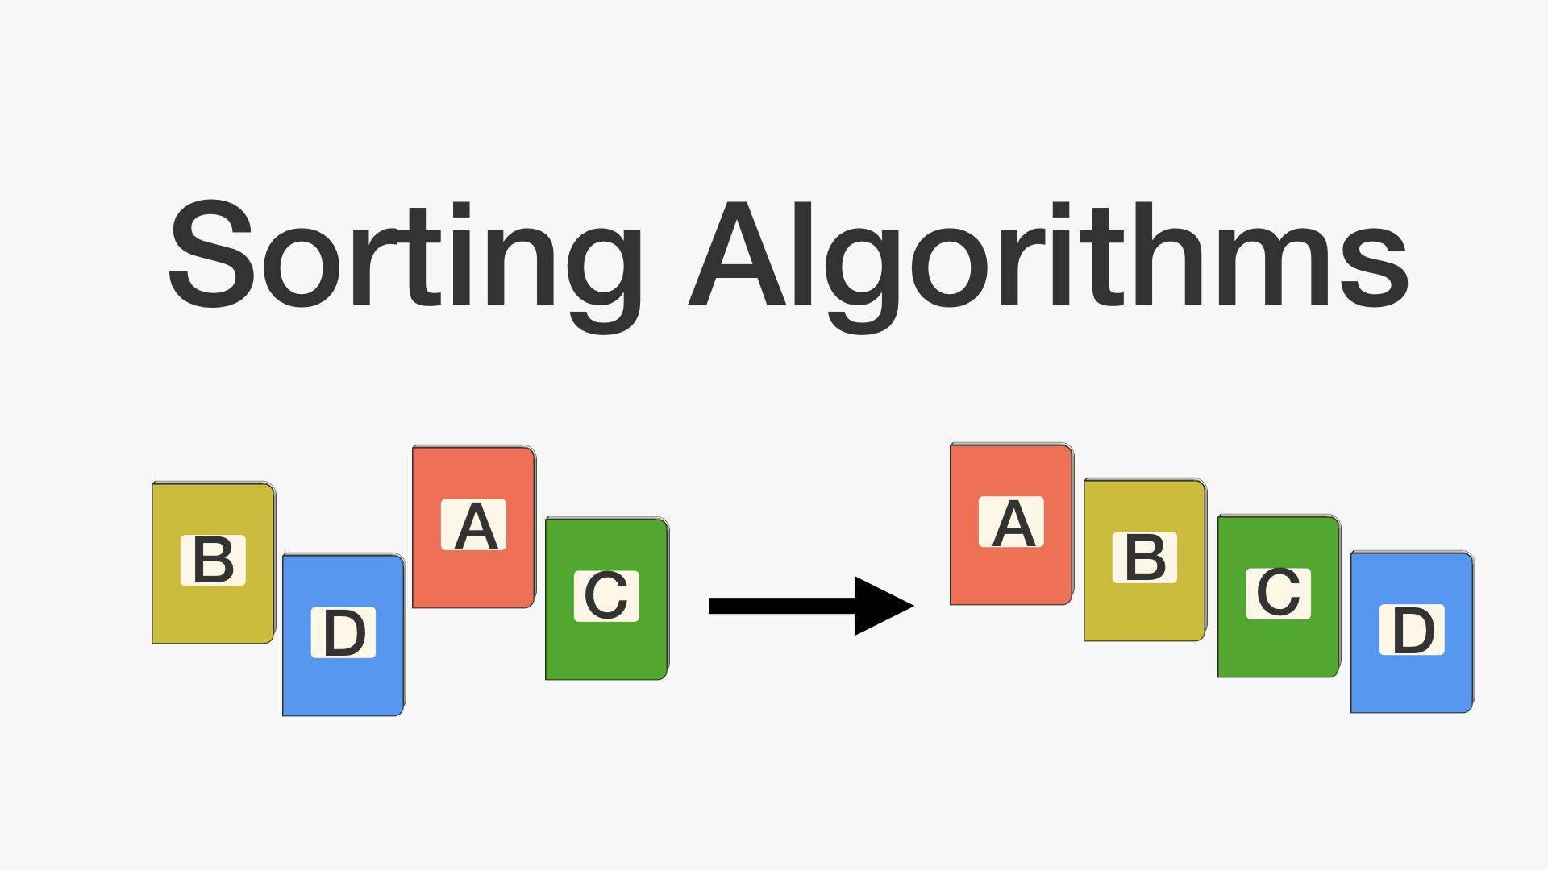
Introduction
What is sorting?
[3,1,2] -> [1,2,3] (ascending order)
BDAC -> ABCD
Why is sorting important?
Easier to
Understand the data
Extract useful information
Notes:
What is sorting? And why is it important?

Slide 4
Introduction
Sorting algorithms
Most popular:
Bubble sort
Insertion sort
Merge sort
Quick sort
?
Sorting algorithm
Notes:
I learned these in COMP 3711- Design and Analysis of Algorithms

Slide 5
Introduction
Basic idea
Bubble sort – repeatedly swap adjacent if in wrong order. Ex: [4,2] -> [2,4]
Insertion sort – selectively sorts first i and inserts the (i+1)th in correct place
Merge sort – divides array at middle, then sorts the 2 halves and merges
Quick sort – Breaks the array at a random place, then sorts the 2 halves and merges
Notes:
I learned these in COMP 3711- Design and Analysis of Algorithms
They are the mostly know ones. Due to the limited time, I will only be able to give a brief description

Slide 6
Introduction
Bubble sort python code
def bubbleSort(alist):
for passnum in range(0, len(alist)-1,-1):
for i in range(passnum):
if alist[i]>alist[i+1]: # Example: In [4,2], 4>2. thus swap 4 and 2 -> [2,4]
temp = alist[i] # Compares each pair of adjacent elements
alist[i] = alist[i+1]
alist[i+1] = temp
alist = [50,20,90,40]
bubbleSort(alist)
print(alist)
Notes:
I learned these in COMP 3711- Design and Analysis of Algorithms
They are the mostly know ones. Due to the limited time, I will only be able to give a brief description

Slide 7
Introduction
Bubble sort no of operations (compare with other algorithms)
Input alist = [50,20,90,40]
Set 1:
1. Compare 50 with 20: swap, alist = [20,50,90,40]
2. Compare 50 with 90: alist = [20,50,90,40]
3. Compare 90 with 40: swap -> [40,90], alist = [20,50,40,90]
Largest element in their correct place
Set 2:
4. Compare 20 with 50, alist = [20,50,40,90]
5. Compare 50 with 40, swap, alist = [20,40,50,90]
Two largest elements in their correct places
Set 3:
Notes:
I learned these in COMP 3711- Design and Analysis of Algorithms
They are the mostly know ones. Due to the limited time, I will only be able to give a brief description

Slide 8
Introduction
Bubble sort no of operations
Input alist = [50,20,90,40]
Set 3: (Current alist = [20,40,50,90])
6. Compare 20 with 40, alist = [20,40,50,90]
Three largest elements in their correct places, thus all elements sorted
Bubble sort took 6 operations
Actually for n elements, it takes n choose 2 operations
(n-1)+(n-2)+(n-3)+…+3+2+1 = (n-1)(n)/2 = n choose 2
Notes:
I learned these in COMP 3711- Design and Analysis of Algorithms
They are the mostly know ones. Due to the limited time, I will only be able to give a brief description

Slide 9
Introduction
Number of operations: N(operations)
Number of elements to be sorted: n
Previous researchers:
Consider n tends to infinity
Consider worst running time
Real life:
n is never infinity
Consider average running time
This creates a research gap
Notes:
N is the number of elements to be sorted

Slide 10
Introduction
Previous researches:
Bubble sort, Insertion sort: O(n^2)
Merge sort, Quick sort: O(nlog(n))
For n tends to infinity
Worst running time

Slide 11
Introduction
My research: (to minimize current research gap)
Practically compute no of operations for Bubble sort, Insertion sort, Merge sort, Quick sort
For n not infinity, instead n = 100 to 1000000
Average running time

Slide 12
Methods Used
My research:
Python programming language
Generate m arrays of n elements, from 1 to n (m is generally 1000, n is 100 to 1 million)
Simple example: 2 arrays of 3 elements from 1 to 3: [1,2,3] & [2,1,3]
Run the algorithms one by one, note the average no of operations

Slide 13
Methods Used
My research:
Try this for different values of n = 100,1000,10000,100000,1000000
Plot and interpret the results

Slide 14
Methods Used
My research:
Compare the results with previous researchers results
Compare the sorting algorithms among themselves

Slide 15
Findings
My research:
Bubble sort takes n(n-1)/2 as N(operations).
Insertion sort takes approximately n(n-1)/4 as N(operations).
Whereas previous researchers used n^2 by assuming n tends to infinity.
N(operations) = Average no. of operations
n = Number of elements to be sorted

Slide 16
Findings
My research:
Number of operations:
Rounded off to one decimal
n (No of elements to sort) | Merge sort (MS) | Quick sort (QS) | nlog(n) (Previous researches) | QS/MS
100 | 14.8% | 97.4% | 664 | 6.6
1000 | 10% | 110.6% | 9966 | 11
10000 | 7.5% | 117.2% | 132877 | 15.6
100000 | 6% | 121.8% | 1660964 | 20.2
1000000 | 5% | 123.2% | 19931568 | 24.6

Slide 17
Conclusion
Insertion sort (IS) is twice better than Bubble sort (BS)
Merge sort (MS) is better than Quick sort (QS)
MS and QS are better than IS and BS
Very useful method for practical comparison
Offers valuable insights
More applicable to real world

Slide 18
Conclusion
Limitations:
Only compared up to n = 1 million. Memory error in Python after that.
Other case-specific ways to implement algorithms
Sometimes, other parameters than N(operations) can also matter
Further research:
Compare other sorting algorithms using methods from this research
Try other ways to implement sorting algorithms
Try cases where n > 1 million

Slide 19
Takeaway
Usefulness of method of comparison: Computational>Theoretical
?
Sorting algorithm

Slide 20
References
K. Ali, A Comparative Study of Well Known Sorting Algorithms, Retrieved from http: //www.ijarcs.info/index.php/Ijarcs/article/view/2903/2886
https://www8.cs.umu.se/kurser/TDBA77/VT06/algorithms/BOOK/BOOK/NODE30.HTM
COMP 3711 Lecture notes, Fall’18, Retrieved from https://course.cse.ust.hk/comp3711/schedule.html

Slide 21
Thank You! ☺
Q & A

