Slide 1
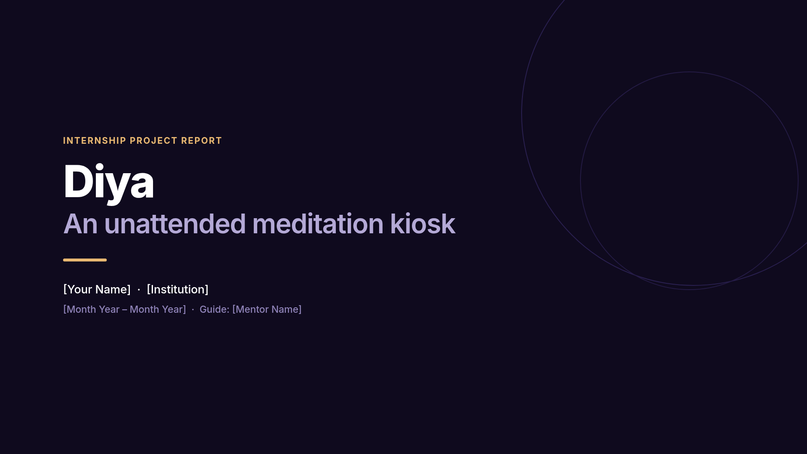
Notes:
Open in one line: "Diya is a meditation kiosk for a museum - a visitor walks up with no
staff present, is identified, does a camera-guided session, gets a report, and it resets."
Then: I built the software side. ~30 seconds, don't linger.

Slide 2
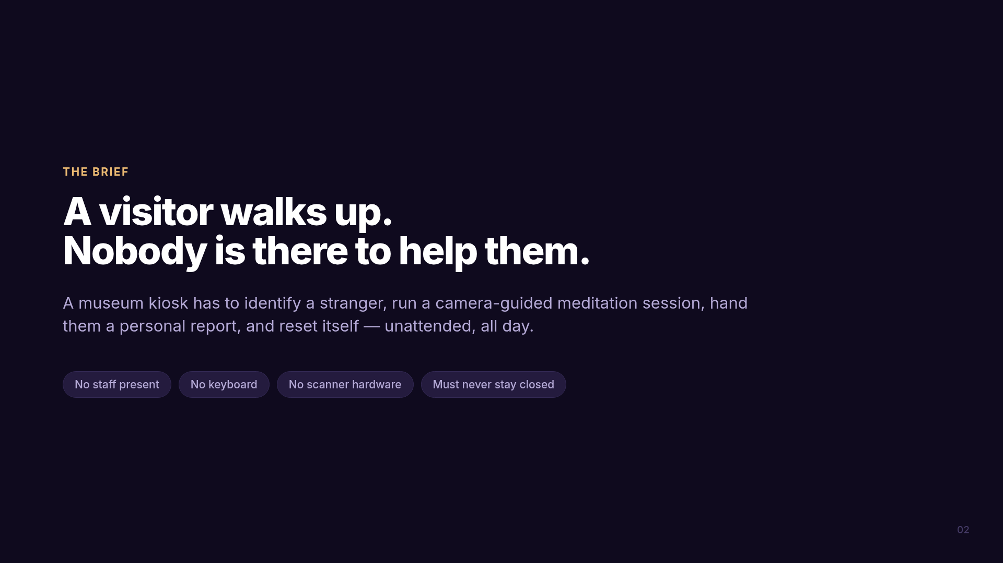
Notes:
The four constraints on the right are the whole design brief. Every one of them ruled
something out. "Must never stay closed" is the one people underestimate - an unattended
machine that crashes and stays down is worthless.

Slide 3
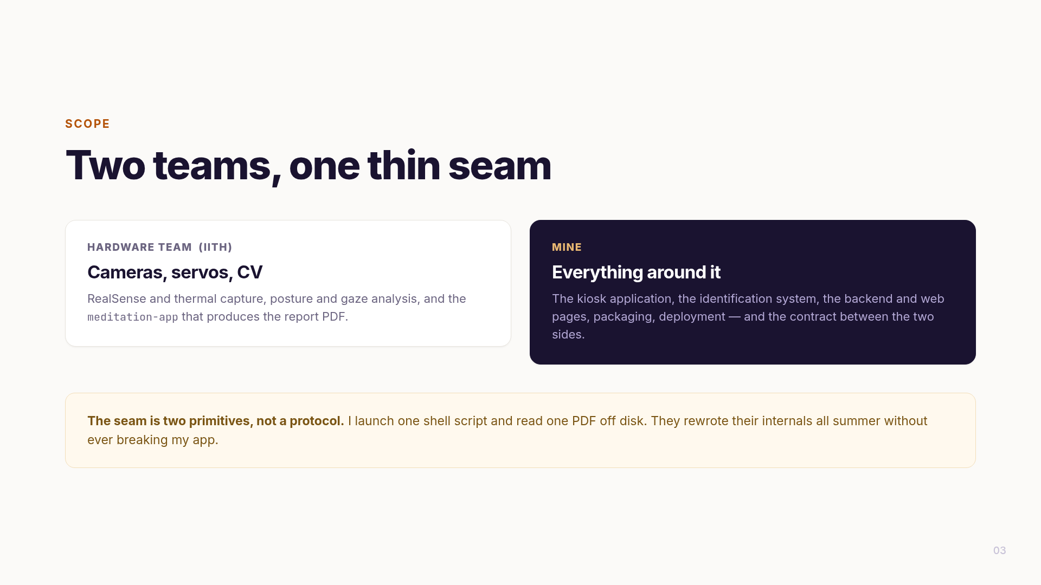
Notes:
Say the scope split explicitly so nobody assumes you built the computer vision.
The line to land is the gold box: the seam is two primitives, not a protocol. That is why
the other team could change their internals all summer without breaking me.

Slide 4
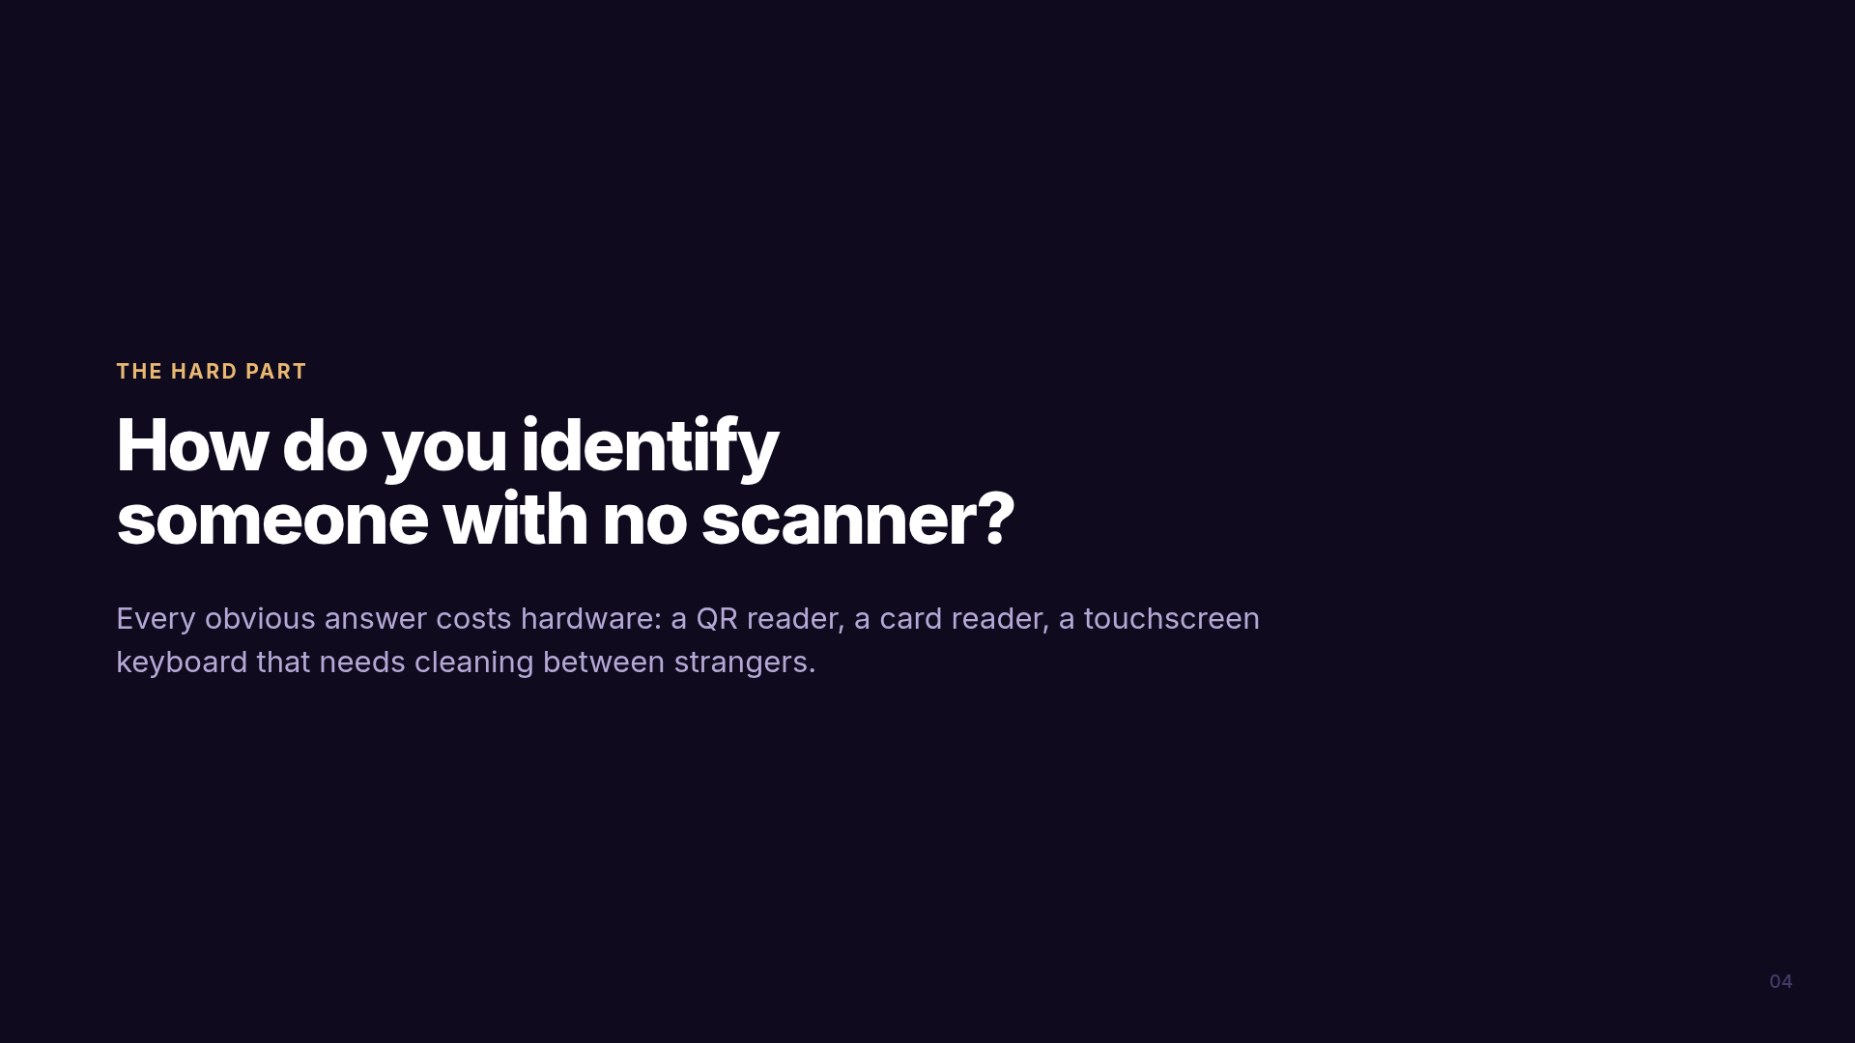
Notes:
Pause here. This is the question the whole project turns on.
If asked why not a touchscreen keyboard: people mistype, it needs cleaning between
strangers, and it cannot verify anyone against a roster.

Slide 5
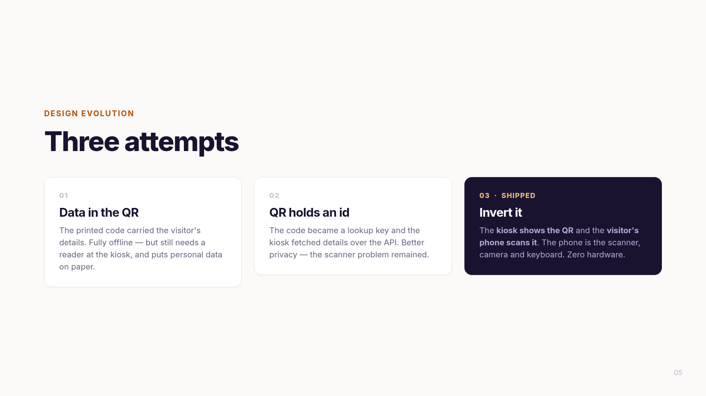
Notes:
Walk left to right - the value is in showing you iterated, not that you guessed right.
Attempt 1 worked offline but needed a reader. Attempt 2 fixed privacy, same hardware problem.
Attempt 3 removed the hardware entirely.

Slide 6
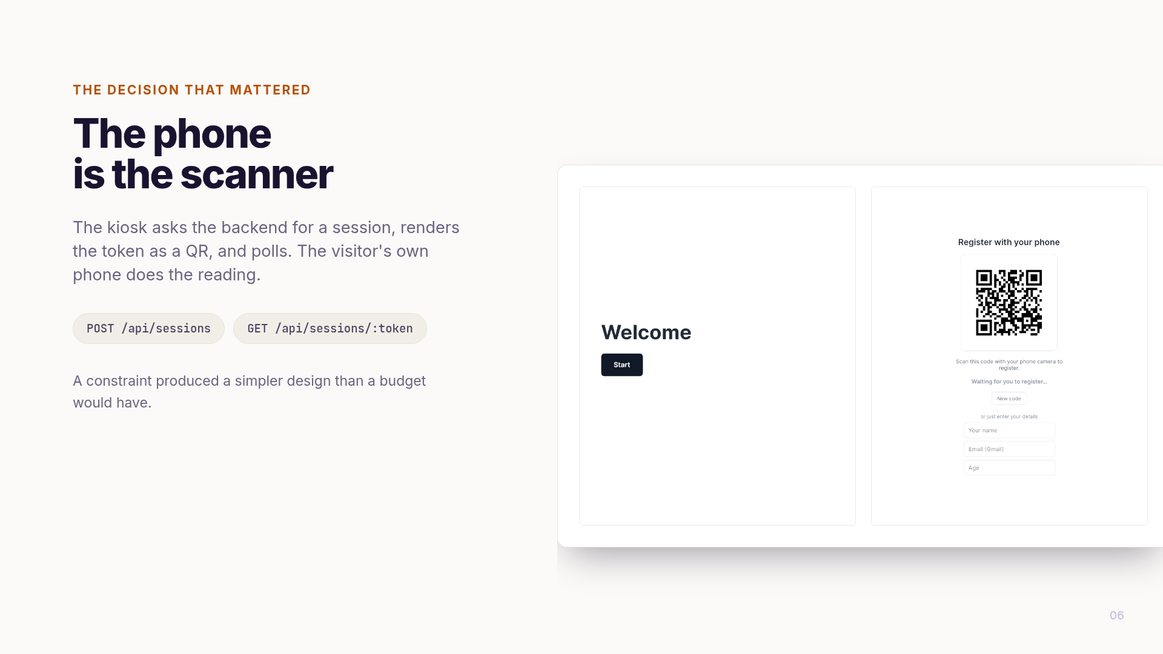
Notes:
The strongest slide. Slow down.
The kiosk creates a session, renders the token as a QR, and polls. The phone reads it.
The phone is already a trusted, personal, camera-equipped input device - so use it.
Closing line: a constraint produced a simpler design than a budget would have.

Slide 7
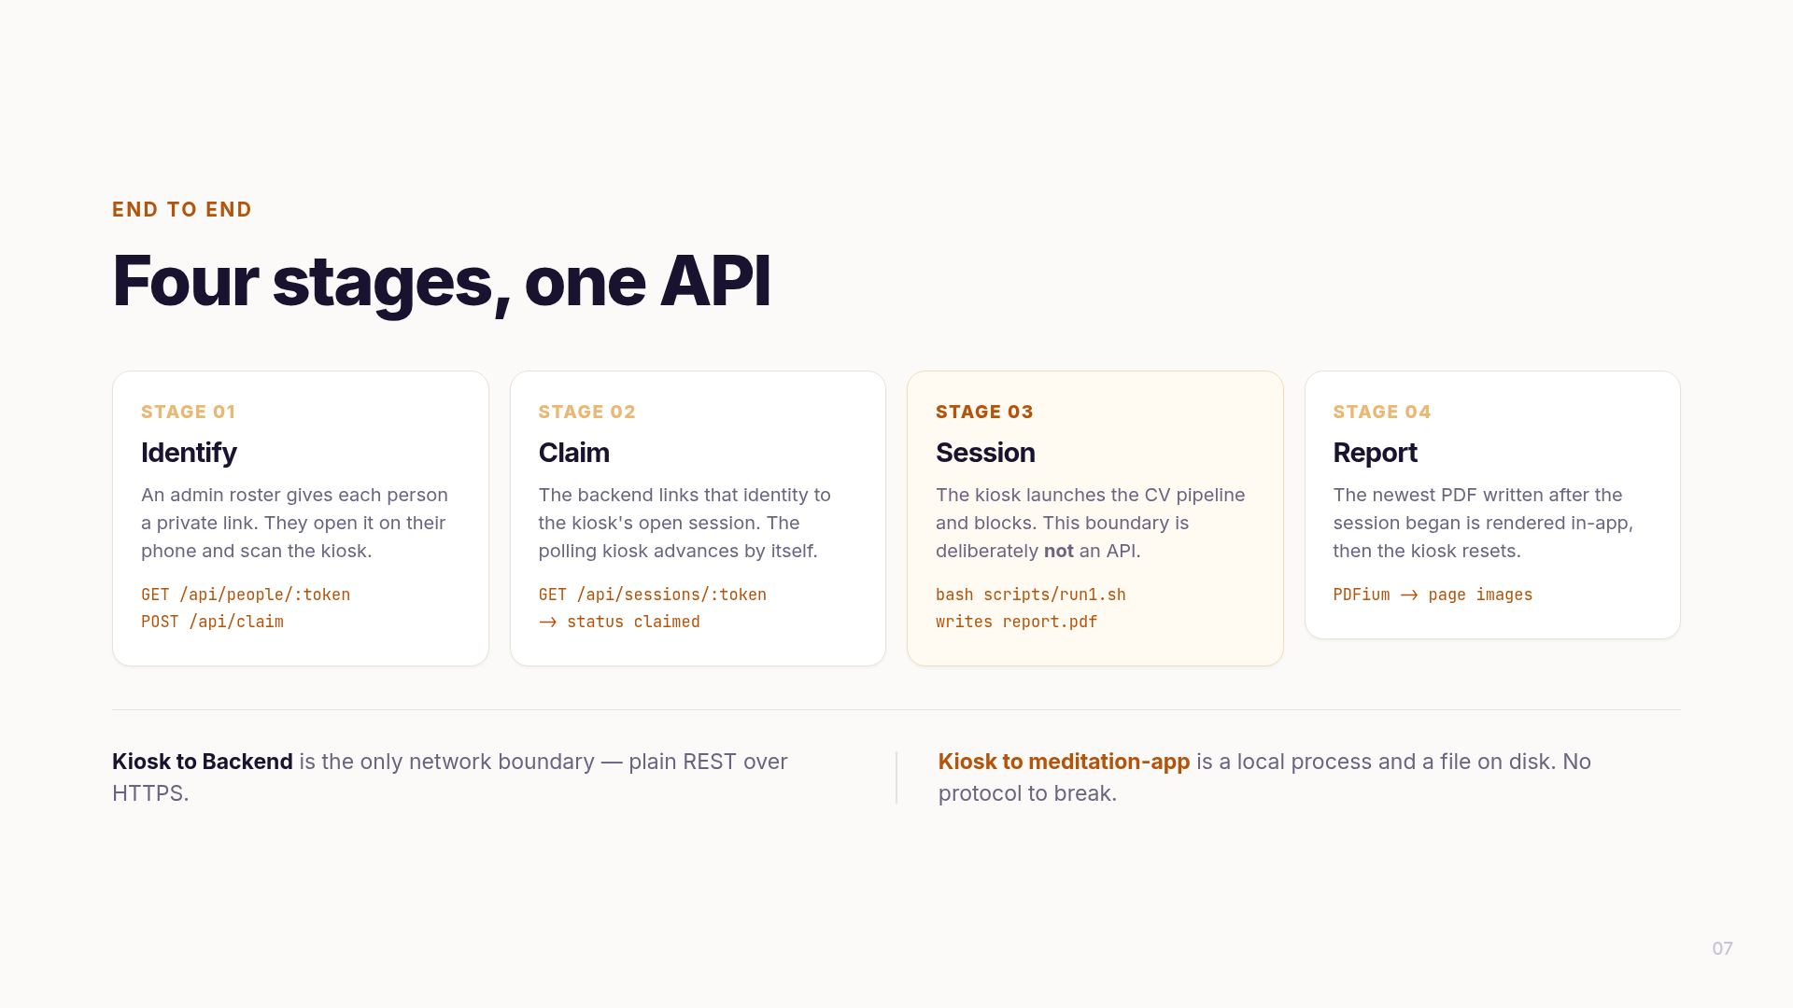
Notes:
This is the architecture answer. Four stages, and note stage 3 is highlighted for a reason:
it is the only boundary that is NOT an API. One shell script, one PDF on disk.
If asked "why not an API there too" - because a protocol is a thing that can break, and
their code was changing weekly.

Slide 8
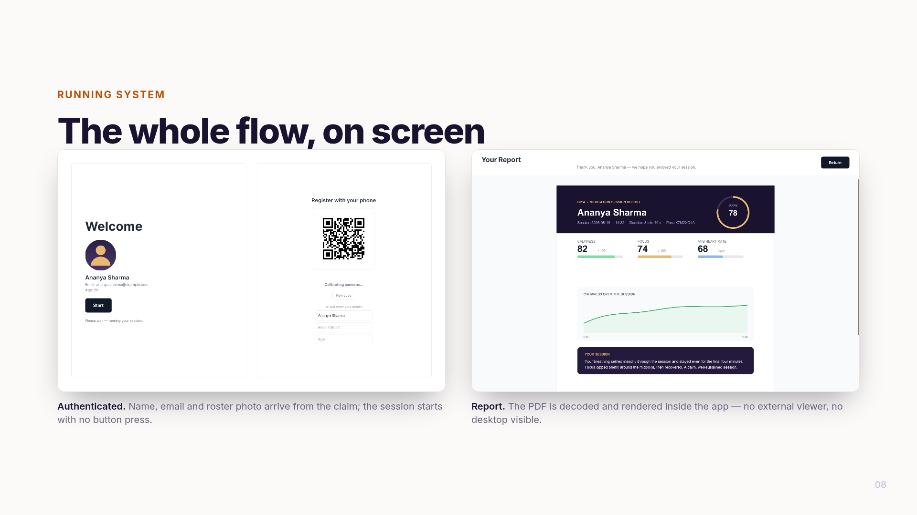
Notes:
These are real frames from the running app, not mockups.
Left: the claim resolved, name and roster photo fetched, session auto-started.
Right: the PDF decoded and rendered in-app - no external viewer, desktop never visible.
Be ready to say the report PDF shown is representative; the real one comes from their app.

Slide 9
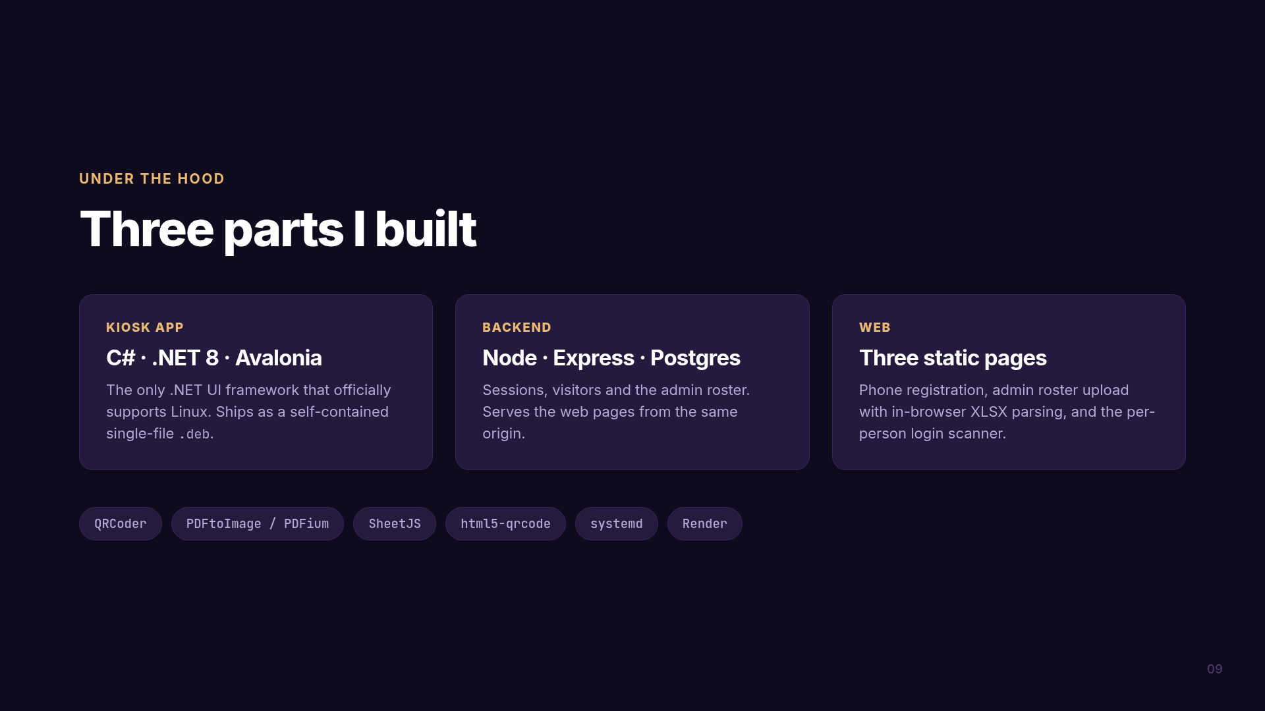
Notes:
Keep this brief - it is reference, not narrative.
If asked why C#/Avalonia: the kiosk drives local hardware on offline Linux, so a web app is
out; a managed runtime means fewer crash classes for all-day unattended operation; and
Avalonia is the .NET UI framework that actually supports Linux.

Slide 10
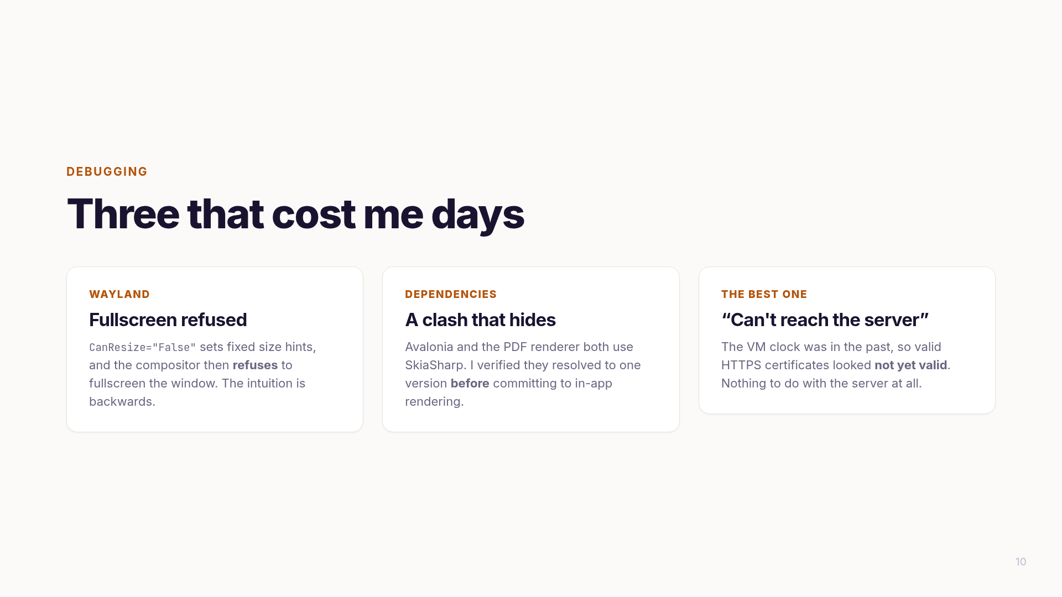
Notes:
Tell ONE properly, mention the others. The clock one usually lands best because the symptom
points completely away from the cause.
The Wayland one is better for a technical audience: you would assume a non-resizable window is
easier to fullscreen, and it is exactly what prevents it.

Slide 11
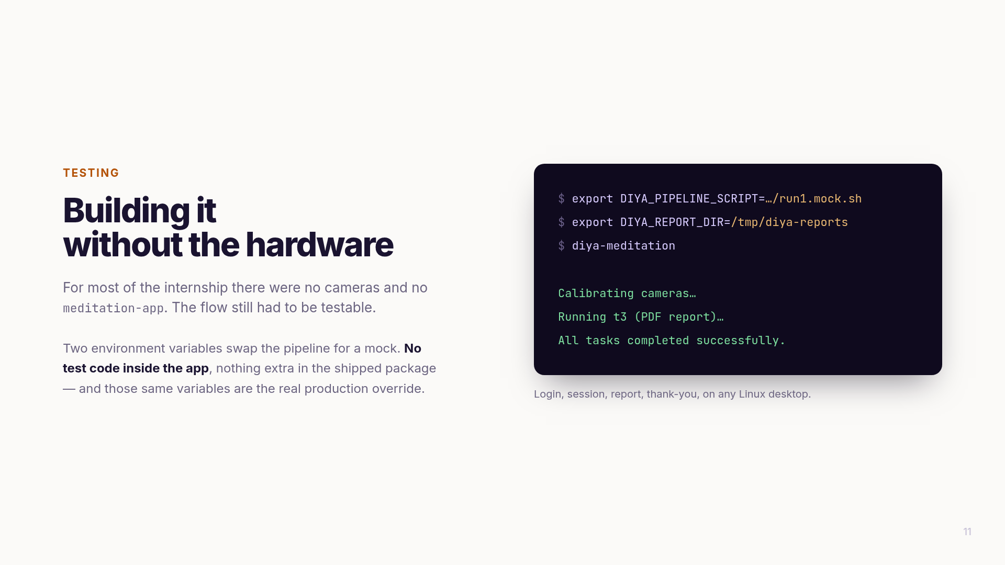
Notes:
The point: the test kit adds no surface area to the product. No mock classes, no #if DEBUG.
It reuses configuration that had to exist anyway for deployment.
Mention the stale-PDF bug it surfaced: "show the newest PDF" would quietly show the previous
visitor their predecessor's report. Fixed by only accepting a file newer than session start.

Slide 12
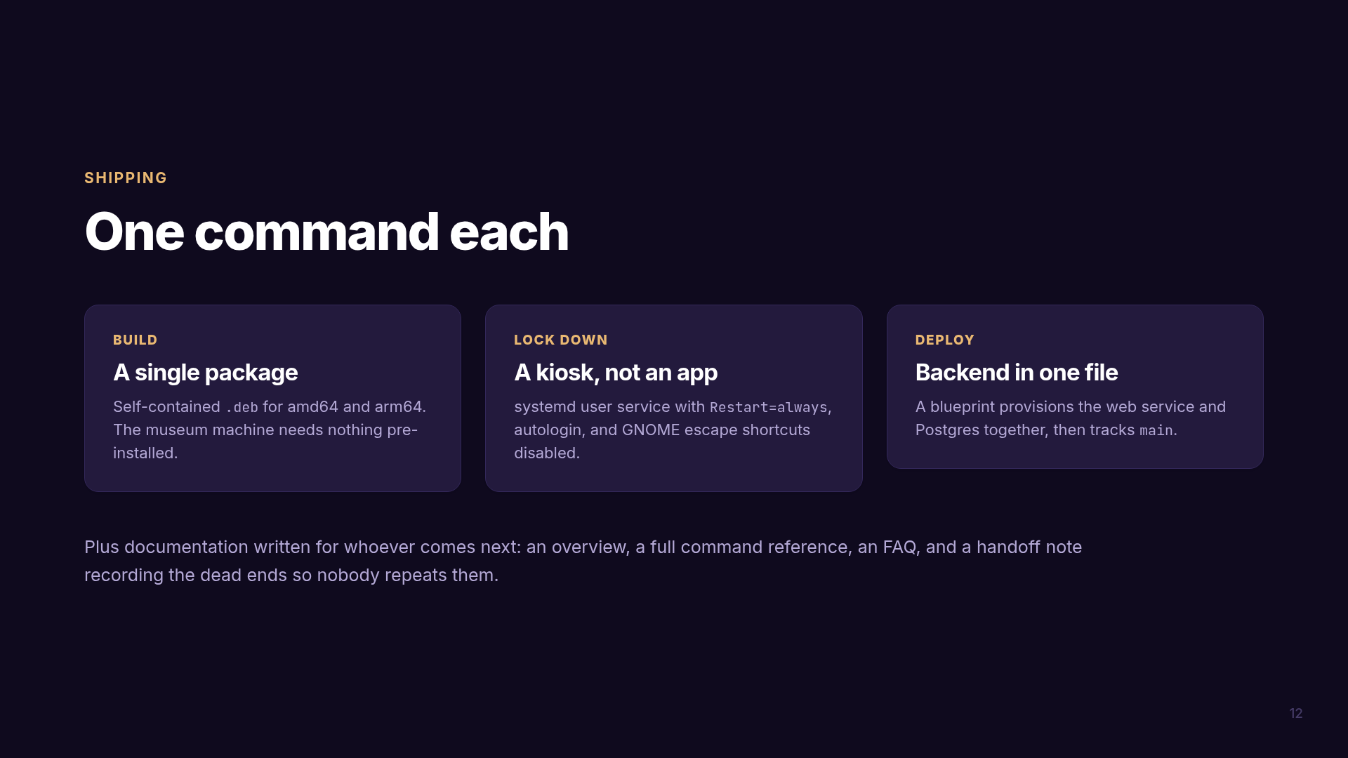
Notes:
Defend the documentation as engineering work, not paperwork. It records what is invisible in
code - why an approach was tried and abandoned, that reinstalling needs the process stopped
first, that auto-deploy must be on or merges never go live.

Slide 13
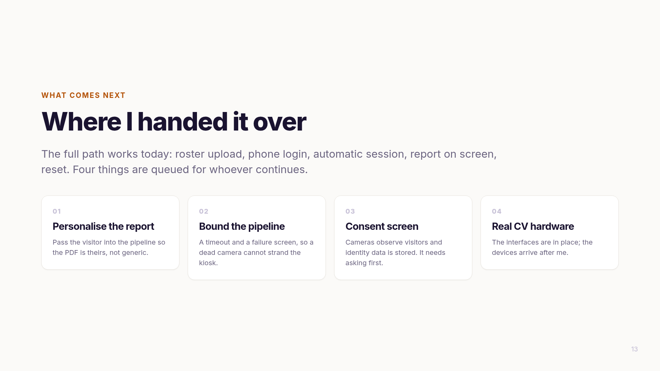
Notes:
Do not apologise through this. Stating precisely what is unfinished, and why, is what
separates a student demo from a handover.
If pressed on personalisation: the launcher starts the pipeline without passing the visitor
through, so the report is generic. Small change my side, but it needs their app to read it.

Slide 14
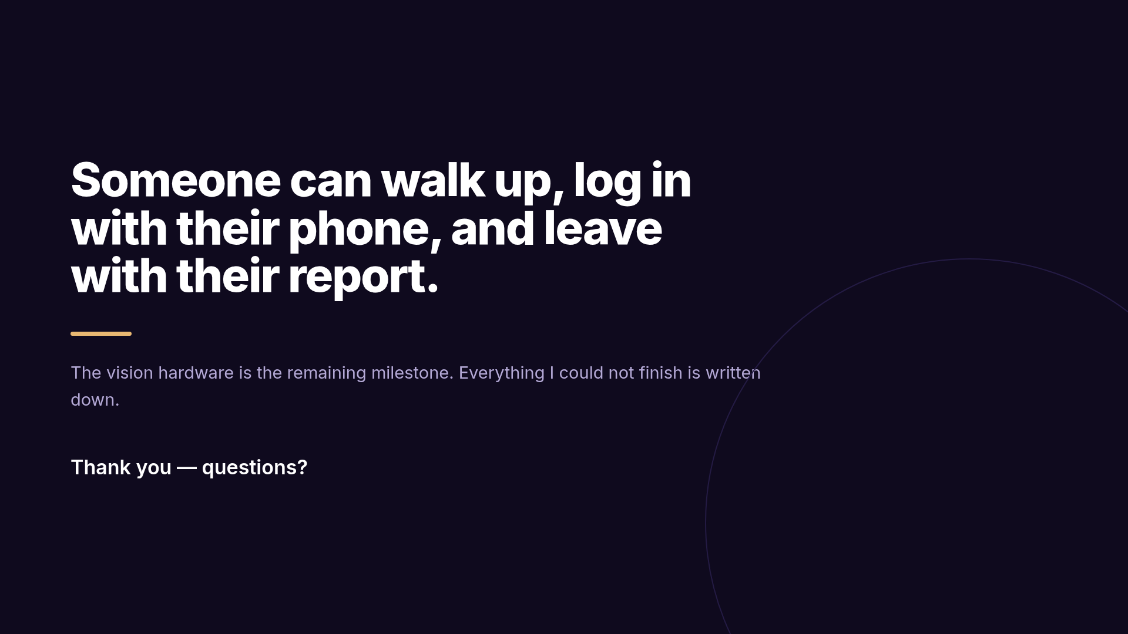
Notes:
Tie back to the opening, then stop talking.
Likely questions: why not Electron (needs local hardware access); what if the internet drops
(QR path fails, manual name entry is the fallback); hardest bug (Wayland fullscreen, or the
clock); what would you do differently (CI on day one).

