Slide 1
Reinforcement Learning-Based
Token Pruning for Diffusion Transformers
Midterm Review — Phase 1 Results & Phase 2 Plan
Ayush | M.Tech AI — IISc Bangalore | Student No. 24839
Supervisor: Prof. Chandra Sekhar
DiT-XL/2
Token Pruning
MAPPO

Slide 2
Problem Statement
Diffusion Transformers are powerful but computationally expensive
The Challenge
The Gap
DiT-XL/2 uses 114 GMACs per forward pass
DyDiT's heuristic SDT gate decides which tokens to skip at each layer independently — with no memory of previous timesteps and no awareness of the full denoising trajectory. It hits the compute budget but skips the wrong tokens.
1
Each image generation runs 50 denoising steps — 5,700 GMACs total per image.
2
Not all tokens are equally important
256 tokens per layer, but many carry redundant spatial information that adds no value to the prediction.
Our Thesis
Replace the heuristic SDT gate with a MAPPO multi-agent policy that observes the full denoising trajectory and learns which tokens to skip — with cross-timestep awareness that no single-step heuristic can provide.
3
DyDiT showed 51% FLOP reduction is possible
By skipping unimportant tokens with a heuristic gate — but the gate has no trajectory awareness.

Slide 3
Parameters
Hidden dim
Layers
Heads
Tokens
GMACs
FID-50K
675M
1152
28
16
256 (16×16)
114.46
2.27
Background: DiT and DyDiT
Diffusion Transformer architecture and existing efficiency work
DiT-XL/2
DyDiT (Zhao et al., ICLR 2025)
Parameters
675M
TDW
Timestep-wise Dynamic Width. Linear router decides which attention heads and MLP channel groups to skip, conditioned on the timestep embedding. Same decision for all tokens.
Hidden dim
1152
Layers
28
Heads
16
SDT
Spatial-wise Dynamic Token. MLP router decides which tokens skip the MLP sub-block, conditioned on post-MHSA features. Different decision per token.
Tokens
256 (16×16)
GMACs
114.46
Result
FID-50K
2.27
Joint fine-tuning of backbone + routers on ImageNet-256 for 210K steps. Achieves 51% FLOP reduction with FID 2.07 — comparable to full DiT baseline.
Our contribution: replace SDT with MAPPO. TDW stays unchanged.

Slide 4
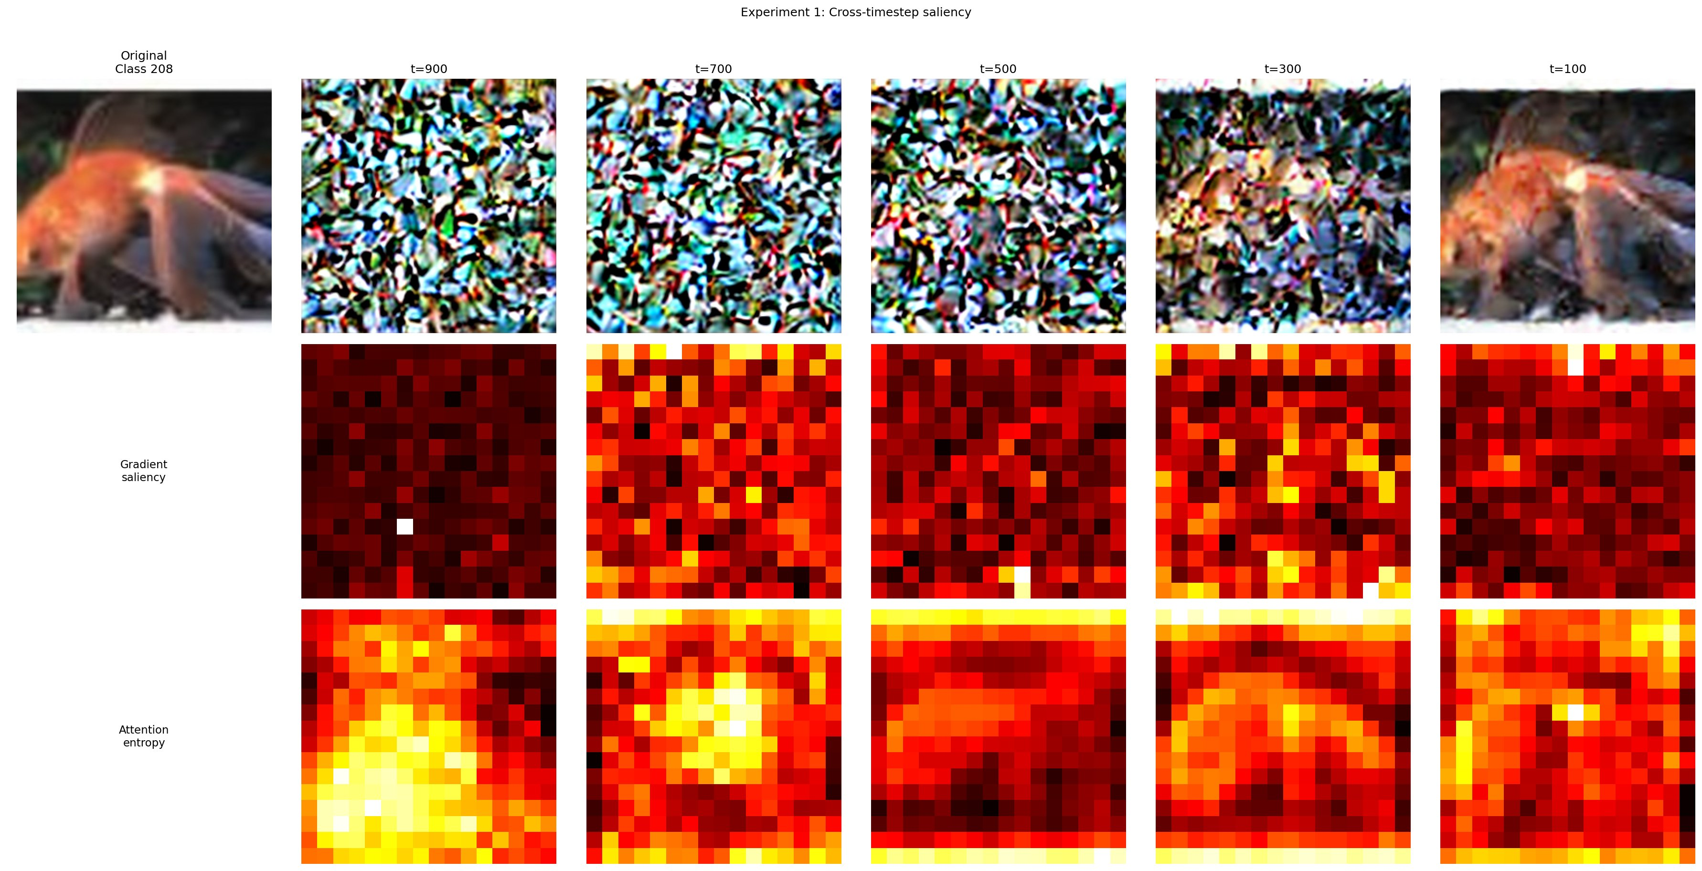
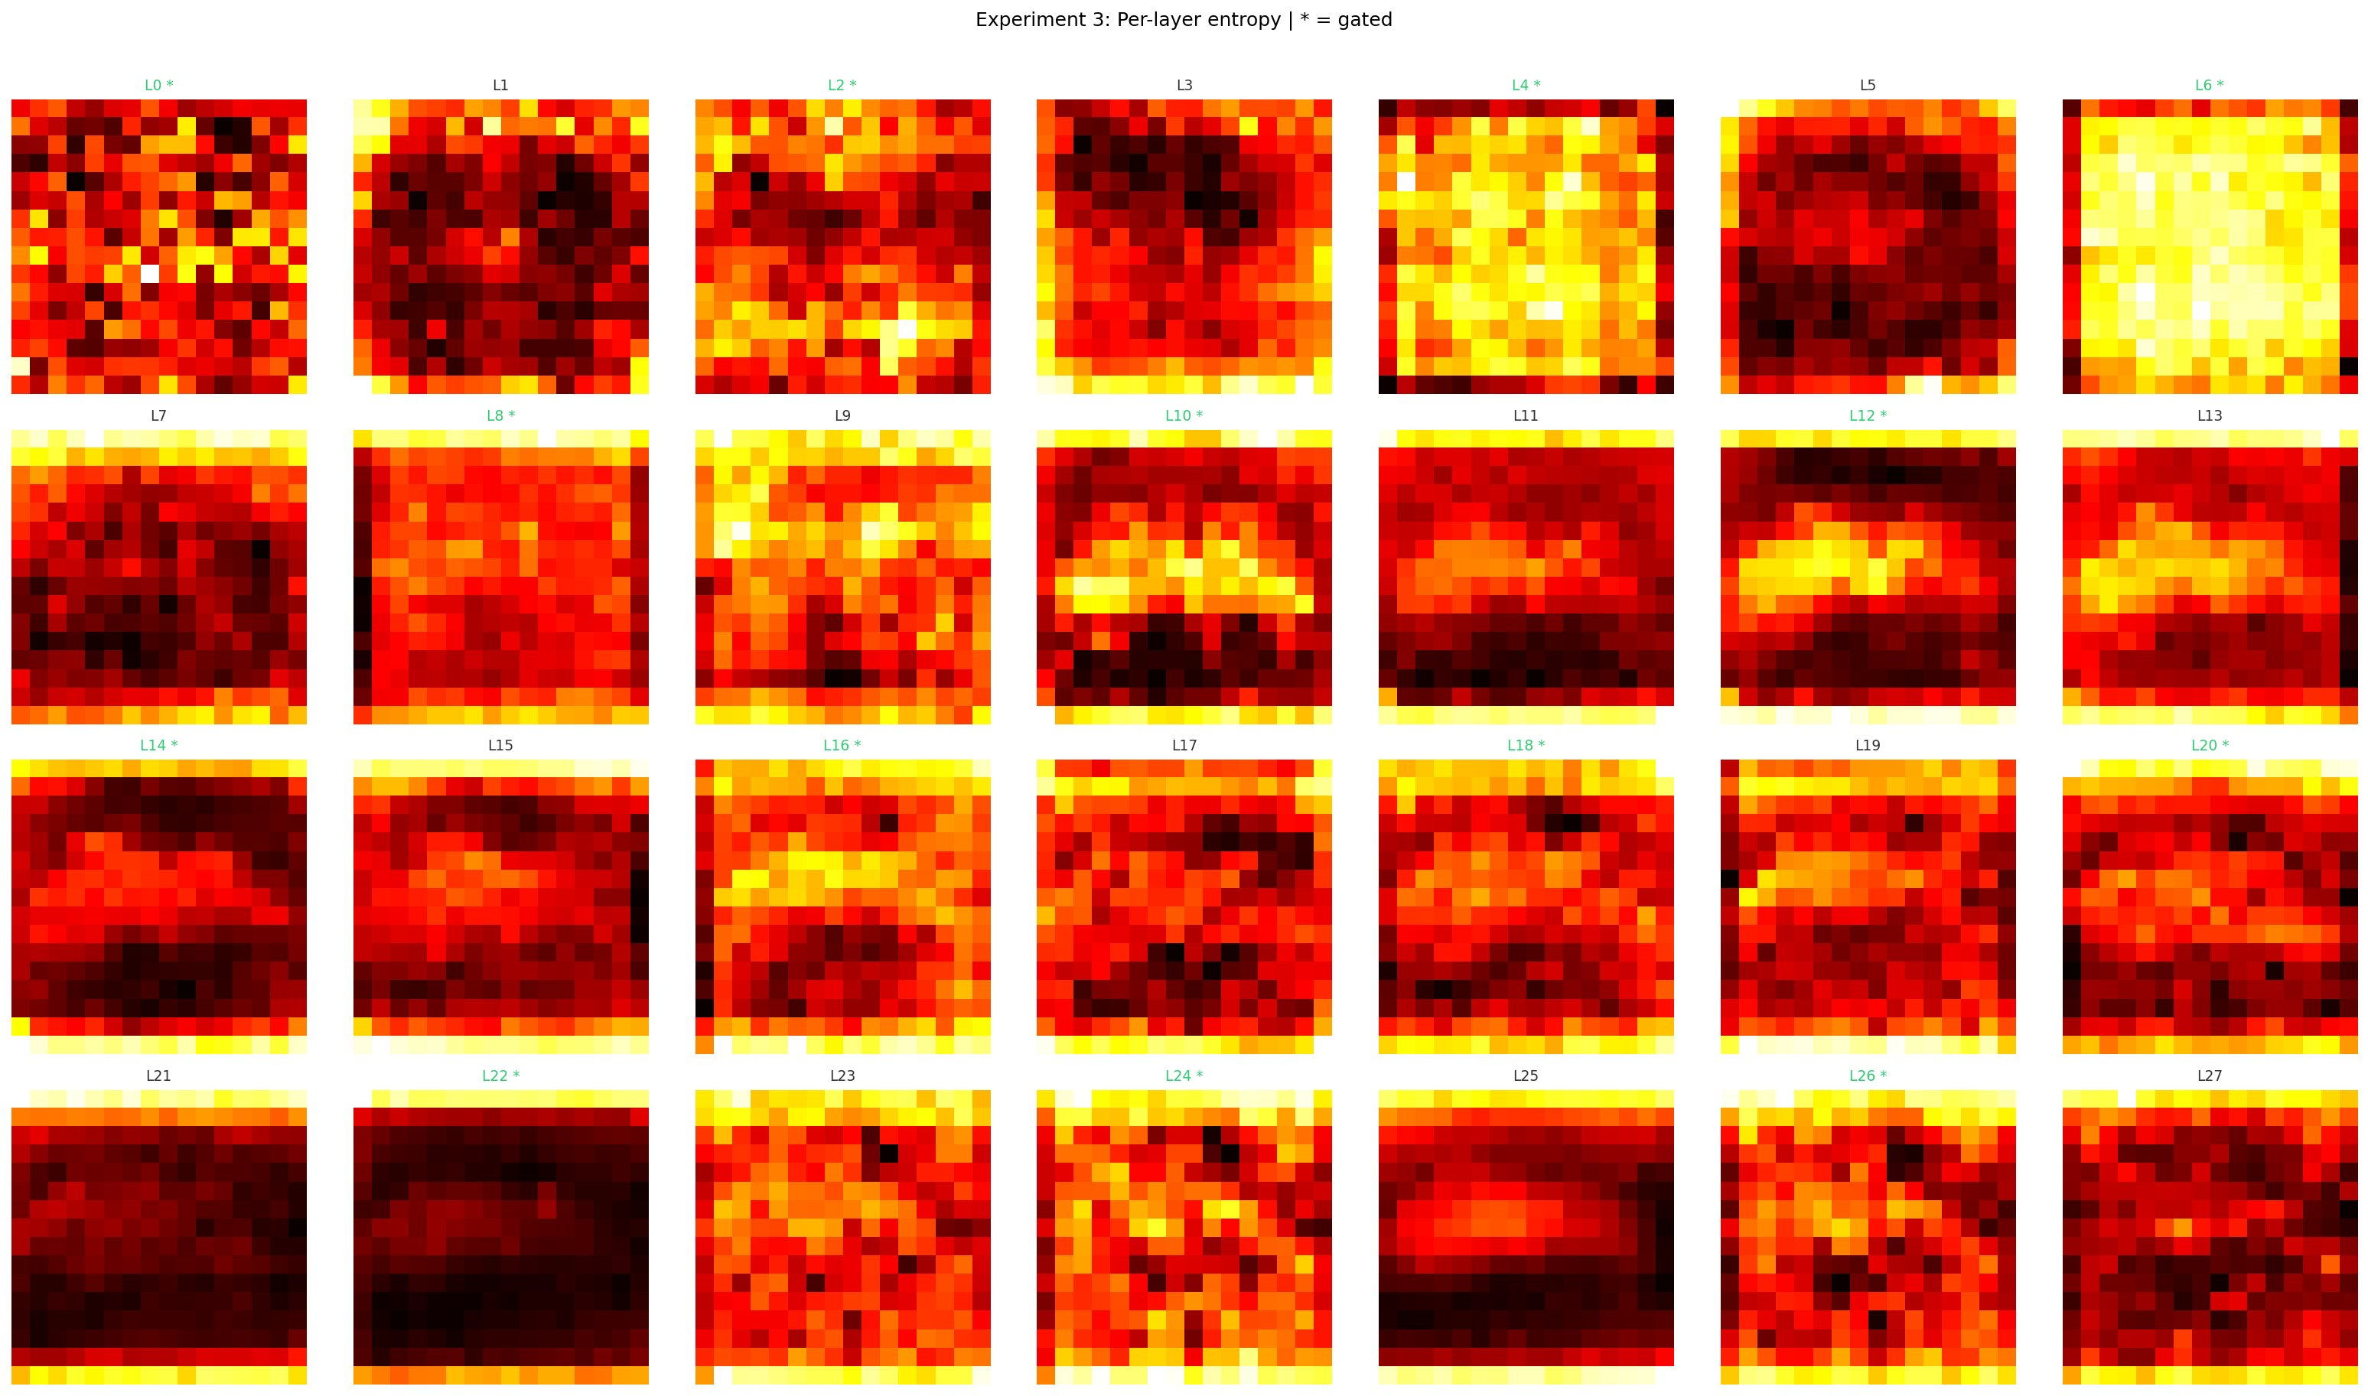
Saliency Analysis — Why the Heuristic Fails
Token importance changes across the denoising trajectory — a per-step gate cannot adapt
Experiment 1: Cross-timestep saliency
Experiment 3: Per-layer entropy
At t=900 importance is diffuse (whole image matters). At t=100 it concentrates on key tokens. A static gate cannot adapt to this shift.
Middle layers (8-16) show clear spatial structure. Early/late layers are noisy. * = gated layer.
Key finding: Token importance is spatially non-uniform, changes across timesteps (diffuse→concentrated), and differs between layers. No single-step heuristic can capture this trajectory-level pattern.

Slide 5
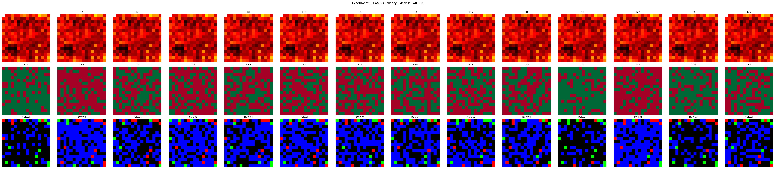
Gate Alignment — IoU vs Saliency Ground Truth
Experiment 2: How well do gate skip decisions match the tokens that actually matter?
Row 1: Saliency ground truth | Row 2: Gate mask (green=kept, red=skipped) | Row 3: Overlay — green=correct keep, blue=correct skip, red=missed important token, black=unnecessary keep
Frozen IoU (5K steps)
Unfrozen IoU (10K steps)
Random chance baseline
MAPPO target
0.298
0.062
0.330
> 0.33
Below random chance
Far below random
50% gate, 50% threshold
Phase 2 objective
12 of 14 gated layers below random chance. Only L0 (0.340) and L26 (0.376) exceed 0.33. Mean IoU unfrozen = 0.062.

Slide 6
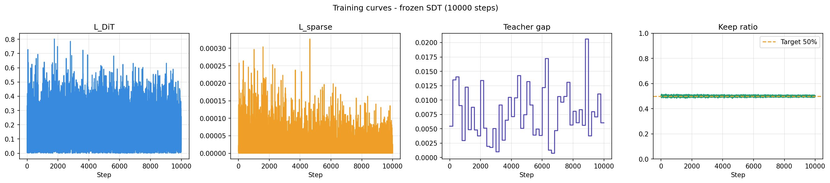
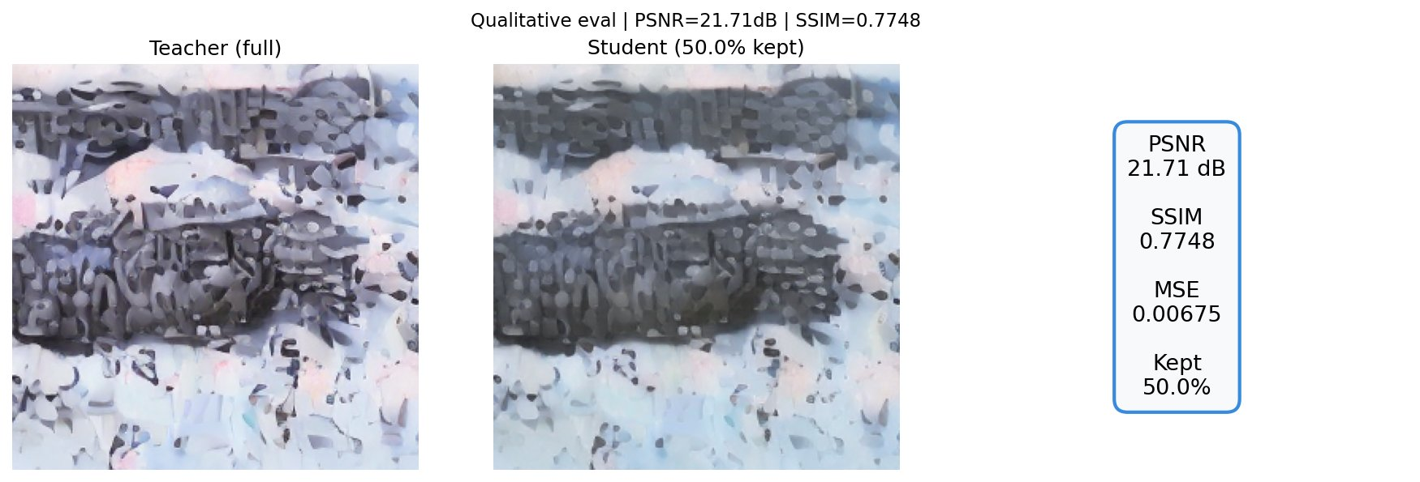
Phase 1 Quantitative Results
Frozen vs unfrozen backbone training — the IoU inversion finding
Training curves (unfrozen, 10K steps)
Qualitative comparison (unfrozen)
Model | GMACs | FLOP ↓ | PSNR | SSIM | IoU | Keep %
DiT-XL baseline | 114.46 | — | — | — | — | 100%
SDT-MLP Frozen (5K) | 96.04 | 16.1% | 10.35 dB | 0.134 | 0.298 | 49.4%
SDT-MLP Unfrozen (10K) | 96.28 | 15.9% | 21.71 dB | 0.775 | 0.062 | 50.0%
MAPPO-SDT (target) | < 96 | > 16% | > 20 dB | > 0.7 | > 0.33 | ~50%
IoU inversion: unfrozen backbone recovers image quality (PSNR +11 dB) but gate loses spatial meaning (IoU 0.298 → 0.062). Quality ≠ spatial alignment.

Slide 7
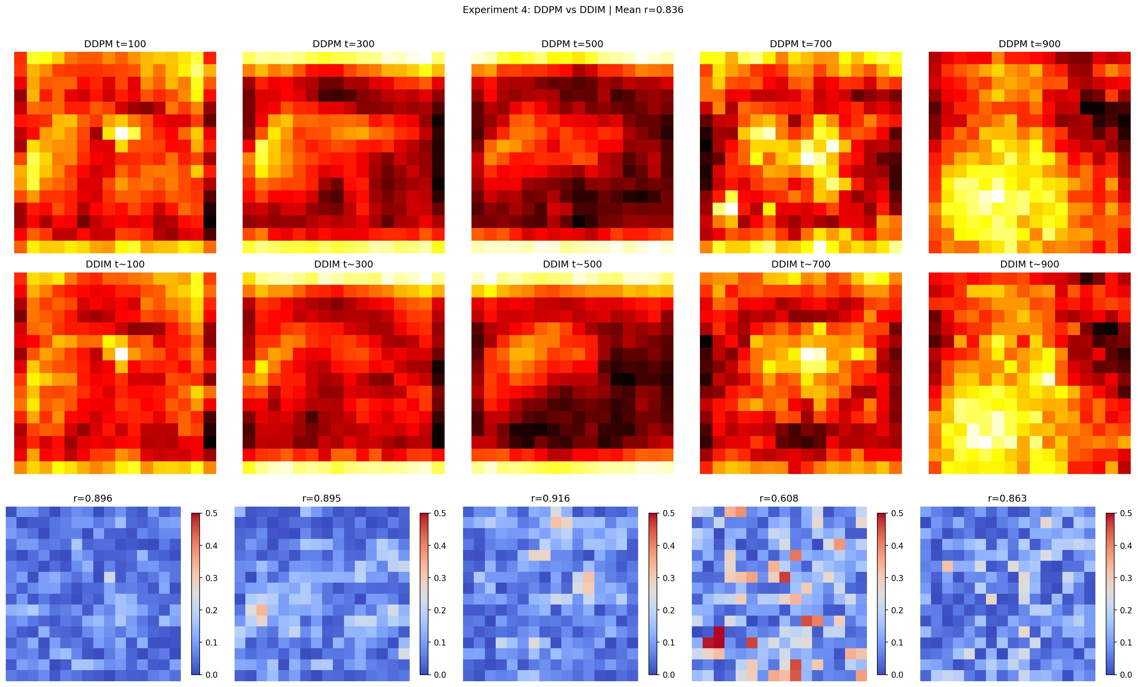
Saliency Consistency Across Noise Instances
Experiment 4: Are saliency maps a reliable ground truth signal?
Correlation Results
Mean r = 0.836
High consistency
t=500: r=0.916
Strongest agreement
t=700: r=0.608
Most variation
Saliency maps are a reliable ground truth. High cross-seed correlation (r=0.836) confirms token importance is image-content driven, not noise-dependent.
Row 1: Saliency at DDPM noise seed 1 | Row 2: Saliency at DDPM noise seed 2 | Row 3: Absolute difference (blue=agree, red=disagree)

Slide 8
Phase 2 Plan — MAPPO Policy
Replacing the heuristic TokenPredictor with a trajectory-aware RL policy
State (what each agent sees)
Action (decision per token)
Post-MHSA token features [N, D] + timestep embedding [D] + layer index (normalised)
Binary skip / keep for each of 256 tokens. One MAPPO actor per gated layer (14 agents total).
Reward (training signal)
Why this fixes IoU
Negative MSE between student noise prediction and true noise, accumulated across the full 50-step DDIM trajectory.
Reward directly penalises skipping important tokens. Backbone cannot silently compensate — wrong skips reduce reward. Spatial alignment is now explicitly optimised.
Targets: IoU > 0.33 (beat random) | Stretch: IoU > 0.50 | PSNR > 20 dB | GFLOPs < 96

Slide 9
Timeline and Next Steps
Phase 1 complete — proceeding to MAPPO implementation
✓ Phase 1 — Complete
→ Phase 2 — MAPPO Implementation
✓ DiT-XL/2 baseline confirmed (114.46 GMACs)
Design MAPPO state, action, reward (done on paper)
Now
✓ SDT gate implemented — TokenPredictor + PruningWrapper
Implement MAPPOActor — replace TokenPredictor
Week 1
✓ Frozen training (5K steps) — IoU 0.298, PSNR 10.35 dB
Verify forward pass runs — single DDIM trajectory
Week 1
✓ Unfrozen training (10K steps) — IoU 0.062, PSNR 21.71 dB
PPO training loop — actor + critic + clipping
Week 2
✓ Four saliency experiments with figures
Train under DDIM schedule — trajectory reward
Week 2-3
✓ IoU inversion finding — core thesis motivation
IoU comparison: MAPPO vs MLP baseline (0.062)
Week 3
✓ Full checkpoint + auto-resume system
250K step run on ImageNet-level data
Month 2
✓ HookManager persistent diagnostics
FID-50K evaluation — ADM evaluator
Month 2-3
✓ Deployed on RTX PRO 6000 Blackwell (102GB)
Thesis writeup — Phase 1 + 2 combined
Month 3
All Phase 1 experiments run on RTX PRO 6000 Blackwell (102GB). Dataset: tiny-imagenet (512 images). Final thesis numbers will use ImageNet-256.

