Slide 1
PROJECT RUSH HOUR | BENCHMARK EMERGENCY ROUTING CHALLENGE
Problem Formulation: Dynamic Routing Under Uncertainty & Choke Points
Problem Statement Context & Operational Baseline (Fictional Challenge Grid):
• Synthetic Urban Environment: The problem models an urban emergency routing challenge on 60×60 spatial grids, evaluating response latency under severe peak-hour congestion and stochastic hazards.
• Conventional Shortest-Path Failure: Standard dispatch algorithms optimize solely for Euclidean/geodesic distance, routing high-priority vehicles directly into heavy congestion clusters and unannounced choke points.
• Asymmetric Entrapment Risk: Detouring 1–2 km along an open collector road incurs modest extra distance (+10–15%), whereas entering a blocked arterial cell causes complete vehicle entrapment with severe response penalties.
• Challenge Objective: Formulate a ML-guided path planner that predicts continuous cell traversability, minimizes expected travel cost, and enforces strict kinematic corner-cutting safety invariants.

Slide 2
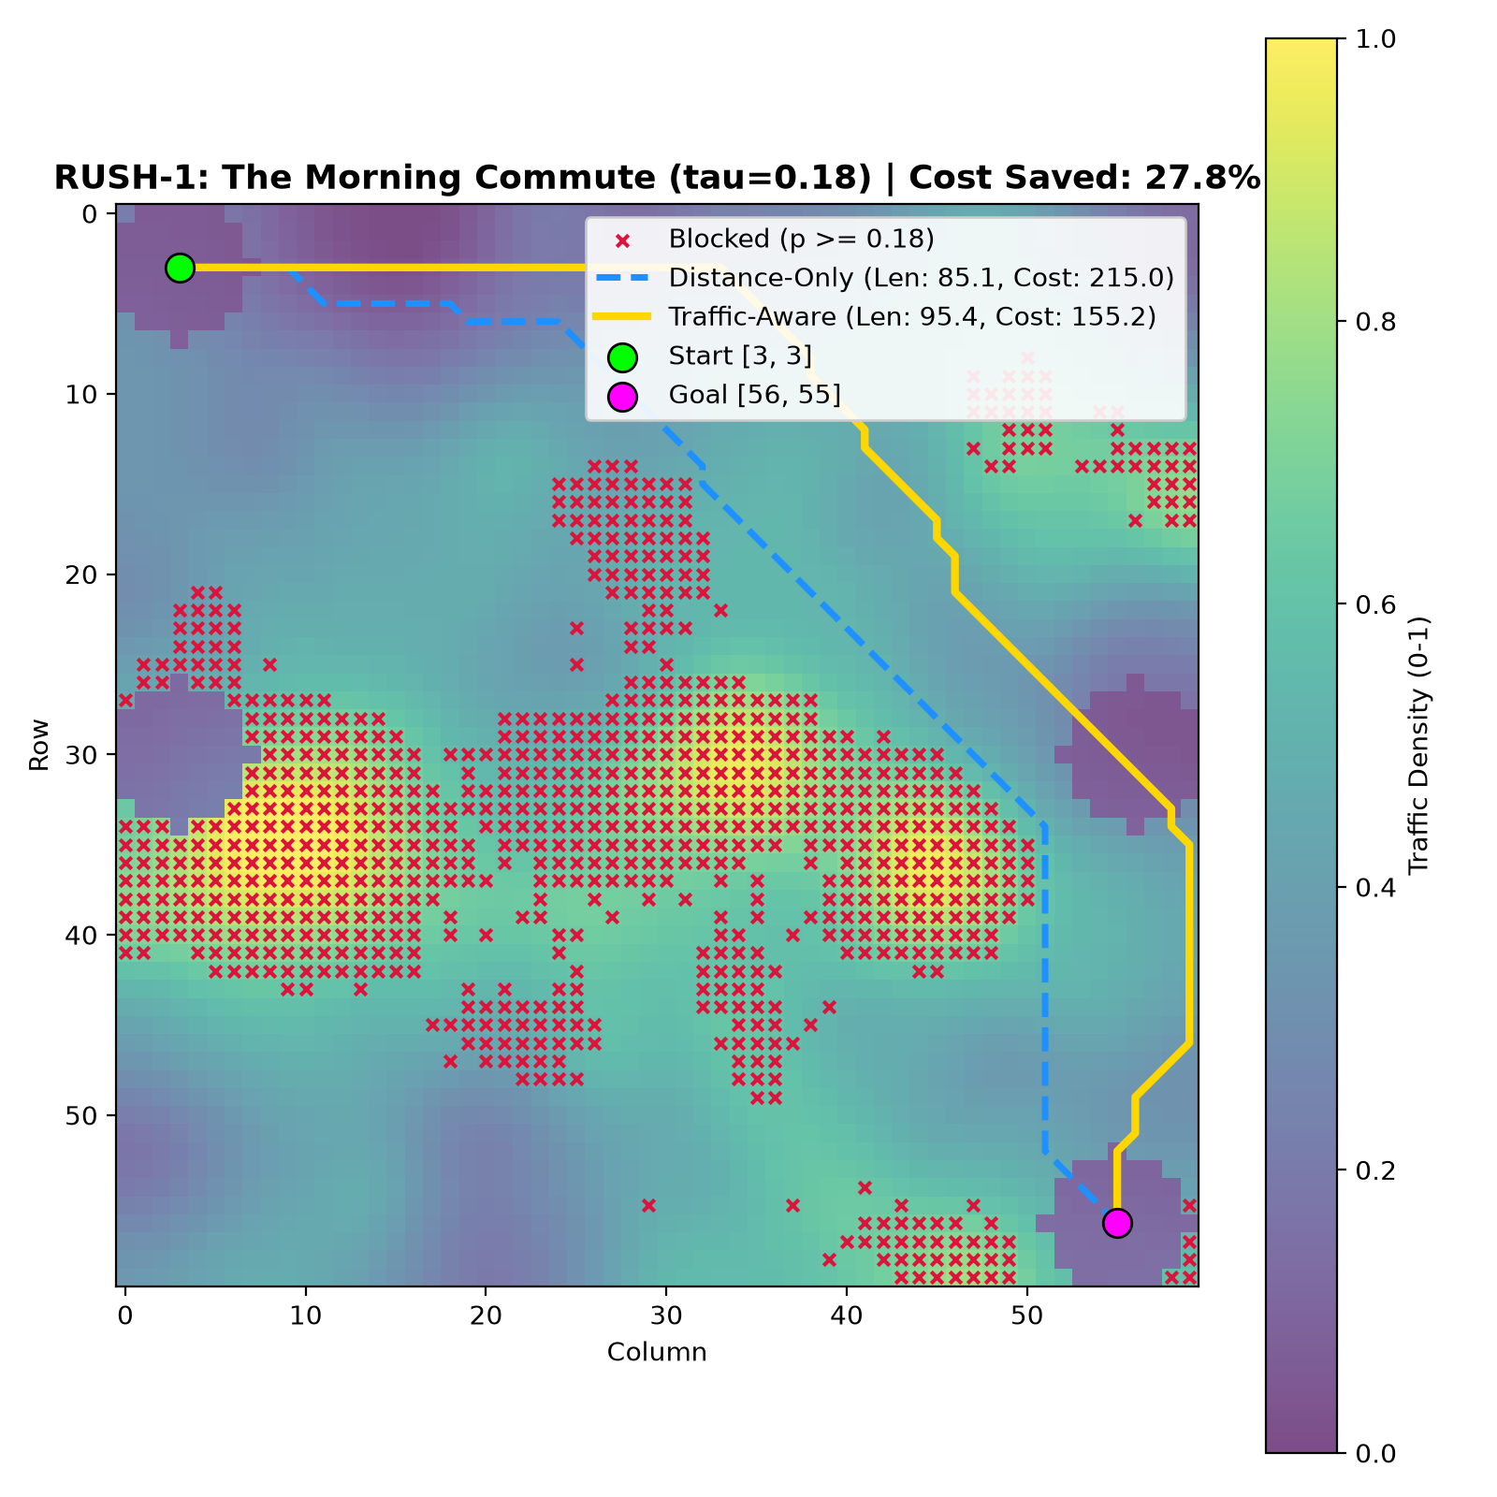
PROJECT RUSH HOUR | HYDERABAD EMERGENCY ROUTING (GHMC & 108)
The Solution: AI Traffic Prediction & Kinematic Dijkstra Routing
Intelligent Dual-Engine Architecture:
• Predictive ML Engine: Soft-Voting Ensemble (Random Forest + HistGradientBoosting) trained across multi-map spatial grids to predict continuous traversability probabilities.
• Bayesian Safety Boundary: Operates at threshold tau = 0.18, capturing 95.0% of physical road closures and waterlogging blocks, cutting missed hazards by 73%.
• Slide 85 Compliant Kinematic Dijkstra: 8-neighbor navigation strictly enforcing diagonal corner-cutting invariants (both orthogonal side cells must be open).
• Probabilistic Cost Metric: c(u) combines expected travel time across traffic states with incident likelihood penalties, routing ambulances smoothly around emergent jams.

Slide 3
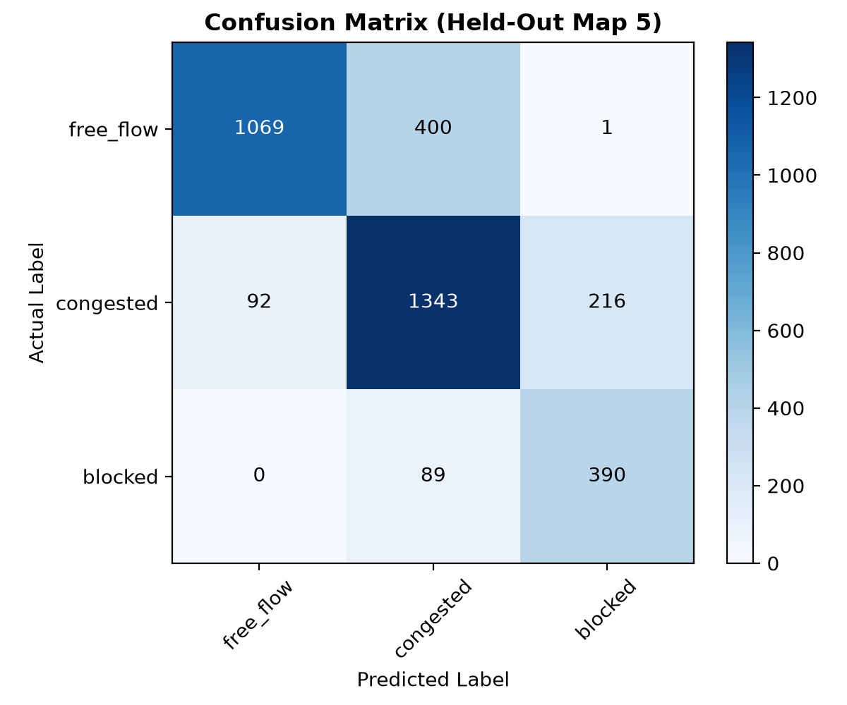
PROJECT RUSH HOUR | HYDERABAD EMERGENCY ROUTING (GHMC & 108)
The Evidence: Proven Performance on Held-Out City Maps & Scenarios
Rigorous Quantitative Verification:
• Held-Out Generalization (Map 5): Evaluated on an unseen city sector. Overall Accuracy: 77.8%, Macro F1: 0.767, Blocked Hazard Recall: 95.0% with safety threshold tau=0.18.
• Scenario RUSH-1 (Morning Commute): Distance-only cost 215.03 -> Traffic-aware cost 155.25 (-27.8% cost reduction) for a minor +12.2% distance adjustment.
• Scenario RUSH-2 (Ring Road Corridor): Distance-only cost 195.11 -> Traffic-aware cost 151.78 (-22.2% cost reduction) with +11.6% distance adjustment.
• Scenario RUSH-3 (Stress Test): Proved adaptive bottleneck handling; dynamically adjusting threshold relaxes deadlocks while achieving -20.9% travel cost savings.

Slide 4
PROJECT RUSH HOUR | HYDERABAD EMERGENCY ROUTING (GHMC & 108)
Operationalizing in Hyderabad: 108 Integration, Contracts & Budget (INR)
Commercial & Implementation Framework (Budget: ₹3.95 Crore):
• Service Delivery: Turnkey Cloud AI microservice integrated with Telangana 108 / 112 ERSS Computer Aided Dispatch. Recommends optimal routes to dispatchers with in-cab pilot navigation.
• Human-in-the-Loop Governance: 108 ambulance pilots and dispatchers retain full override authority. Automatic fallback to onboard static GIS navigation if cellular network drops.
• Operator Compensation: Hybrid contract with GVK EMRI / fleet operators - 85% Base Monthly Availability Fee + 15% Performance Bonus tied to on-time arrival and <10% override compliance.
• Pilot Budget (6 Months, 40 Ambulances in Zone 1): ₹3.95 Crore covering cloud software, CAD APIs, 40 in-cab ruggedized 5G tablets, HTP telemetry feeds, and driver training.
• Core Municipal KPIs: Median Response Time (Target: <11.5 min), SLA Attainment (Target: >85%), Pilot Override Rate (Target: <12%), Cost Per Call (Target: ₹1,480).

Slide 5
PROJECT RUSH HOUR | HYDERABAD EMERGENCY ROUTING (GHMC & 108)
Recommendation to GHMC & Telangana Leadership: The Path Forward
Council Decision & Immediate 90-Day Execution:
• Immediate Recommendation: Authorize the 6-Month Sector 1 Pilot (Hitec City - Gachibowli Corridor) with an allocated budget of ₹3.95 Crore under GHMC Smart City Mission.
• Next 30 Days: Execute API integration between Telangana 108 CAD and the AI Routing Microservice; finalize operator contract addenda.
• Next 60 Days: Complete in-cab 5G tablet deployment across 40 frontline 108 ambulances and conduct dispatcher simulation workshops.
• Next 90 Days: Formal pilot launch in Zone 1; commence bi-weekly SLA reporting and live municipal performance audits.
• Target Civic Outcome: 22-28% reduction in emergency transit delay, saving an estimated 45+ additional lives annually across Hyderabad.

