Slide 1



SMART INDIA HACKATHON 2024
TITLE PAGE
Problem Statement ID - SIH1751
Problem Statement Title - Dashboard for Swachhta and LiFE. Develop a dashboard aimed at maintaining cleanliness and LiFE practices, integrating AI-powered image processing technology for effective monitoring of Swachhta and green practices adopted in post offices. The dashboard needs to be accessible from the Divisional Office offering surveillance capabilities and triggering alerts for deviation from prescribed Swachhta and Green Growth standards to prompt on ground intervention to guide the post office concerned to make necessary changes to conform to set expectations.
Theme - Clean & Green Technology
PS Category - Software
Team ID - 28
Team Name - SwachhaVision

Slide 2
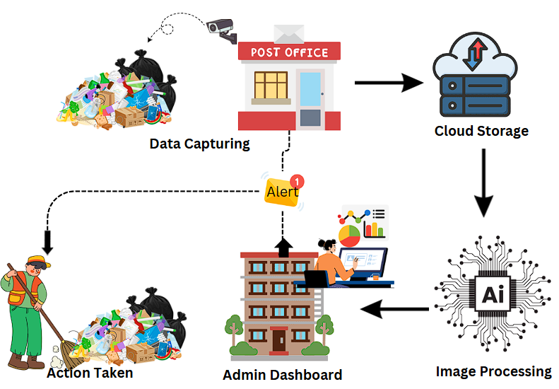
IDEA TITLE
Swachha Vision
INNOVATION AND UNIQUENESS :
Interactive Data Visualization.
Deriving automated periodic reports for better analysis.
AI-Powered image processing.
IDEA / SOLUTION :
Cleanliness monitoring is automated in post offices through CCTV footage using Image Analysis.
Tracking cleanliness and LiFE practices through dashboard created via data analysis.
Efficient data storage and real time alerts to respective post offices.
PROBLEM RESOLUTION:
AI detects deviations from Swachhta standards, enabling timely interventions .
Automated alerts notify admins for immediate corrective actions.
Real-time monitoring ensures scalable adoption across thousands of post offices.

Slide 3
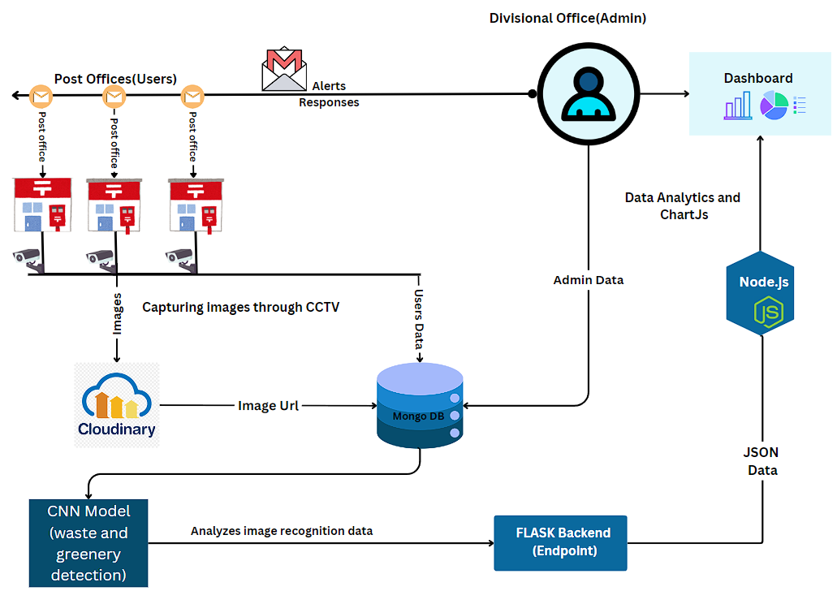














TECHNICAL APPROACH
Swachha
Vision
Technology Stack:
Frontend :- Html, CSS, EJS, Javascript, NextJS, TailwindCSS.
Backend :- Node.Js, Express.Js, Flask, JSON.
Database: MongoDB, Cloudinary.
ML & Deep Learning: TensorFlow, Keras, YAML , YOLO (Ultralytics),Opencv.
Fig. Architecture Diagram

Slide 4
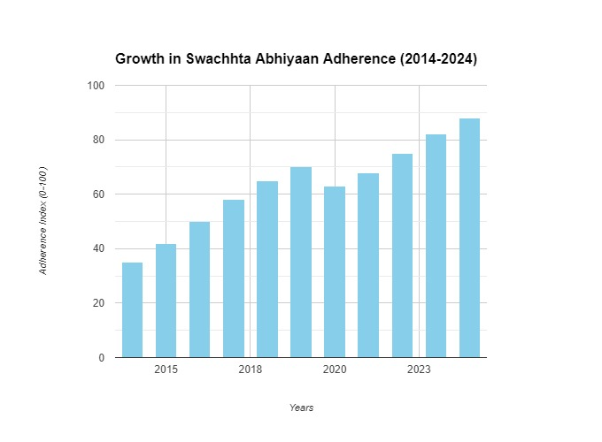
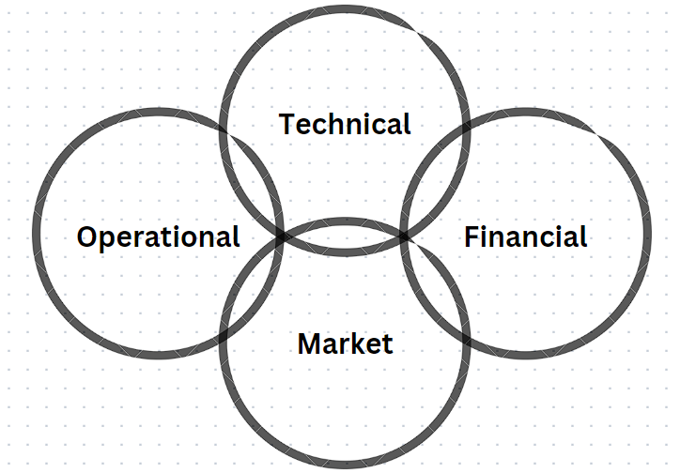
FEASIBILITY AND VIABILITY
Swachha
vision
Analysis of Feasibility*- *Technical*: The system integrates proven technologies like YOLO, Flask, Node.js, and MongoDB, ensuring reliability and scalability.- *Financial*: Cloudinary and MongoDB offer cost-effective storage solutions, minimizing expenses.- *Market*: High demand for AI-driven cleanliness solutions aligns with sustainability goals, ensuring strong market fit.- *Operation
*Potential Challenges and Risks*- *Technical*: Model accuracy in different environments; large data handling.- *Financial*: Potential costs for scaling Cloudinary storage.- *Market*: Adoption reluctance due to initial setup complexities.- *Operational*: Ensuring consistent camera coverage and data collection.
Technical: Model accuracy varies; large data handling is challenging. Strategy: Train models with diverse datasets and use Google Cloud Storage.
Financial: Scaling Cloudinary can be costly. Strategy: Start small and scale gradually with AWS EC2 or Azure.
Market: Setup complexity may hinder adoption. Strategy: Provide staff training and support.
Operational: Consistent camera coverage is difficult. Strategy: Implement routine maintenance and monitoring.
FEASIBILITY ANALYSIS:-
Technical : Image analysis via YOLO, backend using Flask, and MongoDB with Cloudinary for storage.
Financial : Cost effective architecture requiring minimal initial investment.
Market : Adoption potential will be high in public services and urban regions.
Operational : Easy to implement with existing infrastructure and centralized monitoring.

Slide 5
IMPACT AND BENEFITS
Swachha
Vision
Category | Potential Impact | Benefits of the Solution
Social | Positive: Improved cleanliness monitoring. Promotes AI use in government services. Healthier public environments. Negative: Resistance due to unfamiliarity with AI. | Improved access to clean spaces. Empowerment through data-driven decision-making. Reduction in cleanliness-related issues across post offices.
Economical | Positive: Reduced manual check costs. New AI market opportunities. Negative: Upfront infrastructure costs (cameras, storage). | Increased productivity with real-time monitoring. Reduced long-term operational costs. Market opportunity for AI in public sectors.
Environmental | Positive: Reduced waste generation through consistent Swachhta adherence. Lower energy usage through efficient monitoring. | Reduced energy usage through efficient monitoring. Lower waste generation due to consistent Swachhta adherence.
@SIH Idea Submission 5

Slide 6
RESEARCH AND REFERENCES
Swachha
Vision
[1] Garbage Detection using Advanced Object Detection Techniques. (n.d.). IEEE Conference Publication | IEEE Xplore. https://ieeexplore.ieee.org/document/9395916
[2] Aslam, F., Mohammed, H., & Lokhande, P. (2015). Efficient way of web development using Python and Flask. International Journal of Advanced Research in Computer Science, 6.
[3] Bosch, M. (2020). DetecTree: Tree detection from aerial imagery in Python. The Journal of Open Source Software, 5(50), 2172. https://doi.org/10.21105/joss.02172
[4] Jin, S., Yang, Z., Królczykg, G., Liu, X., Gardoni, P., & Li, Z. (2023). Garbage detection and classification using a new deep learning-based machine vision system as a tool for sustainable waste recycling. Waste Management, 162, 123–130. https://doi.org/10.1016/j.wasman.2023.02.014
[5] Rodríguez, C., Baez, M., Daniel, F., Casati, F., Trabucco, J. C., Canali, L., & Percannella, G. (2016). REST APIs: A Large-Scale Analysis of Compliance with Principles and Best Practices. In Lecture notes in computer science (pp. 21–39). https://doi.org/10.1007/978-3-319-38791-8_2

