Slide 1
AcademixIQ
AI-Powered Smart Learning Companion & Accessibility Hub
Bharat Academix CodeQuest 2026 | Round 1: Idea Proposal
Team: Team Academix
Solo Innovator: Ayush Khaitan
Themes: EdTech, AI/ML, Accessibility

Slide 2
The Problem Statement
Key Challenges in Indian Education:
• Passive Learning Model: Traditional systems rely on one-way lectures, leading to poor retention and zero real-time personalized feedback.
• Regional Language Barriers: 80%+ of higher academic research, papers, and specialized resources are exclusively in English, isolating regional-medium students.
• Accessibility Gaps: Neurodivergent learners (ADHD, Dyslexia) and visually/hearing-impaired students lack interactive, adaptive support in physical/digital classrooms.
The Opportunity in Numbers:
250 Million+ Students enrolled in Indian primary/secondary schools needing tailored education.
< 5% Of educational content conforms to international accessibility standards in regional domains.
80% Of classroom knowledge loss occurs within 48 hours without active reinforcement.

Slide 3
The Proposed Solution - AcademixIQ
BhashaTranslate
Real-time vernacular lecture transcription, translating English classes to local Indian languages (Hindi, Tamil, etc.) instantly.
VisualMind Canvas
Generates real-time, interactive mind maps and visual flowcharts from lecture audio or PDFs to simplify complex concepts.
SkillBridge AI
Contextual, adaptive quiz generation that analyzes user performance to pinpoint concept gaps and customize roadmaps.
EduAccess Engine
High-contrast screen-reader styles, speech-to-text navigation, and simplified content modules for neurodiverse learners.
Direct Alignment: Education Technology | Social Impact & Accessibility | AI & Machine Learning

Slide 4
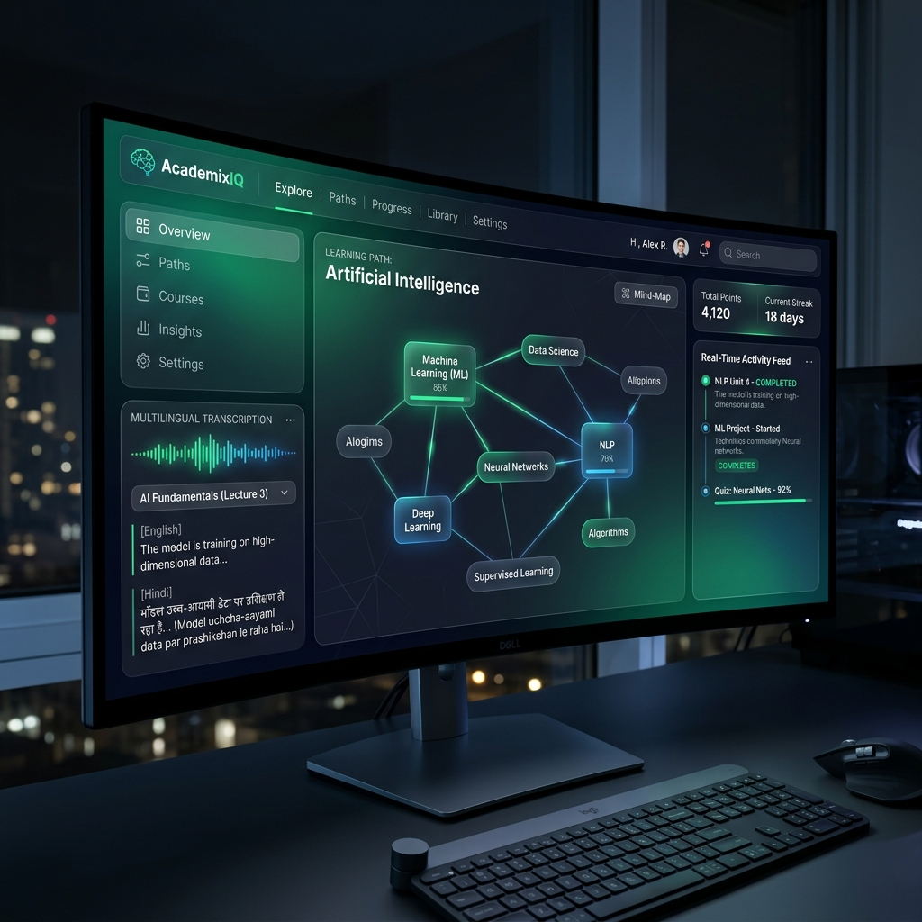
Interactive Student Dashboard Mockup
AcademixIQ Student Dashboard:
• Glassmorphism UI: Optimized for focus with a modern dark aesthetics design system.
• Visual Mind-Mapping: Center stage is occupied by interactive node diagrams illustrating the relation between academic topics.
• Real-Time Transcripts: Left/right panels stream live translations, enabling students to switch languages dynamically.

Slide 5
System Architecture & Processing Pipeline
1. INGESTION LAYER
• Live Classroom Audio Feed
• PDFs & Textbook Scans
• Youtube Lecture URLs
• WebRTC Voice Commands
• Peer Tutors Inputs
2. CORE AI PIPELINE
• Whisper Large v3 STT
• Gemini Pro (JSON/Context Extraction)
• LangChain RAG Search
• Speech-to-Speech Engine
• Graph-modeling algorithms
3. PRESENTATION LAYER
• Interactive Canvas Nodes
• Adaptive Study Cards
• Real-Time Audio Player
• Screen-Reader DOM Layout
• Peer-to-Peer Rewards Hub

Slide 6
The Scalable Technology Stack
FRONTEND (REACT)
Building responsive, highly accessible student portals.
• React.js & Redux Toolkit
• Tailwind CSS (Glassmorphism)
• Lucide React Icons
• Canvas & D3.js (Mind maps)
• WebRTC API (Audio streams)
BACKEND (NODE & AI)
Powering express services and LLM orchestration.
• Node.js & Express.js
• LangChain.js / LlamaIndex
• Gemini Pro & OpenAI API
• Deepgram / Whisper API
• Socket.io (Real-time updates)
DATABASE & CLOUD
Ensuring data persistence and fast edge-deploys.
• MongoDB Atlas (NoSQL database)
• Redis Cache (Session management)
• AWS S3 (Lecture audio storage)
• Render / AWS EC2
• Docker Containerization

Slide 7
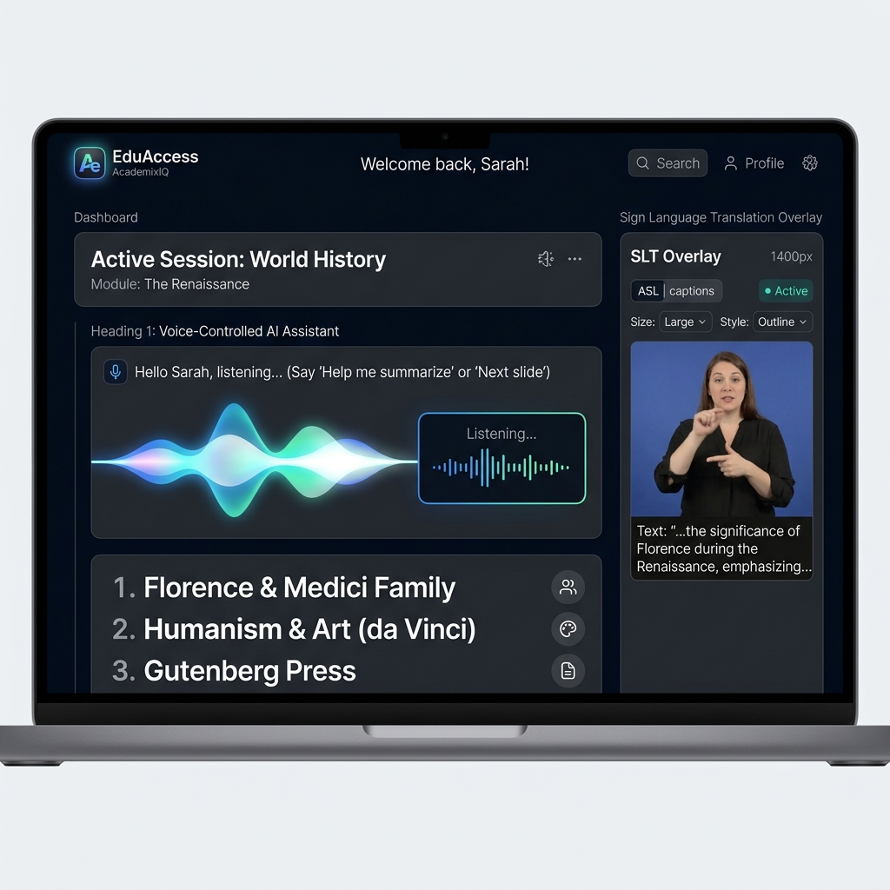
EduAccess & Social Impact
Designing for Universal Inclusion:
• Voice Control Integration: Screen-free interaction models allowing visually impaired students to dictate notes, navigate screens, and search topic nodes using spoken queries.
• Neurodiverse Mode: Auto-simplifies dense jargon into structured, high-contrast summaries with minimized distraction elements.
• Expected Impact: Bridges language-medium gaps for up to 10M+ Indian students annually; reduces prep time for exam prep by 40%; provides a democratic level playing field for diverse abilities.

Slide 8
Development Roadmap & Milestones
ROUND 1
June 17 - 18
• Problem Statement identification • Idea formulation & PPTX deck • Concept validation • Proposal Submission
ROUND 2
June 20 - 22
• Express/Node backend config • Whisper & Gemini integrations • Interactive canvas UI prototype • Source code & Video submission
PHASE 3
June 23 - 26
• Pilot testing & bug fixes • Real-time socket connections • Demo polishing & presentation compilation
GRAND FINALE
June 27 - 28
• Deployment of final MERN app • Pitch presentation to expert jury • Q&A & Design defense
Bharat Academix CodeQuest 2026 | Empowering academic excellence through modern, accessible AI systems.

