Slide 1
AcademixIQ
Multi-Modal AI Classroom Accessibility Platform
Democratizing Academic Content through Adaptive Visualizations, Regional Translations, & Mastery Diagnostic Tools
Team ID: ayushkhaitan2004
Solo Innovator: Ayush Khaitan | SRMIST Ghaziabad
Bharat Academix CodeQuest 2026 | Final Submission

Slide 2
The Problem Statement in Indian Classrooms
Core Accessibility Barriers:
• Linguistic Exclusion: Over 80% of digital academic literature is in English. Vernacular medium students fall behind due to language comprehension gaps.
• Cognitive Strain: Students with learning profiles like ADHD or Dyslexia face severe text fatigue when presented with long, unstructured slides or textbook chapters.
• Diagnostic Mastery Gaps: Standard classrooms evaluate retrospectively. There is no real-time diagnostic pipeline to map exactly which subconcept a student struggles to master.
The Scale of Impact:
10M+ Students Studying in regional language mediums face technical language gaps annually.
< 5% of EdTech Provides customizable typographic or visual focus tools for neurodiverse students.
48 Hours Is the typical timeline where a student forgets 80% of unstructured text-based lessons.

Slide 3
AcademixIQ: The Four Multi-Modal Pillars
VisualMind Canvas
Transforms complex technical documents or text notes into interactive, 3D conceptual mind maps. Features dynamic node expansion powered by Gemini 2.5 Flash.
BhashaTranslate Live
Captures classroom voice audio via browser microphone. Translates English lessons into 6 major regional Indian scripts (Hindi, Tamil, etc.) with synchronized TTS.
SkillBridge Evaluation
Contextual MCQ assessments mapped directly onto concept nodes. Identifies gaps, updates node colors (Mastered/Gap), and compiles customized study checklists.
EduAccess Engine
Accessibility settings offering OpenDyslexic fonts, mouse-guided focus rulers for ADHD, SVG colorblindness filters, and hands-free voice command navigation.

Slide 4

VisualMind: Interactive Concept Mapping
Conceptual Graph Modeling:
• Structured Graphing: Breaks arbitrary academic topics into Root, Subtopic, and Detail nodes on an interactive HTML5 canvas.
• Self-Paced Navigation: Selecting a node displays summaries, flashcards, and conceptual study questions inside a sliding drawer panel.
• Dynamic Node Expansion: Students double-click subtopics to prompt Gemini to generate and branch out further detail nodes on the fly.

Slide 5
BhashaTranslate: Regional Language Hub
Classroom Audio Translation:
• Live Vernacular Script Output: Captures English lecture audio and instantly translates it into standard regional scripts (Devanagari, Tamil, etc.), rather than phonetic English letters.
• SpeechSynthesis (TTS) Vocalizer: Integrates system regional voices (Hindi, Tamil, Kannada, Telugu, Bengali, Marathi) to speak translations aloud with local accent profiles.
• Asynchronous Voice Loading: Subscribes to browser voice-change triggers to prevent silent audio execution on page startup.
High-Fidelity Sandbox Mockups:
Photosynthesis Lesson Module Full 5-page text stream translating scientific processes like Calvin Cycle and RuBisCO into actual Indian scripts.
Quantum Computing Module Superposition and Shor's Algorithm explanations in native script templates.
Neural Network Module Backpropagation and Convolutional edge detections mapped into regional vernaculars.

Slide 6
SkillBridge: Dynamic Mastery Diagnostics
Evaluation & Feedback Loop:
• Adaptive Quiz Generation: Automatically extracts key concepts from Gemini JSON structures to test memory, recall, and application.
• Real-Time Mastery Mapping: Missed questions are linked to specific node labels. The canvas updates node gap status automatically.
• Mastery Color Coding: Mastered nodes turn green (Mastery); weak nodes turn orange (Mastery Gap) to direct student focus.
Mastery Output Features:
SVG Concept Mastery Chart Renders dynamic visual bar charts tracking core subconcepts and percentage scores automatically.
Adaptive Study Checklist Builds a checklist of missed nodes (e.g. 'Review Calvin Cycle' or 'Examine thylakoid'), giving students targeted study instructions.

Slide 7
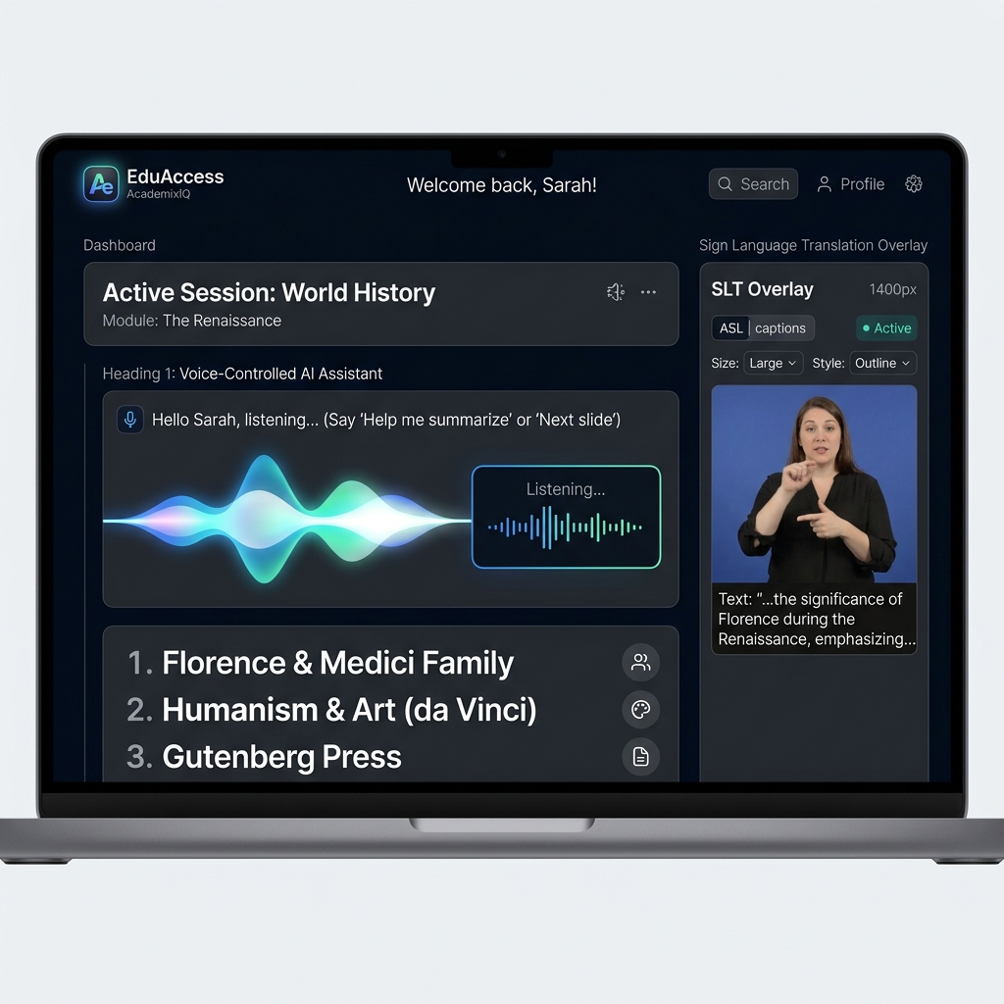
EduAccess: Inclusivity & Accessibility Panel
Accessibility Enhancements:
• Dyslexia Font Mode: Switches styles to OpenDyslexic character spacing with heavier bottom weights, decreasing letter confusion.
• ADHD Focus Ruler: Darkens screen segments and renders a horizontal highlighting ruler following the mouse cursor to boost concentration.
• Contrast & Color Blind Filters: Injects real-time SVG matrix color filters (Protanopia, Deuteranopia, Tritanopia) directly into the DOM.
• Voice Command Navigation: Captures commands like 'open quiz', 'explain superposition' to control the interface hands-free.

Slide 8
System Architecture & Scalability
1. INGESTION LAYER
• HTML5 Audio Microphone Input
• PDF/TXT Study Notes uploads
• SpeechRecognition voice command capture (native browser API)
• Stored environment API keys
2. AI ORCHESTRATION
• Node.js & Express.js server
• Google Generative AI v1beta SDK
• Gemini 2.5 Flash model
• Custom prompts extracting structured JSON graphs & MCQ datasets
• Keyword-based Mock Sandbox routers
3. PRESENTATION LAYER
• React dynamic canvas canvas nodes
• Dynamic color state variables mapping mastery metrics
• Asynchronous voice loader triggering SpeechSynthesis (TTS)
• Inline SVG color matrix filters

