Slide 1

GRAPHIC ERA HILL UNIVERSITY DEHRADUN
SUBMITTED BY : AYUSH KHANDURI
ROLL NO. : 2118405
SEC : L
COURSE : BTECH (CSE)

Slide 2

TOPIC : ANDROID APPLICATION
APPLICATION NAME : My_BookMark

Slide 3

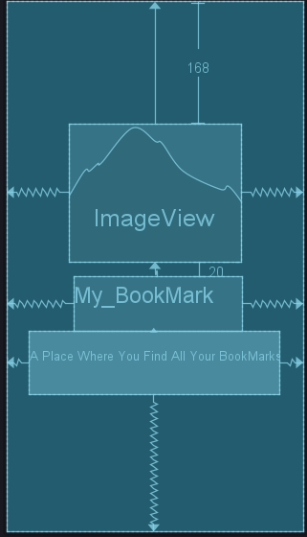
UI OF APPLICATION
1 FIRST ACTIVITY(SPLASH SCREEN)

Slide 4
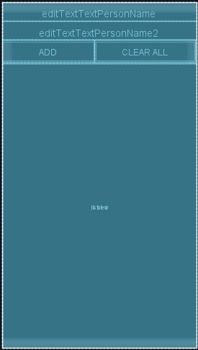
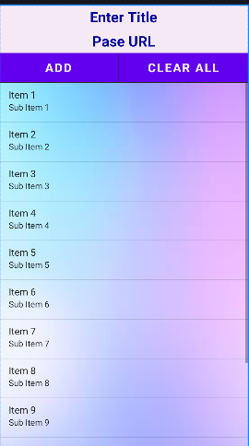
2 SECOND ACTIVITY ( MAIN ACTIVITY)

Slide 5
STEPS TO ADD NEW BOOKMARK
STEP 1 : Enter title of your bookmark
STEP 2 : Paste or type url of the site
STEP 3: Click on ADD button

Slide 6
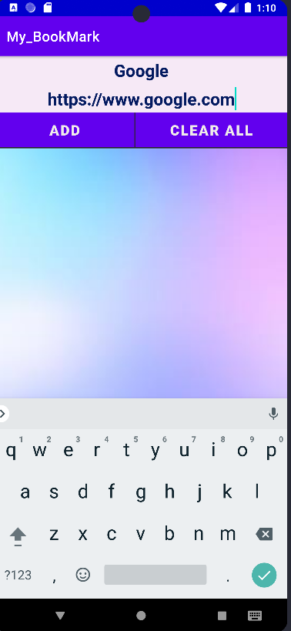
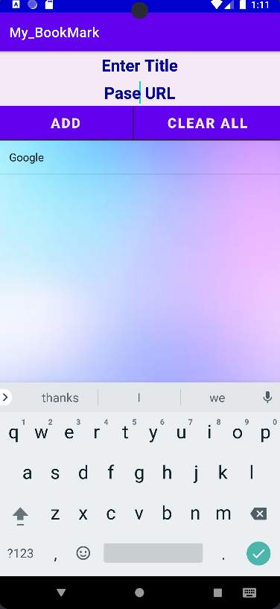

Slide 7
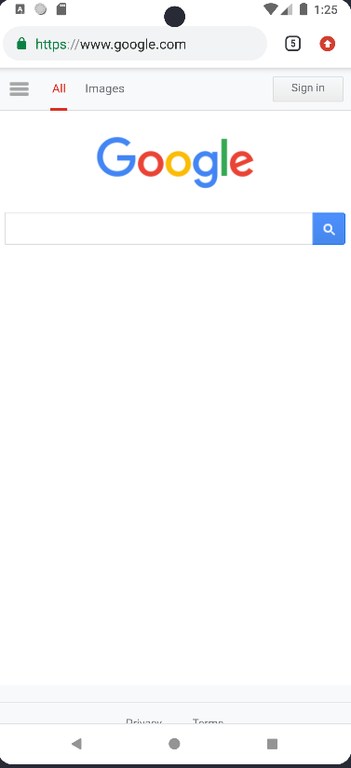
OPEN A BOOKMARK
-> click on a list item
Select

Slide 8
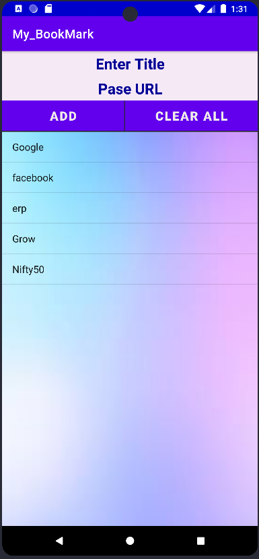
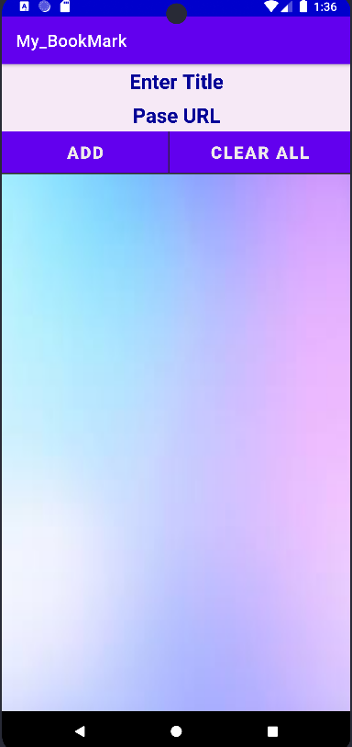
DELETE ITEMS OF LIST
->select Clear all button
Select

Slide 9
THANK YOU…

