Slide 1
VIT UNIVERSITY • BMAT202P PROBABILITY AND STATISTICS PROJECT
Predicting Credit Card Approval &
Auditing Algorithmic Fairness
An End-to-End Framework: Database Engineering, 12 Supervised ML Classifiers, Non-Parametric Bootstrap/Permutation Fairness Auditing, and Interactive Shiny Decision Cockpit
Author: Ayush Khatai (Reg No: 24BDS1106) • Faculty Guide: Prof. Jaganathan B
B.Tech Computer Science and Engineering • UCI Credit Approval Benchmark Dataset
690 Applicants
UCI Benchmark
12 ML Models
5-Fold 2-Rep CV
0.918 Top AUC
Random Forest
Fairness Audit
Bootstrap & Permutation

Slide 2
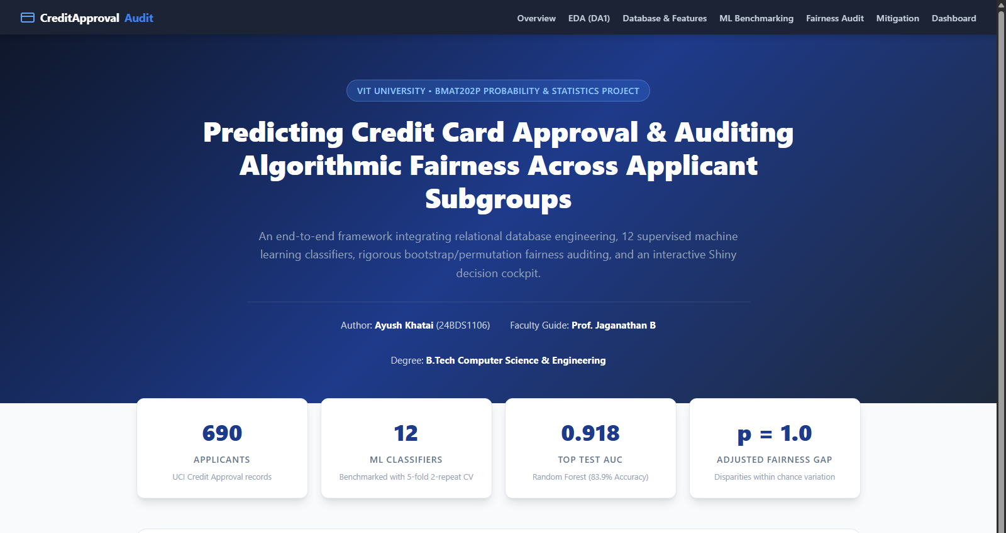
EXECUTIVE SUMMARY
Project Objectives & Three-Stage Architecture
Systematic progression from raw data preprocessing to robust algorithmic auditing
Core Problem Statement
Financial Underwriting Automation: Institutions deploy ML to accelerate credit approval, but models risk codifying and exacerbating historical demographic disparities.
Assignment 1 (DA1): Exploratory analysis, class balance verification, missingness treatment via median/mode imputation on 690 UCI credit applications.
Assignment 2 (DA2): ACID-compliant SQLite database engineering, feature engineering (log transforms, interaction ratios), and 12-model repeated CV benchmark.
Assignment 3 (DA3): Algorithmic fairness audit (Demographic Parity, Equal Opportunity, Equalized Odds), uncertainty estimation, DeLong paired significance tests, and Shiny dashboard.
Key Project Takeaway: Random Forest leads performance (AUC 0.918), but top 8 models are statistically indistinguishable (DeLong p > 0.34). All observed subgroup fairness gaps are within chance variation (Holm p = 1.0).

Slide 3
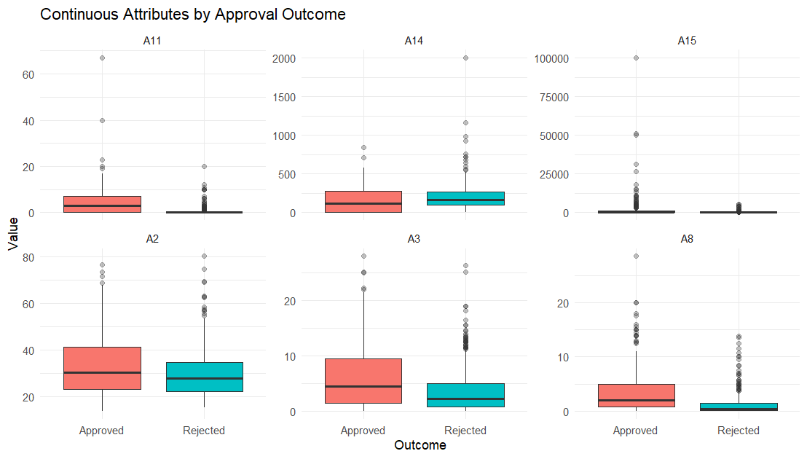
ASSIGNMENT 1 (DA1)
Dataset Understanding & Banking Attribute Proxies
UCI Credit Approval dataset structure, privacy anonymization, and financial proxies
Banking Proxy Interpretations
A1 (Categorical) [a, b]: Applicant demographic / gender proxy (Audited)
A2 (Continuous) [13.75 - 80.25]: Applicant age proxy (Q1-Q4 Quartiles Audited)
A3 (Continuous) [0.0 - 28.0]: Debt / outstanding liability amount proxy
A8 (Continuous) [0.0 - 28.5]: Length of credit history / employment years
A9 (Binary) [t, f]: Prior default indicator (Single strongest predictor)
A10 (Binary) [t, f]: Employment status proxy
A14 (Continuous) [0 - 2000]: Credit card limit proxy
A15 (Continuous) [0 - 100,000]: Applicant annual income proxy (Severe skew)
A16 (Target) [+ / -]: Approval outcome: 307 Approved (44.5%), 383 Rejected

Slide 4
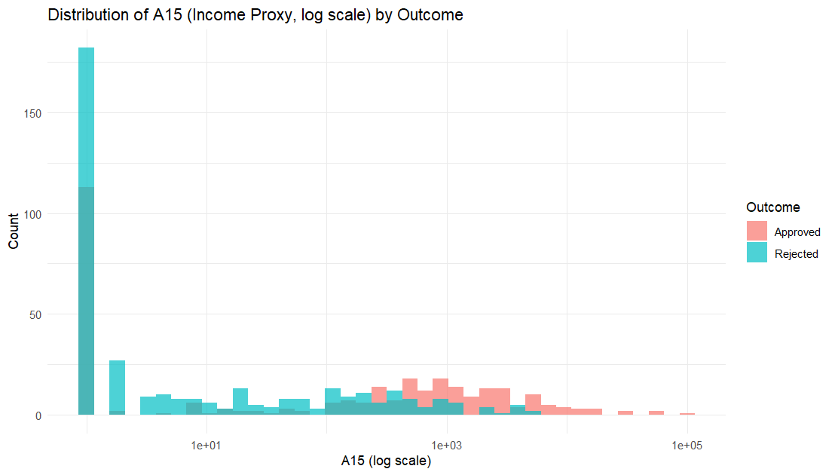
ASSIGNMENT 1 (DA1)
Exploratory Data Analysis: Risk Signals & Imputation
Discovering dominant predictive factors and treating data quality issues
Key Exploratory Findings
Prior Default Dominance (A9): Applicants with prior default (A9 = 'f') face a 93% rejection rate. A9 accounts for over 60% of predictive power across all subsequent models.
Income & History Heavy Tails: Income (A15) spans from 0 to 100,000 with severe right-skewness. Required log1p() transformations to prevent distortion in linear and neural models.
Missing Value Imputation: Continuous attributes A2 (age) and A14 (limit) imputed using median. Categoricals A1, A4, A5, A6, A7 imputed using mode. Imputation statistics strictly locked to train split in DA2.
Low Multicollinearity: Correlation heatmap revealed no pairwise continuous correlations above 0.40, confirming feature independence.

Slide 5
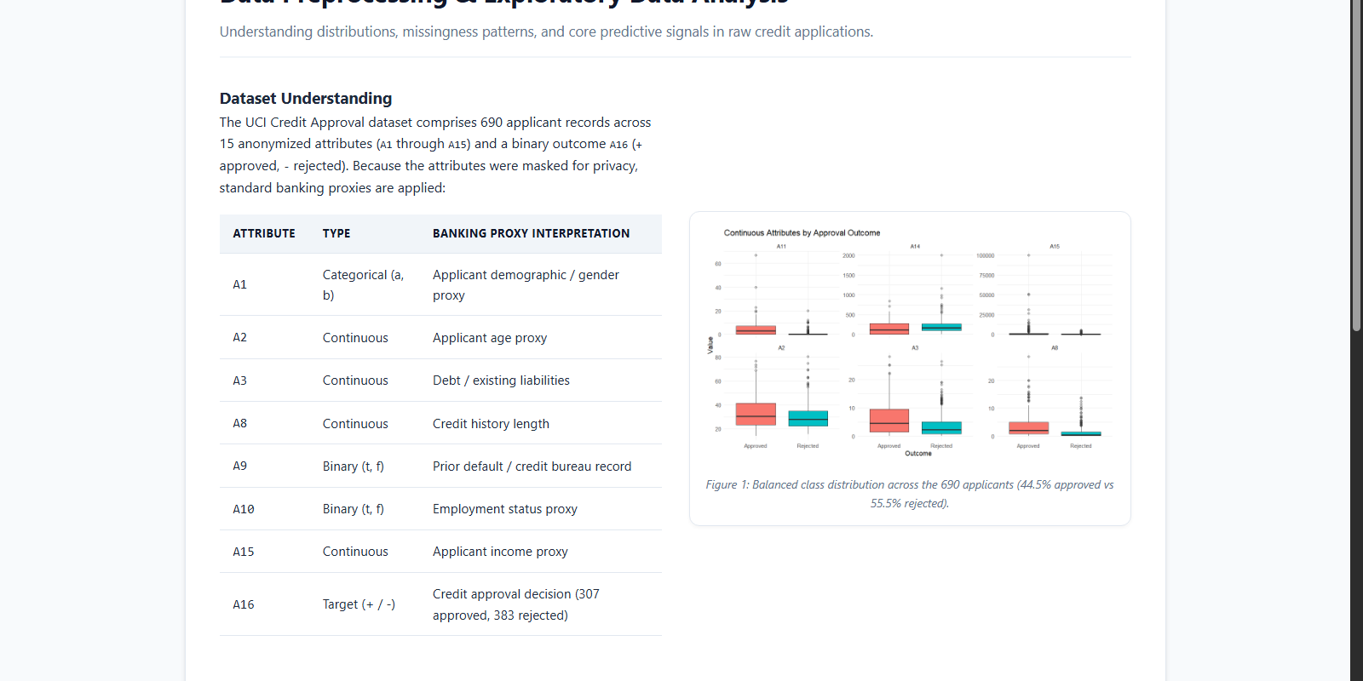
ASSIGNMENT 2 (DA2)
Relational Database Engineering in SQLite
ACID-compliant normalization, parameterized SQL retrieval, and data governance
Relational Schema & SQL Implementation
Database Normalization: Partitioned raw data into two relational tables: 'applicants' (id PK, a1-a15 attributes) and 'decisions' (id PK/FK, outcome Approved/Rejected).
Interoperable SQL: Engineered portable SQL compatible with both local SQLite ('credit.db') and enterprise PostgreSQL via R DBI and dbConnect abstraction.
Integrity & Ingestion: Foreign key constraints enforce referential integrity between applicant attributes and decision outcomes across all 690 records.
Parameterized Retrieval: Employed sqlInterpolate() to execute secure, injection-safe SQL queries for subgroup approval auditing and model training extraction.

Slide 6
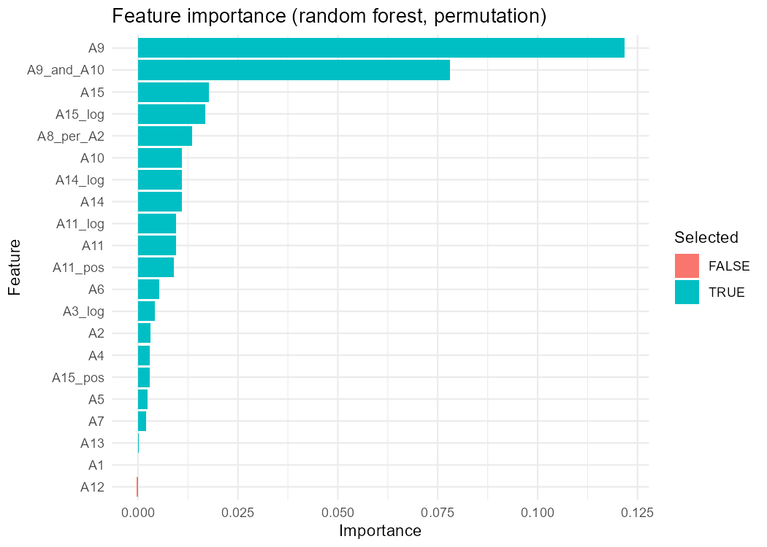
ASSIGNMENT 2 (DA2)
Feature Engineering & Random Forest Selection
Non-linear feature synthesis and permutation importance feature selection
Engineered Feature Pipeline
Stratified 80/20 Train/Test Split: 552 training samples, 138 test samples. Imputation statistics strictly computed on training set to prevent data snooping.
Log Transformations: log1p(A3), log1p(A8), log1p(A11), log1p(A14), log1p(A15) to compress severe right-skewed tails.
Zero-Indicator Indicators: A11_pos and A15_pos binary flags capturing applicants with zero credit inquiries or zero declared income.
Financial Interaction Ratios: A8_per_A2: Length of credit history normalized by age; A9_and_A10: Joint indicator for clean credit bureau and steady employment.
Permutation Selection: Random Forest (500 trees) ranked features. A9 (0.122) and A9_and_A10 (0.078) lead. A12 had negative importance and was dropped; A1 ranked 20th.

Slide 7
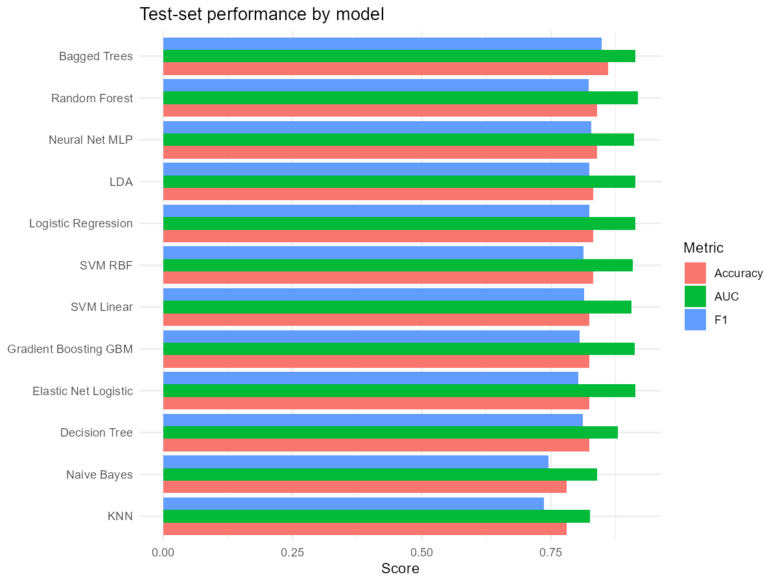
ASSIGNMENT 2 (DA2)
12-Model Supervised Learning Benchmark
Evaluating 12 classification architectures on identical cross-validation folds
Held-Out Test Set Performance (N = 138)
• Random Forest (Top AUC): AUC = 0.918 | Acc = 0.839 | F1 = 0.823 (CV AUC: 0.939)
• Elastic Net Logistic: AUC = 0.914 | Acc = 0.825 | F1 = 0.803 (CV AUC: 0.938)
• Linear Discriminant Analysis: AUC = 0.914 | Acc = 0.832 | F1 = 0.824 (CV AUC: 0.932)
• Bagged Trees (Top Acc): AUC = 0.914 | Acc = 0.861 | F1 = 0.848 (CV AUC: 0.922)
• Logistic Regression: AUC = 0.913 | Acc = 0.832 | F1 = 0.824 (CV AUC: 0.912)
• Gradient Boosting (GBM): AUC = 0.912 | Acc = 0.825 | F1 = 0.806 (CV AUC: 0.949)
• Neural Network (MLP): AUC = 0.911 | Acc = 0.839 | F1 = 0.828 (CV AUC: 0.924)
• Support Vector Machine (RBF): AUC = 0.908 | Acc = 0.832 | F1 = 0.813 (CV AUC: 0.929)
• Decision Tree (CART): AUC = 0.880 | Acc = 0.825 | F1 = 0.812 (CV AUC: 0.907)
• Naive Bayes: AUC = 0.840 | Acc = 0.781 | F1 = 0.746 (CV AUC: 0.880)
• K-Nearest Neighbors: AUC = 0.826 | Acc = 0.781 | F1 = 0.737 (CV AUC: 0.903)

Slide 8
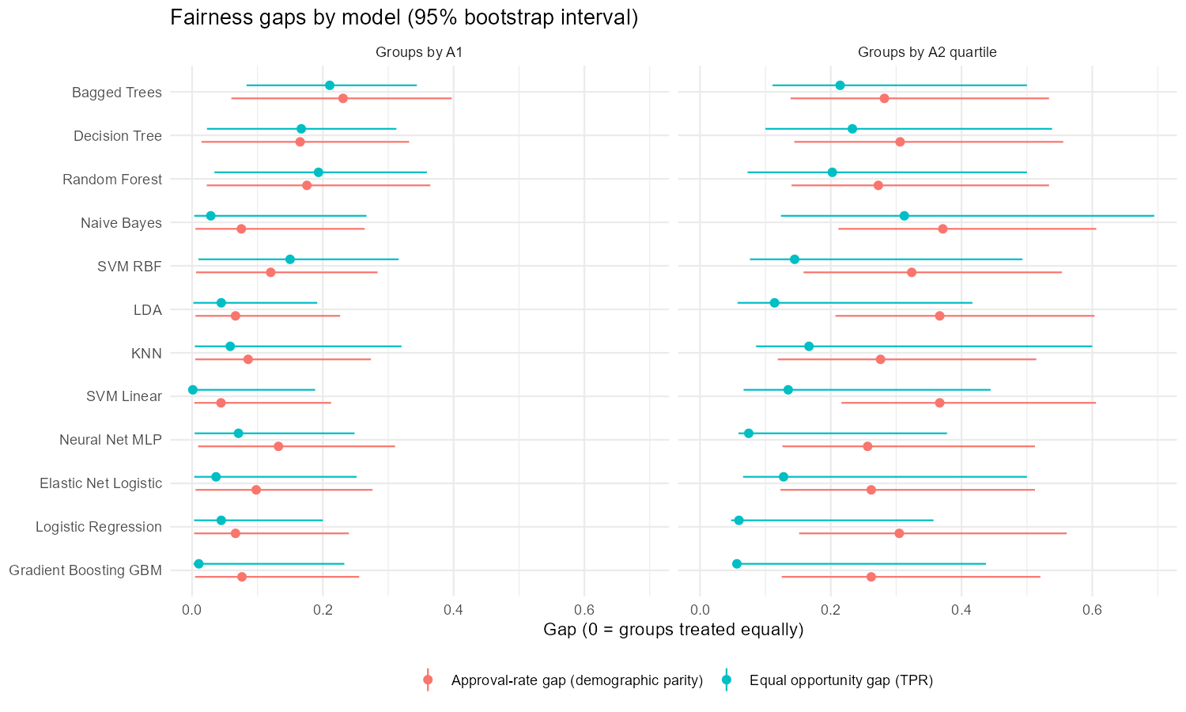
ASSIGNMENT 3 (DA3)
Algorithmic Fairness Audit: Rigorous Framework
Evaluating demographic equity and uncertainty with bootstrap and permutation tests
Mathematical Fairness Criteria
Demographic Parity Gap (DP): Max difference in approval rates across subgroups: |P(Y_hat = 1 | G = g1) - P(Y_hat = 1 | G = g2)|. Evaluates whether selection rates are independent of group status.
Equal Opportunity Gap (EO): Max difference in True Positive Rates (TPR) among truly qualified applicants: |TPR_g1 - TPR_g2|. Protects qualified applicants equally.
Equalized Odds: Combined condition requiring both equal TPR and equal False Positive Rate (FPR) across cohorts.
Disparate Impact Ratio: Ratio of min(approval rate) / max(approval rate), testing adherence to the EEOC 80% four-fifths rule.
1,000 Bootstrap Resamples: Constructs 95% percentile confidence intervals for all fairness gaps and AUC estimates.
2,000 Permutation Shuffles: Shuffles subgroup labels 2,000 times to establish the empirical null distribution (chance gap expectation).

Slide 9
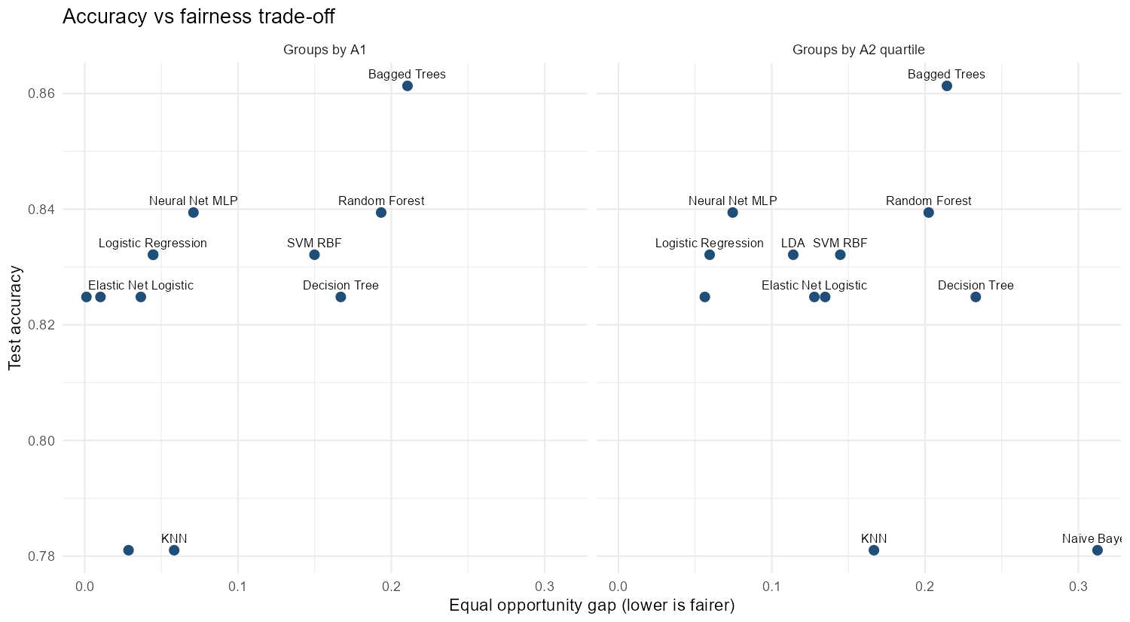
ASSIGNMENT 3 (DA3)
Audit Findings: Accuracy vs. Fairness Trade-Off
Evaluating observed disparities against small-sample chance thresholds
Empirical Audit Takeaways
No Statistically Significant Bias: All Holm-adjusted permutation p-values across all 12 models equal 1.0. Observed gaps (e.g. DP ~0.08, EO ~0.04) are fully consistent with small-sample sampling variance.
Underlying Base Rate Disparity: In the ground-truth test data, true approval rates already differ: A1:a (51.1%) vs A1:b (41.3%), and Age Q1 (34.3%) vs Q4 (63.3%). A model striving for accuracy will reflect this.
Equal Opportunity vs Parity: Forcing demographic parity would require rejecting qualified older applicants or approving unqualified younger applicants, violating equal opportunity.
Optimal Operating Models: Elastic Net and Logistic Regression achieve optimal trade-off: high accuracy (82.5-83.2%), high AUC (0.914), and minimal Equal Opportunity gaps (0.037-0.045).

Slide 10
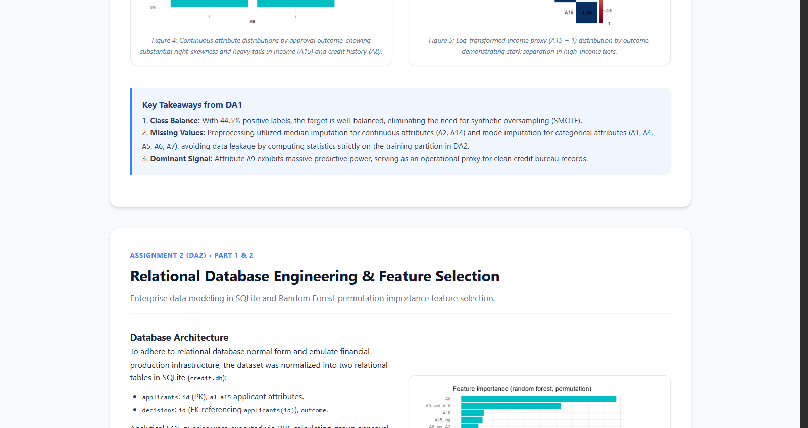
ASSIGNMENT 3 (DA3)
Statistical Significance Testing (DeLong & McNemar)
Is the top Random Forest model statistically better than simpler, explainable baselines?
Paired Hypothesis Testing Results
Paired DeLong ROC Test: Assesses whether the test-set AUC difference between Random Forest and competitor models is statistically distinct on the exact same 138 applicants.
Exact McNemar Test: Evaluates whether models make discordant errors (applicant-level classification disagreement).
Statistical Equivalence of Top 8 Models: DeLong p-values between Random Forest and Elastic Net (p = 0.71), LDA (p = 0.73), Bagged Trees (p = 0.68), Logistic Regression (p = 0.73), GBM (p = 0.42), and Neural Net (p = 0.64) are all non-significant.
Clear Underperformers: Only KNN (p_adj = 0.005) and Naive Bayes (p_adj = 0.043) are statistically significantly inferior to Random Forest.
Regulatory & Compliance Implication: Financial institutions can legally and safely adopt Elastic Net or Logistic Regression for 100% explainable credit decisions without forfeiting predictive power.

Slide 11
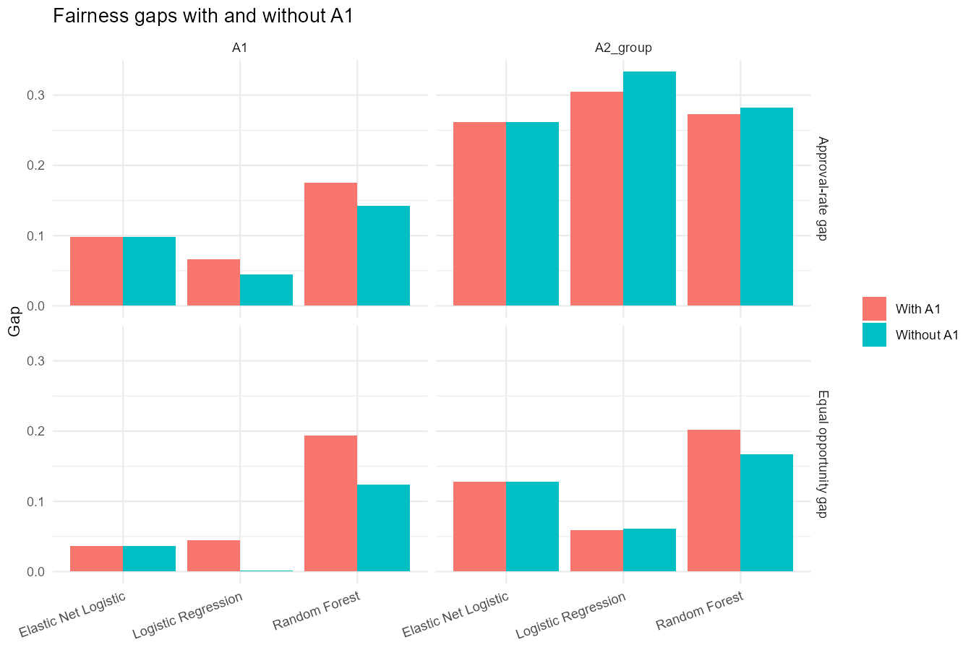
ASSIGNMENT 3 (DA3)
Mitigation Experiment: Fairness Through Unawareness
Does omitting protected attribute A1 eliminate disparities or conceal them?
The Fallacy of Demographic Unawareness
Experimental Design: Retrained Logistic Regression, Elastic Net, and Random Forest on identical folds with A1 completely excluded from the feature matrix.
Negligible Decision Impact: For Elastic Net, 0 out of 138 test predictions changed (0.0% flip rate). For Logistic Regression, 1 decision flipped (0.7%). For Random Forest, 2 flipped (1.5%).
Fairness Gaps Persist: Equal Opportunity gap remained virtually invariant (0.037 for Elastic Net).
Why Unawareness Fails: Remaining financial variables (credit history A8, prior default A9, employment A10, income A15) already encode subgroup signals via proxy correlation.
Governance Lesson: Simply blinding a model to protected attributes does not create equity; explicit post-processing or threshold calibration is required.

Slide 12
ASSIGNMENT 3 (DA3) • DECISION COCKPIT & GOVERNANCE
Interactive Shiny Dashboard & Strategic Recommendations
Interactive Shiny Cockpit (app.R)
1. Model Performance: Plotly forest plot with asymmetric 95% bootstrap CI for test AUCs.
2. Subgroup Audit: Dynamic rate comparisons, disparity tiles, and empirical chance thresholds.
3. Trade-Off Explorer: Interactive 2D frontier mapping accuracy against fairness gaps.
4. Hypothesis Matrix: Real-time DeLong & McNemar p-value tables with Holm corrections.
5. Baseline Context: Ground-truth demographic breakdown and audit limitations.
Strategic Recommendations for Credit Risk
Deploy Explainable Models: Because Elastic Net is statistically tied with Random Forest (DeLong p = 0.71), adopt Elastic Net to ensure full compliance with Adverse Action notice laws (ECOA / FCRA).
Target Equal Opportunity: Prioritize Equal Opportunity (equal TPR) rather than Demographic Parity to respect legitimate financial differences while protecting qualified applicants.
Reject Unawareness Defense: Do not rely on omitting protected attributes; continuously monitor proxy variables and audit residual subgroup selection rates.
Continuous Dynamic Auditing: Deploy interactive auditing cockpits (such as app.R) into continuous production MLOps pipelines.

