Slide 1
DATA SCIENCE PROJECT OVERVIEW
Credit Approval Prediction
& Algorithmic Fairness Audit
An end-to-end pipeline on the UCI Credit Approval dataset — data cleaning, relational database engineering, feature selection, a twelve-model benchmark, a statistical fairness audit and an interactive dashboard.
690 applicants
15 anonymised attributes
12 models
R · SQLite · Shiny
UCI Machine Learning Repository · Quinlan credit-screening data
Notes:
Title slide. The project combines supervised modelling with an algorithmic fairness audit on the anonymised UCI Credit Approval data.

Slide 2
AGENDA
What this presentation covers
01
The question
02
The data
Accurate models, and the fairness of their decisions
UCI Credit Approval — 690 applications, anonymised columns
03
The pipeline
04
EDA & database
Eight stages from raw file to dashboard
What drives approval, and a relational SQL store
05
Features & models
06
Fairness audit
Feature selection, then a 12-model benchmark
Parity, equal opportunity, bootstrap & permutation tests
07
Significance & mitigation
08
Dashboard & takeaways
Is the leader real? Does hiding A1 help?
Interactive review surface and conclusions
Notes:
Roadmap: data, pipeline, EDA and database, features and models, fairness audit, significance and mitigation, then the dashboard and takeaways.

Slide 3
01 — THE QUESTION
Predict credit approvals — then check whether the model is fair
Two goals that are often assumed to conflict: maximise accuracy, and treat applicant groups equally.
Accurate prediction
Fairness audit
Mitigation test
Benchmark 13 algorithms under identical repeated cross-validation and pick the best by test AUC — not by memory of the training data.
Score every model on demographic parity, equal opportunity and equalized odds, with bootstrap intervals and permutation tests.
Retrain three models without the protected attribute A1 and measure whether "unawareness" actually closes the gaps.
KEY INSIGHT
Accuracy and fairness are not opposites here. The best-performing models are also among the fairest by equal opportunity, and the biggest gap — across age quartiles — comes from the data itself: true approval rates range from 34% (Q1) to 63% (Q4), not just from the model.
Credit Approval Prediction & Algorithmic Fairness Audit
3 / 15
Notes:
Frame the two goals. The key finding is that accuracy and fairness are not in conflict on this dataset. Quote the 34% -> 63% true approval spread across age quartiles.

Slide 4
02 — THE DATA
UCI Credit Approval, with every attribute anonymised
Attribute names and values were replaced with meaningless symbols to protect confidentiality — which matters for how fairness can be measured.
Attribute profile
Why anonymity matters for the audit
Instances
690 · 307 approved (44.5%) / 383 rejected (55.5%)
Columns cannot be named gender, age or ethnicity. The audit uses two anonymous grouping variables:
Attributes
15 + class · 6 continuous, 9 nominal
Continuous
A2, A3, A8, A11, A14, A15
▪ A1 — two levels (a / b); widely read as sex in the literature
▪ A2 quartile — four equal-frequency age bands derived from A2
Nominal
A1, A4, A5, A6, A7, A9, A10, A12, A13
Target
A16 → Approved (+) / Rejected (−)
Missingness
67 cells in 37 rows (5%), across 7 columns
The dashboard labels these explicitly as anonymous proxies — not confirmed demographics.
Source
Quinlan · UCI Machine Learning Repository
Missingness is concentrated in seven attributes (A1, A2, A4, A5, A6, A7, A14) — at most 1.9% per column, 5% of rows affected overall.
Credit Approval Prediction & Algorithmic Fairness Audit
4 / 15
Notes:
690 applications, 15 anonymised attributes, 44.5% approved. Because columns are anonymised, A1 and the A2 quartiles are used as anonymous grouping variables — be careful not to over-claim demographics.

Slide 5
03 — ARCHITECTURE
Eight re-runnable stages, raw file to dashboard
Every stage is a separate R script writing intermediate artefacts, so any step can be inspected or re-run on its own.
STEP 1
STEP 2
STEP 3
STEP 4
Preprocessing
Exploratory analysis
Database & SQL ingest
Feature engineering
da1_preprocessing.R
da1_eda.R
da2_01_database.R
da2_02_features.R
STEP 5
STEP 6
STEP 7
STEP 8
12-model benchmark
Fairness audit
Mitigation
Shiny dashboard
da2_03_models.R
da3_01_fairness.R
da3_02_without_A1.R
app.R
Engineering choices
Leakage control
Reproducibility
Modular helpers
Imputation medians/modes and age-quartile cut-points are learned on train only, then applied to test.
Fixed seeds for the split (42), CV folds (123) and audit (2026); CV indices are persisted.
da3_helpers.R holds the shared fairness math so the audit and mitigation cannot drift apart.
Credit Approval Prediction & Algorithmic Fairness Audit
5 / 15
Notes:
Eight stages, each a separate R script with stored intermediate artefacts. Note the leakage controls (train-only imputation) and fixed seeds.

Slide 6
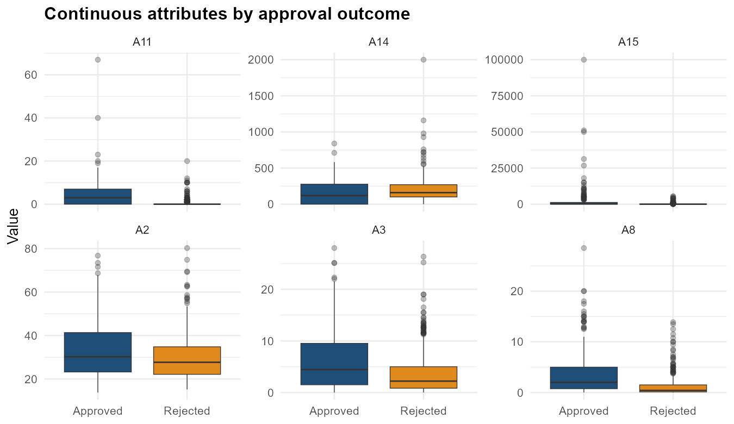
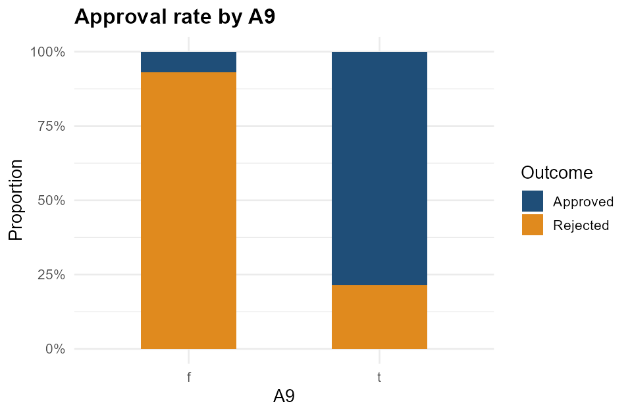
04 — EXPLORATORY DATA ANALYSIS
What actually drives an approval?
Class balance, attribute distributions by outcome, missingness — and one proxy relationship that dominates everything else.
Continuous attributes by outcome — A8 separates approvals most visibly
A9: 't' approved 78.7% of the time, 'f' only 7.0%
Clean-up: median imputation for A2 / A14, mode imputation for A1, A4, A5, A6, A7. A15 (0 → 100,000) is log-transformed later. A9 and its A9×A10 interaction together outweigh all continuous credit attributes.
Credit Approval Prediction & Algorithmic Fairness Audit
6 / 15
Notes:
A9 and its interaction with A10 dominate. A9 = 't' applicants are approved 78.7% of the time, 'f' only 7.0% — this is the engine of the model.

Slide 7
05 — DATABASE ENGINEERING
A normalised SQL store replaces the flat file
Applicant attributes are separated from the decision itself — a clean base for SQL validation and downstream modelling.
SCHEMA · credit.db
Backend switch
applicants
id INTEGER PRIMARY KEY
a1 TEXT a2 REAL a3 REAL a4 TEXT
a5 TEXT a6 TEXT a7 TEXT a8 REAL
a9 TEXT a10 TEXT a11 INT a12 TEXT
a13 TEXT a14 INT a15 INT
decisions
id INTEGER REFERENCES applicants(id)
outcome TEXT -- 'Approved' | 'Rejected'
da2_db_config.R exposes one get_con() function. Set USE_POSTGRES <- TRUE for PostgreSQL; the default is a file-based SQLite database (credit.db).
Validation queries
▪ Row counts for both tables (690 each)
▪ Approval rate by A9 and by A1
▪ Mean A2 / A15 by decision outcome
▪ Per-column missing-value census
▪ Parameterised query (sqlInterpolate)
+ model_results written in stage 5
Verified from credit.db: 690 applicants · 690 decisions · 12 model results · A9 't' approval 78.7% vs 'f' 7.0%
Credit Approval Prediction & Algorithmic Fairness Audit
7 / 15
Notes:
Applicants and decisions live in separate tables linked by id; a db_config switch targets SQLite or PostgreSQL. model_results persists the benchmark.

Slide 8
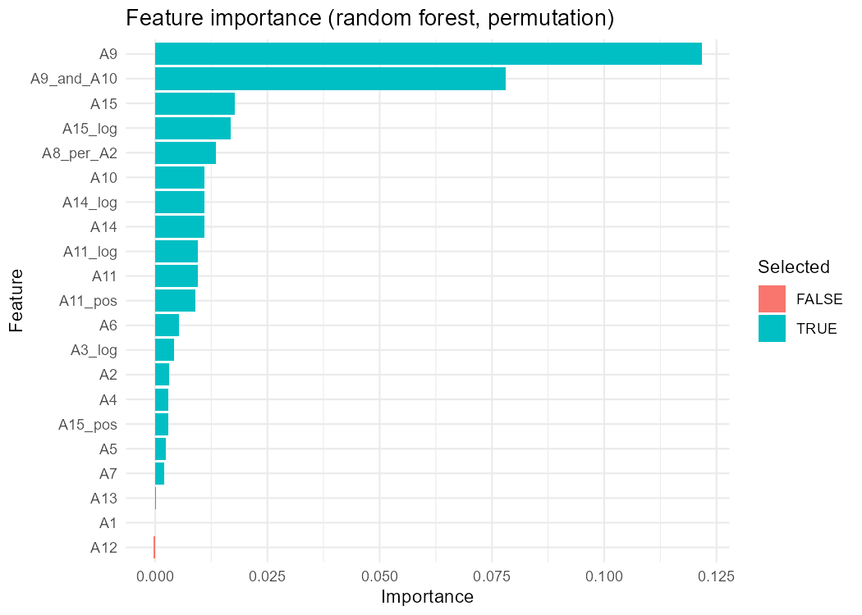
06 — FEATURE ENGINEERING
From 15 attributes to 20 selected features
Engineer signal, then let filters and permutation importance strip the noise.
Engineered features
Split
Stratified 80/20 → 553 train / 137 test applicants
Log transforms
A3, A8, A11, A14, A15 via log1p to tame skew
Flags
A11_pos, A15_pos for zero values
Interaction
A9_and_A10 — both prior-payment flags true
Ratio
A8_per_A2
Age bands
A2_group quartiles — for fairness evaluation, not prediction
Selection pipeline
▪ Near-zero variance → correlation filter (|r| > 0.90) → RF permutation importance
▪ 20 of 21 features survive; A9 is ~1.5× the next-best feature
Credit Approval Prediction & Algorithmic Fairness Audit
8 / 15
Notes:
Stratified 80/20 split, log transforms, flags, one interaction and one ratio; A2 quartiles are kept for evaluation only. All but A12 survive selection.

Slide 9
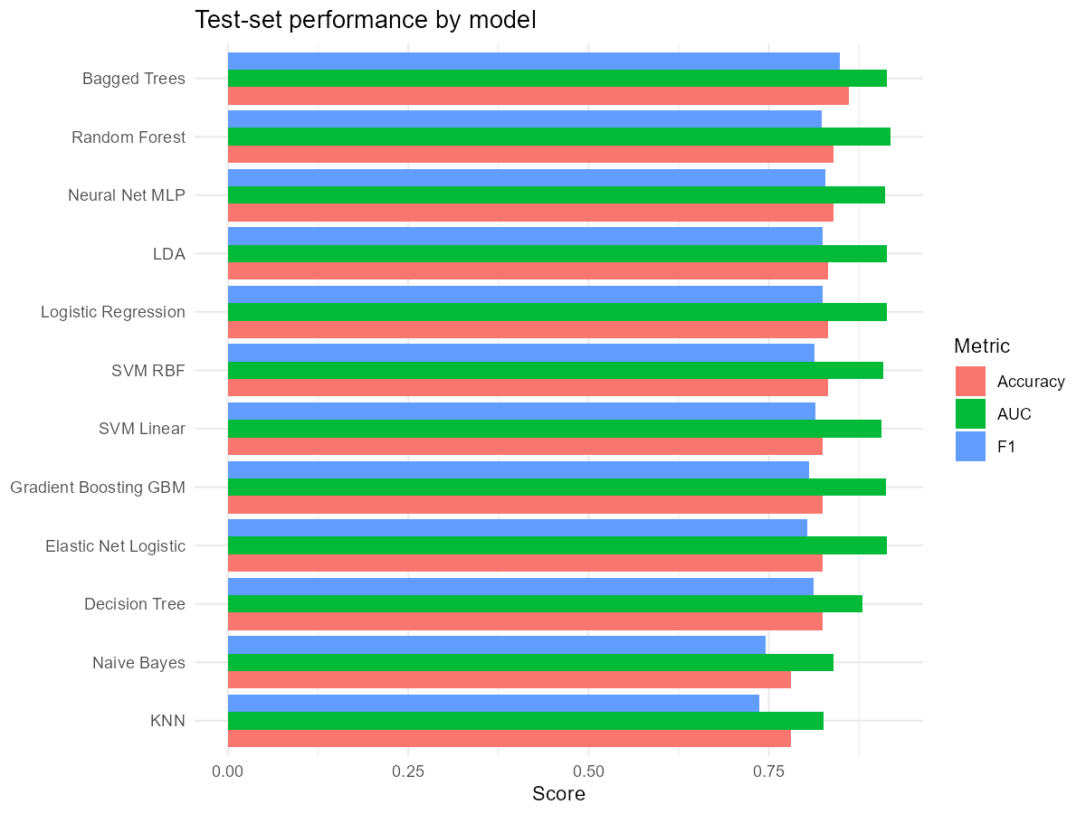
07 — MODELLING
Twelve algorithms, one fair fight
Same pre-processing, same 5-fold × 2-repeat folds, same AUC tuning objective. XGBoost failed to train and is excluded.
Model | Accuracy | Test AUC | CV AUC
Random Forest | 0.839 | 0.918 | 0.939
Elastic Net Logistic | 0.825 | 0.914 | 0.938
LDA | 0.832 | 0.914 | 0.932
Bagged Trees | 0.861 | 0.914 | 0.922
Logistic Regression | 0.832 | 0.913 | 0.912
Gradient Boosting GBM | 0.825 | 0.912 | 0.949
Neural Net MLP | 0.839 | 0.911 | 0.924
SVM RBF | 0.832 | 0.908 | 0.929
SVM Linear | 0.825 | 0.906 | 0.928
Decision Tree | 0.825 | 0.880 | 0.907
Naive Bayes | 0.781 | 0.840 | 0.880
KNN | 0.781 | 0.826 | 0.903
Bagged Trees wins raw accuracy (86.1%) and F1 (0.848); Random Forest leads AUC. KNN and Naive Bayes trail clearly.
Credit Approval Prediction & Algorithmic Fairness Audit
9 / 15
Notes:
Twelve models on identical folds. Random Forest leads AUC (0.918); Bagged Trees leads accuracy (86.1%). XGBoost failed to train and is excluded.

Slide 10
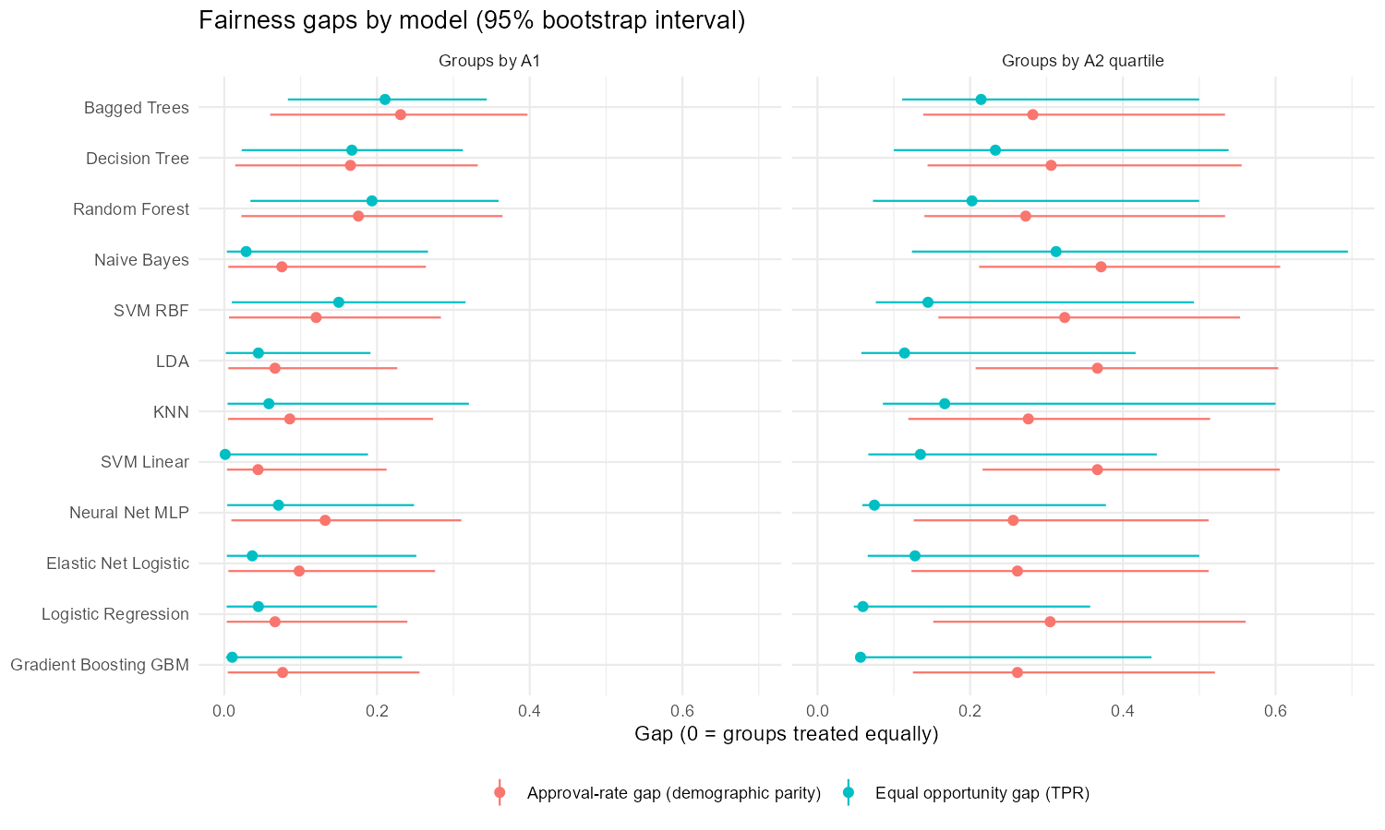
08 — FAIRNESS AUDIT
Three definitions, measured for every model
Grouped by A1 (2 groups) and by A2 quartile (4 groups). Gaps are tested against 1,000 bootstrap resamples and 2,000 permutations.
Demographic parity
Equal opportunity
Equalized odds
Approval-rate gap: highest minus lowest group approval rate. Ignores who truly deserved approval.
TPR gap: among applicants who truly were approved, does each group get the same chance?
Jointly checks the TPR gap and the FPR gap, so false approvals matter too.
Reading the results
▪ A1 gaps are modest: top models show 7–18 pt approval gaps and 1–19 pt equal-opportunity gaps.
▪ Age quartiles are the bigger issue — Q4 truly approves 63% vs Q1's 34%, so ~0.27–0.37 gaps appear almost everywhere.
▪ Fairness ≠ accuracy: GBM and SVM Linear are narrowest on A1 but are not the most accurate.
▪ After Holm adjustment, no equal-opportunity gap is significant.
Credit Approval Prediction & Algorithmic Fairness Audit
10 / 15
Notes:
Three fairness definitions plus a rigorous estimation strategy: 1,000 bootstrap resamples, 2,000 permutations, chance reference, disparate-impact ratio and Holm correction.

Slide 11
08 — FAIRNESS AUDIT
Fairness profile of each model
Unadjusted permutation p-values for the equal-opportunity gap. Green = small gap, red = large gap.
Model | DP gap · A1 | EO gap · A1 | p (EO, A1) | DP gap · A2 quartile | EO gap · A2 quartile
Random Forest | 0.176 | 0.193 | 0.056 | 0.273 | 0.202
Elastic Net Logistic | 0.098 | 0.037 | 0.746 | 0.262 | 0.128
LDA | 0.066 | 0.045 | 0.604 | 0.367 | 0.114
Bagged Trees | 0.231 | 0.211 | 0.020 | 0.282 | 0.214
Logistic Regression | 0.066 | 0.045 | 0.600 | 0.305 | 0.060
Gradient Boosting GBM | 0.076 | 0.010 | 0.929 | 0.262 | 0.056
Neural Net MLP | 0.132 | 0.071 | 0.450 | 0.256 | 0.075
SVM RBF | 0.120 | 0.150 | 0.174 | 0.324 | 0.145
SVM Linear | 0.044 | 0.001 | 1.000 | 0.367 | 0.135
Decision Tree | 0.165 | 0.167 | 0.097 | 0.306 | 0.233
Naive Bayes | 0.075 | 0.029 | 0.831 | 0.371 | 0.312
KNN | 0.086 | 0.058 | 0.673 | 0.276 | 0.167
Cut-offs: green ≤ 0.02, red ≥ 0.35. A2-quartile approval gaps of 0.26–0.37 reflect a 34% → 63% spread in true approval rates.
Credit Approval Prediction & Algorithmic Fairness Audit
11 / 15
Notes:
The A1 gaps are modest; the age-quartile approval gaps of ~0.27–0.37 are largely explained by base rates. After Holm correction no equal-opportunity gap is significant.

Slide 12
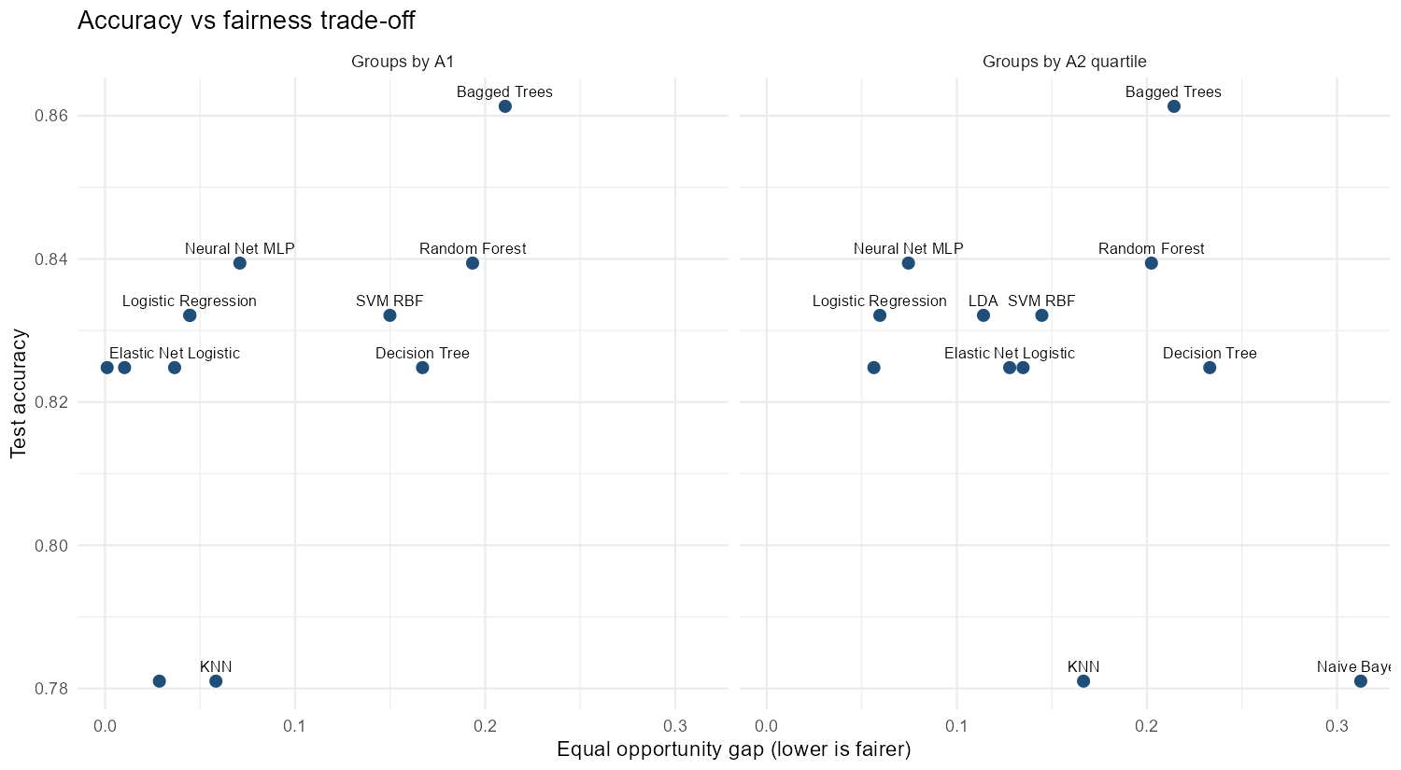
09 — TRADE-OFF
Accuracy versus fairness
Each point is a model. Horizontal position is the equal-opportunity gap; vertical position is test accuracy.
What the quadrant says
▪ Top-left = accurate and fair; that is where a deployable model should sit.
▪ Bagged Trees is the most accurate but sits mid-range on gap.
▪ Logistic Regression and Elastic Net are both accurate and narrow on the A1 split.
▪ Naive Bayes is the outlier on age quartiles (gap > 0.2 with only 78% accuracy).
▪ Base rates: A1 a = 0.51, b = 0.41; quartiles Q1 0.34 → Q4 0.63.
Credit Approval Prediction & Algorithmic Fairness Audit
12 / 15
Notes:
No model dominates the trade-off: Bagged Trees is accurate but gap-heavy, while Logistic Regression and Elastic Net sit closer to the top-left.

Slide 13
10 — STATISTICAL SIGNIFICANCE
Is the best model really better — or is it luck?
Random Forest (highest AUC) is compared with every other model on the same 137 test applicants.
DeLong test
Exact McNemar test
Paired AUC comparison — does ranking quality differ?
Only where one model is right — does raw classification differ?
Model vs Random Forest | AUC | AUC difference | DeLong p (adj.) | Clearly different?
KNN | 0.826 | 0.092 | 0.005 | yes
Naive Bayes | 0.840 | 0.077 | 0.043 | yes
Decision Tree | 0.880 | 0.038 | 0.492 | no
SVM Linear | 0.906 | 0.012 | 1.000 | no
SVM RBF | 0.908 | 0.009 | 1.000 | no
Neural Net MLP | 0.911 | 0.006 | 1.000 | no
GBM | 0.912 | 0.006 | 1.000 | no
Logistic Regression | 0.913 | 0.005 | 1.000 | no
Bagged Trees | 0.914 | 0.004 | 1.000 | no
LDA | 0.914 | 0.004 | 1.000 | no
Elastic Net | 0.914 | 0.003 | 1.000 | no
VERDICT
Only KNN (p = 0.005) is statistically distinguishable by AUC; Naive Bayes is borderline (p = 0.043).
Every other difference — including Bagged Trees vs Random Forest — is within sampling noise on 137 test applicants.
Credit Approval Prediction & Algorithmic Fairness Audit
13 / 15
Notes:
Paired DeLong and exact McNemar tests against Random Forest. Only KNN (and borderline Naive Bayes) differ after Holm adjustment — the leaderboard is mostly noise.

Slide 14
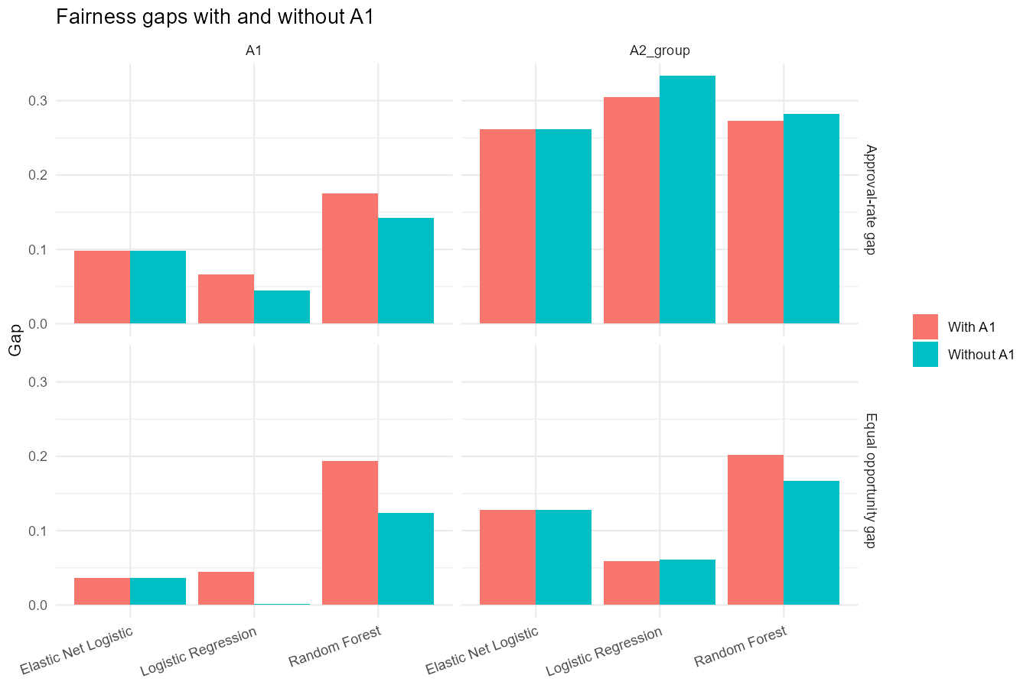
11 — MITIGATION
Does hiding the protected attribute make a model fair?
Three representative models are refit with and without A1 on identical folds. Accuracy is unchanged everywhere.
A1 fairness improves
Logistic Regression EO gap 0.045 → 0.001; Random Forest 0.193 → 0.124.
Age-quartile gaps barely move
0.060 → 0.061 for Logistic Regression, 0.202 → 0.167 for Random Forest.
Elastic Net unaffected
Regularisation already zeroed A1 — 0% of predictions change.
Unawareness is a partial fix at best — the remaining gap comes from features that correlate with A1. It costs nothing in accuracy (82.5–83.9% throughout).
Credit Approval Prediction & Algorithmic Fairness Audit
14 / 15
Notes:
Fairness through unawareness: removing A1 helps A1 fairness and costs nothing in accuracy, but does almost nothing for age quartiles. Elastic Net was already unaffected.

Slide 15
12 — DELIVERY
A Shiny dashboard — and what we learned
Five tabs turn the audit outputs into something a reviewer can explore themselves.
1 · Overview
What we learned
AUC with bootstrap error bars + metrics
▪ A9 (prior-payment proxy) is the single strongest predictor.
▪ Ensembles and regularised linear models dominate the leaderboard.
▪ 12 models span 0.78–0.92 AUC; only KNN is clearly worse.
2 · Fairness by model
Gaps, chance reference, per-group bars
3 · Accuracy vs fairness
Toggle accuracy / AUC and gap type
What we learned about fairness
▪ A1 gaps are modest; age gaps are large but mostly base-rate driven.
▪ No equal-opportunity gap survives Holm correction.
▪ Unawareness helps A1 but not age — and costs nothing in accuracy.
▪ Labels are past decisions, so historical bias is baked into the target.
4 · Is the best really better?
DeLong & McNemar tables
5 · Base rates & limits
True rates per group and caveats
Run: Rscript -e "shiny::runApp()" · data read from da3_dashboard/data/
Credit Approval Prediction & Algorithmic Fairness Audit
15 / 15
Notes:
Five-tab Shiny dashboard over the exported audit CSVs. Close with the limitations: labels are past bank decisions, test set is only 137 applicants, groups are anonymous proxies.

