Slide 1
Flight Booking App
Capstone Project — Full Stack Microservices Application
Developed by: Ayush Kumar Sha
Technologies: Angular • Spring Boot • MySQL • Kafka • Docker
Patterns: CQRS • DDD • SAGA • OpenFeign • Event-Driven
2026 | Wipro Capstone Submission

Slide 2
Problem Statement & Objectives
Background
Key Objectives & Scope
🔹 Problem Statement
Traditional flight booking systems lack scalability and real-time coordination across services
Handling distributed transactions (booking + payment) is complex
🔹 Objective
Build a scalable microservices-based flight booking system
Ensure real-time communication and data consistency across services
🔹 Solution Approach
Designed using Microservices Architecture
Implemented Synchronous (Feign) and Asynchronous (Kafka) communication
Used SAGA pattern for distributed transaction management
🔹 Key Design Patterns
CQRS (Command Query Responsibility Segregation)
SAGA Pattern (Distributed Transactions)
DDD Aggregate (Business Rule Enforcement)
Build 5 microservices: User Write, User Read, Flight, Booking, Payment
Implement CQRS — separate command and query services
Apply DDD Aggregate with dynamic pricing in Flight Service
Use Kafka for async SAGA pattern between Booking & Payment
Use OpenFeign for synchronous REST communication
Provide Angular frontend with login, search, booking & payment flows
Include Swagger, AOP logging, Zipkin tracing, JUnit & Karma tests

Slide 3
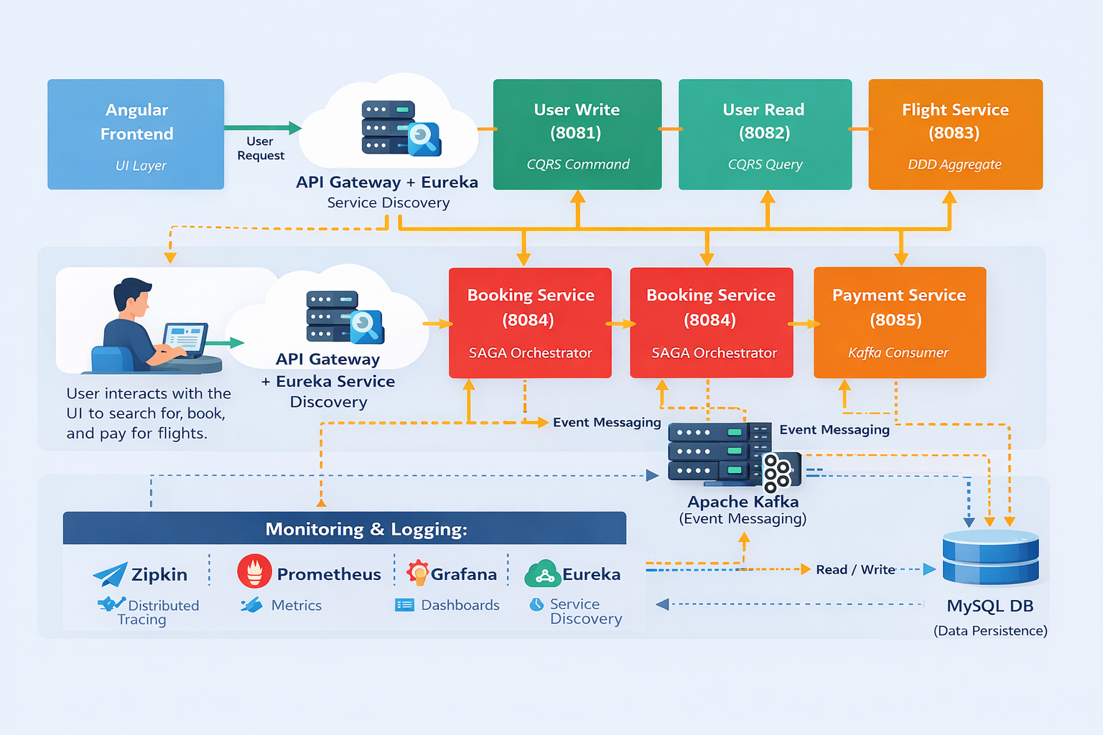
Proposed Solution & System Overview
Angular
Frontend
API Gateway
+ Eureka
User Write
(Port 8081)
User Read
(Port 8082)
Flight Service
(Port 8083)
UI Layer
Service Discovery
CQRS Command
CQRS Query
DDD Aggregate
Workflow
Booking Service
(Port 8084)
Payment Service
(Port 8085)
Apache Kafka
MySQL DB
Login → Search
→ Book → Pay
→ SAGA Result
SAGA + OpenFeign
Kafka Consumer
Async Events
Persistence
Monitoring & Observability: Zipkin (Distributed Tracing) • Prometheus (Metrics) • Grafana (Dashboards) • Eureka (Service Discovery)
5 Microservices | Kafka Async | Feign Sync | SAGA Pattern | CQRS | DDD

Slide 4
Technology Stack & Implementation
Frontend
Backend
Database & Tools
Patterns Used
Angular 21+
TypeScript
Bootstrap 5
RxJS
Angular Routing
Karma / Jasmine Tests
Spring Boot 3.4
Java 21
Spring Security
Spring Data JPA
OpenFeign (sync)
Apache Kafka (async)
MySQL 8
Hibernate ORM
Swagger / OpenAPI
AOP Logging
Zipkin Tracing
Prometheus + Grafana
CQRS (User MS)
DDD Aggregate (Flight)
SAGA + Compensation
OpenFeign REST
Event-Driven Kafka
Eureka Discovery

Slide 5
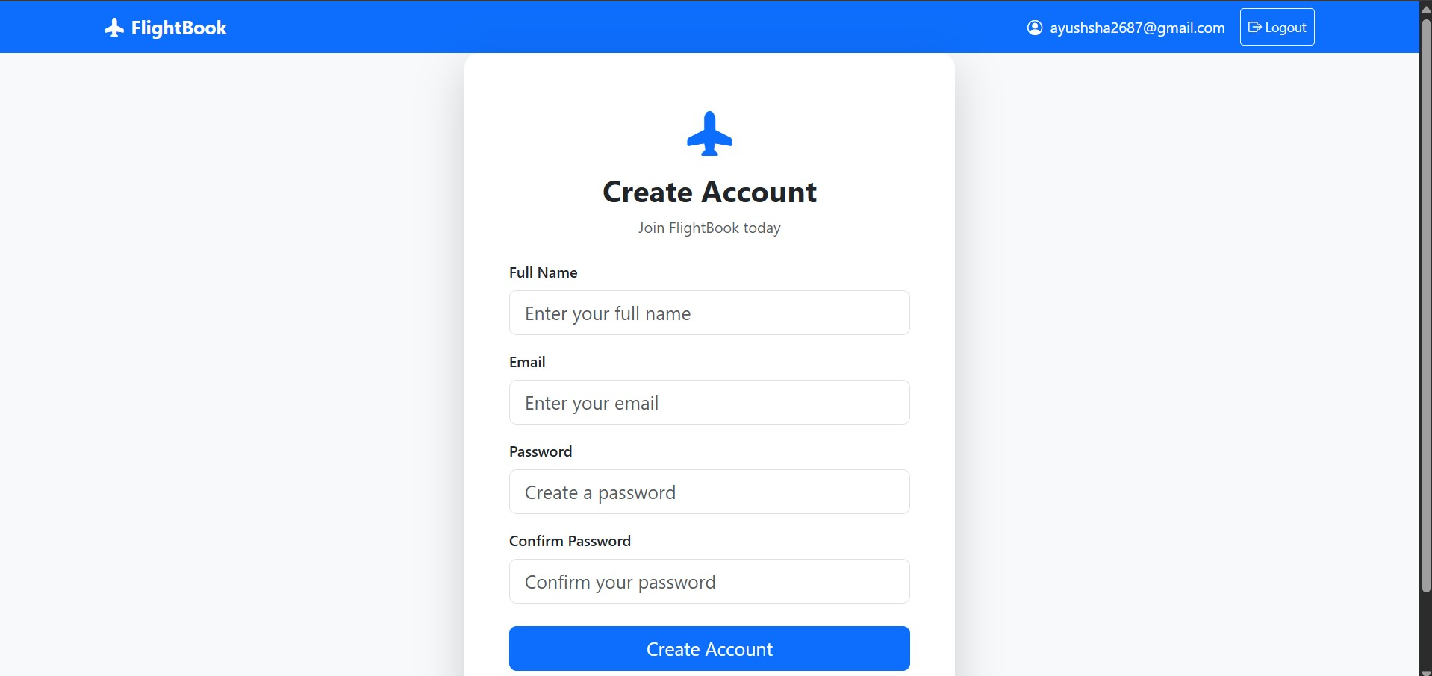
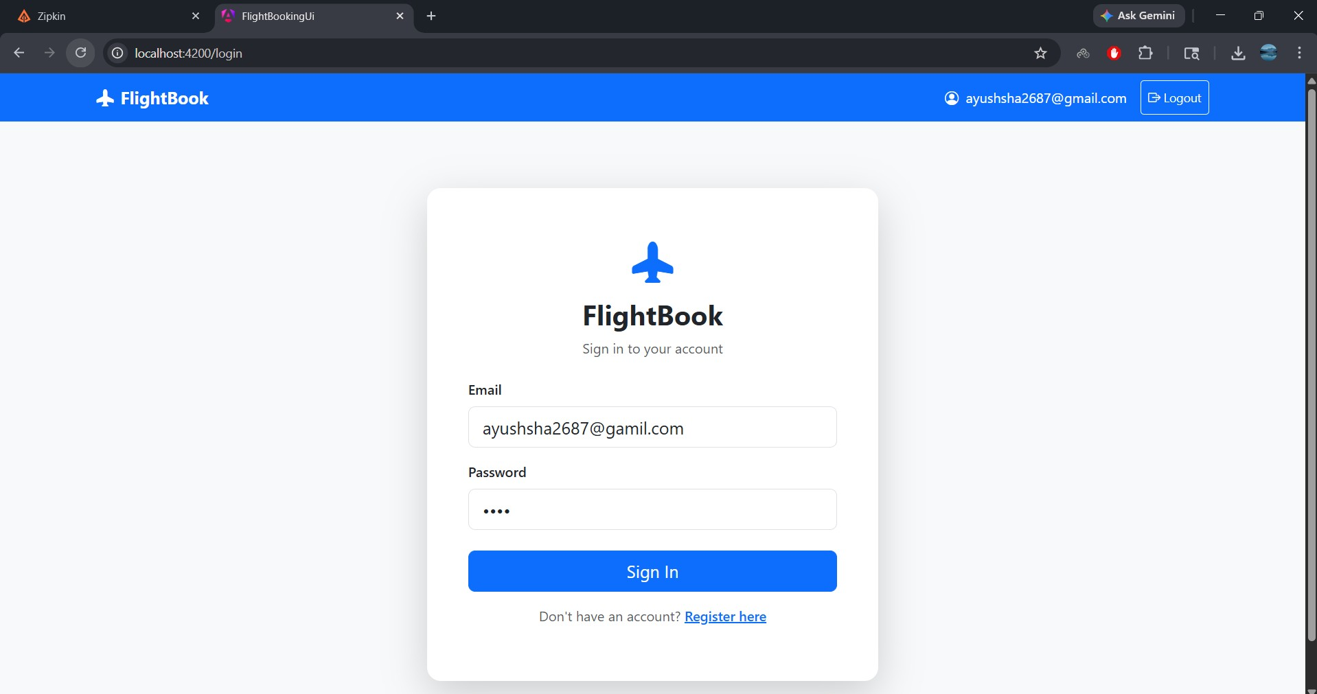
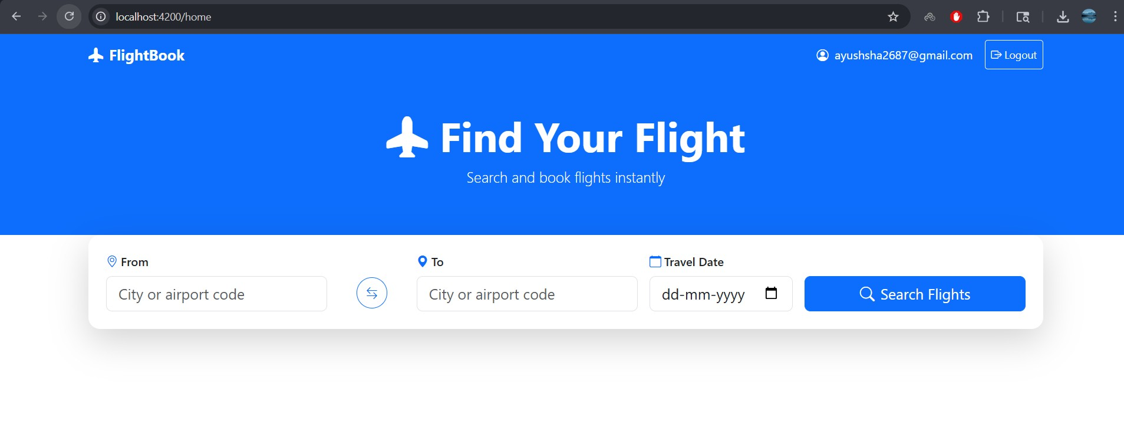
Results & Demo
Register / Login
02
User registers & logs in via User Write Service (Port 8081)
Search Flights
Search by source, destination & date via Booking → Flight Service (Feign)
Key Results Achieved
✓ Full SAGA flow working end-to-end ✓ All 5 APIs documented in Swagger ✓ AOP logging on all services ✓ Zipkin traces visible across services ✓ JUnit & Karma tests passing

Slide 6
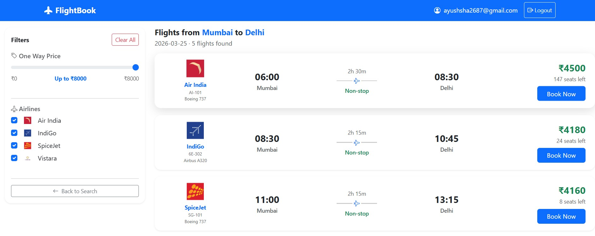
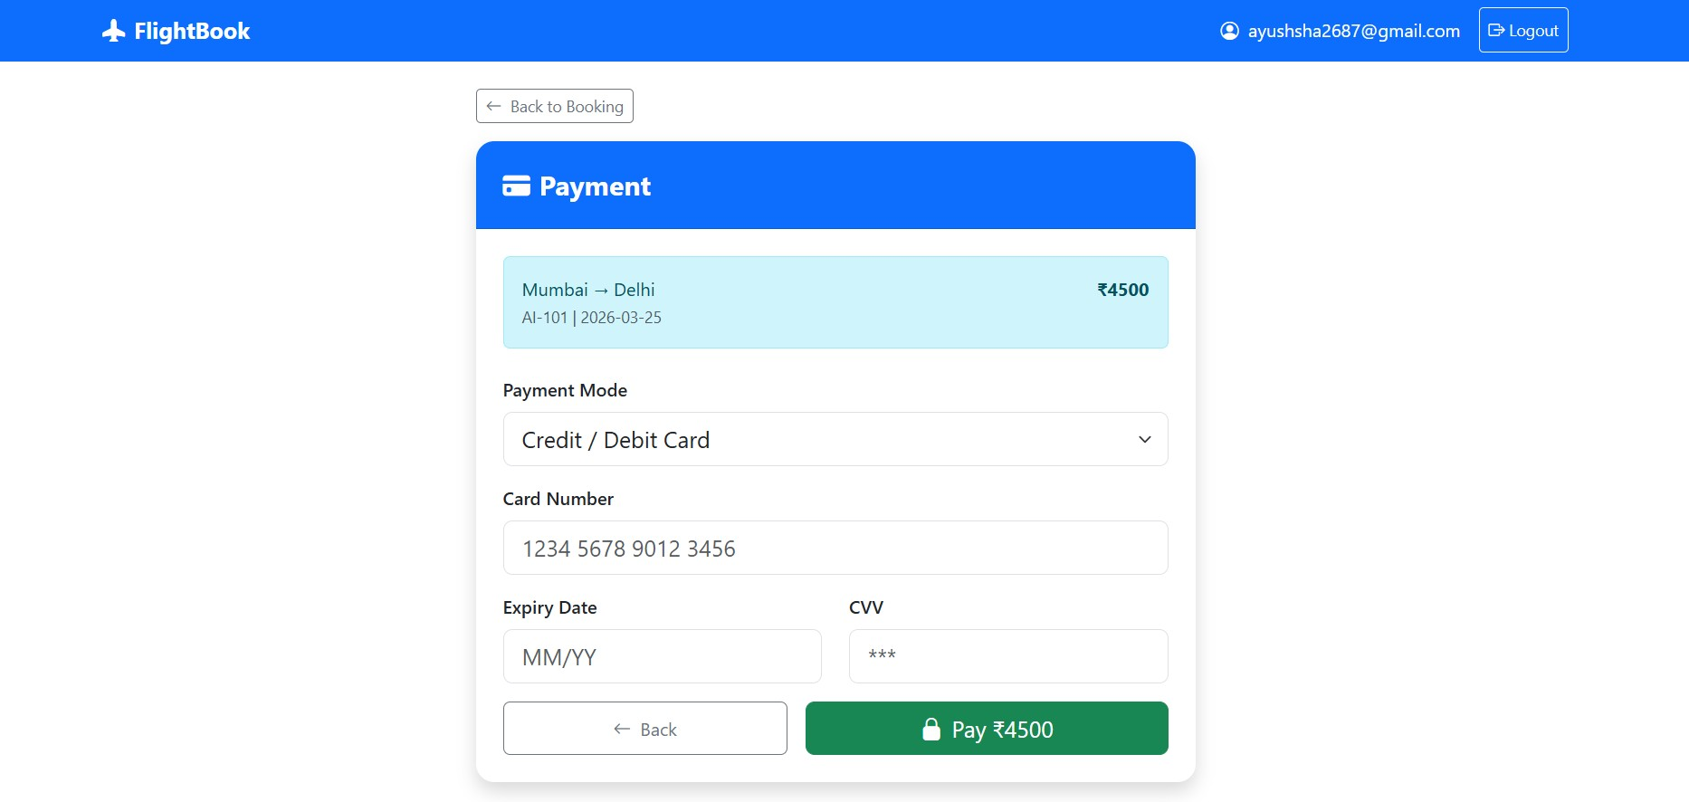
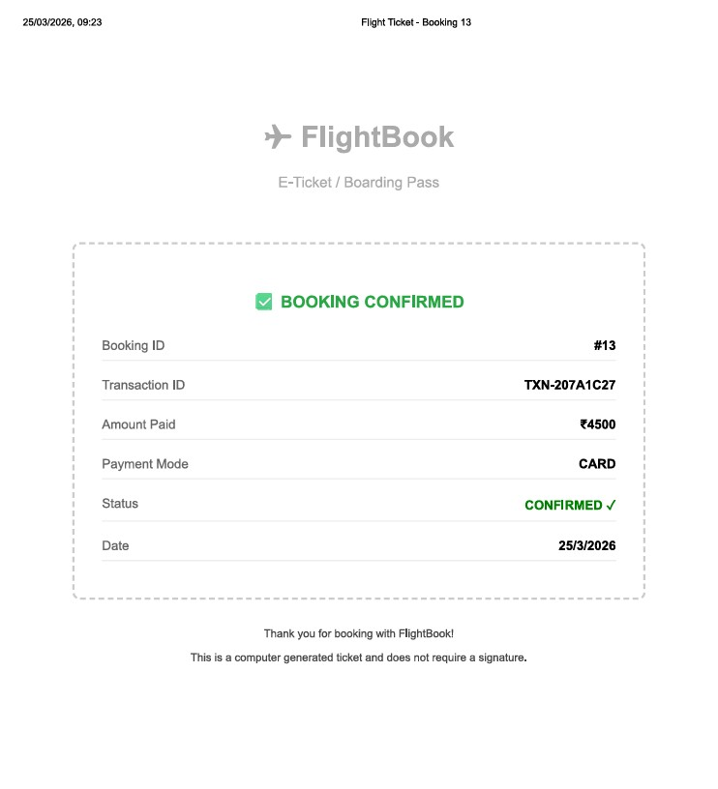
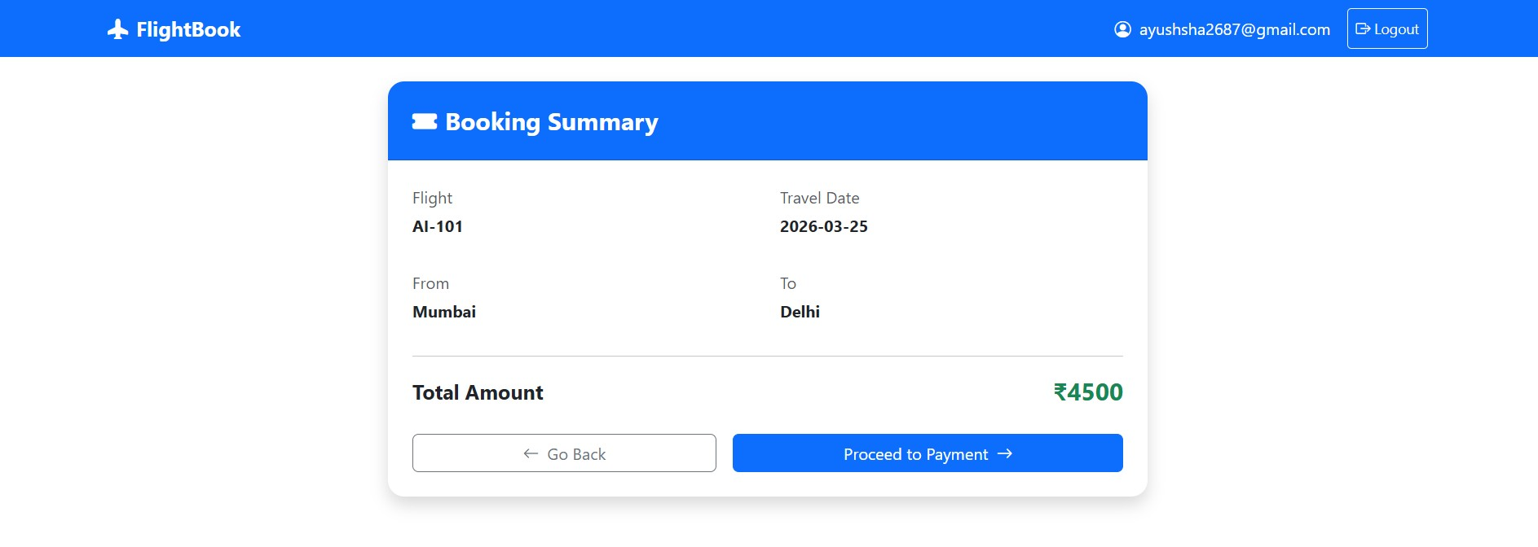
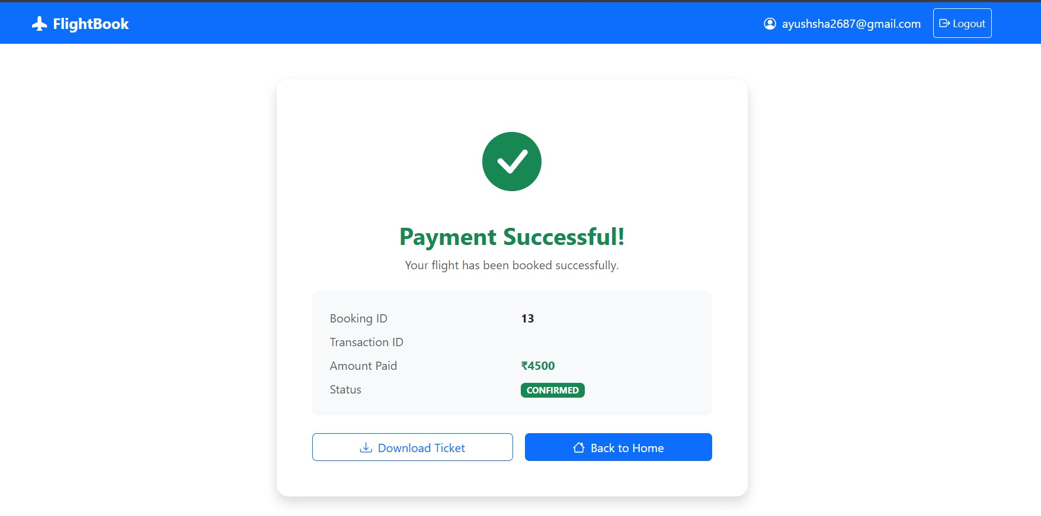
Results & Demo
Book a Flight
Payment Processing
Result & E-Ticket
Booking service;
Payment Service;
Booking status updated; PDF ticket generated on success
Key Results Achieved
✓ Full SAGA flow working end-to-end ✓ All 5 APIs documented in Swagger ✓ AOP logging on all services ✓ Zipkin traces visible across services ✓ JUnit & Karma tests passing

Slide 7
Conclusion & Future Scope
What We Achieved
Challenges Faced
Future Enhancements
5 Spring Boot microservices fully working
CQRS, DDD, SAGA & OpenFeign implemented
Angular frontend with 8 screens
Kafka async communication
Swagger on all 5 services
Zipkin + Prometheus + Grafana
Eureka service discovery
JUnit & Karma tests passing
Spring Boot 3.5 & Spring Cloud version compatibility
Kafka consumer group stabilisation
SAGA compensation logic for distributed rollbacks
Spring Security blocking Eureka registration
Zipkin jar download in restricted network
Angular standalone component test configuration
Real payment gateway integration (Razorpay / Stripe)
JWT-based authentication & authorization
Multi-passenger booking support
Email notifications via SMTP
CI/CD pipeline with GitHub Actions
Kubernetes deployment
Mobile app (React Native / Flutter)
AI-based dynamic seat pricing
Thank You! | Questions & Answers | Ayush Kumar Sha — Flight Booking App Capstone

