Slide 1
OBJECTIVE
To Accurately predict International Classification of Disease(ICD) Codes.
To provide a proper Billing Narrative from Narrative and ICD codes.

Slide 2
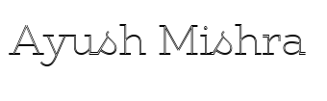
ICD Codes Prediction Model
Red partition – ICD codes prediction
Blue partition – Billing Narrative prediction
Narrative
Large Language Model
Input
LLM
Billing Narrative
Output
Summarized Narrative
ML Pipeline
ICD Codes
Output
Codes Verifier
ICD codes ✔️ ICD codes❌
Fig: Flow Diagram

Slide 3
Working of Code Prediction Model
The Model is Divided in Three Parts.
Pre-Processing : The Input data is treated with the help of LLM locally without sending it to server hence ensures data privacy and a summarized Input is obtained.
Prediction : Used ML models such as Random Forest Classifier, Multi-Output Classifier for better understanding of the data.
Verifying (Additional) : Added a verifier for analysing the predicted code is correct or not with the help of LLM.

Slide 4
Working of Billing Narrative Model
The summarized Input (Narrative) and predicted ICD codes both are fed to LLM for generation of Billing Narrative
Note : The LLM used is not sending any data to the server it runs locally ensures data privacy.

Slide 5
Issues/Problems
Model fails to predict because of, Overfitting, Complexness of the data, Compatibility issues of models.
Less Training Data, Model need to learn different patterns for that it needs to get trained on vivid datasets.
For example : Letters in ICD10 have sub-types so it must be trained heavily for accurate and exact prediction of codes.

Slide 6
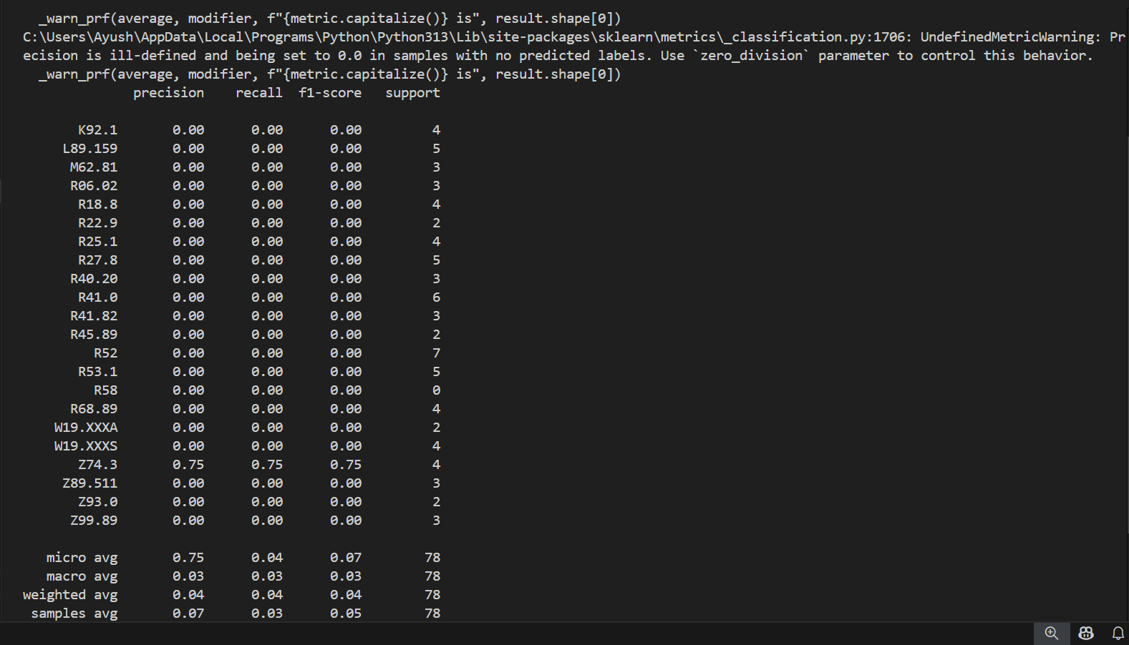
Issues/Problems

