Slide 1
Healthcare Infrastructure Analysis – Kenya
Premium Insights • Visual Storytelling • Data-Driven Decisions

Slide 2
Project Overview
• Comprehensive analysis of 10,000+ healthcare facilities
• Integrated population & facility datasets
• Fuzzy-matched sub-counties using NLP similarity
• Built a full health access scoring model
• Identified service gaps, shortages & operational performance

Slide 3
Key National Metrics
• Total Sub-Counties Analyzed: 309
• Average Beds per 10k: 12.58
• Average Facilities per 10k: 2.56
• Operational Facilities: 90.34%

Slide 4
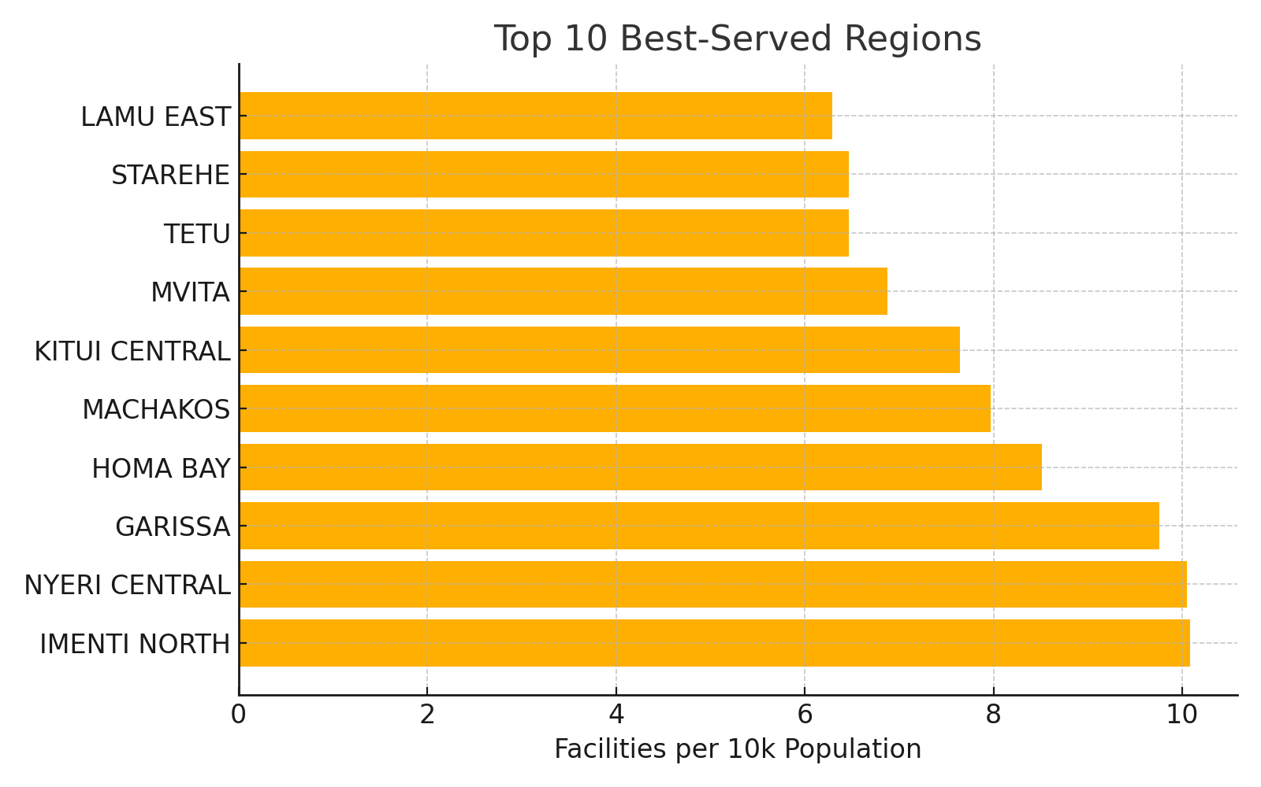
Top 10 Best-Served Sub-Counties

Slide 5
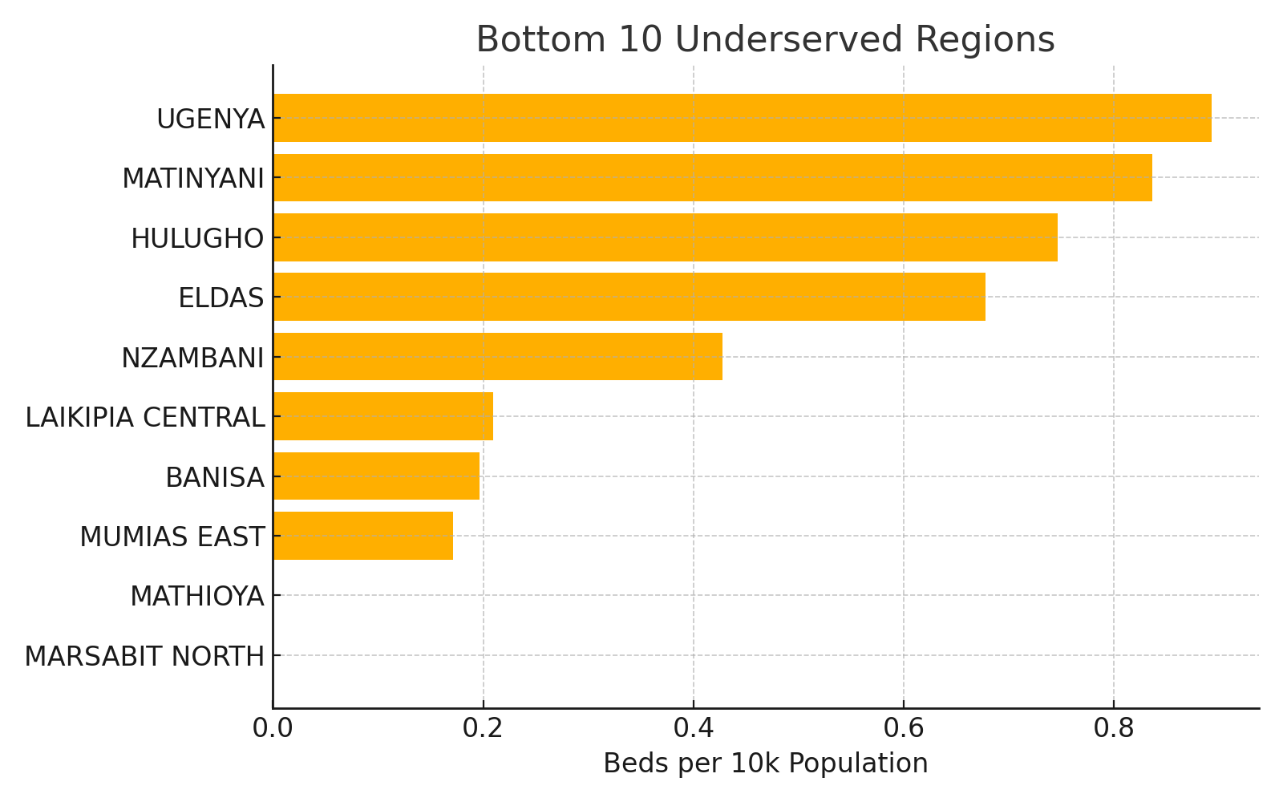
Bottom 10 Most Underserved (Beds per 10k)

Slide 6
Key Findings
• Extreme inequality in facility distribution across Kenya
• Some regions exceed 10 facilities per 10k; others have <0.2
• Several densely populated counties remain severely underserved
• Bed capacity shortages are widespread in rural and peri-urban regions
• Operational performance is generally high (90%+)

Slide 7
Recommendations
• Prioritize facility expansion in underserved counties
• Create government dashboards for real-time capacity tracking
• Allocate more beds to high-density regions with <2 beds per 10k
• Strengthen ART, ANC, TB diagnostic service coverage
• Invest in digital health mapping for better allocation

Slide 8
Conclusion
This project reveals the structural imbalances in Kenya's healthcare access. By combining facility-level data, population insights, and advanced analytics, we built a clear picture of where healthcare investments are most needed.

