Slide 1


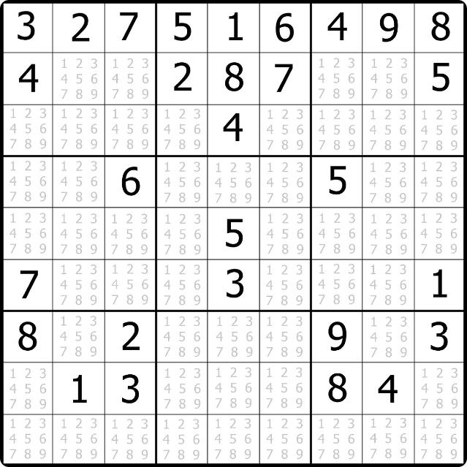
Introduction to Sudoku Solver Visualization
Sudoku is a captivating logic-based number puzzle that challenges players to fill a 9x9 grid with digits in a way that satisfies specific constraints. This presentation will explore a visual approach to solving Sudoku puzzles using a step-by-step algorithm.

Slide 2

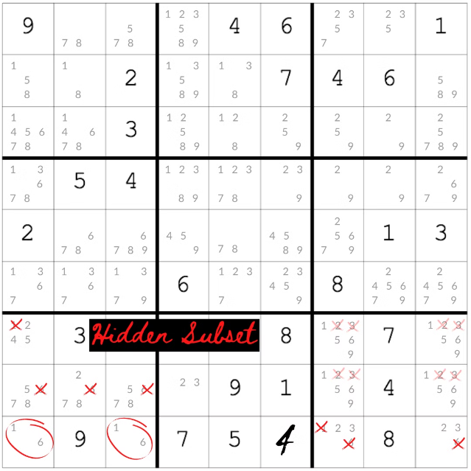
Importance of Sudoku Solving Techniques
Mastering Sudoku solving techniques is valuable for developing logical reasoning, problem-solving, and analytical skills. The visual representation of the solution process can help users better understand the underlying strategies and apply them to solve more complex puzzles.

Slide 3

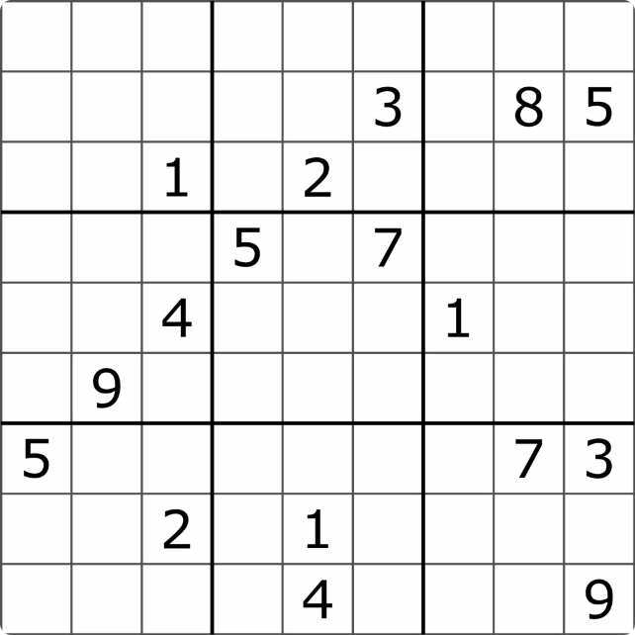
Overview of the Sudoku Solving Algorithm
1
Constraint Identification
Analyze the grid to determine the constraints for each cell, row, column, and 3x3 box.
2
Candidate Placement
Identify the possible numbers that can be placed in each empty cell based on the constraints.
3
Backtracking
Recursively fill the grid, backtracking when a placement leads to a contradiction.

Slide 4

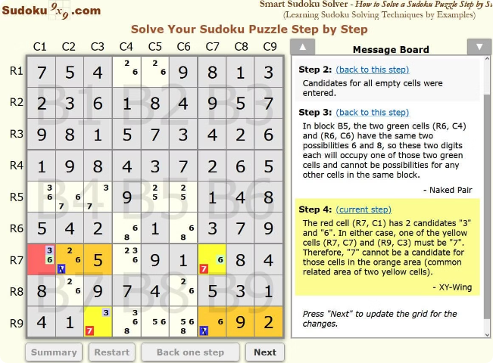
Step-by-Step Visualization of the Algorithm
1
Initial Grid
The starting point is an incomplete Sudoku grid with some pre-filled numbers.
2
Constraint Analysis
Identify the constraints for each empty cell based on the existing numbers in the row, column, and 3x3 box.
3
Candidate Placement
Determine the possible numbers that can be placed in each empty cell without violating the constraints.

Slide 5




Highlighting the Backtracking Process
Recursive Filling
Backtracking
Constraint Adjustment
The algorithm recursively fills the grid, attempting to place the next available number in each empty cell.
If a placement leads to a contradiction, the algorithm backtracks to the previous step and explores alternative options.
After backtracking, the constraints are updated to reflect the new state of the grid.

Slide 6
Handling Empty Cells and Constraints
Empty Cells
Constraint Tracking
Constraint Enforcement
The algorithm identifies and focuses on the empty cells, prioritizing them for placement of valid numbers.
The solver maintains a comprehensive understanding of the constraints for each row, column, and 3x3 box to ensure a valid solution.
The algorithm strictly enforces the constraints, ensuring that each row, column, and 3x3 box contains unique digits from 1 to 9.

Slide 7


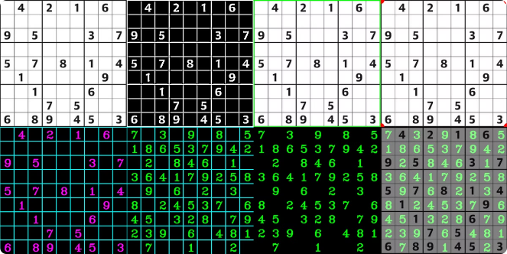



Optimizing the Visualization for Efficiency
Fast Execution
The visualization employs efficient algorithms and data structures to solve Sudoku puzzles quickly.
Memory Management
The solver optimizes memory usage to handle complex puzzles without performance degradation.
Scalability
The visualization can handle Sudoku puzzles of varying difficulty levels and grid sizes.
User-Friendly
The interface is designed to be intuitive and engaging for users to follow the solution process.

Slide 8

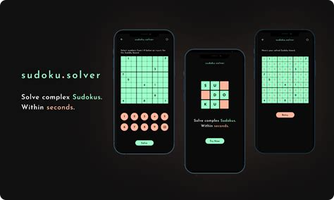
Conclusion and Potential Applications
Educational Tool
The Sudoku solver visualization can be used as an educational tool to teach logical reasoning and problem-solving skills.
Brain Stimulation
Solving Sudoku puzzles with the help of this visualization can enhance cognitive abilities and mental sharpness.
Entertainment
The interactive nature of the visualization can make Sudoku solving an enjoyable and engaging experience for users.
Real-World Applications
The Sudoku solving techniques can be adapted to solve similar constraint-based problems in various domains, such as scheduling and resource allocation.

