Slide 1
Internship Project Submission
A structured exploration of AI, sustainability, and green skilling — aligned with the United Nations Sustainable Development Goal 17: Partnerships for the Goals.

Slide 2
Student Details
Fill in your personal and academic information below. This slide serves as the official identification page for your internship project submission.
Personal Information
Full Name: Ayush Mehta
Enrollment Number: 230470116007
College / University: V.V.P. Engineering College
Stream / Branch: B.E. in Information & Technology
Semester / Year: 4th Year, 7th Semester

Slide 3
Key Learnings from Resources
The following insights were gathered from curated resources including SDG documentation, data centre sustainability reports, and government portals on green technology.
SDG 17 — Partnerships for the Goals
Data Centre Sustainability
Government Digital Initiatives
Documentaries revealed that data centres consume ~1–2% of global electricity. Green data centres use renewable energy, liquid cooling, and AI-driven energy management to drastically reduce their carbon footprint.
Portals like India's National AI Portal and MoEFCC highlight how policy frameworks are integrating AI for climate monitoring, smart agriculture, and urban sustainability planning across Indian states.
SDG 17 emphasizes global cooperation between governments, private sectors, and civil society. Technology and AI are critical enablers for achieving all 17 SDGs through shared data, innovation, and capacity building.

Slide 4
Green Skilling, Sustainability & AI
What is Green Skilling?
AI: A Double-Edged Sword for Sustainability
Green skilling refers to equipping individuals with knowledge, competencies, and values to support sustainable economic practices. It spans renewable energy, circular economy, sustainable agriculture, and climate-resilient infrastructure.
✅ AI for Good
⚠️ AI's Environmental Cost
Predictive climate modelling
Smart grid energy optimisation
Precision agriculture reducing waste
Wildlife monitoring via computer vision
High GPU energy consumption
E-waste from hardware upgrades
Carbon emissions from training LLMs
Water usage in data centre cooling
Sustainability in the Digital Age
Sustainability means meeting present needs without compromising future generations. In tech, this translates to energy-efficient algorithms, responsible data usage, and designing systems that minimize environmental harm.

Slide 5
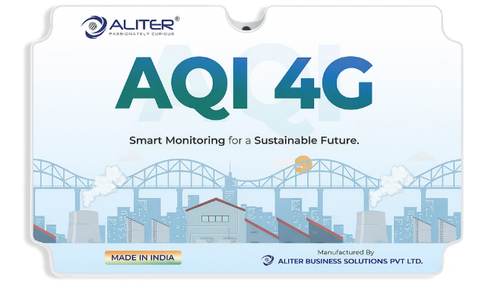
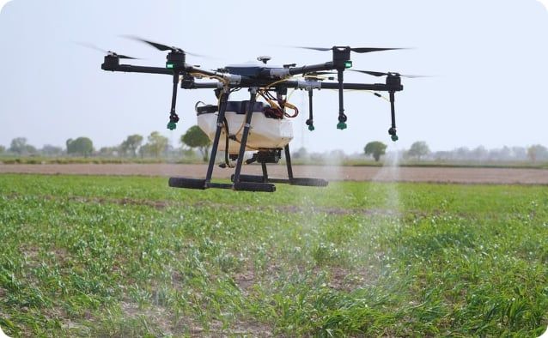
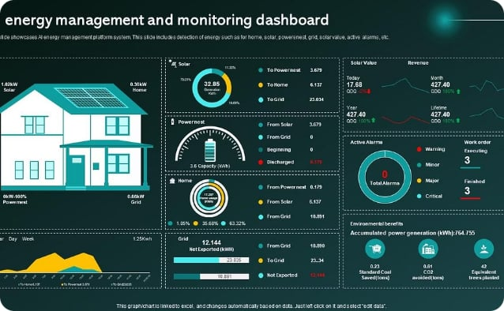
Capstone Project Proposals
The following project ideas leverage AI to address environmental challenges and advance SDG 17 through technology-driven partnerships and green innovation.
AI-Powered Air Quality Predictor
Green Skilling Platform for Farmers
Renewable Energy Optimiser
Build a real-time air quality forecasting model using IoT sensor data and ML. Predict pollution spikes and recommend mitigation strategies for urban Indian cities, aligned with SDG 11 & 13.
Design an AI chatbot + mobile app that delivers hyperlocal sustainable farming advice in regional languages. Integrates weather data, soil health, and government schemes — promoting SDG 2 & 4.
Develop an AI dashboard that analyses solar/wind energy output for micro-grids. Recommends optimal energy distribution, reducing waste and promoting clean energy adoption — supporting SDG 7 & 17.

