Slide 1
STARTUP PROFIT PREDICTION
Project: Startup Profit Prediction Using Linear Regression
Tools: Python, Pandas, Scikit-learn
Presented by: Ayush Nigam, Yash Goyal

Slide 2
Problem Statement & Objectives
Problem Statement:
Startups invest in various departments without clear profit estimation.
Objective:
- Predict startup profits using linear regression.
- Understand impact of R&D, marketing, admin spending.
- Automate profit prediction using ML.

Slide 3
Data Preprocessing Applied
- Loaded dataset using Pandas.
- Separated features and target (Profit).
- Applied OneHotEncoder on 'State' column.
- Used ColumnTransformer to combine features.
- Built a Pipeline for preprocessing and model training.

Slide 4
Model & Evaluation Metrics Used
Model: Linear Regression (from sklearn.linear_model)
Why Linear Regression?
- Simple, interpretable, efficient for numerical prediction.
Evaluation Metrics:
- Mean Squared Error (MSE)
- R² Score (coefficient of determination)
Example Output:
MSE: 9133600.5, R² Score: 0.91

Slide 5
Dataset Details
- Dataset Name: 50_Startups.csv
- Rows: 50
- Features: R&D Spend, Administration, Marketing Spend, State
- Target: Profit
- Type: Real-world startup investment data

Slide 6
Challenges & Solutions
Challenges:
- Small dataset size (only 50 rows)
- Categorical data handling
- Dummy variable trap
- Pipeline complexity
Solutions:
- Used train-test split and random state
- Applied OneHotEncoding with drop='first'
- Built processing and model pipeline

Slide 7
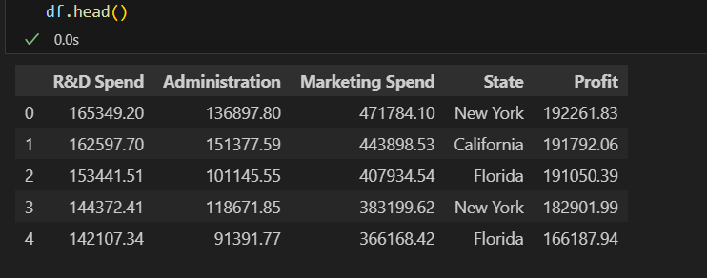
Demo Screenshots
1. Dataset preview (df.head())

Slide 8
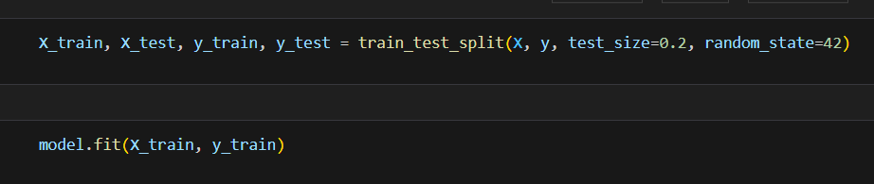
2. Model training code snippet

Slide 9
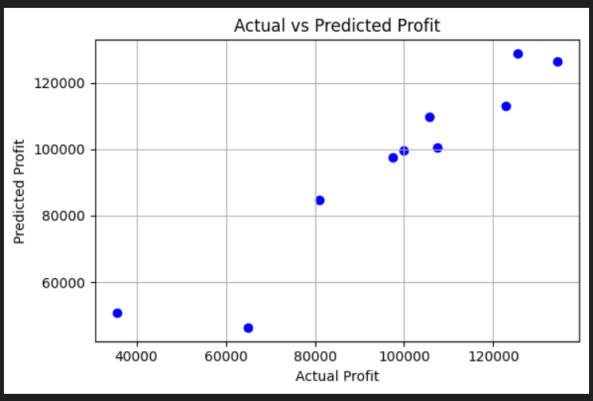
3. Predicted vs Actual plot (scatter plot)

Slide 10
THANKYOU

