Slide 1
MAVEN PROJECT ASSIGNMENT
Submitted by-Ayush Pathak
1858

Slide 2
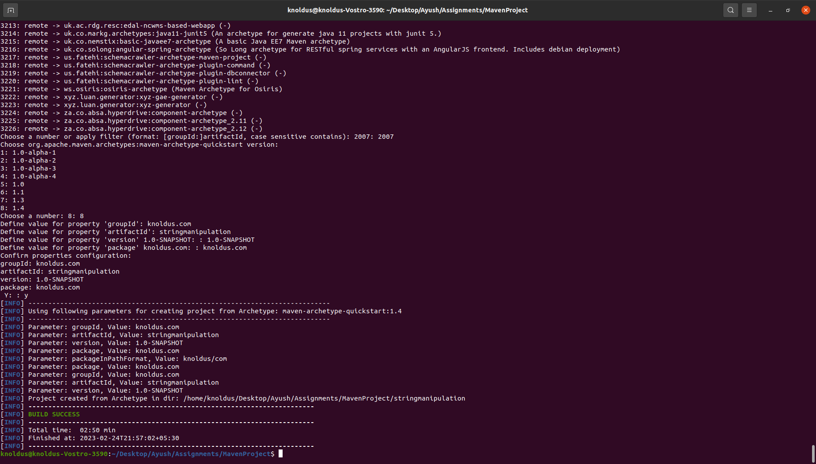
Creating Project Using Terminal

Slide 3
STEPS TO MAKE MULTI MODULE PROJECT
To make a maven project we will be first using command mvn archetype:generate.
We will input 2007 and select the version 1.4 to specify the archetype version we want to use.
In group id we will be adding the organization name ie;com.knoldus.
In artifact Id we will use the project name ie stringmanipulation.(In case of adding module we will write the module name”.
In version we will enter the version of our update in maven project.
In project id we will use the same name as the group Id ie; com.knoldus.

Slide 4
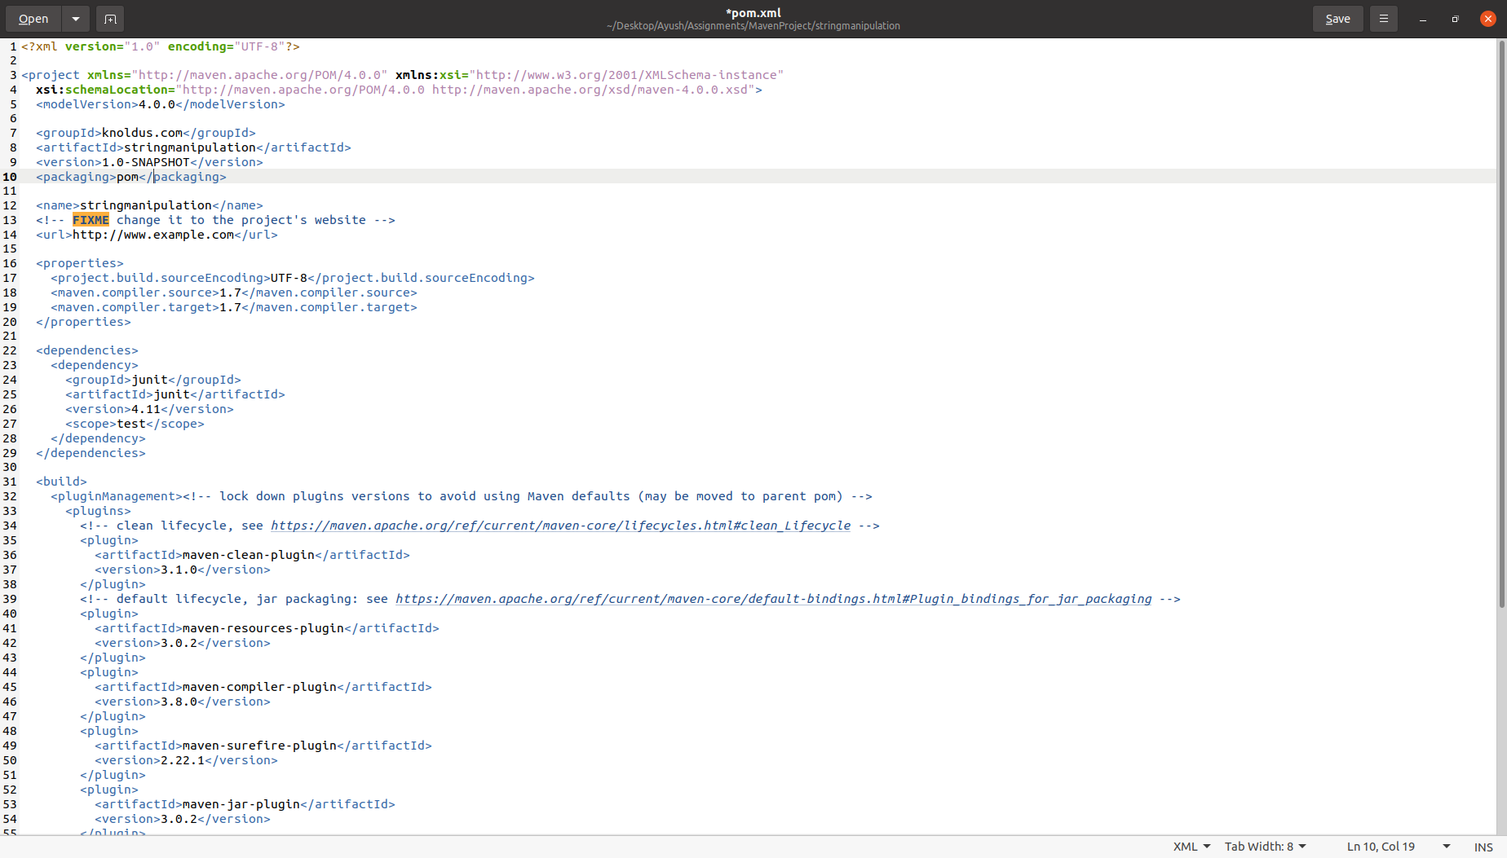
Creating modules
We will the change our current directory to stringmanipulation using cd command.
Then open the pom file using gedit command to edit the pom.xml file.
We will add <packaging>pom</packaging> in pom file which will allow us to create sub-modules in this directory.

Slide 5
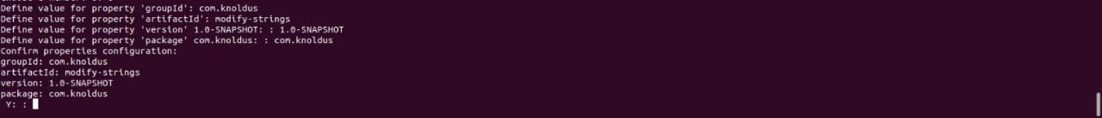
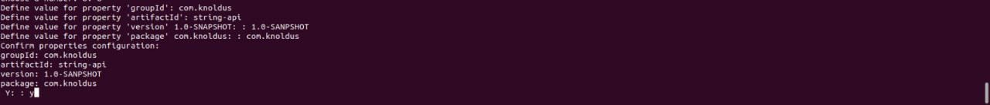
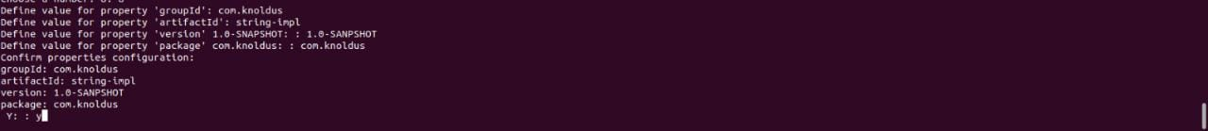
Creating modules
Now repeat the same steps to create a new module in current directory as in first slide.
New sub-modules can be added as in the second slide.
The maven project will have only 2 src folders ie; in string-api and string-impl.

Slide 6
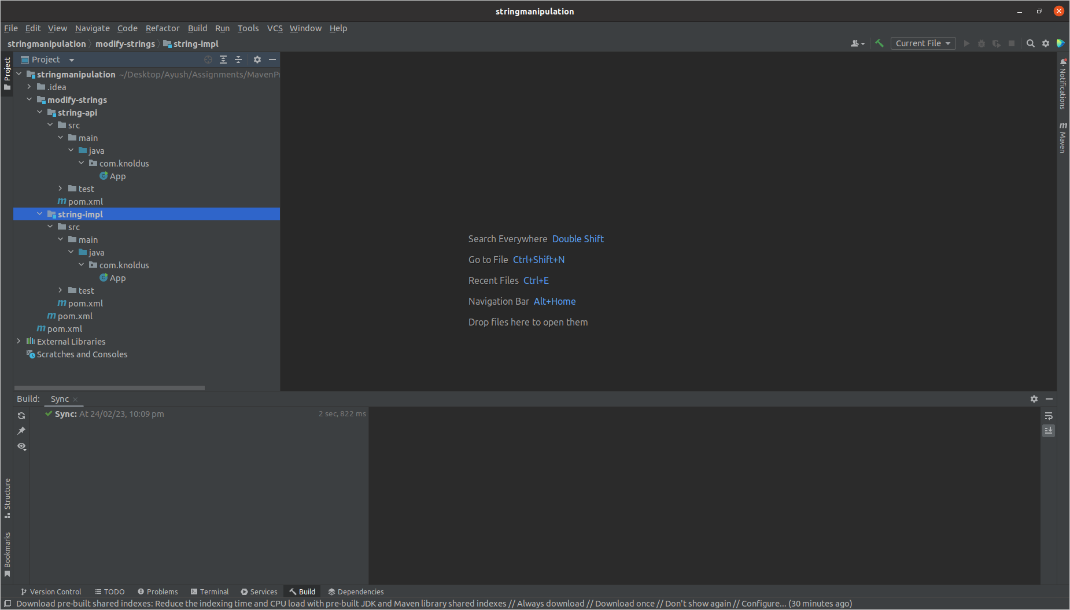
RESULT IN INTELLIJ
We will be able to see the project structure in the intellij IDE.
We will now add the assigned dependencies in the main pom which is created in
stringmanipulation.

Slide 7
THANK YOU!!

