Slide 1

Notes:
#

Slide 2

TEAM-FUNITY
Title: Flip - AI-Powered Seller Interaction Simulator Gen AI
Team Name: Funity
Team Leader: Sai Suthirth- Backend model Development, PPT
Team Members:
R Uday Sri Kumar- Frontend Development, Model Development, PPT
Ayush Ravishankar Shetty – Frontend-Backend Integration
College: Manipal Institute of Technology, Manipal
Date: 25/8/2024
Title: Flip - AI-Powered Seller Interaction Simulator Gen AI
Team Name: Funity
Team Members: uday -
Ayush -
Sai suthirth -
College/University: Manipal Institute of Technology
Date: 24/8/2024

Slide 3

Executive Summary:
Problem Overview :
Developing an AI-based voice assistant that acts like a top-notch salesperson talking to customers in real time. This assistant will give correct details about products, handle tricky questions, and have the same appeal as a seasoned seller.
Proposed Solution :
The AI helper acts like a seasoned seller giving correct details and having genuine talks. It suggests items tailored to each person and mimics bargaining situations.
Key Findings and Recommendations :
Naturalness and Fluency: Ensure the voice agent speaks naturally and avoids artificial speech patterns.
Accuracy and Relevance: our AI provides accurate product information and customized, personalized recommendations.
Multilingual Support: To service a varied customer base, emphasize the agent's fluency in multiple languages like Hindi, English.
Context Maintenance: Throughout long interactions, the AI efficiently keep context and the selling personal.
Low Latency: Maintain a fast reaction time to mimic a real vendor.
Expected Impact :
We believe that the AI speech agent will revolutionize e-commerce customer service by offering a flawless, multilingual, and professional-level shopping experience. Particularly in diversified markets, this will likely end up resulting in higher levels of consumer satisfaction, better sales, and stronger brand loyalty. It will also be helpful to specially abled people to interact and use the site more comfortably .

Slide 4

Technical Approach:
Methodology:
Our approach to solving the problem involved creating an AI voice assistant using Flask. We designed the assistant to listen to user input, generate responses through the Groq API, and speak the answers out loud. This process included integrating speech recognition to capture user queries, using natural language processing via Groq to provide relevant answers, and implementing text-to-speech to vocalize responses. Additionally, we incorporated features like negotiation scenarios to simulate real-time conversations and set up price drop alerts to notify users of changes in product prices. This combination of technologies and features aimed to deliver a comprehensive, interactive experience.
Tools and Technologies:
Flask: A lightweight Python web framework used for building the web application and restful API.
Groq: API used to generate chat completions based on user input .
Speech Recognition: A Python library for capturing and recognizing speech input.
Pyttsx3: A text-to-speech conversion library that speaks the AI's response aloud.
Logging: Standard Python logging for tracking events and errors.
Algorithm/Logic:
Voice Input Capture: The system uses the Speech Recognition library to capture audio input from the user's microphone.
Text Generation: The captured text is sent to the Groq API, which processes the input and generates a corresponding response to Voice .
Output: The response is converted from text to speech using the pyttsx3 library, allowing the AI to "speak" the response.
API Interaction: The Flask server exposes endpoints to handle incoming requests and send back responses.

Slide 5
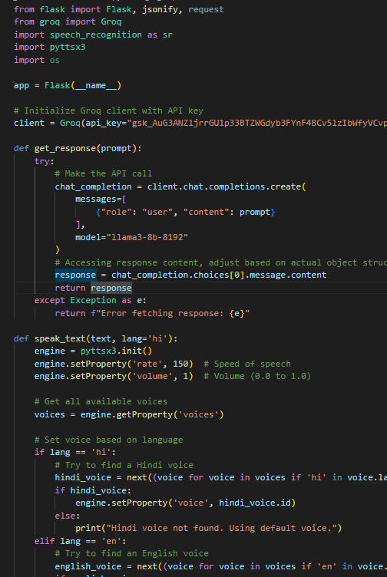
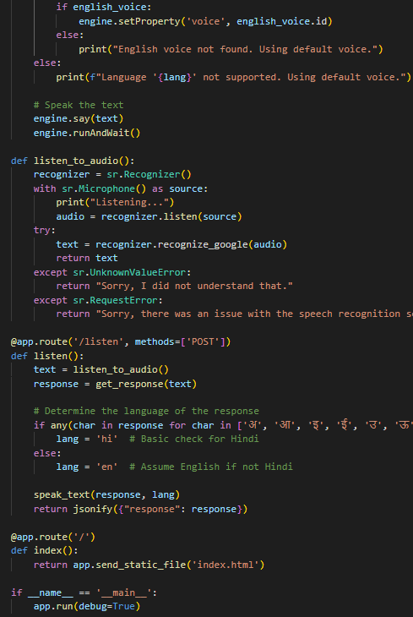
Code Snippet
Main.py

Slide 6
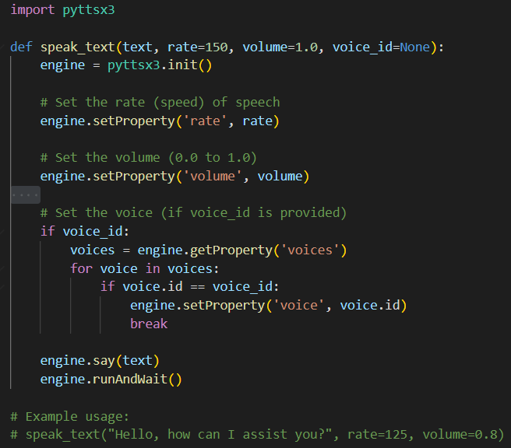
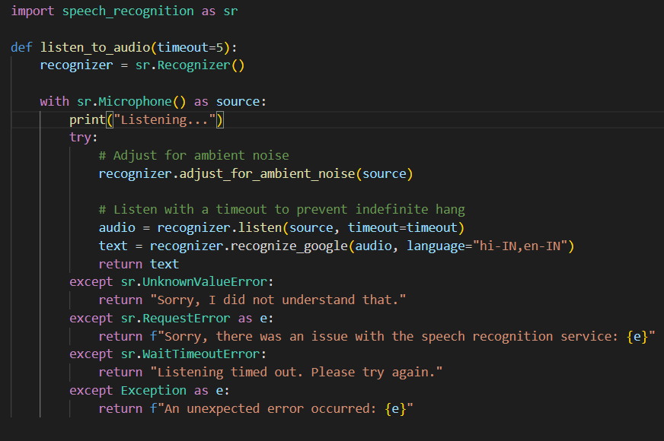
Code Snippet contd…
Text to speech :
Voice Recognition :

Slide 7
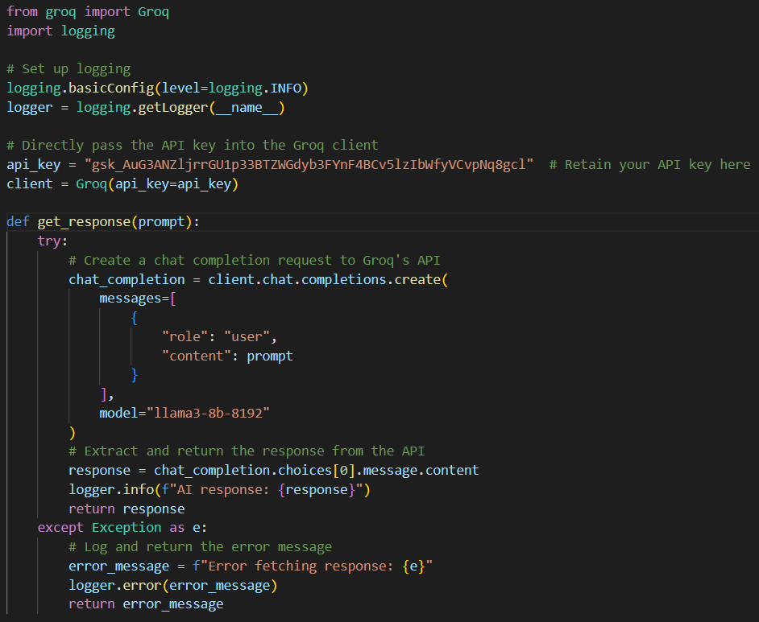
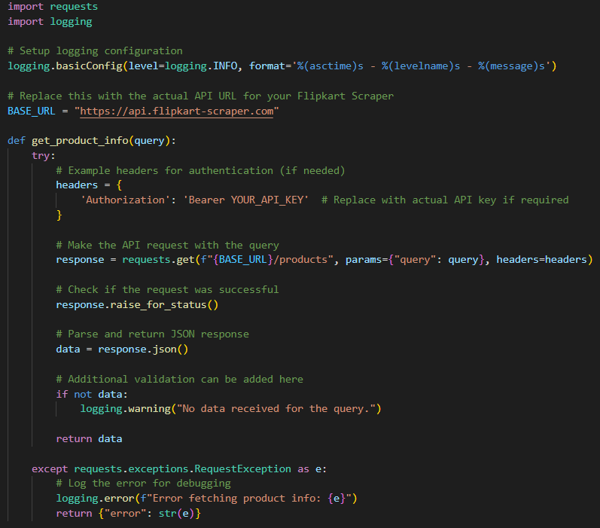
Code Snippet Contd…
Groq Api Integration :
Flipkart scraper:

Slide 8
Technical Approach contd..
Setup and Configuration: We installed all the necessary libraries like Flask, speech_recognition, pyttsx3, and set up the Groq API client. After that, we configured the API key in config.py and ensured that all dependencies were in place.
Deployment: We carried out the implementation of the solution on a Flask-compatible hosting service, confirming the microphone and speech recognition capabilities were operational, and served the Html, JS file as the frontend.
Testing: We ran the system through tests, inputting audio and checking the quality of the recognition, confirming the Groq API operated as expected and then verifying the speech output, as well as test edge cases such as timeouts and error handling.

Slide 9
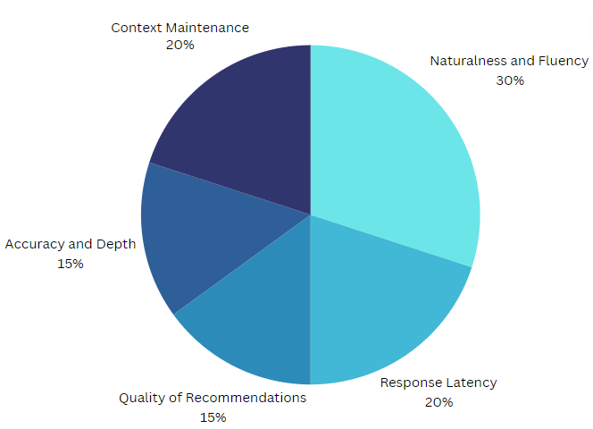
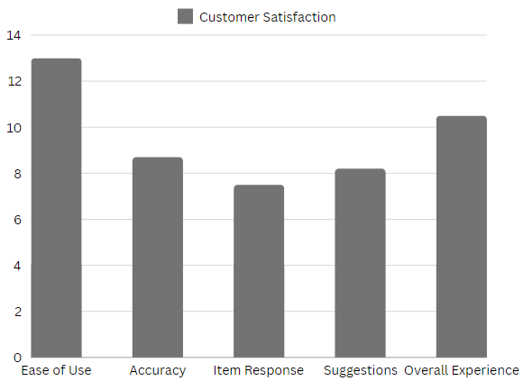
Results and Analysis

Slide 10
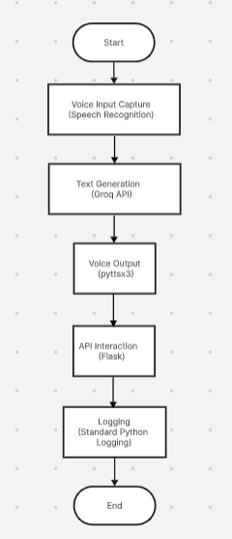
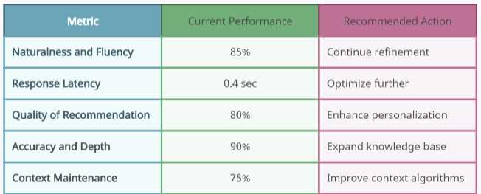
Results and Analysis

Slide 11

Challenges and Limitations:
Initially, we faced a substantial barrier, the issue being, the system only accepted input that was text-based and provided no option to return speech-based output. This issue required we troubleshoot the integration of the pyttsx3 text-to-speech engine with the response system. The process of confirming the system could recognize spoken words, but also respond via an audio text output was quite involved, particularly when trying to maintain the flow of a more natural conversation. We also needed to fine-tune the speech engine's speed of delivery, clarity of answers, and timing of responses to enable an interaction with a more natural tone.
Another challenge we faced was during the integration of the frontend and backend. The main challenge was accurately recognizing the user's voice input and transmitting it to the backend. There were numerous points of failure to ensure the user's voice commands were recognized to speech, sent to the backend via flask, and then processing by Groq's API without errors. Connecting the different components of the system while maintaining a fluid user experience proved to be a tough but rewarding task

Slide 12
Recommendations and Future Work
User Feedback Mechanism: Implement a feedback system for users to rate responses and report issues, which can help in continually refining the assistant's performance.
Integrating the speech agent with augmented and virtual reality (AR/VR) technology could result in immersive and interactive retail experiences where customers can interact with the AI in a virtual store setting.
Voice Agent Adaptability in Various Marketplaces: Research the voice agent's adaptability in various e-commerce platforms and industries to make sure it can be readily adjusted and used in a variety of retail settings with little to no modification. Addition of few more languages to be inclusive of all states and regions
Security and Privacy in AI Interactions: Develop strong strategies to guarantee data security and privacy in AI-customer interactions, especially when managing sensitive data such as personal or payment information.

Slide 13
Appendices
Comprehensive data regarding the accuracy of voice recognition tests at different noise levels, environments, and
accents.
Graphics representing the response times before and after optimizing API calls to allow for real-time interaction.
Code snippets showing how pyttsx3 was configured to work with speech rate, volume, and choices of voice.
Details on the frontend-backend integration process using Flask to allow for voice input to interact with Groq's API.
Other logging when troubleshooting related to errors with speech recognition and timeouts with the system.
Breakdown of all test cases that were used for the accuracy of voice commands, API response, and edge cases
related to the connectivity being lost.
Documentation on the approaches we took regarding handling speech recognition limitations and improving the
real-time processing.
Other possibilities and suggestions for future improvements related to improving voice accuracy in noisy
environments or scenarios when we have low connectivity.

Slide 14


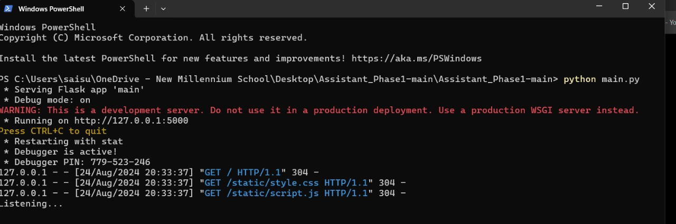
Frontend:
Development Evidence
Backend:

Slide 15

Thank You
-Team Funity

