Slide 1
NATIONAL INSTITUTE OF TECHNOLOGY MEGHALAYA
Department of Electrical Engineering
“Load Management System Using LSTM-Based Solar Power Forecasting”
Under the supervision of Dr. Piyush Pratap Singh
Name : Ayush Raj Roll No.: B22EE013
Name : Siddhant Purkayastha Roll No.: B22CS021

Slide 2
Content
OBJECTIVE
AIM
ABOUT DATASET
SOLAR FORCASTING
LOAD MANAGEMENT SYSTEM
CONCLUSION
FURURE SCOPE
REFERENCES

Slide 3
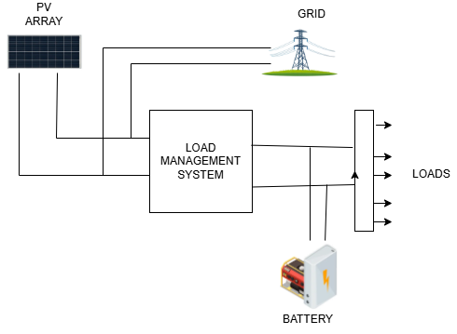
Introduction
Objective:- To implement a load management system that allocates power to essential and non-essential loads based on forecasted solar output, battery status, and load demand, minimizing reliance on grid or generator backup.
Project Components:
Solar Power Forecasting: To provide reliable input for energy planning and load allocation decisions in the system.
Load Management System: To optimize power distribution between essential and non-essential loads by leveraging forecasted solar generation and battery status, thereby reducing reliance on backup sources.
Fig1. Load management with solar forecasting

Slide 4
DATASET
The dataset was collected over a period of 6 months from a rooftop solar installation at NIT Meghalaya, Shillong (geographic location with hilly terrain and frequent weather variability).
A total of 21 features are used, which include:
  Atmospheric conditions (e.g., temperature, humidity, pressure)
  Cloud cover layers (high, medium, low)
  Solar radiation (shortwave backward radiation)
  Wind characteristics (speed and direction at various altitudes)
  Sun positioning (zenith, azimuth, angle of incidence)
  Target variable: generated solar power (in kilowatts)
Significance:- Unlike generalized datasets, our localized data—collected from the NIT Meghalaya rooftop—provides higher contextual accuracy for solar power prediction in this specific region.

Slide 5
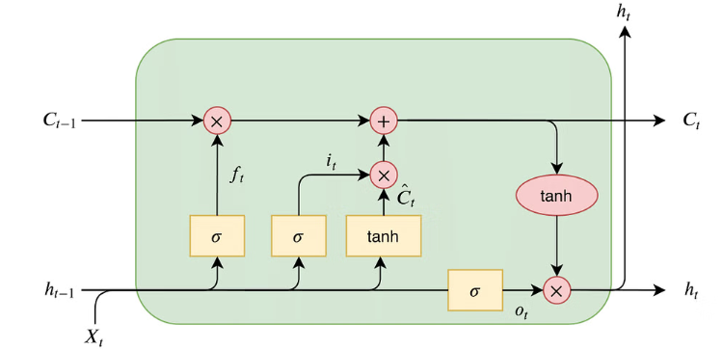
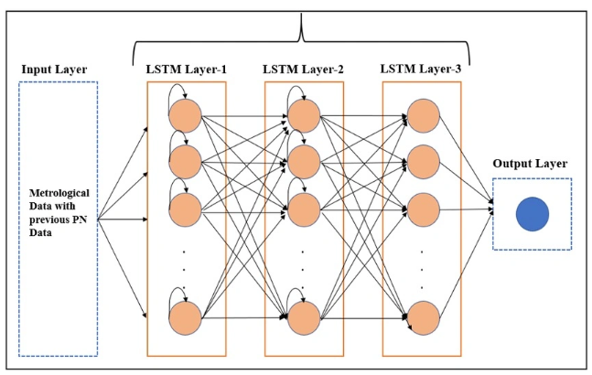
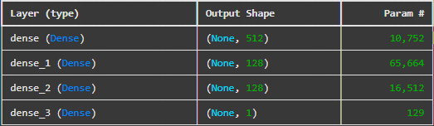
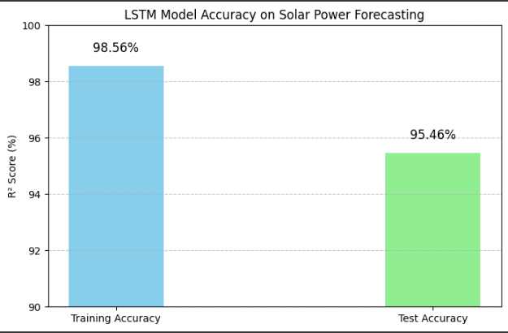
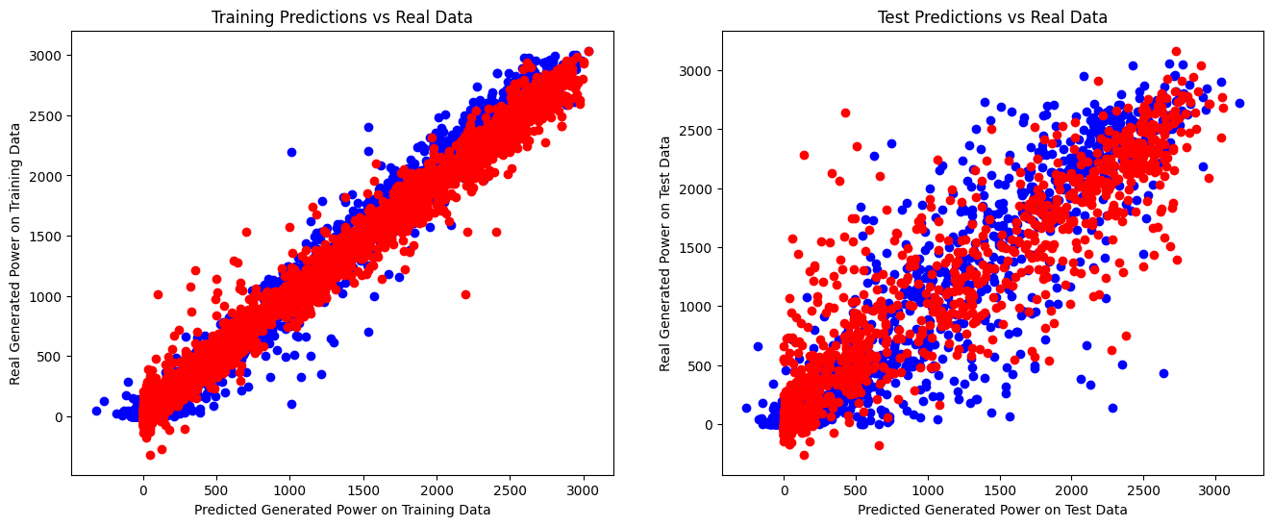
SOLAR POWER FORECASTING
Long Short-Term Memory (LSTM)
A Long short-term memory (LSTM) is a type of Recurrent Neural Network specially designed to prevent the neural network output for a given input from either decaying or exploding as it cycles through the feedback loops. The feedback loops are what allow recurrent networks to be better at pattern recognition than other neural networks. Memory of past input is critical for solving sequence learning tasks and Long short-term memory networks provide better performance compared to other RNN architectures by alleviating what is called the vanishing gradient problem.
Fig 3. Neural Network Summary
Fig 4. LSTM Architecture
Fig 2. LSTM Based NN
A solar power forecasting model was developed using an LSTM neural network.
1. R² score of 98.56% on training data
2. R² score of 95.46% on test data
Fig 5. Accuracy and Prediction Vs Real

Slide 6
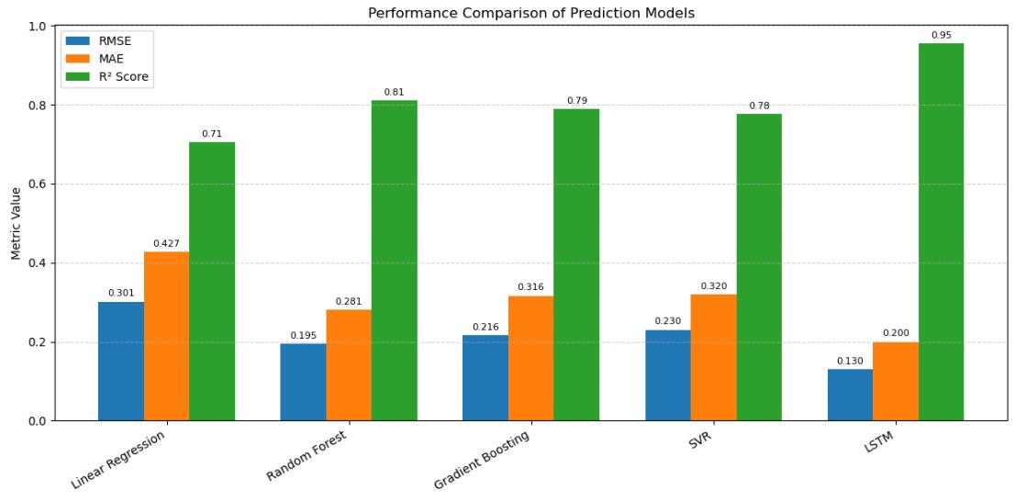
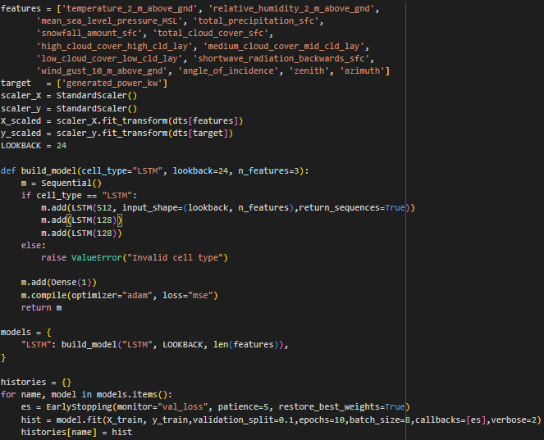
SOLAR POWER FORECASTING
Significance of Solar Forecasting in the Project
Allows early assessment of power balance by comparing forecasted solar output, battery SOC, and estimated load demand.
Facilitates dynamic load prioritization between essential and non-essential loads based on forecasted supply.
Reduces dependence on backup sources (grid/generator) by optimizing renewable energy utilization.
Ensures reliable power delivery to critical (essential) loads under variable solar generation conditions.
Fig 6. Comparative Analysis

Slide 7
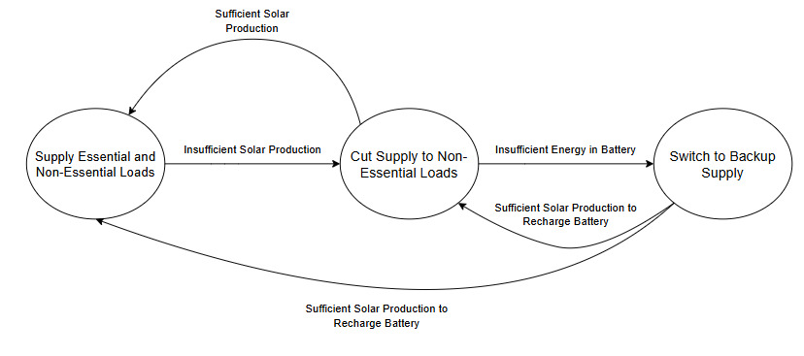
LOAD MANAGEMENT SYSTEM
System States:
All Loads Supplied (Normal Operation): Energy supply (from solar and battery) is sufficient to meet both essential and non-essential load demands
Non-Essential Load Cut (Partial Curtailment): Energy supply is insufficient for full load demand but enough for essential services
Switch to Backup Power (Critical Condition): System cannot support the essential loads with available solar and battery power. In this state, the LMS triggers the use of backup sources such as the grid or generators to ensure continuity of essential operations.
Fig 7. System State Block Diagram

Slide 8
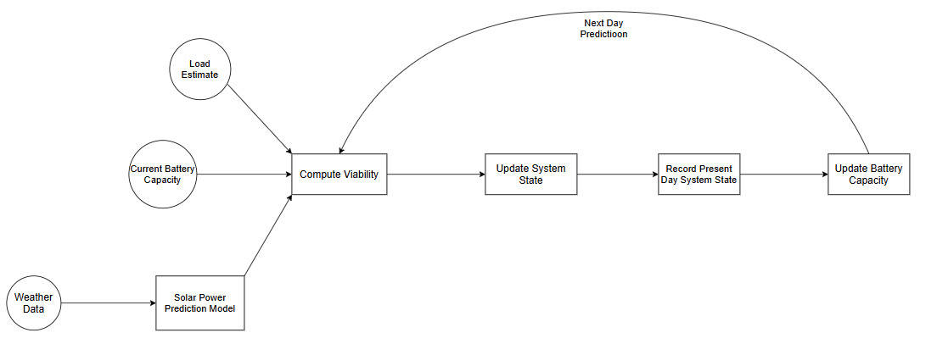
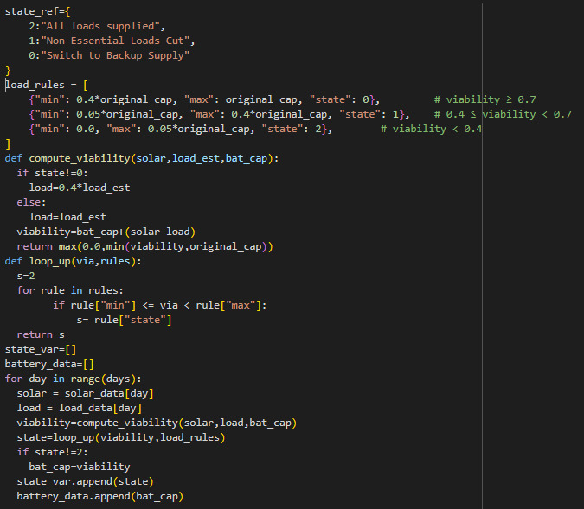
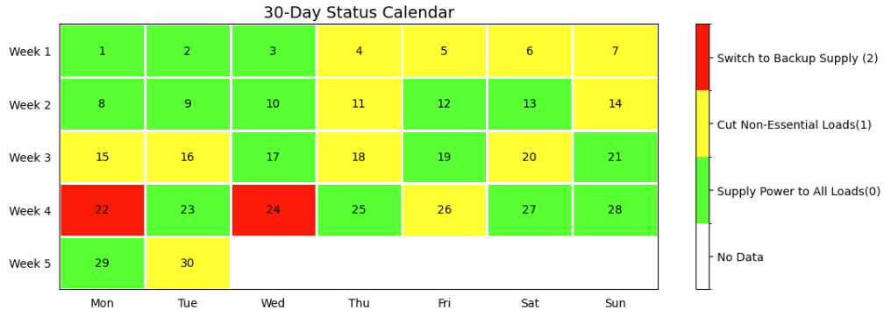
Load Management System Architecture and Result
Fig 9. Overall Load Management System Block Diagram
Fig 8. Load management on 30 day of December
Fig 10. Code Implementation of Load management Logic

Slide 9
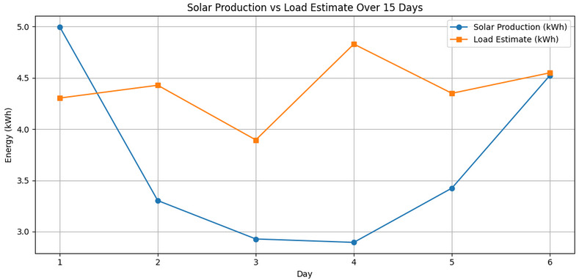
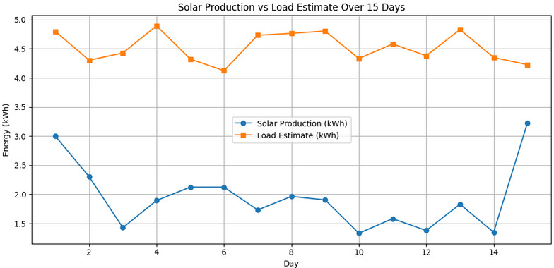
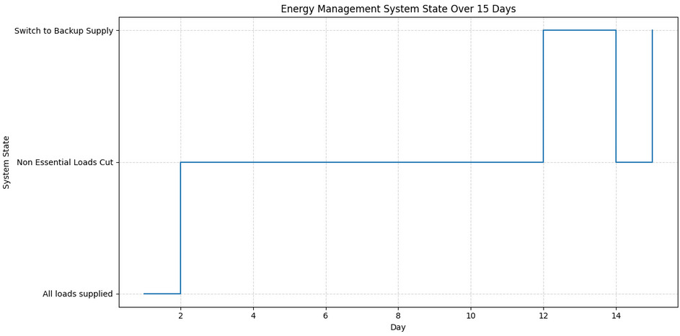
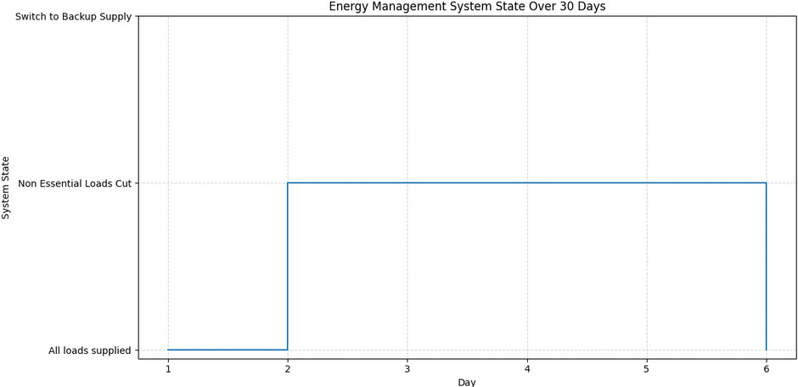
Case1: Extended low radiation Due to Fault Weather
Case2: Extreme Events like Natural Calamities
Fig 11.
Fig 13.
Fig 14.
Fig 12.

Slide 10
Conclusion
Developed a solar power forecasting model using LSTM, trained on real-world data from NIT Meghalaya.
Implemented a Python-based Load Management System that distributes power based on solar prediction, battery energy, and load demand.
Simulated 30 days of system operation to ensure uninterrupted power to essential loads while minimizing dependency on grid or generator backup.

Slide 11
Future Scope
Adding machine learning models to predict future load demand based on historical usage patterns can allow the control system to plan even more efficiently, avoiding blackouts and battery over discharge.
Implement more detailed load profiling that includes time-of-day consumption patterns, user preferences ,and critical load thresholds to allow more control.
Replace the rule-based lookup table with a fuzzy logic controller or trained reinforcement learning agents to make more adaptive, real-time decisions.
Develop a simple user interface or dashboard to visualize predicted solar generation, current battery level, and the daily system state for easier monitoring by users or operators.

Slide 12
Reference
Wan, C., Zhao, J., Song, Y., et al. ”Photovoltaic and solar power forecasting for smart grid energymanagement.” CSEE Journal of Power and Energy Systems 1.4 (2015): 38-46. DOI: 10.17775/CSEE-JPES.2015.00046
Li-Ion Aging Dataset (https://data.nasa.gov/dataset/li-ion-battery-aging-datasets
”Deep Learning Models for PV Power Forecasting” https://www.mdpi.com/1996-1073/17/16/3973
”Load Management System with Integration of Renewable Energy” https://www.researchgate.net/publication/354586799_Load_Management_System_with_Integration_of_Renewable_Energy_Resources

Slide 13
Thank you

