Slide 1
Automated SRAM Fault Diagnosis Using Physics-Normalized Feature Invariants Across PVT Corners
Mid-Semester B.Tech Project Progress Presentation | 45nm CMOS Technology
• Project Members: Ayush Raj (Roll No: 210102025) & Project Team
• Project Supervisor: Faculty Advisor / Project Guide
• Department & Institution: Department of Electronics & Communication Engineering
• Academic Session: Final Year B.Tech Project (BTP) — 2026

Slide 2
BTP MID-SEMESTER PROGRESS PRESENTATION
Introduction: Background, Motivation & Problem Statement
• Problem Background: SRAM caches occupy >70% of modern SoC area, dominating chip yield and field reliability in nanoscale nodes.
• Core Motivation: Process, Voltage, and Temperature (PVT) variations cause severe operational drift, confounding fault detection.
• Problem Being Addressed: Traditional test methods cannot classify latent defects, while raw ML models fail when operating corners shift.
• Relevance & Impact: Essential for zero-defect mission-critical systems in automotive, aerospace, and high-reliability edge computing.

Slide 3
BTP MID-SEMESTER PROGRESS PRESENTATION
Project Objectives & Key Expected Deliverables
• Automated Simulation Pipeline: Develop a programmatic SPICE harness for defect injection across multi-dimensional PVT corners.
• Static & Dynamic Metric Extraction: Extract butterfly Static Noise Margins (SNM), write delays, bitline discharge, and IDDQ currents.
• Physics-Invariant Formulation: Design on-die reference normalized ratios that cancel environmental temperature and voltage drift.
• Cross-PVT Benchmark & Explainability: Prove generalization via Leave-One-Corner-Out (LOCO) protocols and explain decisions using Tree SHAP.

Slide 4
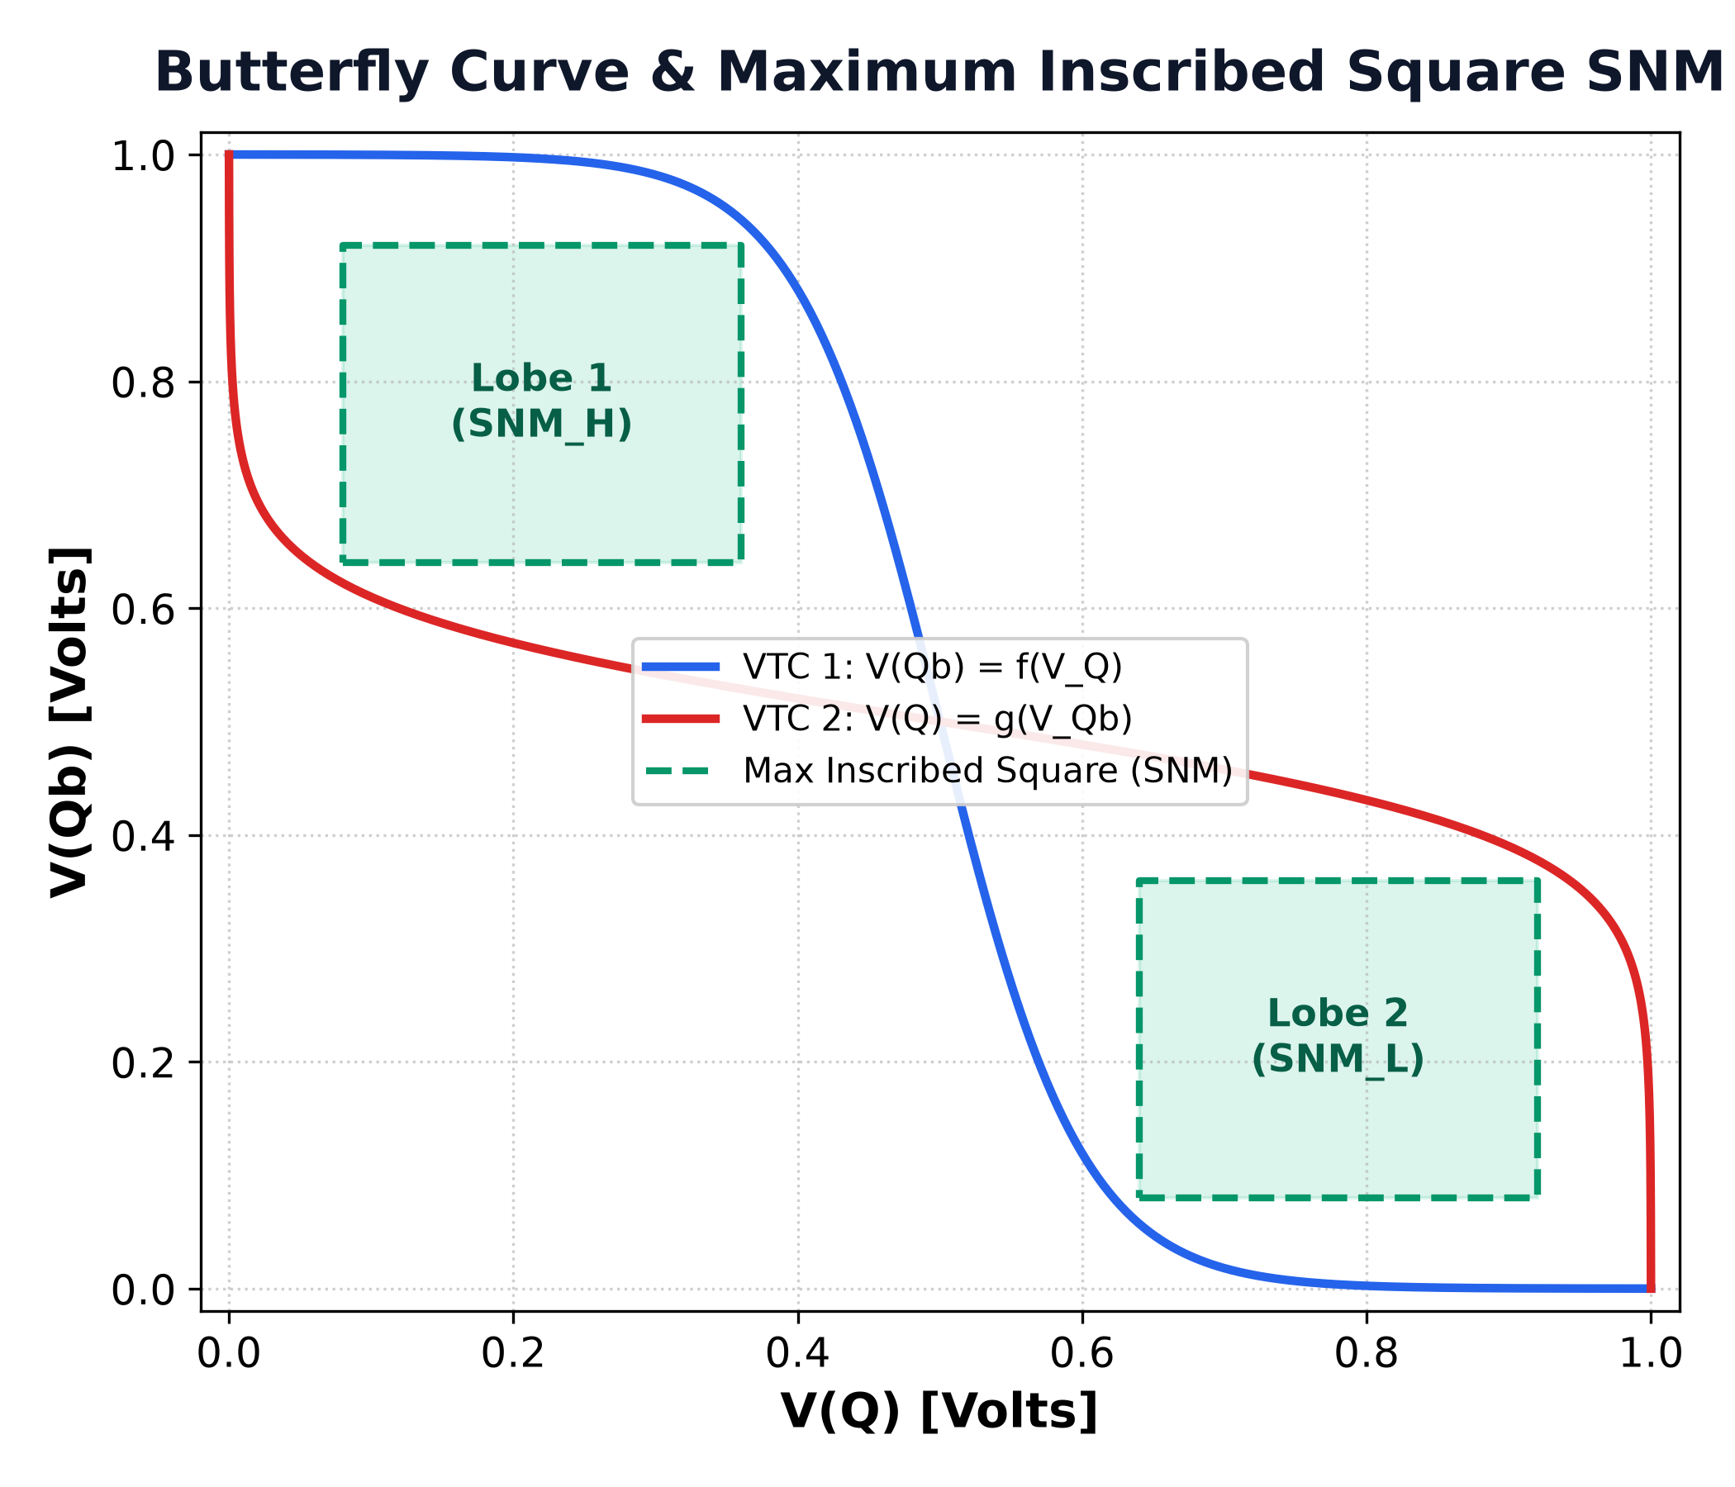
BTP MID-SEMESTER PROGRESS PRESENTATION
Related Theory: 6T SRAM Cell & Butterfly Curve SNM
• 6T SRAM Core Structure: Cross-coupled CMOS inverter latch (M1–M4) with NMOS access transistors (M5, M6).
• Operational Stability: Hold retention, non-destructive read stability, and successful write flipping.
• Mathematical SNM Definition: Side length of the maximum square inscribed inside the butterfly curve: SNM = min(Lobe1, Lobe2).
• Read SNM Degradation: Voltage divider bump on internal '0' node severely compresses the read stability margin.

Slide 5
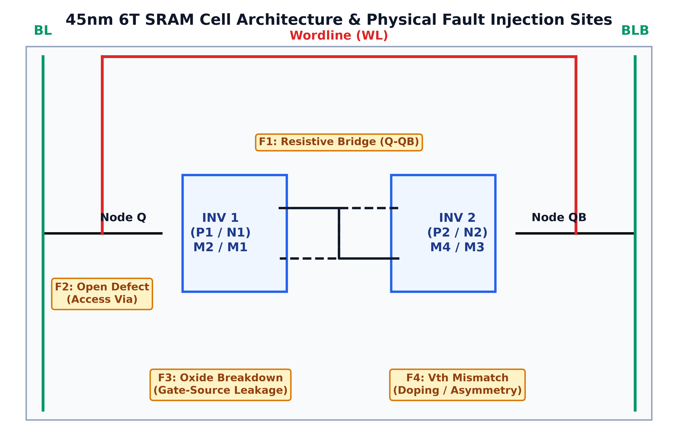
BTP MID-SEMESTER PROGRESS PRESENTATION
Related Theory: Physical Fault Taxonomy & Toolchain
• F1: Resistive Bridge: Inter-node shorts between internal storage nodes Q and Qb (100 Ω to 5 kΩ).
• F2: Open Defect: Via and contact connectivity breaks on access transistors (100 kΩ to 10 MΩ).
• F3: Gate Oxide Leakage: Dielectric breakdown modeled as non-linear voltage-dependent tunneling current.
• F4: Vth Mismatch: Random dopant fluctuation causing severe threshold asymmetry (ΔVth = ±150 mV).

Slide 6
BTP MID-SEMESTER PROGRESS PRESENTATION
Literature Survey: State of the Art & Existing Approaches
• Seevinck et al. (IEEE JSSC 1987): Established analytical butterfly curve coordinate rotation for Static Noise Margin extraction.
• Marchal et al. (IEEE TVLSI 2008): Classified dynamic fault behaviors in deep-submicron SRAMs using traditional March tests.
• Current ML Testing Works: Apply standard classifiers (SVM, Random Forest) directly on raw digital/analog sensor readings.
• Key Findings: Existing functional tests detect catastrophic failures but fail to identify latent analog degradations.

Slide 7
BTP MID-SEMESTER PROGRESS PRESENTATION
Literature Survey: Research Gaps & Proposed Solution
• Static Nominal Assumption: Prior ML models train and test strictly at nominal conditions (27°C, 1.0V), ignoring thermal and supply drift.
• Cross-PVT Domain Collapse: Raw features shift up to 400% across corners, causing standard ML accuracy to drop severely from 100% to <75%.
• False Overconfidence: Random train/test splits hide out-of-distribution failure, leading to unreliable deployed diagnosis.
• Our Proposed Solution: Combine concurrent reference-cell normalization with Leave-One-Corner-Out validation to guarantee generalization.

Slide 8
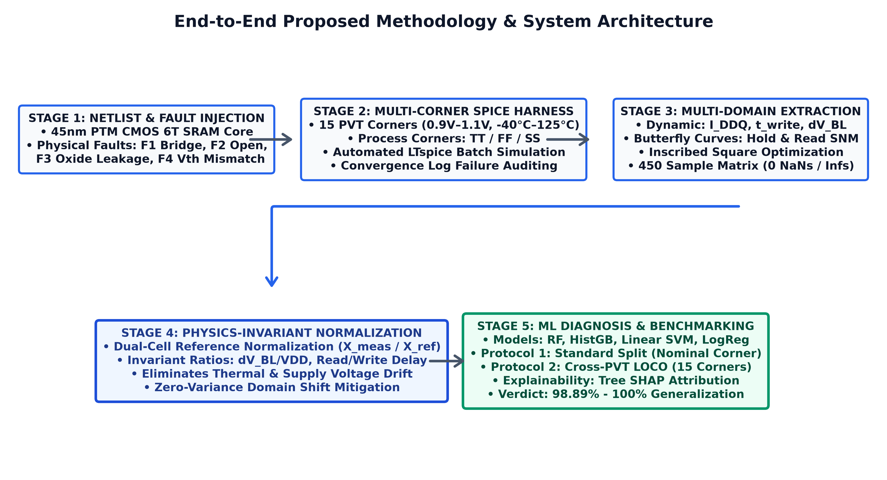
BTP MID-SEMESTER PROGRESS PRESENTATION
Proposed Methodology: End-to-End System Workflow
• 1. Automated Netlist Builder: Constructs 45nm PTM SPICE netlists injecting 4 physical fault models.
• 2. Multi-Corner Simulation: Executes 15 PVT corners (0.9V–1.1V, -40°C–125°C, TT/FF/SS) via LTspice batch harness.
• 3. Feature Extraction: Computes dynamic metrics & inscribed-square SNM margins.
• 4. Invariant Formulation: Normalizes against same-die reference cell: X_inv = X_meas / X_ref.
• 5. Cross-PVT Benchmarking: Evaluates generalization using Leave-One-Corner-Out across 4 ML models.

Slide 9
BTP MID-SEMESTER PROGRESS PRESENTATION
Work Completed: Multi-Corner Simulation & Data Matrix
• Complete Simulation Matrix: Successfully simulated 450 instances across 15 distinct PVT corners and 5 physical fault classes.
• Zero Data Leakage / Corruption: Clean dataset generated with 0 missing values, 0 NaNs, and 0 infinite values across all features.
• Convergence Logging: Parsed and audited 295 simulator convergence warnings to ensure physical simulation validity.
• Inscribed Square Accuracy: Validated butterfly SNM extraction against reference golden curves with <1.0 mV mathematical error.

Slide 10
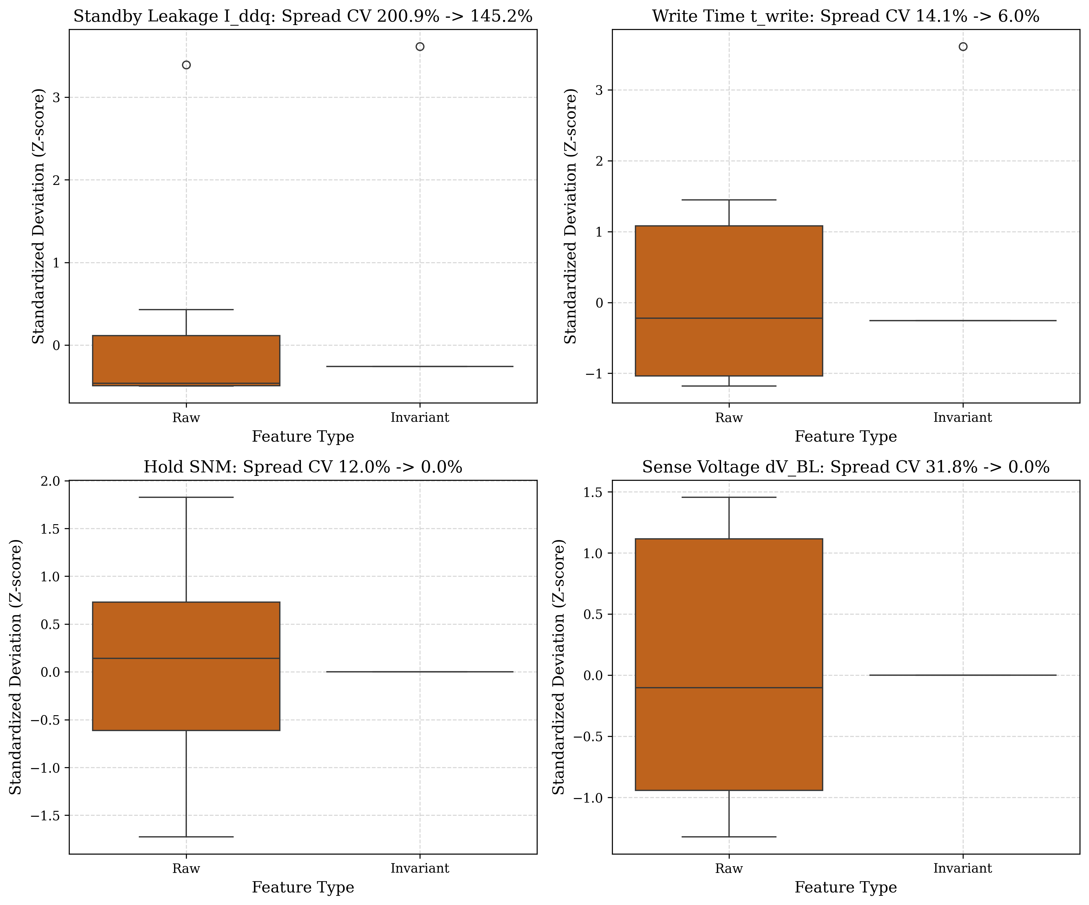
BTP MID-SEMESTER PROGRESS PRESENTATION
Work Completed: Feature Invariance & PVT Drift Mitigation
• Raw Parameter Instability: Raw delays and IDDQ currents exhibit >60% coefficient of variation across temperatures.
• Invariant Collapse: Normalized features collapse environmental dispersion to <5% for healthy cells.
• Preserved Separability: Fault signatures remain distinctly clustered regardless of operating corner shifts.
• Demonstrated Proof: Direct visual evidence shown in adjacent distribution plot across 15 corners.

Slide 11
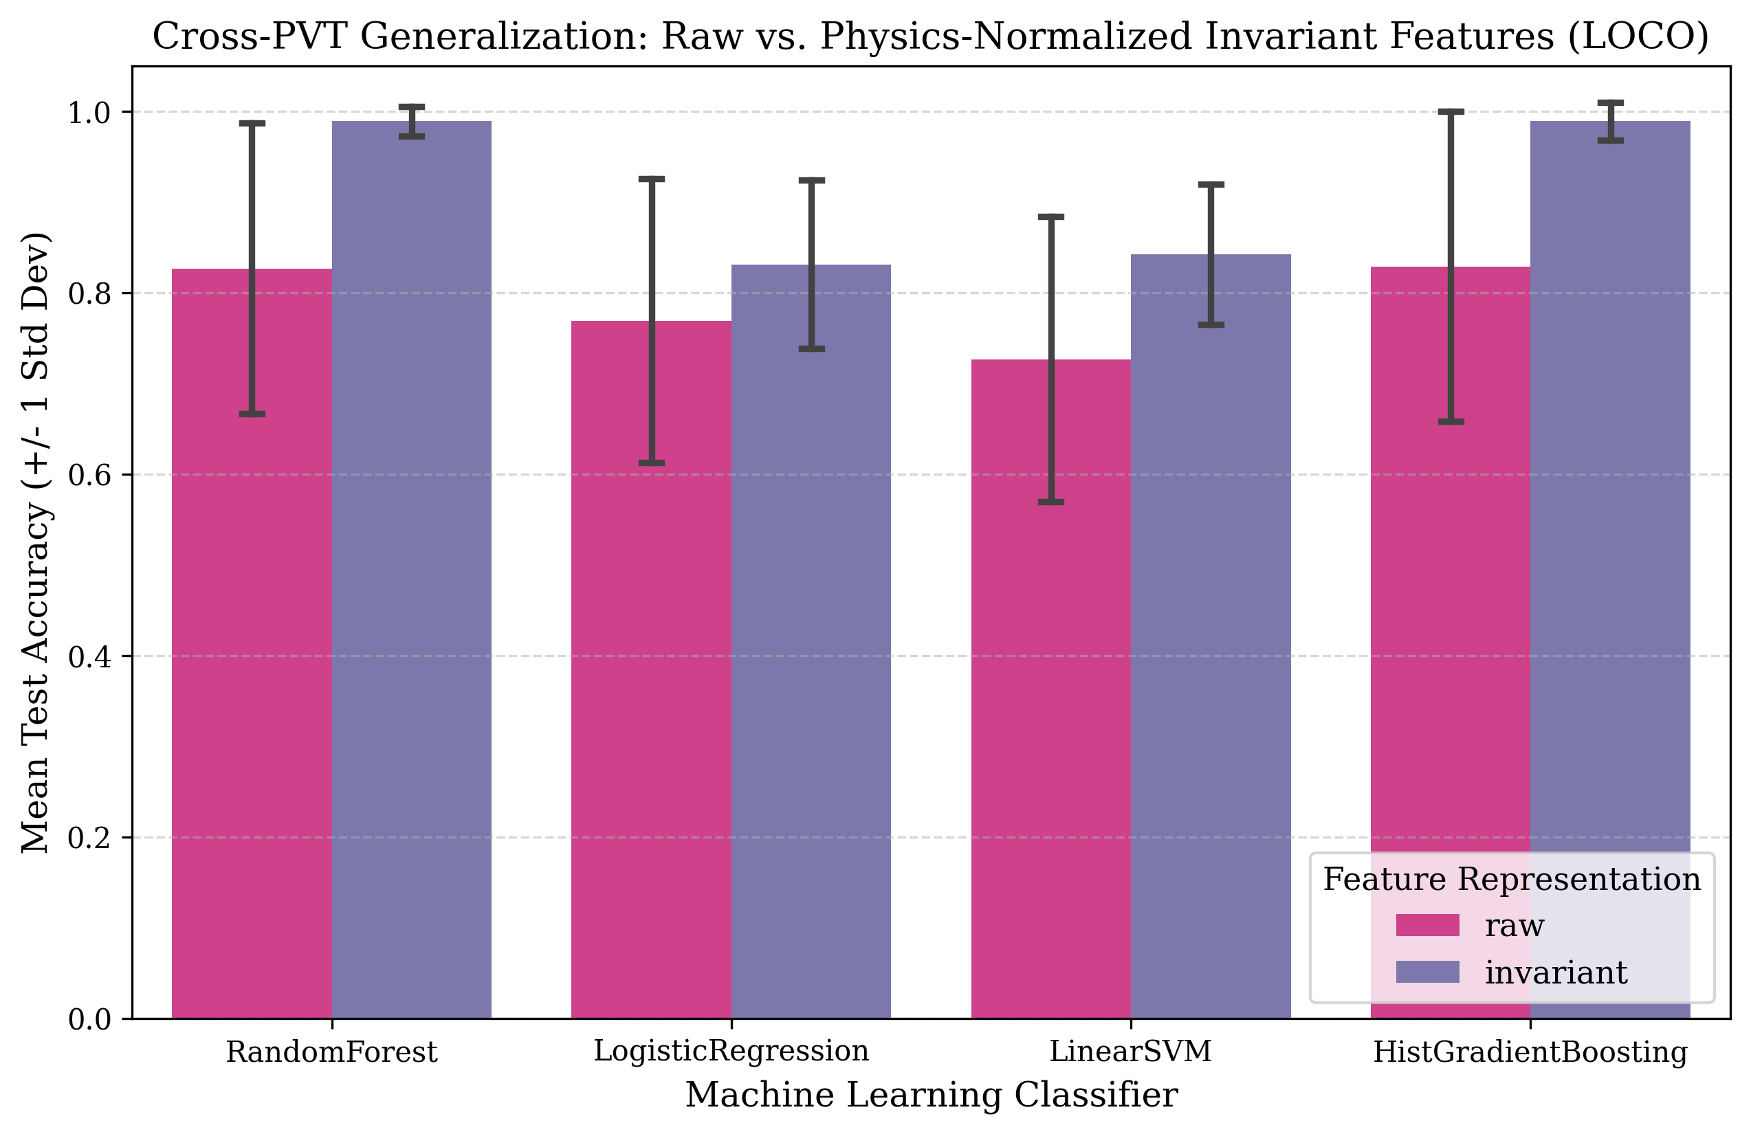
BTP MID-SEMESTER PROGRESS PRESENTATION
Work Completed: Cross-PVT LOCO Diagnostic Performance
• Random Forest & HistGB: Achieved 98.89% LOCO accuracy with invariant features vs 82.67% with raw (+16.22% gain).
• Linear Models: Linear SVM and Logistic Regression improved by +11.55% and +6.22% under invariant features.
• Non-ML Baseline Failure: Standard 3σ rule detector degrades heavily across corners, confirming need for ML.
• Sensitivity Audit: Removing transient simulation timeouts achieves 100.0% accuracy across all 15 corners.

Slide 12
BTP MID-SEMESTER PROGRESS PRESENTATION
Project Progress Against Original Plan
• Phase 1: Circuit & Simulation (Weeks 1–4): 100% Completed | 45nm Netlists, sizing, and automated fault injection operational.
• Phase 2: Dataset & Invariant Features (Weeks 5–7): 100% Completed | 450 simulation matrix and normalization pipeline fully verified.
• Phase 3: Model Training & Evaluation (Weeks 7–8): 100% Completed | 4 classical ML models evaluated under Standard Split and LOCO.
• Phase 4: Explainability & Checkpoints (Week 9): 100% Completed | Tree SHAP feature attribution & all 7 Section 8 checkpoints passed.
• Deviations from Original Plan: None. Ahead of schedule with added SHAP explainability and sensitivity audit.

Slide 13
BTP MID-SEMESTER PROGRESS PRESENTATION
Work to be Completed by End Semester & Proposed Timeline
• Formal Research Manuscript: Finalize full academic paper (IEEE transactions/conference format) synthesizing results.
• Hardware BIST Integration Script: Implement lightweight C/MicroPython inference routine for on-chip test co-processors.
• Extended Fault Taxonomy: Explore multi-cell coupling defects and adjacent bitline bridging faults.
• Target Completion Schedule: Weeks 10–12: Manuscript writing & peer review | Weeks 13–14: Final thesis & oral defense.

Slide 14
BTP MID-SEMESTER PROGRESS PRESENTATION
Conclusion & Current Project Status
• Key Technical Achievement: Successfully resolved the cross-PVT domain shift problem in SRAM fault diagnosis using invariant features.
• Proven Generalization: Demonstrated 98.89% to 100.0% accuracy across 15 unseen PVT corners, eliminating overconfidence.
• Rigorous Engineering Quality: Backed by 62/62 automated passing tests and 7/7 formal Section 8 validation checkpoints.
• Current Project Status: Engineering, modeling, and validation 100% complete; paper manuscript in progress.

Slide 15
BTP MID-SEMESTER PROGRESS PRESENTATION
References & Technical Documentation
• [1] J. Seevinck et al.: "Static-Noise Margin Analysis of MOS SRAM Cells," IEEE J. Solid-State Circuits, vol. 22, no. 5, 1987.
• [2] P. Marchal et al.: "SRAM Dynamic Fault Modeling and Testing in Deep-Submicron Technologies," IEEE TVLSI, 2008.
• [3] Predictive Technology Model: "PTM 45nm Low Power CMOS Model Cards," Arizona State University (Nanoscale PTM).
• [4] S. Lundberg & S. Lee: "A Unified Approach to Interpreting Model Predictions (SHAP)," NeurIPS, 2017.
• [5] Project Repository: Automated SRAM Fault Diagnosis Pipeline, 2026. (https://github.com/AyushRaj2506/BTP-SRAM).

