Slide 1
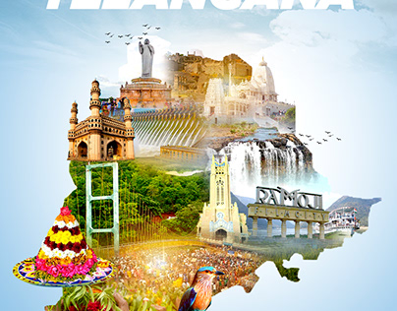

Telangana Tourism: Insights & Recommendations

Slide 2

Problem Statment
Telangana is one of India’s leading states and has published its tourism data under its open data policy.
As a data analyst, my task to analyze the given data from 2016-2019, do additional research and provide data information and recommendation to the telengana government which can be used to increase their revenue by improving operations.

Slide 3
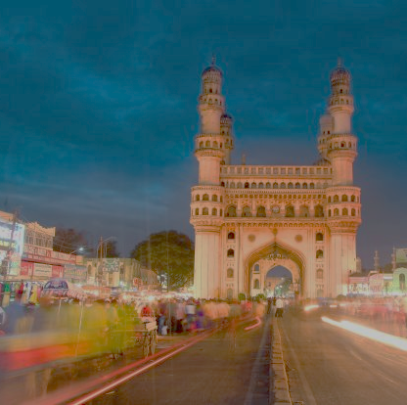
About Telangana
Telangana is a state located in southern India. It was officially formed as the 29th state of India on June 2, 2014, following the division of the larger state of Andhra Pradesh.
The state covers an area of approximately 112,077 square kilometers and has a population of over 39 million people (as of 2021). Telugu is the official language of the state.

Slide 4
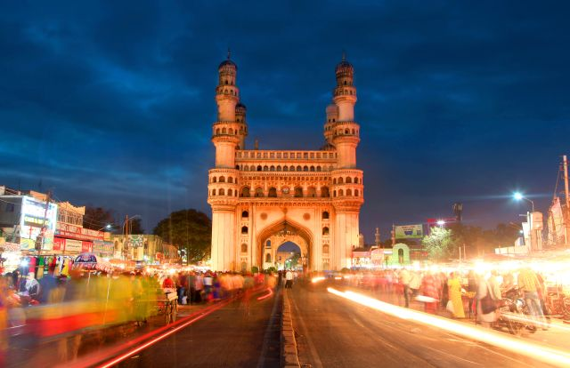
Historical Attractions: Telangana is home to several historical sites that attract tourists. The iconic Charminar and Golconda Fort in Hyderabad are must-visit landmarks known for their architectural brilliance
Lakes and Water Bodies: The state boasts picturesque lakes and water bodies that provide scenic beauty and recreational opportunities.
Wildlife and Nature: Telangana offers diverse wildlife and natural landscapes. The Kawal Wildlife Sanctuary and Eturnagaram Wildlife Sanctuary are known for their rich biodiversity, including tigers, leopards, and various bird species.
Heritage and Culture: The state celebrates its rich heritage and culture through festivals, arts, and crafts.
Spiritual Tourism: Telangana is home to numerous temples and religious sites. The Bhadrakali Temple in Warangal, Yadagirigutta Temple dedicated to Lord Narasimha, and the iconic Kaleshwara Mukteswara Swamy Temple in Karimnagar are popular pilgrimage
The state offers a unique blend of historical sites, natural beauty, vibrant culture, and warm hospitality. Here are some key points about Telangana's tourism:

Slide 5

Overview

Slide 6
1. List down the Top 10 Districts that have the highest number of domestic visitors overall (2016-2019)

Slide 7
Insights and Recommendation
Hyderabad, the capital of Telangana, attracts the highest number of domestic visitors in the state due to its rich historical and cultural heritage showcased by iconic landmarks like the Charminar and Golconda Fort. As an economic and technological hub, it draws business travelers. The city's delectable cuisine, including the famous Hyderabadi biryani, is a major draw for food enthusiasts. Hyderabad's shopping options, entertainment venues, excellent connectivity, and well-developed infrastructure further contribute to its appeal. The presence of esteemed educational institutions and renowned hospitals also drives domestic visitors, making Hyderabad a multifaceted destination for a range of interests.
Rajanna Sircilla, a district in Telangana, has gained popularity as a destination for domestic tourists, ranking second in terms of visitor numbers. The district showcases unique cultural traditions, handicrafts, and handloom products that attract tourists. Rajanna Sircilla is also known for its historic sites, including ancient temples and architectural marvels. Additionally, the district's natural beauty, serene lakes, and scenic landscapes contribute to its appeal. The local government's efforts to promote tourism and enhance infrastructure have further boosted its recognition among domestic travelers.
Hanamkonda, a city in Telangana, has secured the third position in terms of domestic tourist visits due to several factors. The city holds historical significance, with attractions like the Thousand Pillar Temple, Warangal Fort, and Bhadrakali Temple drawing tourists interested in exploring ancient architecture and cultural heritage.
Districts with good accessibility, well-developed infrastructure, vibrant cultural events, and government support tend to attract higher domestic tourist footfall. Easy transportation, amenities, cultural festivities, and promotional efforts play a crucial role in making these districts popular among domestic tourists.

Slide 8
Top 3 District based on CAGR 2016-2019

Slide 9
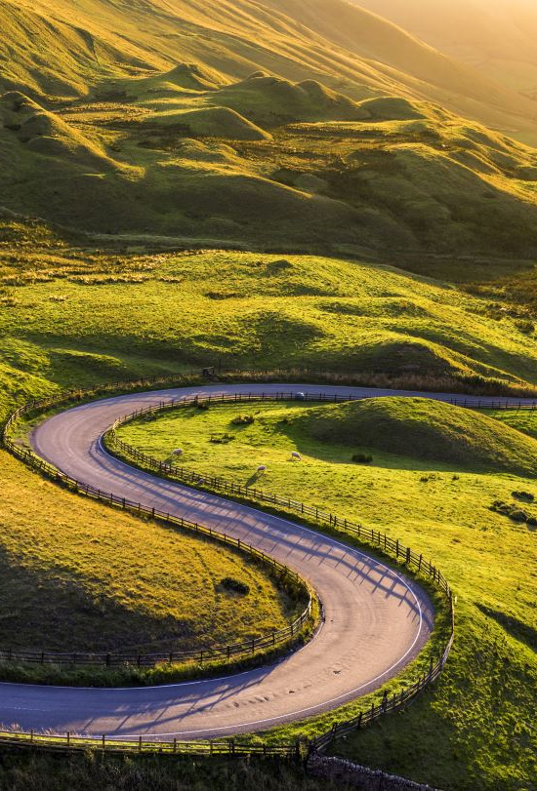
Insights and Recommendation
Mancherial district in Telangana has experienced the highest Compound Annual Growth Rate (CAGR) in tourist visits due to its emergence as a new and offbeat destination with untapped tourism potential. The district's natural beauty, including scenic landscapes, forests, and lakes, along with adventure and eco-tourism activities, have attracted nature enthusiasts and adventure seekers. The presence of historical and cultural sites, such as the Jainath Temple, adds to its appeal. Promotion efforts, infrastructure development, and its proximity to other popular tourist destinations have further contributed to the district's growth. All these factors combined have made Mancherial a favored choice for tourists seeking diverse experiences.
Warangal district in Telangana has witnessed the second highest Compound Annual Growth Rate in tourist visits due to its rich historical and cultural significance. The district's historical attractions, including the magnificent Warangal Fort, intricately carved temples, and relics from the Kakatiya Dynasty, attract history enthusiasts and heritage lovers. The district's natural beauty, with serene lakes, lush landscapes, and wildlife sanctuaries, appeals to nature enthusiasts and wildlife lovers. Warangal's reputation as an educational hub, excellent connectivity, well-developed infrastructure, and government initiatives to promote tourism have all contributed to its growth. Together, these factors have made Warangal a popular destination and contributed to its significant CAGR in tourist visits.
Bhadradri Kothagudem district in Telangana has witnessed the third highest Compound Annual Growth Rate (CAGR) in tourist visits. The district's popularity can be attributed to its significant pilgrimage centers, including the renowned Bhadrachalam Temple. The district's scenic beauty, with the Godavari River and mesmerizing waterfalls, attracts nature enthusiasts. The presence of the Kinnerasani Wildlife Sanctuary offers opportunities for eco-tourism. Cultural celebrations and good accessibility, along with adequate infrastructure, further contribute to the district's growth in tourism. These factors combined have led to Bhadradri Kothagudem district's impressive CAGR in tourist visits.

Slide 10
Bottom 3 District based on CAGR between 2016-2019

Slide 11
Karimnagar district in Telangana has experienced a negative Compound Annual Growth Rate (CAGR) of -70% in tourist visits due to factors such as a lack of prominent tourist attractions, limited tourism infrastructure, inadequate marketing and promotion, accessibility challenges, and a lack of focused tourism development initiatives. These factors combined may have hindered the district's ability to attract and retain tourists, resulting in the negative CAGR. A detailed analysis of the district's specific circumstances would be necessary to gain deeper insights into its tourism decline.
The decline in tourist visits in Nalgonda district could be due to factors such as limited attractions, insufficient tourism infrastructure, inadequate marketing and promotion, negative perception or image, accessibility challenges, and socio-economic factors. A detailed analysis is necessary to identify the specific causes accurately. Strategies such as enhancing attractions, improving infrastructure, implementing effective marketing campaigns, and addressing accessibility issues can help revive tourism in Nalgonda district.
The decline in domestic tourist visits to Warangal, Telangana, can be attributed to factors such as limited awareness and promotion, perception and image issues, inadequate tourist infrastructure, competition from other destinations, lack of engaging experiences, and economic factors. Addressing this decline requires collaborative efforts in improving promotion, enhancing infrastructure, diversifying experiences, and providing value-added services to attract and retain domestic tourists.
What Government can do to Improve the CAGR of tourist spots?
To improve the CAGR of these districts, the government can take several measures. These include enhancing existing tourist attractions, developing new attractions, improving tourism infrastructure, implementing effective marketing and promotional campaigns, addressing accessibility issues, fostering partnerships with the private sector, and providing incentives for tourism development. Additionally, investing in skill development, training programs, and capacity building for local communities can help create a welcoming and sustainable tourism environment.
Insights and Recommendation

Slide 12
Peak and low season months for Hyderbad based on data from 2016-2019

Slide 13
During the month of June, tourism in Hyderabad experiences a significant increase due to several factors. The pleasant weather, with the onset of the monsoon season, provides relief from the summer heat, making it an appealing time for tourists. The city's cultural and festive celebrations, such as the Bonalu festival, attract visitors interested in immersing themselves in local traditions. The coinciding school and college holidays allow families and students to plan trips, with Hyderabad offering a blend of historical landmarks and modern attractions. Additionally, the festive shopping opportunities and renowned Hyderabadi cuisine contribute to the city's appeal. These factors collectively drive the rise in tourism during June.
What Government can do for consistent tourist visit to Hyderabad ?
To encourage consistent tourist visits to Hyderabad throughout the year, the government should focus on developing year-round events and festivals, promoting business and MICE tourism, enhancing infrastructure and connectivity, marketing the city as a weekend getaway, collaborating with the travel industry, emphasizing Hyderabad's heritage and culture, and implementing sustainable tourism practices. By taking these steps, the government can create a diverse and attractive tourism environment that appeals to visitors from different segments and ensures a steady flow of tourists, irrespective of seasonal fluctuations.
To attract foreign tourists to Hyderabad and other districts in Telangana, the government can focus on enhancing international connectivity, developing specialized tourism products, promoting cultural heritage, investing in tourism infrastructure, creating attractive tourism packages and marketing campaigns, streamlining visa and travel processes, training tourism professionals, and emphasizing sustainable tourism practices. These initiatives will help create a convenient and appealing environment for foreign travelers, showcasing the unique cultural and natural attractions of Telangana. Collaborations with international partners and the provision of high-quality services will further enhance the state's reputation as a desirable destination, ultimately boosting international tourism.
Insights and Recommendation

Slide 14
Show the top and bottom 3 district with high domestic to foreign tourist ratio.

Slide 15
Insights and Recommendation
Lower Domestic to Foreign ration is an indication of increased tourism revenue as Foreign visitor tend to spend more money on their travels.
Warangal, Hyderabad, and Mulugu districts exhibit a balanced exposure of tourist spots to both domestic and foreign visitors, as reflected by their low domestic-to-foreign tourist ratio.
Adilabad , jangaon and Nirmal district exhibit a imbalanced exposure of tourist spots to both domestic and foreign visitors, as reflected by their high domestic to foreign trourist ratio.
To attract foreign tourists the following strategies can be implemented.
Implement targeted international marketing campaigns through travel websites, social media, and travel fairs. Collaborate with international travel trade to develop attractive tour packages. Improve tourism infrastructure and services to meet international standards. Organize cultural exchanges, festivals, and events. Provide language and cultural training to tourism professionals. Simplify visa and travel processes, and collaborate with foreign governments and embassies. Conduct research and gather market intelligence to tailor marketing strategies. By implementing these measures, these districts can effectively attract and cater to foreign tourists.

Slide 16
Develop and Promote Unique Tourist Experiences: Identify and promote the unique attractions and experiences in each district. This can include natural wonders, historical sites, cultural festivals, adventure activities, and local cuisine
Enhance Tourism Infrastructure: Improve tourism infrastructure by developing accommodations, transportation networks, and visitor facilities. Ensure a range of options to suit different budgets and preferences, including hotels, guesthouses, homestays
Marketing and Promotion: Implement targeted marketing campaigns to create awareness about the districts and their attractions. Utilize digital platforms, social media, travel websites, and collaboration with travel agencies to reach a wider audience
Engage Local Communities and Stakeholders: Involve local communities and stakeholders in tourism development initiatives.
. Collaborate with Travel Trade and Associations: Collaborate with travel trade associations, tour operators, and travel agents to promote these districts as part of broader travel itineraries.
Conduct Familiarization Tours and Press Trips: Organize familiarization tours and press trips for travel journalists, bloggers, and influencers to showcase the districts' attractions. This exposure can generate positive media coverage and word-of-mouth recommendations, attracting both domestic and foreign tourists.
To attract domestic and foreign tourists to districts like Bhadradri Kothagudem, Jagtial, Jayashankar Bhoopalpally, and Kamareddy where there is no tourist visit inspite there are numbers tourist site, the government can undertake the following measures:

