Slide 1




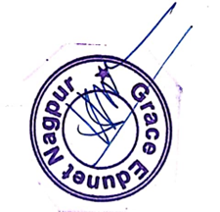

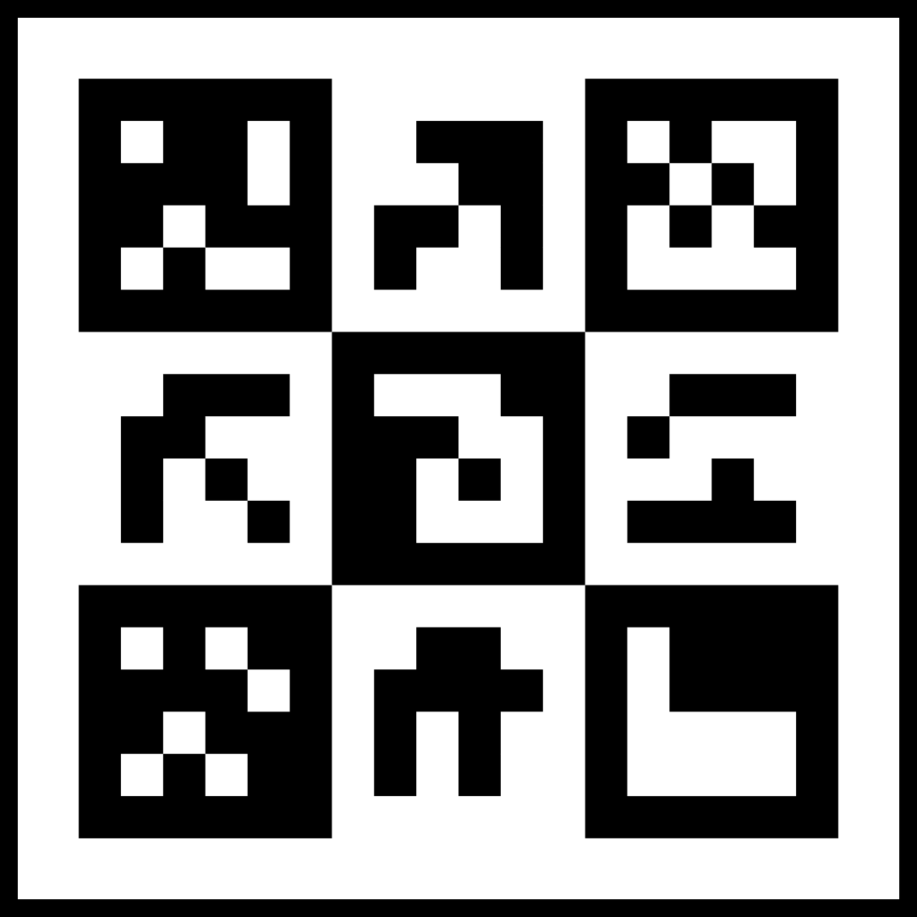
CERTIFICATE
Date: 19-08-2024
OF
COMPLETION
This is to certify that Mr. Ayush Raje S/O Mr. Nitin Raje has successfully completed the course of Motor & Circuit Development (CS183) under Skill Development Training Program scheme at Mahatma Jyotiba Phule Research And Training Institute,(MAHAJYOTI), Nagpur
Authorized Signatory
Managing Director, Grace Edunet
Mr. Mohan Vaidya
*Verify this certificate at: https://vercel.graceedunet.app/verify/uid/223562 or Scan the above QR code

