Slide 1


FashionCart
Prepared by:
Name: PATEL YATRIK N.
Enroll no: 24002171210125
Div : B2
Name: THANTH SANJAY H.
Enroll no: 24002171210193
Div : B2
Name: RANA AYUSH J.
Enroll no: 24002171210151
Div : B2

Slide 2

Project overview
FashionCart is an e-commerce platform designed to sell fashion products online for:
👔 Men
👗 Women
🧒 Children
👟 Footwear

Slide 3
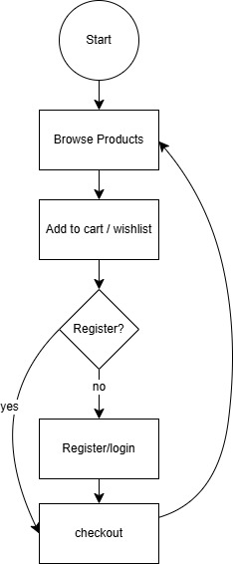
Working Flow
1. User Access
2. Browse Products
3. Add to Cart
4. Checkout Process

Slide 4

Technologies Used
Frontend
- HTML, CSS, JAVASCRIPT, BOOTSTRAP
Database
- Local Storage

Slide 5

Future Scope
- AI-based product recommendations
- Virtual Try-On feature
- Mobile Application (Android & iOS)
- Multi-language & multi-currency support
- Loyalty programs & discount coupons
- Integration with social media shopping

Slide 6
Thank You

