Slide 1





Learn2Trade
COMPLETE LEARNING & PRACTICE ECOSYSTEM
Prepared By:
Name: THANTH SANJAY H.
Enroll No: 24002171210193
Name: PATEL YATRIK N.
Enroll No: 24002171210125
Name: RANA AYUSH J.
Enroll No: 24002171210151

Slide 2


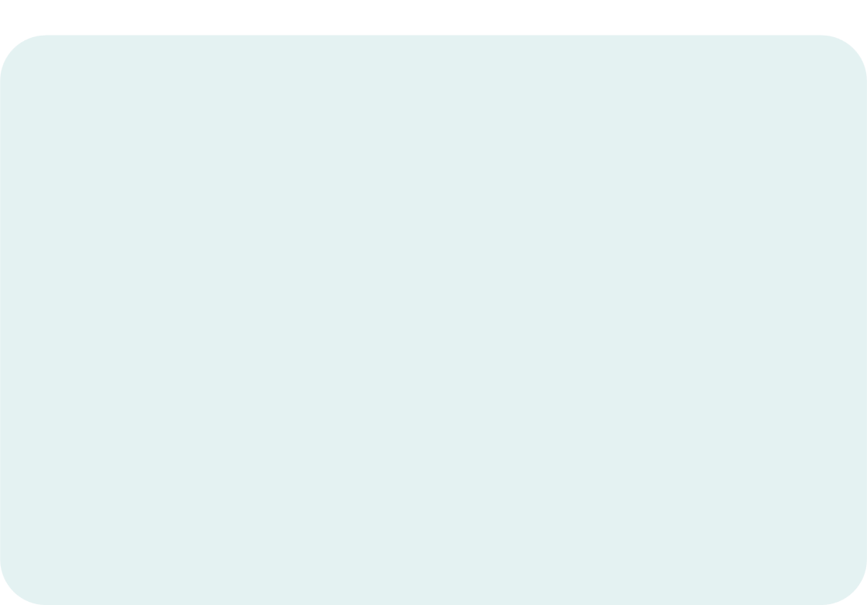
Project Overview
A comprehensive web-based platform that enables users to:
Learn
Practice
Trade
VIRTUAL TRADING WITH RANDOM DAY’S RANDOM STOCK
PAPER TRADING WITH REAL-TIME MARKET DATA
STOCK MARKET CONCEPTS

Slide 3





Technologies Used
PYTHON
STREAMLIT
MATPLOTLIB, PLOTLY
YAHOO FINANCE
POSTGRESQL

Slide 4
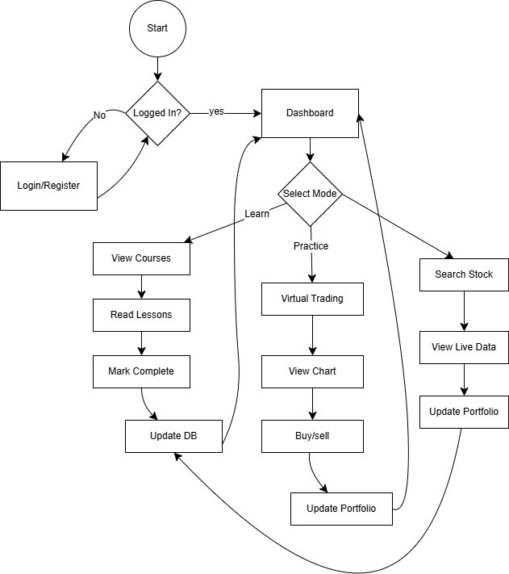
Flowchart

Slide 5




Future Scope
AI-POWERED RECOMMENDATIONS
LIVE TRADING INTEGRATION WITH REAL BROKERS
COMMUNITY FEATURES (LEADERBOARDS)

Slide 6
Thank You

