Slide 1

Project on Indian election 2014 & 2019
Insights from Lok Sabha Elections 2014 & 2019
Presented by:
Ayush Ranjan Soni

Slide 2
Introduction
For the Lok Sabha election analysis encompassing both the 2014 and 2019 elections, I leveraged three primary datasets: the election data for both years and a supplementary dataset containing state abbreviations. The overarching goal was to derive actionable insights in line with the project's objectives.
Excel served as the initial platform for data preprocessing and standardization, facilitating the cleaning and formatting of raw data records. Subsequently, SQL was employed to execute targeted queries, extracting specific insights crucial to the project's requirements.
In the visualization phase, Microsoft Power BI emerged as the preferred Business Intelligence tool, enabling the creation of dynamic dashboards. These dashboards efficiently encapsulated all pertinent information within a single interface, offering stakeholders a comprehensive overview of key metrics and trends.
To encapsulate the project journey and outcomes comprehensively, Microsoft PowerPoint was utilized to craft a cohesive presentation. This presentation outlined the project's scope, methodologies employed, key findings, and actionable recommendations. Through this structured approach, stakeholders were empowered to make informed decisions based on the insights gleaned from the electoral data analysis.

Slide 3
List top 5/ bottom 5 constituencies of 2014 and 2019 in terms of voter turnout ratio?
Top 5 Constituencies in 2014
Bottom 5 Constituencies in 2014
Tura | 26.80586667
Nagaland | 20.68527500
Nabarangpur | 19.08137500
Ladakh | 17.50580000
Daman & diu | 17.65687500
Nizamabad | 0.36911027
Anantnag | 0.49267778
Belgaum | 1.18513333
Srinagar | 1.19247500
Nalanda | 1.38190000
Top 5 Constituencies in 2019
Bottom 5 Constituencies in 2019
Tura | 37.41565000
Nagaland | 29.19803333
ARUNACHAL EAST | 27.37263333
MIZORAM | 20.25653333
Daman & diu | 19.20757500
Varanasi | 1.38643333
Chennai South | 1.39371667
Amethi | 1.53738529
Chennai North | 1.56891500
Malkajgiri | 1.68782667

Slide 4
List top 5/ bottom 5 states of 2014 and 2019 in terms of voter turnout ratio?
Top 5 States in 2014
Bottom 5 States in 2014
Nagaland | 29.19803333
Mizoram | 20.25653333
Daman & Diu | 19.20757500
Lakshadweep | 14.39446667
Arunachal Pradesh | 14.26041818
Puducherry | 2.65432667
NCT OF Delhi | 3.02812200
Haryana | 3.09745565
Maharashtra | 3.20756499
Tamil Nadu | 3.36172577
Top 5 States in 2019
Bottom 5 States in 2019
Nagaland | 20.68527500
Daman & Diu | 17.65687500
Meghalaya | 16.16860000
Lakshadweep | 14.16616667
Arunachal Pradesh | 13.47262500
Chandigarh | 1.94239444
Telangana | 2.44592709
NCT OF Delhi | 2.56951646
Punjab | 3.04544245
Haryana | 3.14892466

Slide 5
Which constituencies have elected the same party for two consecutive elections, rank them by % of votes to that winning party in 2019.
Constituencies | Party | Rank
Lakshadweep | NCP | 1
Daman & diu | BJP | 2
Ladakh | BJP | 3
ARUNACHAL WEST | BJP | 4
CHANDIGARH | BJP | 5
North Goa | BJP | 6
Tura | NPEP | 7
Kishanganj | INC | 8
Lohardaga | BJP | 9
Pathanamthitta | INC | 10

Slide 6
Which constituencies have voted for different parties in two elections (list top 10 based on difference (2019-2014) in winner vote percentage in two elections).
Constituencies | Winning Percentage difference(2019-2014)
Wayanad | 21.77
Alipurduars | 20.91
Kodarma | 19.22
Mandi | 18.96
Autonomous District | 17.56
Puducherry | 17.33
Bhiwani-Mahendragarh | 17.08
Hazaribagh | 16.92
Kanniyakumari | 16.37
KHAJURAHO | 16.14

Slide 7
Top 5 candidates based on margin difference with runners in 2014 and 2019.
Constituencies | 2019 Candidates Name | 2014 Candidates Name | Margin
Alipurduars | JOHN BARLA | DASRATH TIRKEY | 388351
Kodarma | ANNPURNA DEVI | RAVINDRA KR. RAY | 387606
Barmer | KAILASH CHOUDHARY | COL. SONA RAM | 357779
Kaliabor | Gaurav Gogoi | GOURAV GOGOI | 342777
KHAJURAHO | V.D. SHARMA (VISHNU DATT SHARMA) | NAGENDRA SINGH | 336169

Slide 8
% Split of votes of parties between 2014 vs 2019 at national level
National Party | Percentage Votes in 2019 | Percentage Votes in 2014 | Difference
BJP | 30.65641766 | 25.84745682 | 4.80896084
AITC | 24.08228710 | 11.55044715 | 12.53183995
INC | 17.33964727 | 15.21153449 | 2.12811278
NCP | 14.16660000 | 15.46111667 | -1.29451667
CPI | 5.06617959 | 5.02093934 | 0.04524025
BSP | 3.23648146 | 2.82250510 | 0.41397636

Slide 9
% Split of votes of parties between 2014 vs 2019 at state level.
State Party | Percentage Votes in 2019 | Percentage Votes in 2014 | Difference
AJSUP | 39.30350000 | 3.51535556 | 35.78814444
AGP | 28.22433333 | 3.37189167 | 24.85244166
RLD | 28.45953333 | 4.30643000 | 24.15310333
DMK | 39.41172917 | 19.68598571 | 19.72574346
AIUDF | 28.62076667 | 9.08466111 | 19.53610556
JD(S) | 24.48740000 | 6.87108235 | 17.61631765
JD(U) | 20.22334800 | 4.13371978 | 16.08962822
JVM | 21.40180000 | 6.57756875 | 14.82423125
YSRCP | 39.47518800 | 24.91597895 | 14.55920905
AIMIM | 21.61030000 | 7.39192000 | 14.21838000
BOPF | 25.15110000 | 10.94420000 | 14.20690000
SP | 17.45022245 | 5.75793704 | 11.69228541

Slide 10
List top 5 constituencies for two major national parties where they have gained vote share in 2019 as compared to 2014.
Constituencies | Party | Total Votes in 2019 | Total Votes in 2014 | Gained Percentage
Hisar | BJP | 603289 | 128 | 471219.5313
Hisar | BJP | 603289 | 134 | 450115.6716
Hisar | BJP | 603289 | 176 | 342677.8409
EAST DELHI | BJP | 696156 | 210 | 331402.8571
NEW DELHI | BJP | 504206 | 158 | 319017.7215
Puducherry | INC | 444981 | 198 | 224637.8788
Tiruchirappalli | INC | 621285 | 355 | 174909.8592
Bangalore South | INC | 408037 | 246 | 165768.6992
Sonipat | INC | 422800 | 259 | 163143.2432
Thiruvananthapuram | INC | 416131 | 261 | 159337.1648

Slide 11
List top 5 constituencies for two major national parties where they have lost vote share in 2019 as compared to 2014.
Constituencies | Party | Total Votes in 2019 | Total Votes in 2014 | Lost Percentage
Lakshadweep | BJP | 125 | 21665 | -99.4230
Kadapa | BJP | 4085 | 671983 | -99.3921
Lakshadweep | BJP | 125 | 20130 | -99.3790
Kadapa | BJP | 4085 | 481660 | -99.1519
Machilipatnam | BJP | 6481 | 587280 | -98.8964
Kadapa | INC | 8341 | 671983 | -98.7587
Amalapuram | INC | 7887 | 594547 | -98.6734
Ongole | INC | 8139 | 589861 | -98.6202
Ongole | INC | 8139 | 574302 | -98.5828
Amalapuram | INC | 7887 | 473971 | -98.3360

Slide 12
Which constituencies have elected candidates whose party has less than 10% vote share at state level in 2019?
Constituency Name | Party Name
Aruku | YSRCP
Srikakulam | TDP
Vizianagaram | YSRCP
Visakhapatnam | YSRCP
Anakapalli | YSRCP
Kakinada | YSRCP
Amalapuram | YSRCP
Rajahmundry | YSRCP
Narsapuram | YSRCP
Eluru | YSRCP
Machilipatnam | YSRCP
Vijayawada | TDP
Guntur | TDP
Narasaraopet | YSRCP

Slide 13
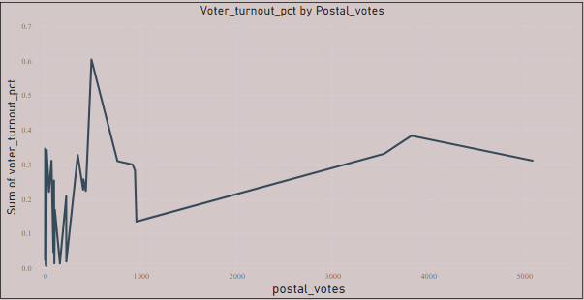
Which constituency has voted the most for NOTA?
Year | Constituency Name | Total Votes
2014 | Nilgiris | 46559
2019 | Gopalganj (SC) | 51660
Further analysis & recommendations:
Is there a correlation between postal votes % and voter turnout %?
Answer:- There is no relation between postal votes percentage and voter turnout percentage.
Correlation Value = -0.05686786

Slide 14
Is there any correlation between GDP of a state and voter turnout %?
Answer:- No, because I do not have such evidence to prove that the relationship between the GDP and voter turnout % (Total Votes Cast / Total Electors)× 100%).
Is there any correlation between literacy % of a state and voter turnout %?
Answer:-Yes, I think, There is a positive correlation between literacy rates and voter turnout. Studies have shown that states with higher literacy rates tend to have higher voter turnout. This is likely due to the fact that literate individuals are more likely to be politically engaged and aware of their rights and responsibilities as citizens. Additionally, higher literacy rates may indicate a more educated and informed population, which can lead to more informed voting decisions.

Slide 15
Provide 3 recommendations on what the election commission/government can do to increase the voter turnout %?
Voter Education: Given that India embraced voter education relatively late, continued and intensified efforts in this area are crucial. Voter education campaigns should focus on informing citizens about the importance of voting, the electoral process, and the impact of their votes on governance.
These campaigns can be conducted through various mediums, including TV, radio, social media, and community outreach programs.
Remote Voting: Implementing remote voting options to empower internal migrants who face logistical and financial barriers to voting. This is particularly beneficial in a country as vast and diverse as India.
Political consensus and investment in secure and accessible remote voting technology are necessary for this to become a reality.

Slide 16
Campaign Quality: Enhance the quality of election campaigns to make them more engaging and informative.
Political parties should present compelling agendas and candidates to motivate voters. This can include debates, town halls, and discussions on pressing issues.
Accessibility and Ease of Voting: Improve the ease of voting by addressing issues related to the physical accessibility of polling stations, reducing wait times, and making the voting process more convenient for citizens. The use of technology can also help streamline the voting process.

Slide 17
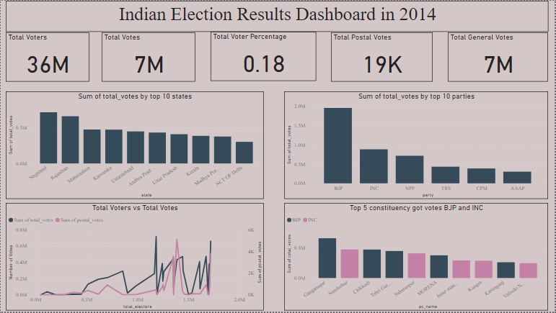

Slide 18
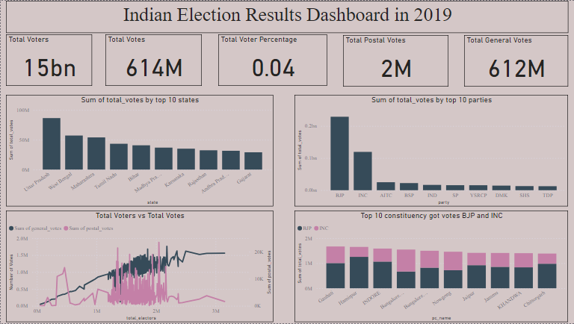

Slide 19
Expression of Gratitude
Big thanks to Dhaval Patel Sir, Hemanand Vadivel Sir, and the entire Codebasics team for providing this resume project where I can show my knowledge and skills.
I urge aspiring data analysts to engage in such challenges. They not only enhance your skills but also provide a glimpse into the dynamic and impactful world of industries.
Exciting times are ahead! Let's connect if you're passionate about data stories and making informed decisions! https://www.linkedin.com/in/ayushranjansoni/

Slide 20
Thank you very much for your time.

