Slide 1

Academic Session 2025-26
ODD Semester Jul-Dec 2025
UNIVERSITY INSTITUTE OF COMPUTING
MCA
Master of Computer Applications
AIML/ 1
Artificial Intelligence
(25CAT-613)
Unit No. Chapter No. Lecture No.
Topic : ________3___________________1_________________41-43________
NISHA SHARMA and E2915 Designation:AP

Slide 2
16
Learning Objectives
LO1: Gain a foundational understanding of Artificial Intelligence (AI) concepts and applications
LO2: Analyze and formulate single-agent search problems in state space representation.
LO3: Apply various search algorithms to solve problems using Python.
LO4: Evaluate the efficiency and effectiveness of different search algorithms based on problem characteristics
LO5: Developing AI agents that can play games by utilizing search algorithms to make

Slide 3
Adversarial Search and Game-Playing

Slide 4
Environment Type
Fully Observable
Turn-taking: Semi-dynamic
Deterministic and non-deterministic
yes
Multi-agent
yes
Sequential
yes
no
Discrete
no
yes
Discrete
yes
Game Tree Search
Game Matrices
Continuous Action Games
Notes:
Discuss discrete variables a little bit.

Slide 5
Adversarial Search
Examine the problems that arise when we try to plan ahead in a world where other agents are planning against us.
A good example is in board games.
Adversarial games, while much studied in AI, are a small part of game theory in economics.

Slide 6
Typical AI assumptions
Two agents whose actions alternate
Utility values for each agent are the opposite of the other
  creates the adversarial situation
Fully observable environments
In game theory terms: Zero-sum games of perfect information.
We’ll relax these assumptions later.

Slide 7
Search versus Games
Search – no adversary
  Solution is (heuristic) method for finding goal
  Heuristic techniques can find optimal solution
  Evaluation function: estimate of cost from start to goal through given node
  Examples: path planning, scheduling activities
Games – adversary
  Solution is strategy (strategy specifies move for every possible opponent reply).
  Optimality depends on opponent. Why?
  Time limits force an approximate solution
  Evaluation function: evaluate “goodness” of game position
  Examples: chess, checkers, Othello, backgammon

Slide 8
Types of Games
 | deterministic | Chance moves
Perfect information | Chess, checkers, go, othello | Backgammon, monopoly
Imperfect information (Initial Chance Moves) | Bridge, Skat | Poker, scrabble, blackjack
on-line backgammon
on-line chess
tic-tac-toe
Theorem of Nobel Laureate Harsanyi: Every game with chance moves during the game has an equivalent representation with initial chance moves only.
A deep result, but computationally it is more tractable to consider chance moves as the game goes along.
This is basically the same as the issue of full observability + nondeterminism vs. partial observability + determinism.
Notes:
If Nature is not a player, then poker etc. involve chance moves like drawing cards, tiles. The other card games involve no more chance. Play with class.

Slide 9
Game Setup
Two players: MAX and MIN
MAX moves first and they take turns until the game is over
  Winner gets award, loser gets penalty.
Games as search:
  Initial state: e.g. board configuration of chess
  Successor function: list of (move,state) pairs specifying legal moves.
  Terminal test: Is the game finished?
  Utility function: Gives numerical value of terminal states. E.g. win (+1), lose (-1) and draw (0) in tic-tac-toe or chess
Notes:
Explain these conventions carefully. Maybe contrast with general game trees.

Slide 10
Size of search trees
b = branching factor
d = number of moves by both players
Search tree is O(b^{d})
Chess
  b ~ 35
  D ~100
  - search tree is ~ 10 ¹⁵⁴ (!!)
  - completely impractical to search this
Game-playing emphasizes being able to make optimal decisions in a finite amount of time
  Somewhat realistic as a model of a real-world agent
  Even if games themselves are artificial

Slide 11
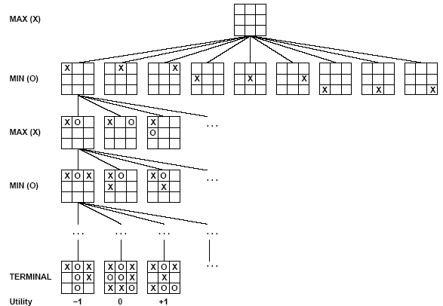
Partial Game Tree for Tic-Tac-Toe

Slide 12
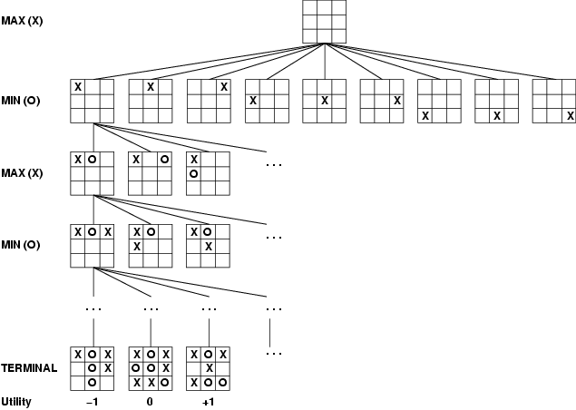
Game tree (2-player, deterministic, turns)
How do we search this tree to find the optimal move?
Notes:
Add tic-tac-toe demo.

Slide 13
Minimax strategy: Look ahead and reason backwards
Find the optimal strategy for MAX assuming an infallible MIN opponent
  Need to compute this all the down the tree
  Game Tree Search Demo
Assumption: Both players play optimally!
Given a game tree, the optimal strategy can be determined by using the minimax value of each node.
Zermelo 1912.

Slide 14
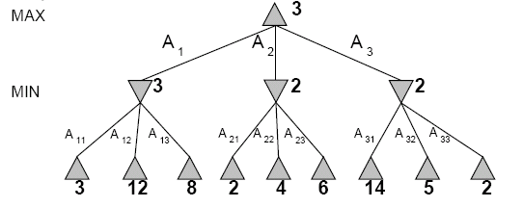
Two-Ply Game Tree
Notes:
Chocolate playing: max gets x number of chocolates, min has to give up x number of chocolates.

Slide 15
Two-Ply Game Tree

Slide 16
Two-Ply Game Tree
Notes:
Ply = 2 half moves

Slide 17
Two-Ply Game Tree
Minimax maximizes the utility for the worst-case outcome for max
The minimax decision

Slide 18
What if MIN does not play optimally?
Definition of optimal play for MAX assumes MIN plays optimally:
  maximizes worst-case outcome for MAX
But if MIN does not play optimally, MAX will do even better
  Can prove this (Problem 6.2)

Slide 19
Pseudocode for Minimax Algorithm
function MINIMAX-DECISION(state) returns an action
inputs: state, current state in game
v←MAX-VALUE(state)
return the action in SUCCESSORS(state) with value v
function MAX-VALUE(state) returns a utility value
if TERMINAL-TEST(state) then return UTILITY(state)
v ← -∞
for a,s in SUCCESSORS(state) do
v ← MAX(v,MIN-VALUE(s))
return v
function MIN-VALUE(state) returns a utility value
if TERMINAL-TEST(state) then return UTILITY(state)
^{v ← ∞}
for a,s in SUCCESSORS(state) do
^{v ← MIN(v,MAX-VALUE(s))}
^{return v}

Slide 20
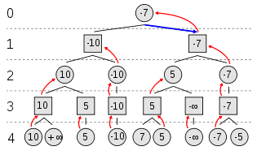
Example of Algorithm Execution
MAX to move
Notes:
Can have negative values too

Slide 21
Minimax Algorithm
Complete depth-first exploration of the game tree
Assumptions:
  Max depth = d, b legal moves at each point
  E.g., Chess: d ~ 100, b ~35
Criterion | Minimax
Time | O(b^{d})
Space | O(bd)
☹
☺

Slide 22
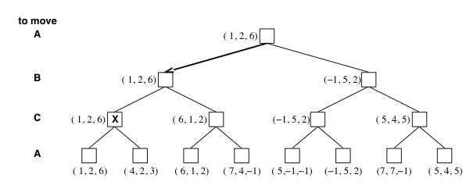
Multiplayer games
Games allow more than two players
Single minimax values become vectors

Slide 23
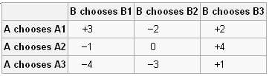
Example
Zero sum games: zero-sum describes a situation in which a participant's
gain or loss is exactly balanced by the losses or gains of the other participant(s).
If the total gains of the participants are added up, and the total losses are subtracted, they will sum to zero
A and B make simultaneous moves, illustrates minimax solutions.
Can they do better than minimax?
Can we make the space less complex?
Pure strategy vs mix strategies

Slide 24
Aspects of multiplayer games
Previous slide (standard minimax analysis) assumes that each player operates to maximize only their own utility
In practice, players make alliances
  E.g, C strong, A and B both weak
  May be best for A and B to attack C rather than each other
If game is not zero-sum (i.e., utility(A) = - utility(B) then alliances can be useful even with 2 players
  e.g., both cooperate to maximum the sum of the utilities

Slide 25
QUIZ
Adversarial search problems involve:
a) A single agent and passive environment
b) Multiple cooperating agents
c) Agents with conflicting goals
d) Random environments
Answer: c) Agents with conflicting goals
The minimax algorithm is used in:
a) Optimization problems
b) Probabilistic reasoning
c) Adversarial games
d) Planning problems
Answer: c) Adversarial games
In the minimax algorithm, the MAX player aims to:
a) Minimize the minimum loss
b) Maximize the maximum gain
c) Maximize the utility value
d) Minimize the utility value
Answer: c) Maximize the utility value

Slide 26
Which of the following is not a property of the minimax algorithm?
a) Complete
b) Optimal against an optimal opponent
c) Requires less memory
d) Works only for deterministic games
Answer: c) Requires less memory
Alpha-beta pruning is used to:
a) Improve accuracy
b) Reduce the number of nodes evaluated
c) Increase the depth of the game tree
d) Store more heuristics
Answer: b) Reduce the number of nodes evaluated
What are alpha and beta values in alpha-beta pruning?
a) Lower and upper bounds for possible solutions
b) Probability values
c) Cost functions
d) Heuristic scores
Answer: a) Lower and upper bounds for possible solutions

Slide 27
In alpha-beta pruning, if beta ≤ alpha:
a) Prune the remaining branches
b) Explore deeper nodes
c) Increase alpha
d) Continue evaluating
Answer: a) Prune the remaining branches
What is the time complexity of minimax algorithm in a game tree of depth m and branching factor b?
a) O(b + m)
b) O(m²)
c) O(b^m)
d) O(m^b)
Answer: c) O(b^m)
Which of the following will improve alpha-beta pruning performance the most?
a) Evaluating nodes randomly
b) Expanding the least promising node first
c) Ordering moves to examine the best ones first
d) Increasing depth of tree
Answer: c) Ordering moves to examine the best ones first
Which games are suitable for adversarial search algorithms like minimax?
a) Single-agent pathfinding
b) Deterministic turn-based two-player games
c) Probabilistic board games
d) Optimization scheduling problems
Answer: b) Deterministic turn-based two-player games

Slide 28
23
Text and Reference Books
TEXT BOOKS
T1. Stuart Russell and Peter Norvig,” Artificial Intelligence: A Modern Approach”, 4th Edition.
T2. Kevin Murphy, “Machine Learning: A Probabilistic Perspective”, 2nd Edition.
REFERENCE BOOKS
R1 John D. Kelleher, Brian Mac Namee, and Aoife D'Arcy, “Fundamentals of Machine Learning for Predictive Data Analytics”, 2nd Edition.
R2 Christoph Molnar, “Interpretable Machine Learning”, 2nd Edition.G.

Slide 29
Thank You

