Slide 1

Academic Session 2025-26
ODD Semester Jul-Dec 2025
UNIVERSITY INSTITUTE OF COMPUTING
MCA
Master of Computer Applications
AIML/ 1
Artificial Intelligence
(25CAT-613)
Unit No. Chapter No. Lecture No.
Topic : ________3___________________1_________________37-40________
NISHA SHARMA and E2915 Designation:AP

Slide 2
16
Learning Objectives
LO1: Gain a foundational understanding of Artificial Intelligence (AI) concepts and applications
LO2: Analyze and formulate single-agent search problems in state space representation.
LO3: Apply various search algorithms to solve problems using Python.
LO4: Evaluate the efficiency and effectiveness of different search algorithms based on problem characteristics
LO5: Developing AI agents that can play games by utilizing search algorithms to make

Slide 3
Practical problem with minimax search
Number of game states is exponential in the number of moves.
  Solution: Do not examine every node
  => pruning
    Remove branches that do not influence final decision
Revisit example …

Slide 4
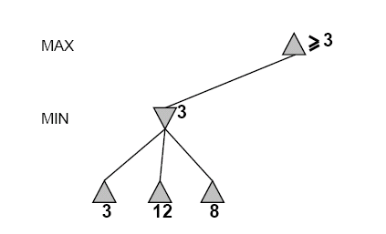
Alpha-Beta Example
Do DF-search until first leaf
Range of possible values
[-∞,+∞]
[-∞, +∞]

Slide 5
Alpha-Beta Example (continued)
[-∞,+∞]
[-∞,3]

Slide 6
Alpha-Beta Example (continued)
[-∞,+∞]
[-∞,3]

Slide 7
Alpha-Beta Example (continued)
[3,+∞]
[3,3]

Slide 8
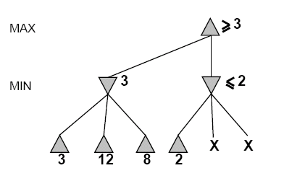
Alpha-Beta Example (continued)
[3,+∞]
This node is worse
for MAX
[3,3]
[-∞,2]

Slide 9
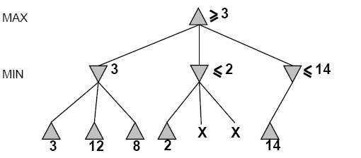
Alpha-Beta Example (continued)
[3,14]
,
[3,3]
[-∞,2]
[-∞,14]

Slide 10
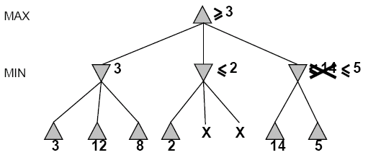

Alpha-Beta Example (continued)
[3,5]
,
[3,3]
[−∞,2]
[-∞,5]

Slide 11
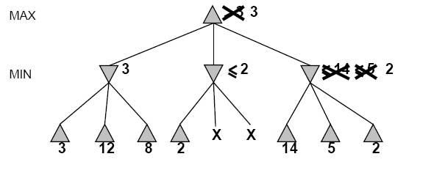
Alpha-Beta Example (continued)
[3,3]
[3,3]
[−∞,2]
[2,2]

Slide 12
Alpha-Beta Example (continued)
[3,3]
[3,3]
[-∞,2]
[2,2]

Slide 13
Alpha-beta Algorithm
Depth first search – only considers nodes along a single path at any time
α = highest-value choice that we can guarantee for MAX so far in the current subtree.
β = lowest-value choice that we can guarantee for MIN so far in the current subtree.
update values of α and β during search and prunes remaining branches as soon as the value is known to be worse than the current α or β value for MAX or MIN.
Alpha-beta Demo.

Slide 14
Pseudocode for Alpha-Beta Algorithm
function ALPHA-BETA-SEARCH(state) returns an action
inputs: state, current state in game
v←MAX-VALUE(state, - ∞ , +∞)
return the action in SUCCESSORS(state) with value v

Slide 15
Pseudocode for Alpha-Beta Algorithm
function ALPHA-BETA-SEARCH(state) returns an action
inputs: state, current state in game
v←MAX-VALUE(state, - ∞ , +∞)
return the action in SUCCESSORS(state) with value v
function MAX-VALUE(state,α , β) returns a utility value
if TERMINAL-TEST(state) then return UTILITY(state)
v ← - ∞
for a,s in SUCCESSORS(state) do
v ← MAX(v,MIN-VALUE(s, α , β))
if v ≥ β then return v
α ← MAX(α ,v)
return v

Slide 16
Effectiveness of Alpha-Beta Search
Worst-Case
  branches are ordered so that no pruning takes place. In this case alpha-beta gives no improvement over exhaustive search
Best-Case
  each player’s best move is the left-most alternative (i.e., evaluated first)
  in practice, performance is closer to best rather than worst-case
In practice often get O(b^{(d/2)}) rather than O(b^{d})
  this is the same as having a branching factor of sqrt(b),
    since (sqrt(b))^{d} = b^{(d/2)}
    i.e., we have effectively gone from b to square root of b
  e.g., in chess go from b ~ 35 to b ~ 6
    this permits much deeper search in the same amount of time
    Typically twice as deep.

Slide 17
Example
-which nodes can be pruned?
MAX
MIN
MAX
3
5
6
4
1
2
7
8
Notes:
Nothing actually.

Slide 18
Summary
Game playing can be effectively modeled as a search problem
Game trees represent alternate computer/opponent moves
Evaluation functions estimate the quality of a given board configuration for the Max player.
Minimax is a procedure which chooses moves by assuming that the opponent will always choose the move which is best for them
Alpha-Beta is a procedure which can prune large parts of the search tree and allow search to go deeper
For many well-known games, computer algorithms based on heuristic search match or out-perform human world experts.
Notes:
Add something on retrograde analysis

Slide 19
QUIZ
Adversarial search problems involve:
a) A single agent and passive environment
b) Multiple cooperating agents
c) Agents with conflicting goals
d) Random environments
Answer: c) Agents with conflicting goals
The minimax algorithm is used in:
a) Optimization problems
b) Probabilistic reasoning
c) Adversarial games
d) Planning problems
Answer: c) Adversarial games
In the minimax algorithm, the MAX player aims to:
a) Minimize the minimum loss
b) Maximize the maximum gain
c) Maximize the utility value
d) Minimize the utility value
Answer: c) Maximize the utility value

Slide 20
Which of the following is not a property of the minimax algorithm?
a) Complete
b) Optimal against an optimal opponent
c) Requires less memory
d) Works only for deterministic games
Answer: c) Requires less memory
Alpha-beta pruning is used to:
a) Improve accuracy
b) Reduce the number of nodes evaluated
c) Increase the depth of the game tree
d) Store more heuristics
Answer: b) Reduce the number of nodes evaluated
What are alpha and beta values in alpha-beta pruning?
a) Lower and upper bounds for possible solutions
b) Probability values
c) Cost functions
d) Heuristic scores
Answer: a) Lower and upper bounds for possible solutions

Slide 21
In alpha-beta pruning, if beta ≤ alpha:
a) Prune the remaining branches
b) Explore deeper nodes
c) Increase alpha
d) Continue evaluating
Answer: a) Prune the remaining branches
What is the time complexity of minimax algorithm in a game tree of depth m and branching factor b?
a) O(b + m)
b) O(m²)
c) O(b^m)
d) O(m^b)
Answer: c) O(b^m)
Which of the following will improve alpha-beta pruning performance the most?
a) Evaluating nodes randomly
b) Expanding the least promising node first
c) Ordering moves to examine the best ones first
d) Increasing depth of tree
Answer: c) Ordering moves to examine the best ones first
Which games are suitable for adversarial search algorithms like minimax?
a) Single-agent pathfinding
b) Deterministic turn-based two-player games
c) Probabilistic board games
d) Optimization scheduling problems
Answer: b) Deterministic turn-based two-player games

Slide 22
23
Text and Reference Books
TEXT BOOKS
T1. Stuart Russell and Peter Norvig,” Artificial Intelligence: A Modern Approach”, 4th Edition.
T2. Kevin Murphy, “Machine Learning: A Probabilistic Perspective”, 2nd Edition.
REFERENCE BOOKS
R1 John D. Kelleher, Brian Mac Namee, and Aoife D'Arcy, “Fundamentals of Machine Learning for Predictive Data Analytics”, 2nd Edition.
R2 Christoph Molnar, “Interpretable Machine Learning”, 2nd Edition.G.

Slide 23
Thank You

