Slide 1

Academic Session 2025-26
ODD Semester Jul-Dec 2025
UNIVERSITY INSTITUTE OF COMPUTING
MCA
Master of Computer Applications
AIML/ 1
Artificial Intelligence
(25CAT-613)
Unit No. Chapter No. Lecture No.
Topic : ________3___________________1_________________43-45________
NISHA SHARMA and E2915 Designation:AP

Slide 2
16
Learning Objectives
LO1: Gain a foundational understanding of Artificial Intelligence (AI) concepts and applications
LO2: Analyze and formulate single-agent search problems in state space representation.
LO3: Apply various search algorithms to solve problems using Python.
LO4: Evaluate the efficiency and effectiveness of different search algorithms based on problem characteristics
LO5: Developing AI agents that can play games by utilizing search algorithms to make

Slide 3
AI Games vs. Economics Game Theory
Seminal Work on Game Theory: Theory of Games and Economic Behavior, 1944, by von Neumann and Morgenstern.
Agents can be in cooperation as well as in conflict.
Agents may move simultaneously/independently.
Notes:
Add something on retrograde analysis

Slide 4
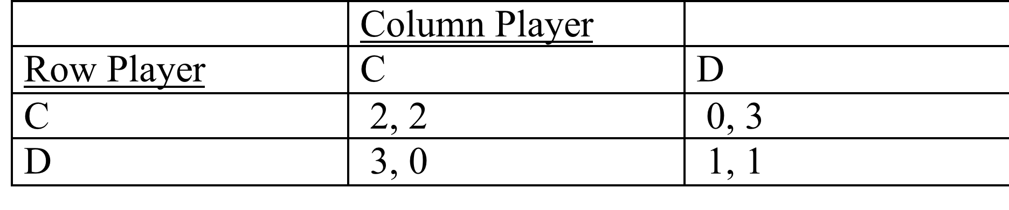
Example: The Prisoner’s Dilemma
Other Famous Matrix Games:
Chicken
Battle of The Sexes
Coordination
Notes:
Add something on retrograde analysis

Slide 5
Solving Zero-Sum Games
Perfect Information: Use Minimax Tree Search.
Imperfect Information: Extend Minimax Idea with probabilistic actions.
von Neumann’s Minimax Theorem: there exists an essentially unique optimal probability distribution for randomizing an agent’s behaviour.
Notes:
Add something on retrograde analysis

Slide 6
Matching Pennies
Why should the players randomize?
What are the best probabilities to use in their actions?
 | Heads | Tails
Heads | 1,-1 | -1,1
Tails | -1,1 | 1,-1
Notes:
Suppose that the row player announces their probability. What is the best one to use?

Slide 7
Nonzero Sum Game Trees
The idea of “look ahead, reason backward” works for any game tree with perfect information.
  I.e., also in cooperative games.
In AI, this is called retrograde analysis.
In game theory, it is called backward induction or subgame perfect equilibrium.
Can be extended to many games with imperfect information (sequential equilibrium).
Notes:
Add something on retrograde analysis

Slide 8
Backward Induction Example: Hume’s Farmer Problem
1
H
Not H
2
notH1
2
Not H2
H1
H2
2
2
0
3
3
0
1
1

Slide 9
Summary: Solving Games
 | Zero-sum | Non zero-sum
Perfect Information | Minimax, alpha-beta | Backward induction, retrograde analysis
Imperfect Information | Probabilistic minimax | Nash equilibrium
Nash equilibrium is beyond the scope of this course.
Notes:
Add something on retrograde analysis

Slide 10
Single Agent vs. 2-Players
Every single agent problem can be considered as a special case of a 2-player game. How?
  Make one of the players the Environment, with a constant utility function (e.g., always 0).
    The Environment acts but does not care.
  An adversarial Environment, with utility function the negative of agent’s utility.
    In minimization, Environment’s utility is player’s costs.
    Worst-Case Analysis.
    E.g., program correctness: no matter what input user gives, program gives correct answer.
So agent design is a subfield of game theory.

Slide 11
Single Agent Design = Game Theory
Von Neumann-Morgenstern Games
Decision Theory = 2-player game, 1st player the “agent”, 2nd player “environment/nature”
(with constant or adversarial utility function)
From
General
To
Special
Case
Markov Decision Processes
Planning Problems
Notes:
Mention that problem of computing best reply = problem of optimal planning in game with nature.

Slide 12
Example: And-Or Trees
If an agent’s actions have nondeterministic effects, we can model worst-case analysis as a zero-sum game where the environment chooses the effects of an agent’s actions.
Minimax Search ≈ And-Or Search.
Example: The Erratic Vacuum Cleaner.
  When applied to dirty square, vacuum cleans it and sometimes adjacent square too.
  When applied to clean square, sometimes vacuum makes it dirty.
  Reflex agent: same action for same location, dirt status.

Slide 13
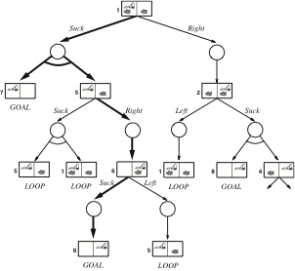
And-Or Tree for the Erratic Vacuum
The agent “moves” at labelled OR nodes.
The environment “moves” at unlabelled AND nodes.
The agent wins if it reaches a goal state.
The environment “wins” if the agent goes into a loop.

Slide 14
Summary
Game Theory is a very general, highly developed framework for multi-agent interactions.
Deep results about equivalences of various environment types.

Slide 15
QUIZ
Adversarial search problems involve:
a) A single agent and passive environment
b) Multiple cooperating agents
c) Agents with conflicting goals
d) Random environments
Answer: c) Agents with conflicting goals
The minimax algorithm is used in:
a) Optimization problems
b) Probabilistic reasoning
c) Adversarial games
d) Planning problems
Answer: c) Adversarial games
In the minimax algorithm, the MAX player aims to:
a) Minimize the minimum loss
b) Maximize the maximum gain
c) Maximize the utility value
d) Minimize the utility value
Answer: c) Maximize the utility value

Slide 16
Which of the following is not a property of the minimax algorithm?
a) Complete
b) Optimal against an optimal opponent
c) Requires less memory
d) Works only for deterministic games
Answer: c) Requires less memory
Alpha-beta pruning is used to:
a) Improve accuracy
b) Reduce the number of nodes evaluated
c) Increase the depth of the game tree
d) Store more heuristics
Answer: b) Reduce the number of nodes evaluated
What are alpha and beta values in alpha-beta pruning?
a) Lower and upper bounds for possible solutions
b) Probability values
c) Cost functions
d) Heuristic scores
Answer: a) Lower and upper bounds for possible solutions

Slide 17
In alpha-beta pruning, if beta ≤ alpha:
a) Prune the remaining branches
b) Explore deeper nodes
c) Increase alpha
d) Continue evaluating
Answer: a) Prune the remaining branches
What is the time complexity of minimax algorithm in a game tree of depth m and branching factor b?
a) O(b + m)
b) O(m²)
c) O(b^m)
d) O(m^b)
Answer: c) O(b^m)
Which of the following will improve alpha-beta pruning performance the most?
a) Evaluating nodes randomly
b) Expanding the least promising node first
c) Ordering moves to examine the best ones first
d) Increasing depth of tree
Answer: c) Ordering moves to examine the best ones first
Which games are suitable for adversarial search algorithms like minimax?
a) Single-agent pathfinding
b) Deterministic turn-based two-player games
c) Probabilistic board games
d) Optimization scheduling problems
Answer: b) Deterministic turn-based two-player games

Slide 18
23
Text and Reference Books
TEXT BOOKS
T1. Stuart Russell and Peter Norvig,” Artificial Intelligence: A Modern Approach”, 4th Edition.
T2. Kevin Murphy, “Machine Learning: A Probabilistic Perspective”, 2nd Edition.
REFERENCE BOOKS
R1 John D. Kelleher, Brian Mac Namee, and Aoife D'Arcy, “Fundamentals of Machine Learning for Predictive Data Analytics”, 2nd Edition.
R2 Christoph Molnar, “Interpretable Machine Learning”, 2nd Edition.G.

Slide 19
Thank You

