Slide 1
Power System Fault Detection and Classification Using Machine Learning
CAPSTONE PROJECT
Presented By:
1. AYUSH SHARMA GALGOTIAS UNIVERSITY – B.TECH CSE(AIML)

Slide 2
OUTLINE
Problem Statement (Should not include solution)
Proposed System/Solution
System Development Approach (Technology Used)
Algorithm & Deployment
Result (Output Image)
Conclusion
Future Scope
References

Slide 3
Problem Statement
Power distribution systems are prone to various types of faults such as line-to-ground, line-to-line, and three-phase faults. These faults can disrupt power supply and reduce system reliability. The challenge lies in accurately detecting and classifying these faults using electrical measurement data (voltage, current, phasors) to differentiate them from normal operating conditions, thereby ensuring the stability of the power grid.

Slide 4
Proposed Solution
Develop a machine learning model that classifies power system faults using the dataset provided. The model will process electrical measurements to identify the type of fault rapidly and accurately. This classification will help automate fault detection and assist in quicker recovery actions, ensuring system reliability.
Key components:
Data Collection: Use the Kaggle dataset on power system faults.
Preprocessing: Clean and normalize the dataset.
Model Training: Train a classification model (e.g., Decision Tree, Random Forest, or SVM).
Evaluation: Validate the model using accuracy, precision, recall, and F1-score.

Slide 5
System Approach
The "System Approach" section outlines the overall strategy and methodology for developing and implementing the Power System Fault Detection and Classification. Here's a suggested structure for this section:
System requirements
IBM Cloud (Mandatory)
IBM Watson studio for model development and deployment
IBM cloud storage for dataset handling
Library required to build the model
Pandas – for data manipulation
NumPy – for numerical operations
Scikit-learn – for building and evaluating ML models
Matplotlib – for visualization

Slide 6
Algorithm & Deployment
Algorithm Selection: Random Forest Classifier (or SVM based on performance)
Data Input: Voltage, current, and phasor measurements from the dataset
Training Process: Supervised learning using labeled fault types
Prediction Process: Model deployed on IBM Watson Studio with API endpoint for real-time predictions

Slide 7
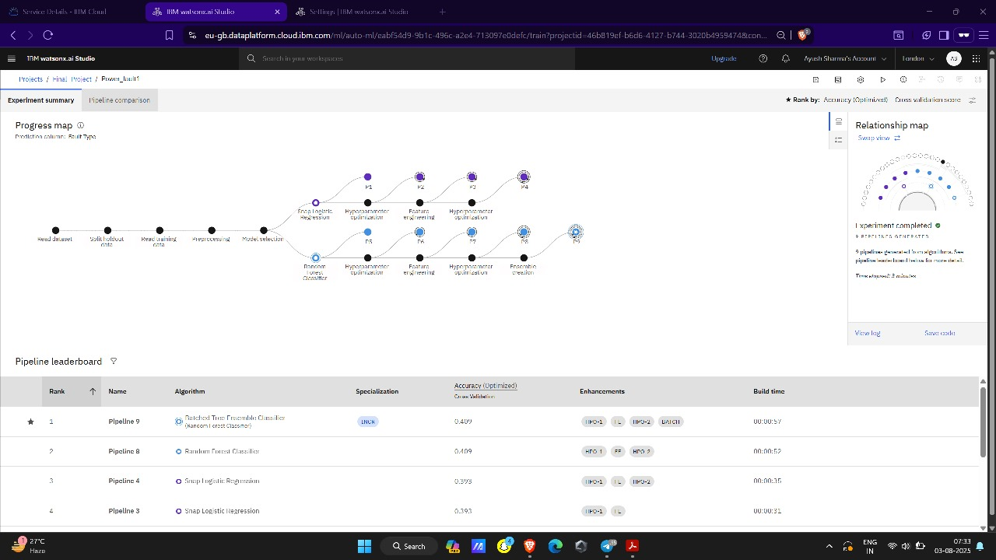
Result

Slide 8
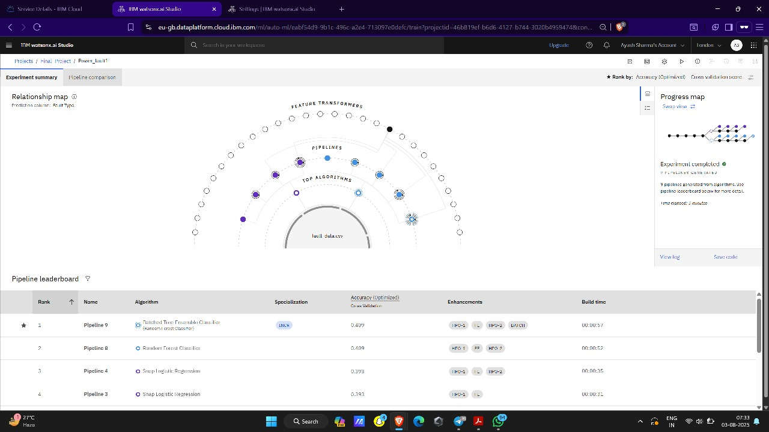
Result

Slide 9
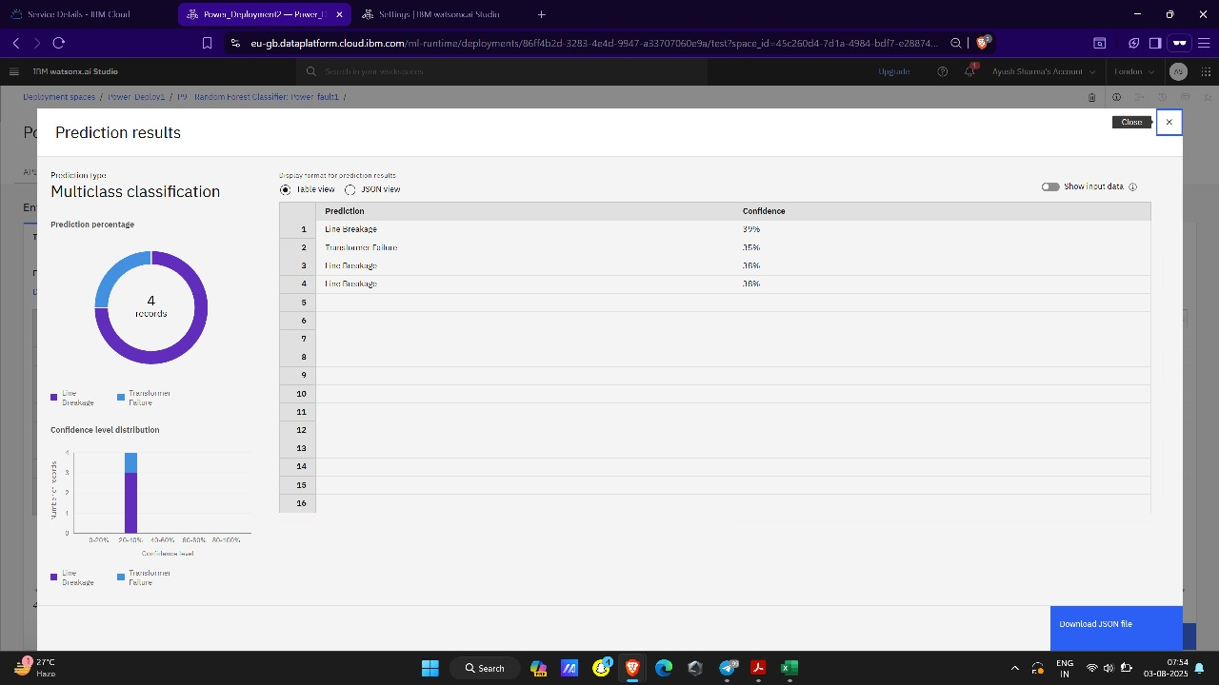
Result

Slide 10
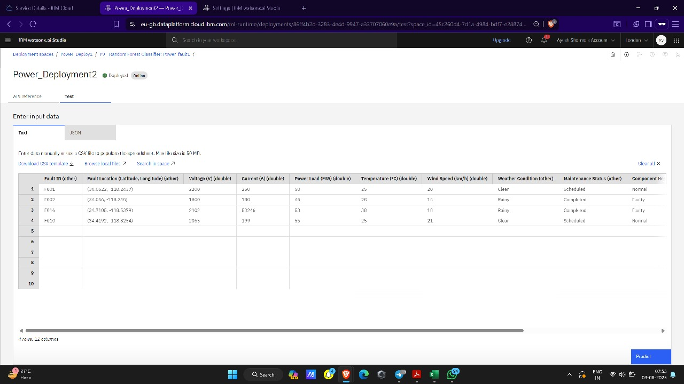
Result

Slide 11
Conclusion
The machine learning model effectively classifies various power system faults, providing accurate and timely fault detection. This improves the reliability and stability of power grids and assists in automating recovery actions. Future improvements can focus on real-time data integration and advanced ensemble methods.

Slide 12
Future scope
Integrate real-time sensor data using IoT
Explore deep learning models for better accuracy
Expand to classify faults in regional and national grids
Deploy the model on edge devices in substations

Slide 13
References
Kaggle Dataset on Power System Faults
IBM Watson Studio Documentation
Research papers on fault classification
Python Libraries: Scikit-learn, Pandas, Matplotlib

Slide 14
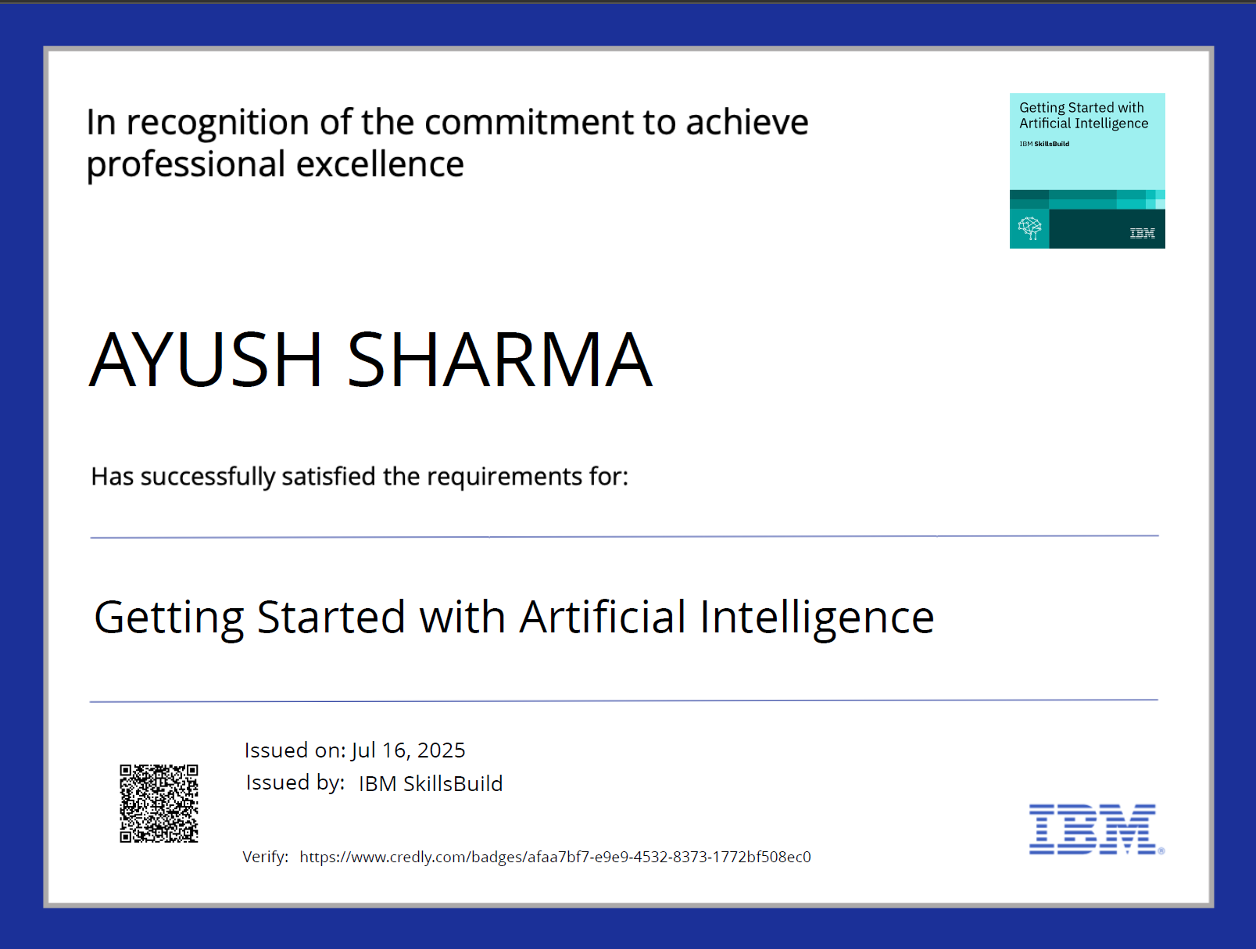
IBM Certifications

Slide 15
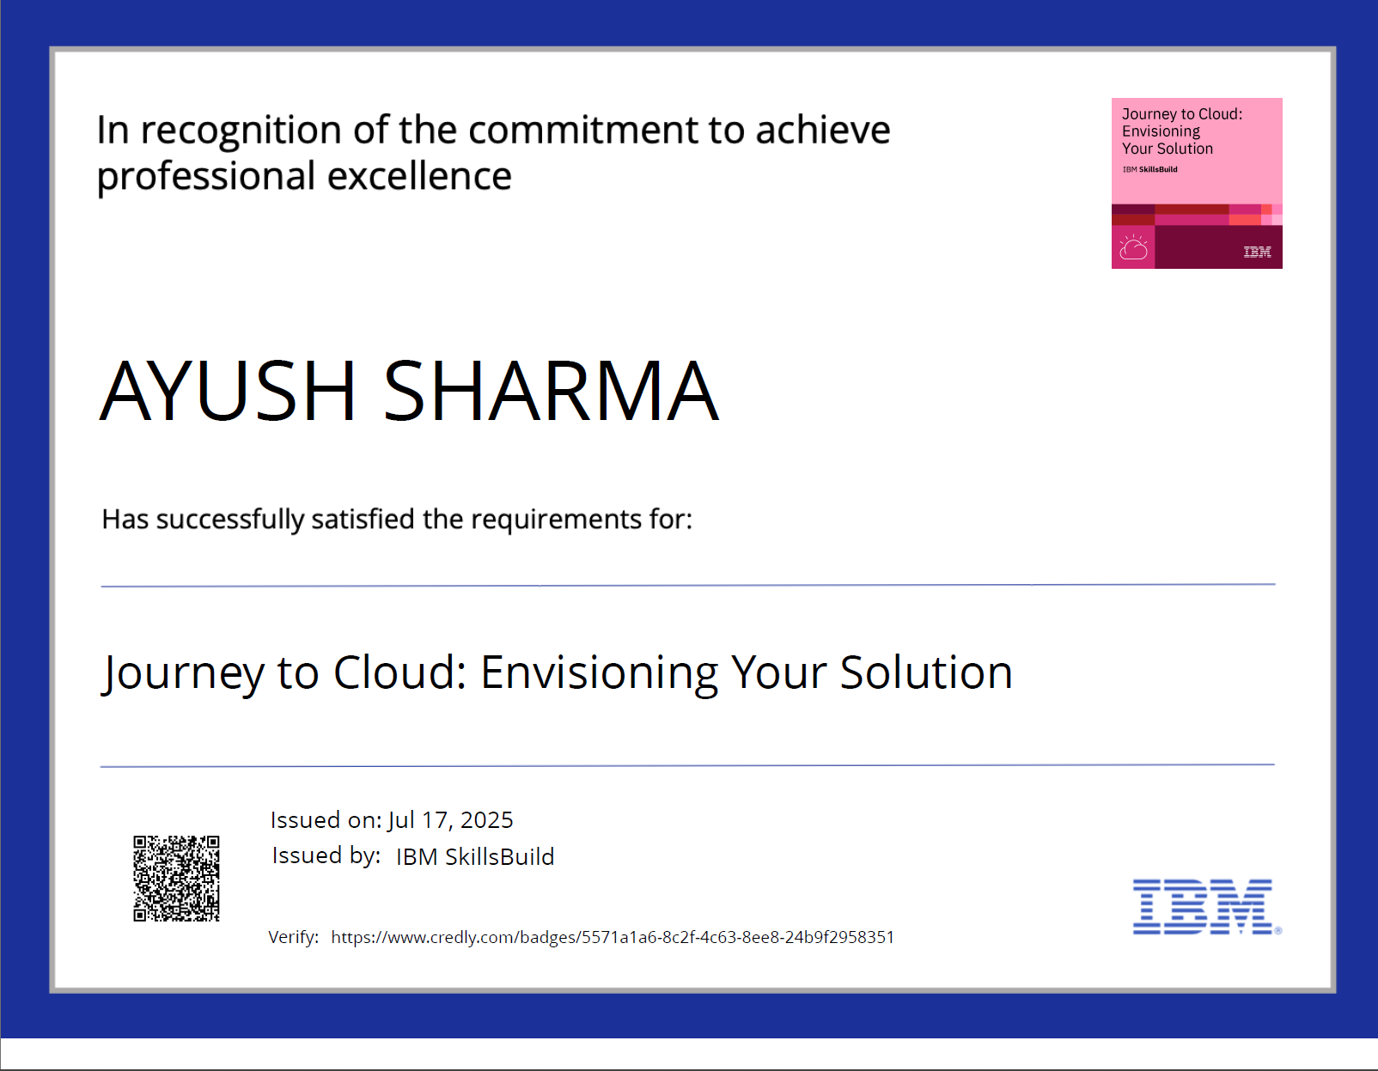
IBM Certifications

Slide 16
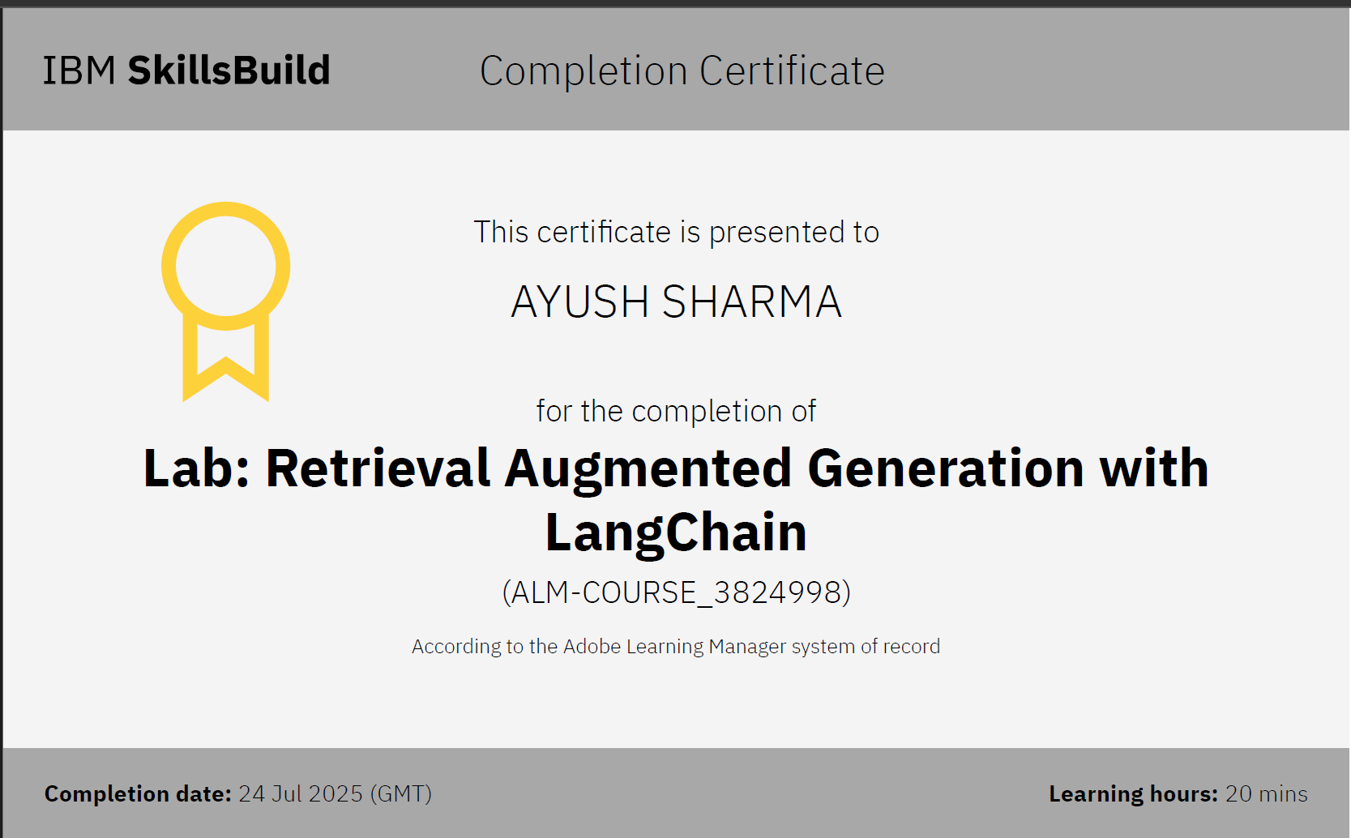
IBM Certifications

Slide 17
THANK YOU

