Slide 1












SMART INDIA HACKATHON 2026
SMART INDIA HACKATHON 2026
ADVANTE
IDEA SUBMISSION
SMART
INDIA HACKATHON 2026
PROBLEM STATEMENT ID
26013
PROBLEM STATEMENT TITLE
Automated Integration and Intelligent Harmonization of Multi-source Geospatial Data for Urban Land Record Management
THEME
Smart Automation
PS CATEGORY
Software
Advante
TEAM NAME

Slide 2







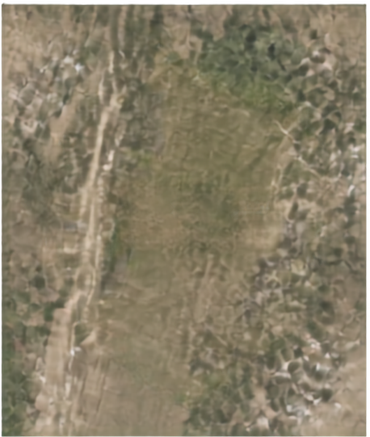
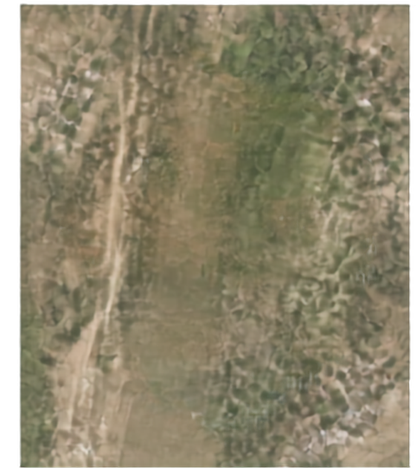








SMART INDIA HACKATHON 2026
SMART INDIA HACKATHON 2026
ADVANTE
IDEA SUBMISSION
Bhumi-Nakasha-
From Survey Number
to Intelligent Land Parcel
PROPOSED SOLUTION
TODAY
WITH BHUMI-NAKASHA
AI/GeoAI fuses cadastrad maps + textual land records
CV extracts survey boundaries from scanned sheets + drone imagery
Area-constrained ML splitss Survey No. 255 into 255/1, 255/2, 255/3
HOW IT ADDRESSES THE PROBLEM
255/1
Automates spatial matching, topology correction, conflict resolution
SURVEY NO. 255 (UNDIVIDED)
255/2
Integrates drone, ORI, DSM/DTM, GNSS, revenue, municipal, utility data
Removes manual GIS-technician bottlenecks in cadastral finalization
INNOVATION AND UNIQUENESS
255/3
India-specific fractional survey-number inference using ML + GNN
Human-in-loop confidence scoring, no auto legal boundary decisions
Natural-language GIS assistant for English/Hindi queries
INTELLIGENT PARCELS. ACCURATE RECORDS. EMPOWERING INDIA.

Slide 3



















SMART INDIA HACKATHON 2026
SMART INDIA HACKATHON 2026
ADVANTE
IDEA SUBMISSION
TECHNICAL APPROACH
1
Cadastral PDF/Image + Drone ORI + GNSS points
2
Docx
3
CV Boundary Segmentation
GEOSPATIAL DATA & SERVICES
AI and GeoAI pipeline that harmonizes multi-source data into intelligent, trusted land parcels
PostgreSQL + PostGIS
4
Area-constrained Sub-division Partitioning (GNN-refined)
GeoPandas
5
Georeferencing + Coordinate Transformation
GDAL
6
APPLICATION LAYER
GeoServer OGC WMS/WFS
Conflict Resolution + Confidence Scoring
Spatial Matching with 7/12, Khata, Municipal records
AI / ML ENGINE
PyTorch
Segment Anything Model
U-Net
PyTorch Geometric (GNN)
auto-publish
FastAPI
7
human review
React + Mapbox GL/MapLibre
send toveyor
Tesseracl/Cloud Vision OCR
IndicBERT
LLM + RAG
8
PostGIS Golden Record →
Web-GIS + NL Assistant
Locker/Kubernetes
AWS/Gol Cloud
INTELLIGENT PARCELS. ACCURATE RECORDS. EMPOWERING INDIA.

Slide 4



























SMART INDIA HACKATHON 2026
SMART INDIA HACKATHON 2026
ADVANTE
IDEA SUBMISSION
Feasibility and Viability
CHALLENGE
MITIGATION
Legal defensibility
<90% confidence advisory
survey outputs need legal certainty
officer sign-off required
Scan-quality variance
Document-quality classifier
varied document and scan quality
routes poor scans for review
Datum/CRM mismatch
Datum transformation step
Everest 1830 vs WGS84 differences
harmonizes all data to a common frame
Sensitive ownership data
Role-based access + encryption
land records require strict protection
per Bhumi Abhidekh policy
INTELLIGENT PARCELS. ACCURATE RECORDS. EMPOWERING INDIA.

Slide 5


















SMART INDIA HACKATHON 2026
SMART INDIA HACKATHON 2026
ADVANTE
IDEA SUBMISSION
fewer title/boundary conflicts; clearer parcel boundaries online
REDUCED DISPUTES
SOCIAL
ECONOMIC
fewer disputes, transparency
faster loans, reduced legal costs
FASTER CREDIT ACCESS
quicker loan/title verification for citizens
IMPACT THAT MATTERS
shared standardized spatial layer for revenue, municipal, utilities
INTER-DEPARTMENT DATA EXCHANGE
GOVERNANCE
ENVIRONMENTAL / PLANNING
versioned golden record, interoperability
STANDARDIZED DIGITAL LAND GOVERNANCE
village-level land-use dashboards support planners
accurate land-use, infrastructure planning
INTELLIGENT PARCELS. ACCURATE RECORDS. EMPOWERING INDIA.

Slide 6























SMART INDIA HACKATHON 2026
SMART INDIA HACKATHON 2026
ADVANTE
IDEA SUBMISSION
Ministry of Rural Development / DoLR – SIH Problem Statement 26013
NAKSHA programme (National Geospatial Knowledge-based Land Survey)
Research and
SVAMITVA Scheme, Ministry of Panchayati Raj
Maharashtra Bhumi Abholekh / Mahabhulekh portal (bhulekh.mahabhumi.gov.in)
References
Pilot: Plot Report, Village Khedi, Taluka Narkhed, District Nagpur (Survey No. 255)
Segment Anything Model paper
PostGIS documentation
PyTorch Geometric documentation
INTELLIGENT PARCELS. ACCURATE RECORDS. EMPOWERING INDIA.

