Slide 1


SMART INDIA HACKATHON 2025
TITLE PAGE
Problem Statement ID – 25028
Problem Statement Title- Smart Classroom &
Timetable Scheduler
Theme- Smart Education
PS Category- Software
Team ID- 401
Team Name- InnoHex

Slide 2
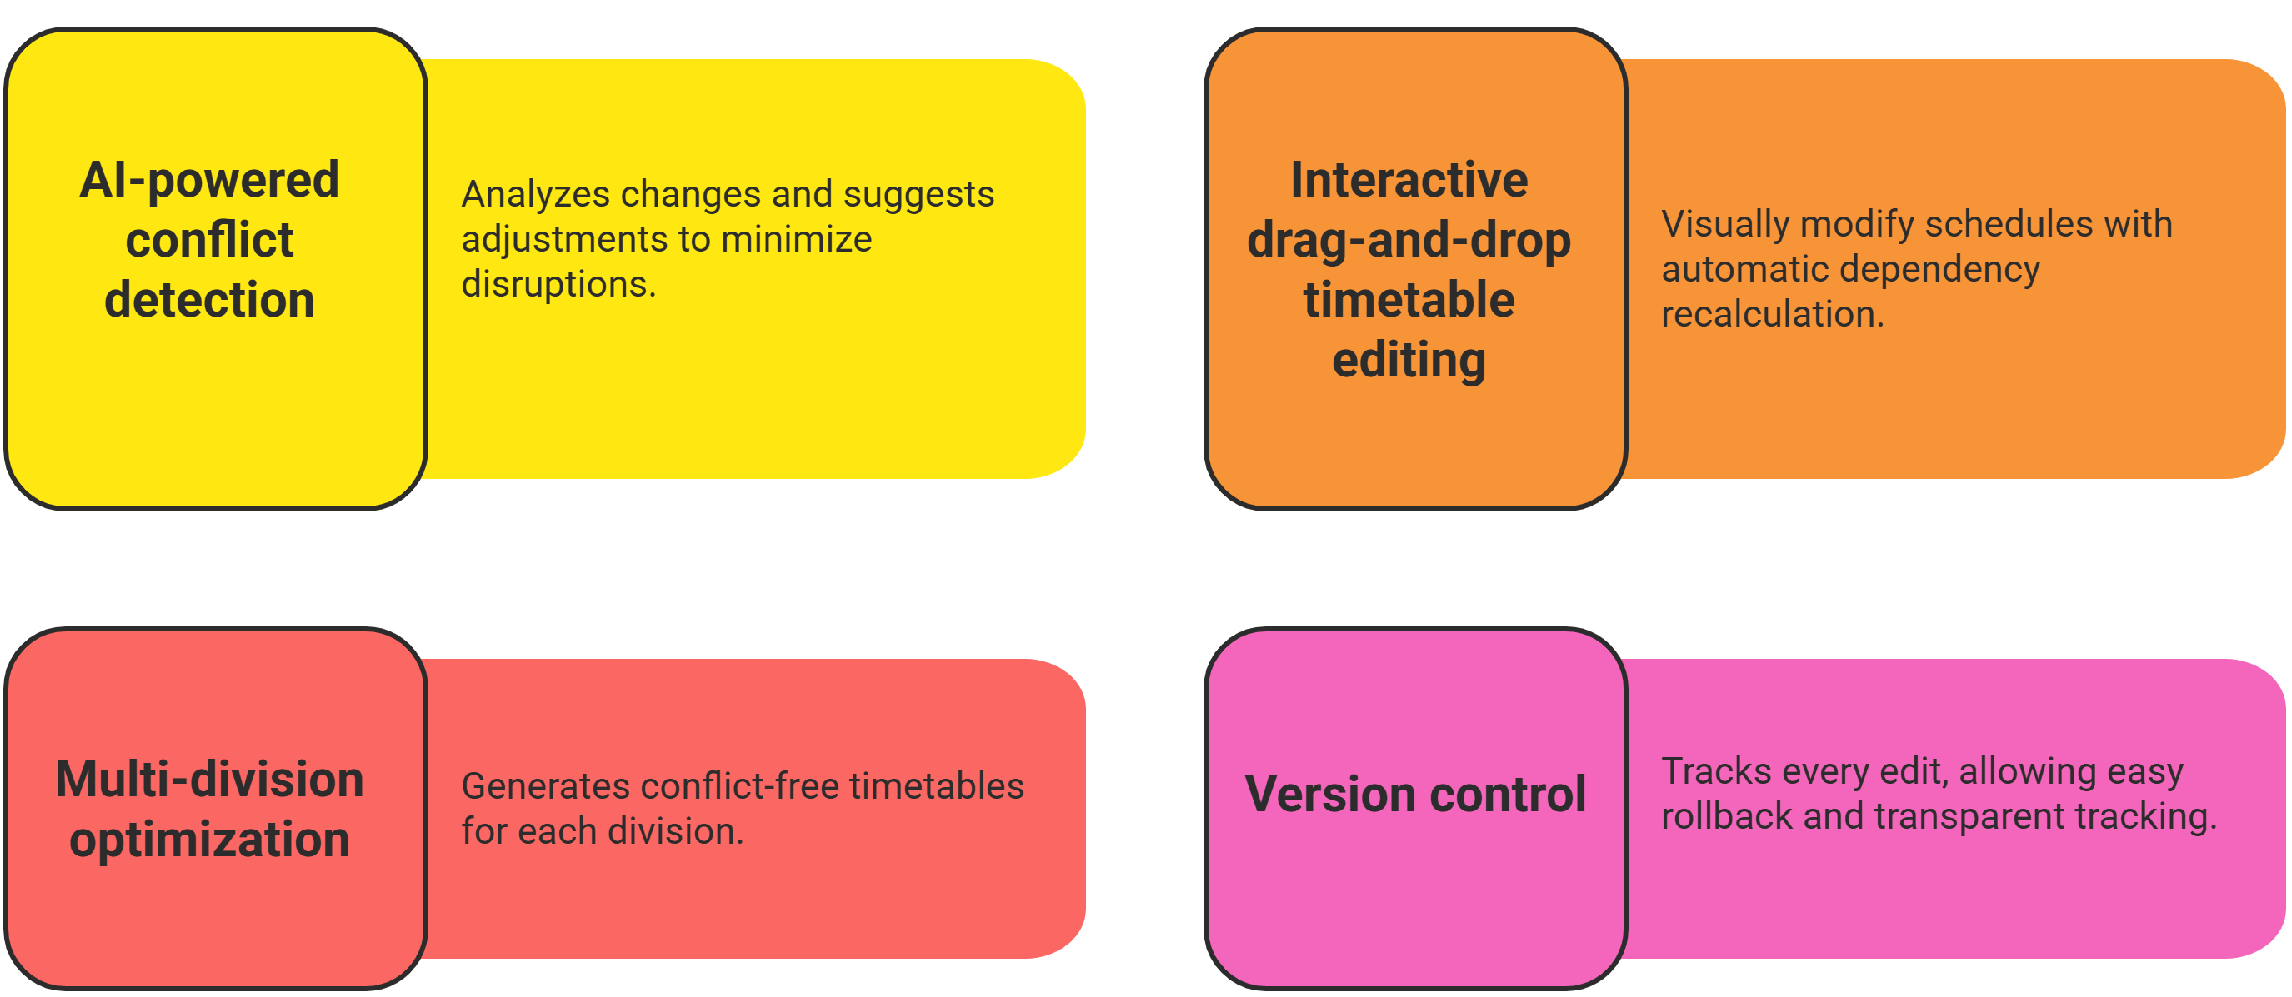
IDEA TITLE
InnoHex
Problem – 1. Manual scheduling causes frequent conflicts and errors.
2. Faculty and classroom resources are underutilized.
3. Last-minute changes are hard to manage.
4. Student and staff satisfaction is reduced.
Proposed Solution - EduScheduler Pro: AI-Powered Smart Timetable Revolution
Intelligent web-based platform that transforms manual scheduling chaos into automated optimization, generating conflict-free timetables for multiple divisions simultaneously with real-time editing and smart collaboration.
🎯 Multi-Division Intelligence: Processes all divisions simultaneously
⚡ 6-Hour Academic Limit: Enforces balanced student workload
🤖 Zero-Conflict Guarantee: No faculty double-booking across divisions
📊 Smart Break Placement: Prevents continuous 6-hour sessions
🔄 Lab Session Optimization: Perfect break hour block allocation
📱 Real-Time Configuration: Live constraint adjustment capability
Uniqueness -

Slide 3
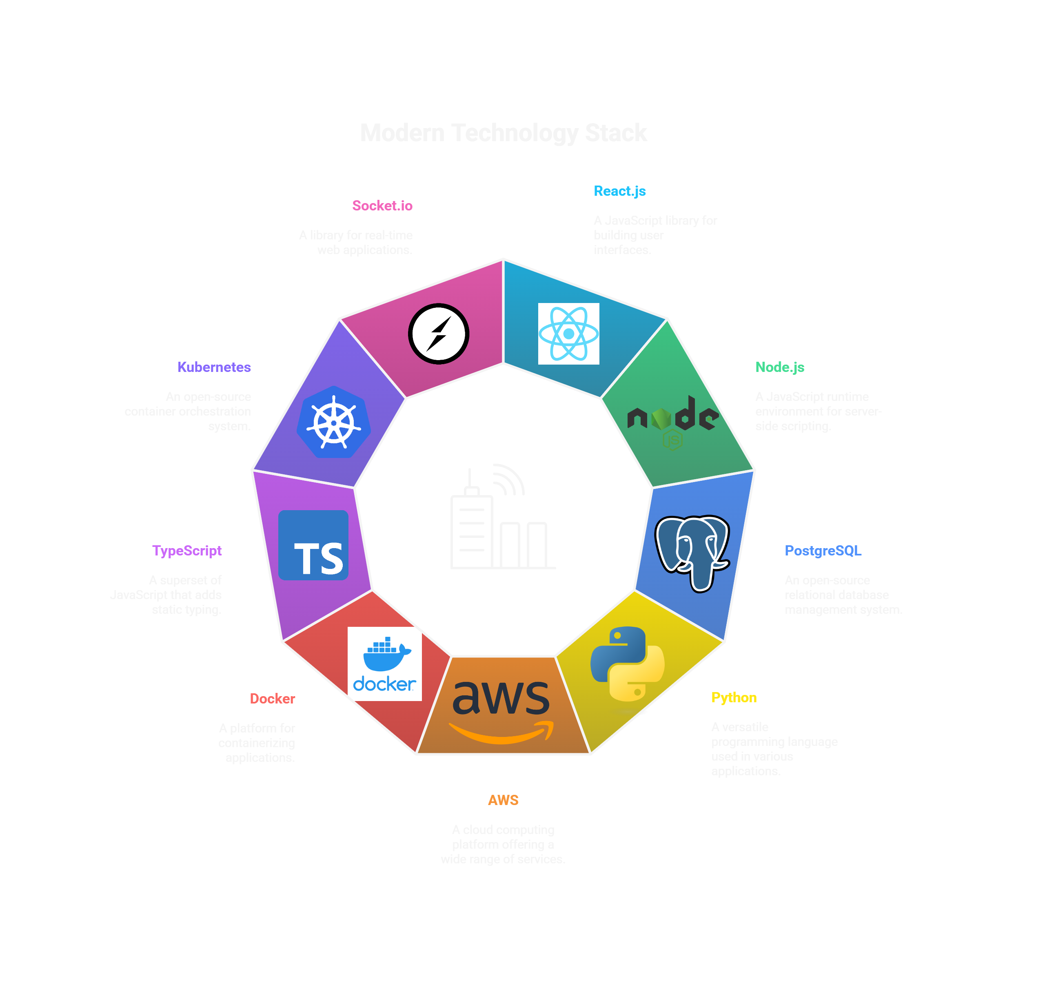
TECHNICAL APPROACH
InnoHex

Slide 4

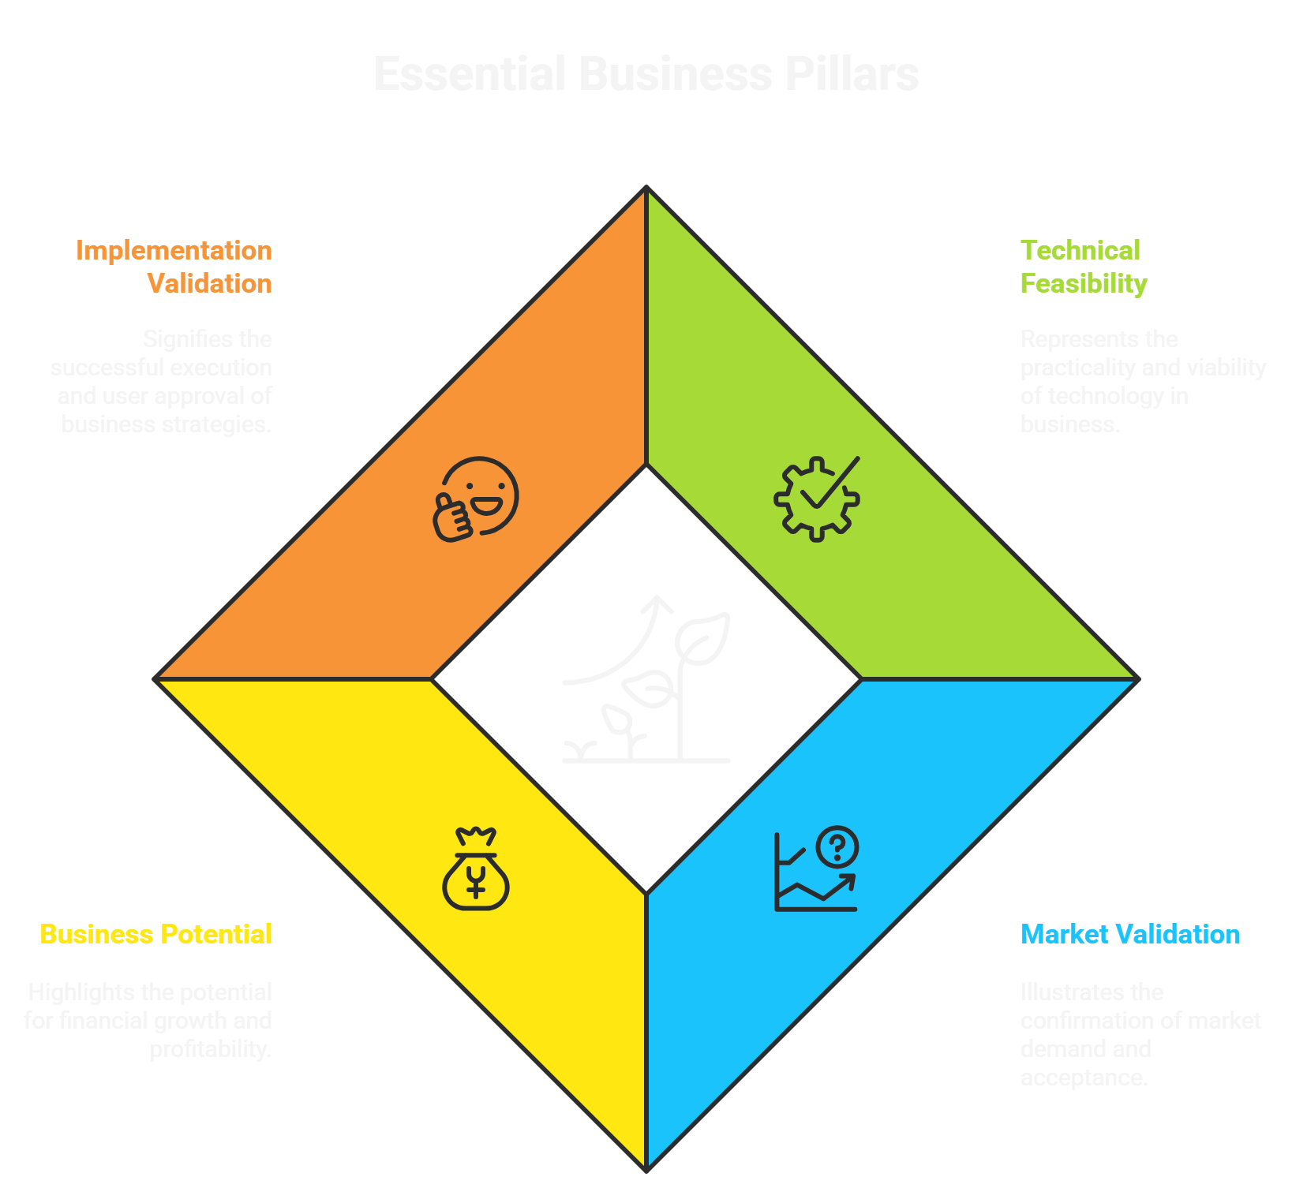


FEASIBILITY AND VIABILITY
InnoHex
FEASIBILITY
Market Validation & Business Potential
Proven AI Algorithms: Genetic algorithms achieve 95% optimization success
Modern Stack tools support rapid development and reliability.
Generates conflict-free timetables for multi-divisions.
VIABILITY
87% of universities still use the traditional way of spreadsheets for timetabling.
Reduces 12–15 days of manual scheduling to 2–3 hours.
No existing system handles 6-hour limits + multi-division optimization
POTENTIAL CHALLENGES AND STRATEGIES
1. Complex Input Requirements: Multiple configuration
parameters needed
Strategy: Guided setup wizard with pre-filled templates
and validation
2. Algorithm Complexity: Advanced constraint satisfaction
requirements
Strategy: Modular algorithm design with incremental optimization
3. Performance Scaling: Large datasets with multiple
constraints
Strategy: Parallel processing and cloud auto-scaling for peak loads

Slide 5


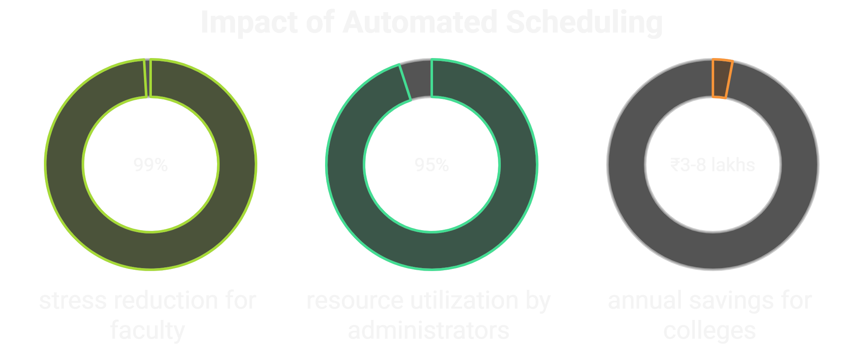

IMPACT AND BENEFITS
InnoHex
Impact on Target
Audience
Benefits
Faculty: 99% stress reduction from manual scheduling
Students: Zero schedule confusion, fair break distribution, improved academic satisfaction
Administrators: 15 days → 2 hours scheduling time
Social: Eliminates faculty burnout, reduces student scheduling anxiety, improves work-life balance for 500+ staff per college
Economic: Cost savings of ₹3-8 lakhs annually, 95% classroom utilization optimization, reduced administrative workforce needs
15 days ->
few hours
Real User Validation - Prof. Vikas Nandeshwar (VIT Instrumentation Dept)
Global Market Impact: 87% of universities still use manual timetabling - our solution can transform scheduling for 45,000+ higher education institutions in India alone, affecting 40+ million students and faculty.

Slide 6
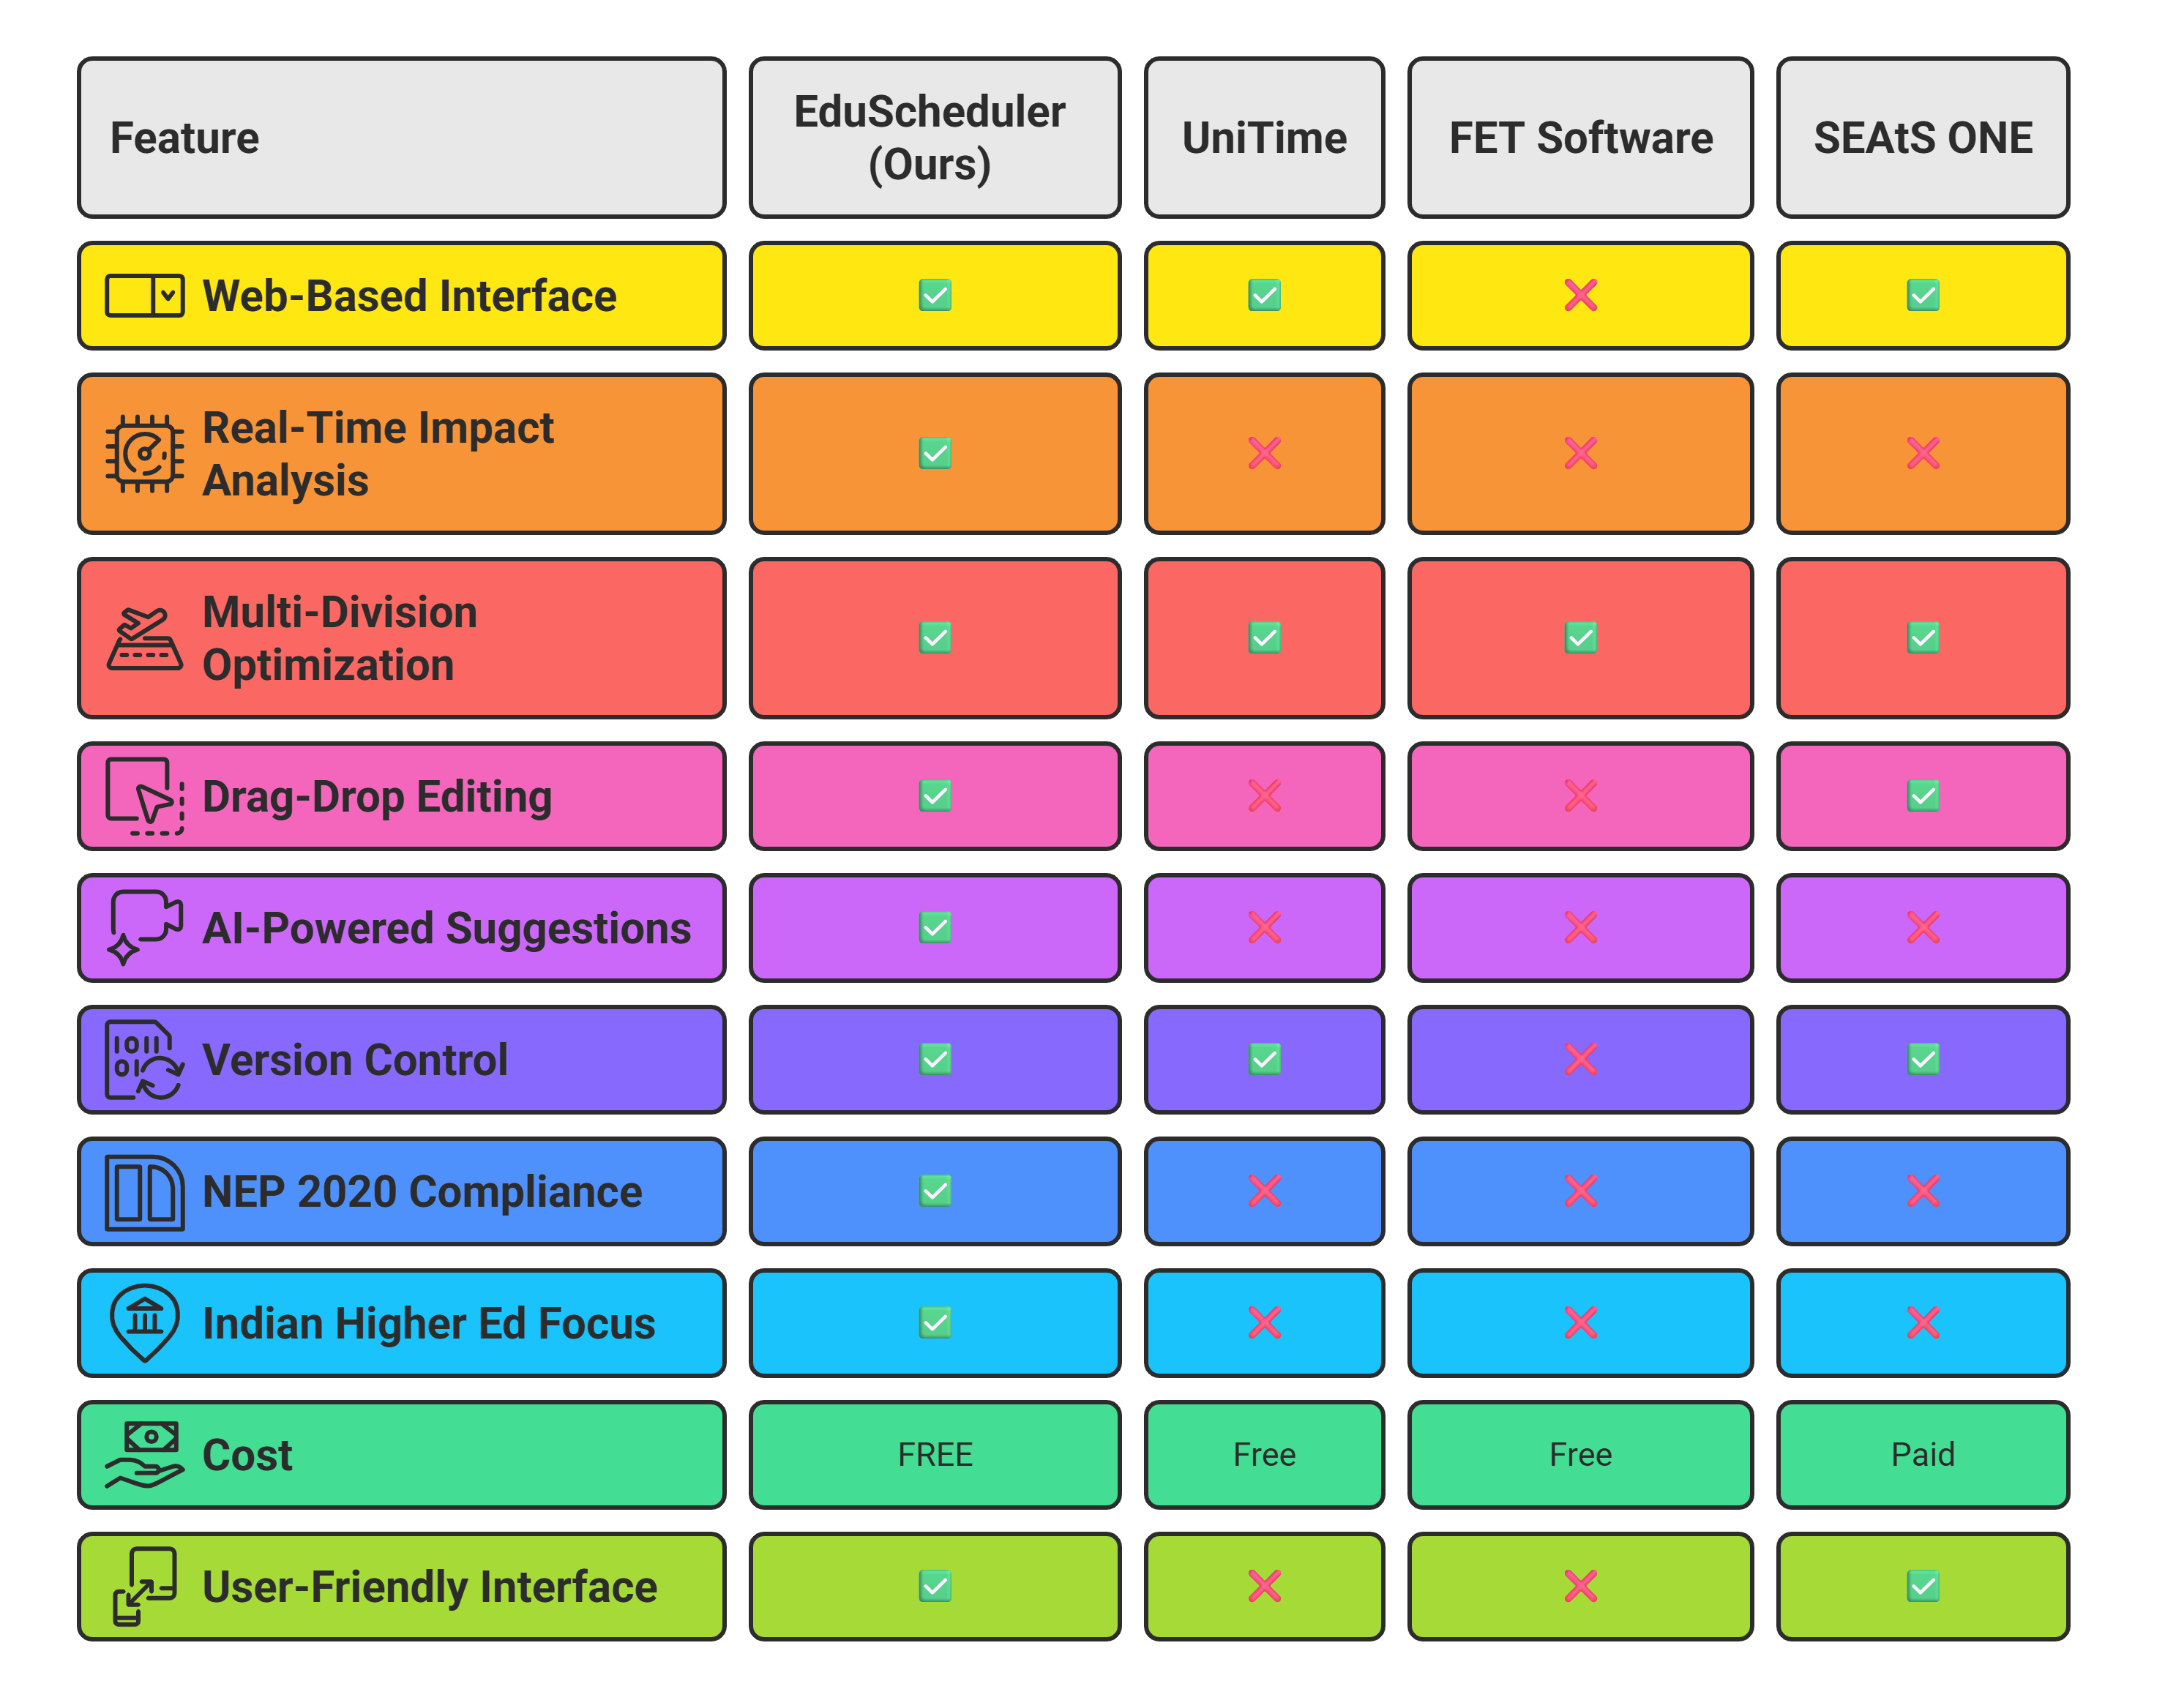


RESEARCH AND REFERENCES
InnoHex
Competitor Links:
UniTime: https://www.unitime.org
FET Software: https://lalescu.ro/liviu/fet/
SEAtS ONE: https://seatssoftware.com
Research Foundation Citations:
"Educational Timetabling: Problems, Benchmarks, and State-
of-the-Art Results" (2023) - https://doi.org/10.1016/j.ejor.2022.07.018
"Genetic Algorithm for University Course Timetabling
Problem" (2017) - University of Mississippi Research
"System of Automated Timetabling" (2003) - Silesian
University of Technology
"Timetable Management in Educational Institutions" (2025) – IRJMETS Journal

Slide 7


SOCIOTHON 2025
TITLE PAGE
  Problem Statement Title - Higher Education Scheduling Crisis
  Theme - Smart Education
  Team ID -
  Team Name - RANCKET’S
  Team Leader Name -
PRISM : Sociothon 2025

Slide 8
IDEA TITLE
Problem – 1. Manual scheduling causes frequent conflicts and errors.
2. Faculty and classroom resources are underutilized.
3. Last-minute changes are hard to manage.
4. Student and staff satisfaction is reduced.
Proposed Solution - EduScheduler Pro: AI-Powered Smart Timetable Revolution
Intelligent web-based platform that transforms manual scheduling chaos into automated optimization, generating conflict-free timetables for multiple divisions simultaneously with real-time editing and smart collaboration.
🎯 Multi-Division Intelligence: Processes all divisions simultaneously
⚡ 6-Hour Academic Limit: Enforces balanced student workload
🤖 Zero-Conflict Guarantee: No faculty double-booking across divisions
📊 Smart Break Placement: Prevents continuous 6-hour sessions
🔄 Lab Session Optimization: Perfect break hour block allocation
📱 Real-Time Configuration: Live constraint adjustment capability
PRISM : Sociothon 2025

Slide 9

IMPACT AND INNOVATION
Impact on Target
Audience
Innovation-
Faculty: 99% stress reduction from manual scheduling
Students: Zero schedule confusion, fair break distribution, improved academic satisfaction
Administrators: 15 days → 2 hours scheduling time
Real User Validation - Prof. Vikas Nandeshwar (VIT Instrumentation Dept)
Global Market Impact: 87% of universities still use manual timetabling - our solution can transform scheduling for 45,000+ higher education institutions in India alone, affecting 40+ million students and faculty.
PRISM : Sociothon 2025

Slide 10
TECHNICAL APPROACH
PRISM : Sociothon 2025

Slide 11


FEASIBILITY AND VIABILITY
FEASIBILITY
Proven AI Algorithms: Genetic algorithms achieve 95% optimization success
Modern Stack tools support rapid development and reliability.
Generates conflict-free timetables for multi-divisions.
VIABILITY
87% of universities still use the traditional way of spreadsheets for timetabling.
Reduces 12–15 days of manual scheduling to 2–3 hours.
No existing system handles 6-hour limits + multi-division optimization
PRISM : Sociothon 2025

Slide 12
InnoHex
Market Validation & Business Potential
POTENTIAL CHALLENGES AND STRATEGIES
1. Complex Input Requirements: Multiple configuration
parameters needed
Strategy: Guided setup wizard with pre-filled templates
and validation
2. Algorithm Complexity: Advanced constraint satisfaction
requirements
Strategy: Modular algorithm design with incremental optimization
3. Performance Scaling: Large datasets with multiple
constraints
Strategy: Parallel processing and cloud auto-scaling for peak loads

Slide 13


RESEARCH AND REFERENCES
Competitor Links:
UniTime: https://www.unitime.org
FET Software: https://lalescu.ro/liviu/fet/
SEAtS ONE: https://seatssoftware.com
Research Foundation Citations:
"Educational Timetabling: Problems, Benchmarks, and State-
of-the-Art Results" (2023) - https://doi.org/10.1016/j.ejor.2022.07.018
"Genetic Algorithm for University Course Timetabling
Problem" (2017) - University of Mississippi Research
"System of Automated Timetabling" (2003) - Silesian
University of Technology
"Timetable Management in Educational Institutions" (2025) – IRJMETS Journal
PRISM : Sociothon 2025

