Slide 1
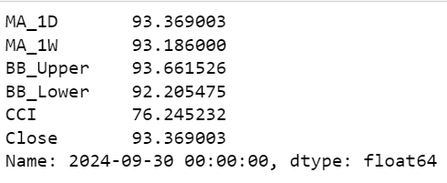
Technical Analysis of EUR/INR
Table of Decisions from Sept 30,2024
Collecting data
MA_1D = Moving Average 1 day, MA_1W = Moving Average 1 week, BB_Upper = Bollinger upper band,
BB_Lower = Bollinger upper band, CCI = Commodity Channel Index, Close = Closing Value

Slide 2
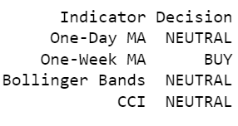
Decision Table

Slide 3
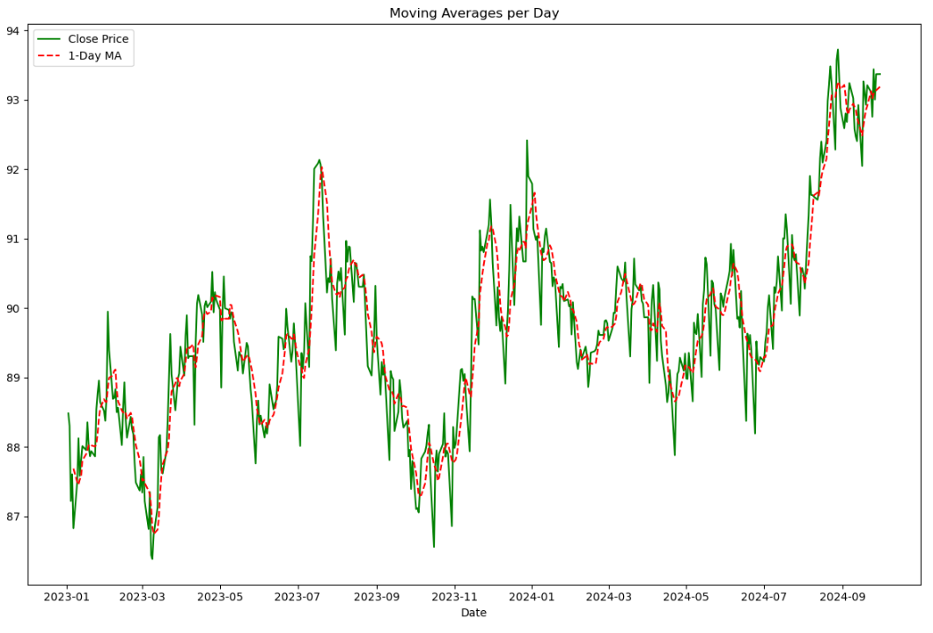
Graphs of Metrics
Decision annotation for Moving Averages per Day graph

Slide 4
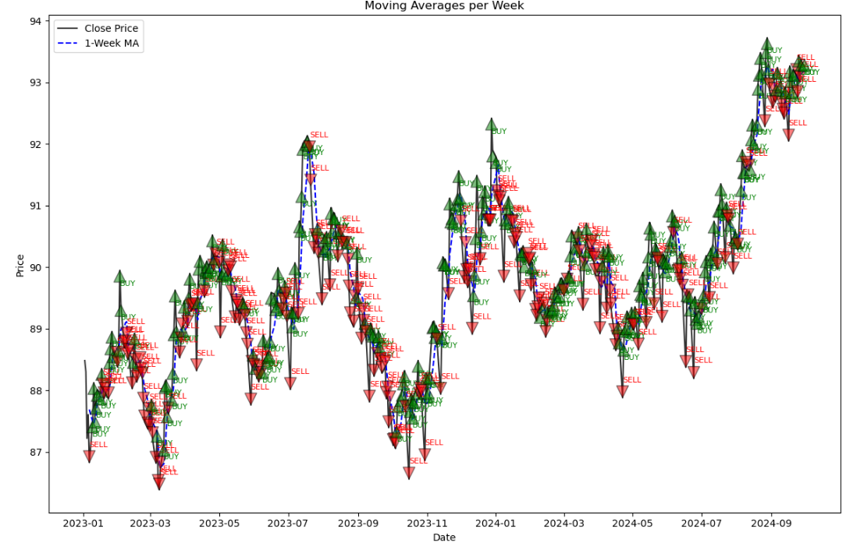
Decision annotation for Moving Averages per Week graph

Slide 5
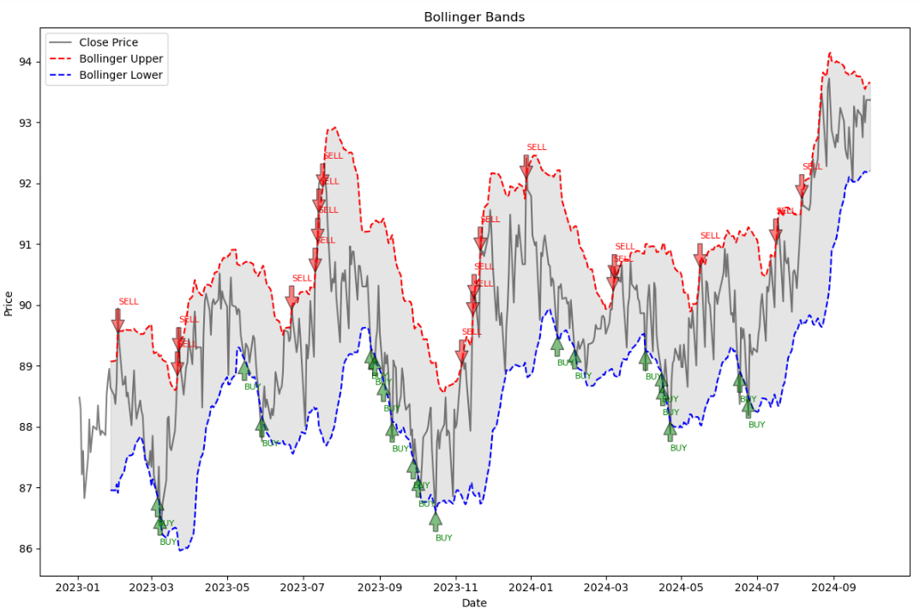
Decision annotations for Bollinger Bands graph

Slide 6
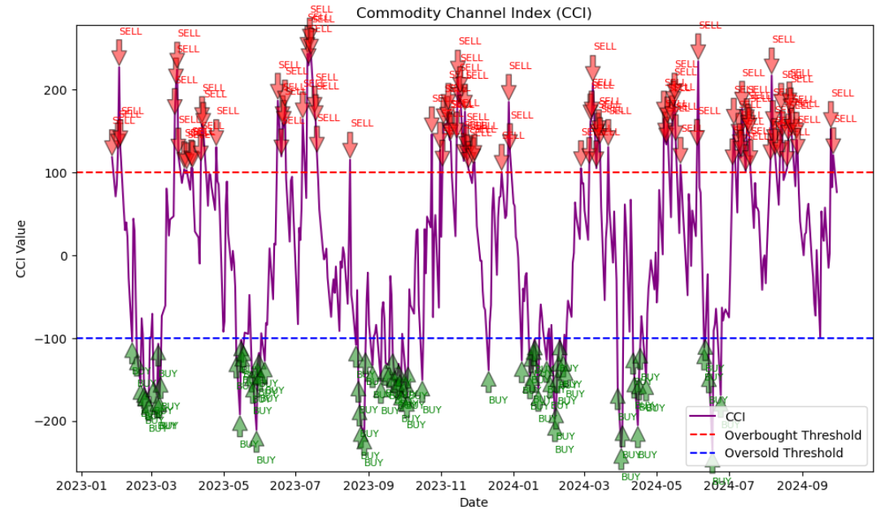
Decision annotations for Commodity Channel Index graph

Slide 7
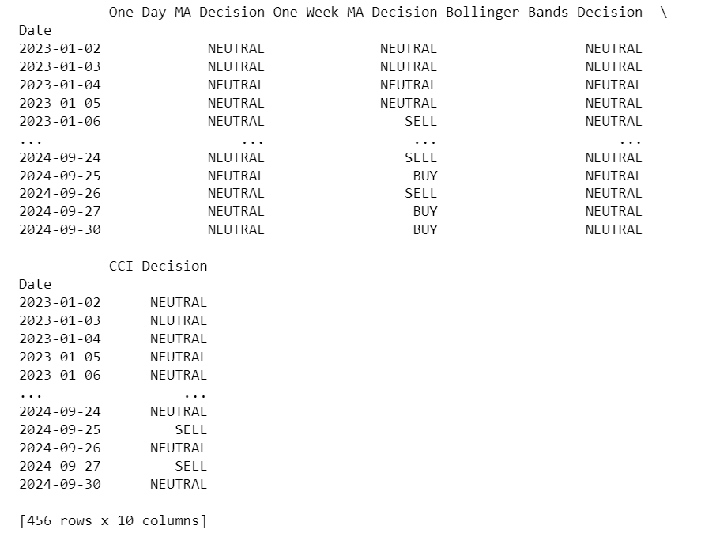
Corresponding decisions of each metrics for the specified time frames ( January 1, 2023, to sept 30, 2024)

Slide 8
Assumptions and Approach
1. Assumption on Moving Averages for Bollinger Bands
Reasoning for 20-Day Mid-Term Moving Average:
The 20-day moving average was chosen for Bollinger Bands calculations because it is a widely used standard that captures medium-term price trends, balancing between short-term price noise and long-term trend smoothing. This mid-range period is often used to help gauge the overall market trend while still being sensitive to recent price movements.
2. Separate Modules for Decision Making
Reasoning for Modular Functions:
Separate functions (‘decision_ma’, ‘decision_bb’, and ‘decision_cci’) were created to handle each indicator’s decision-making logic. This modular approach improves readability and reusability. By encapsulating each indicator’s logic within its function, any future adjustments to an indicator’s decision logic can be made in a single location without impacting the broader code structure. This approach also aligns with best practices in code design, supporting scalability and maintainability.

Slide 9
3. Decision Annotations in Graphs
Reasoning for Annotating Graphs:
Decision annotations were added to each graph to provide a visual representation of where "BUY" and "SELL" signals occurred relative to price trends. By marking these signals directly on the graphs, it’s easier to see how each indicator’s decision aligns with actual price movements, making it easier to analyze the historical accuracy of the signals. This annotation aids in assessing the strength of each indicator and whether it aligns with actual price trends over time.
4. Decision Calculation form 30th September 2024 to Each Row
Reasoning for Single Date Decision:
Initially, decisions were calculated for a specific date, 30th September 2024, to verify the correct functioning of each indicator’s decision logic individually. This allowed for spot-checking each function in isolation and ensuring that they provided expected outputs. After confirming that individual decisions worked correctly for the specific date, the decision logic was applied across every row in the dataset. This full dataset analysis enables a comprehensive view of how each indicator’s signals performed historically, giving more context and robustness to the analysis.

