Slide 1
Portfolio App
Presentation by Ayush Satpathy for Mobile Application Development Training

Slide 2
Objectives
🎯
Build a Complete Portfolio App
💾
Persist Data with AsyncStorage
Create a full-featured personal portfolio mobile application using React Native that digitises a resume into an interactive Android experience.
Ensure all user edits survive app restarts using AsyncStorage — fulfilling the optional enhancement from the assignment spec.
⚛️
Master React Native Fundamentals
🧩
Demonstrate Component-Based Design
Apply core concepts: components, props, hooks (useState, useEffect), StyleSheet, Flexbox, navigation, and list-based rendering.
Build 12+ reusable components with props-driven data flow, mirroring real-world production React Native patterns.
🔄
Implement Full CRUD Operations
🚀
Deliver a Presentable Product
Enable Create, Read, Update, and Delete across 5 data sections — Profile, Skills, Experience, Achievements, and Projects.
Produce a polished, demo-ready app with consistent UI theme, smooth animations, and intuitive navigation between all screens.

Slide 3
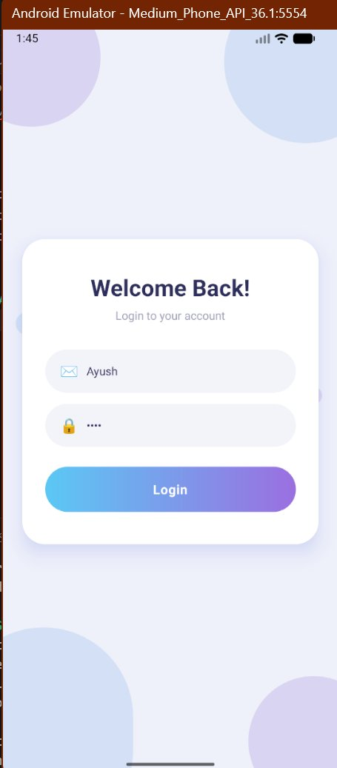
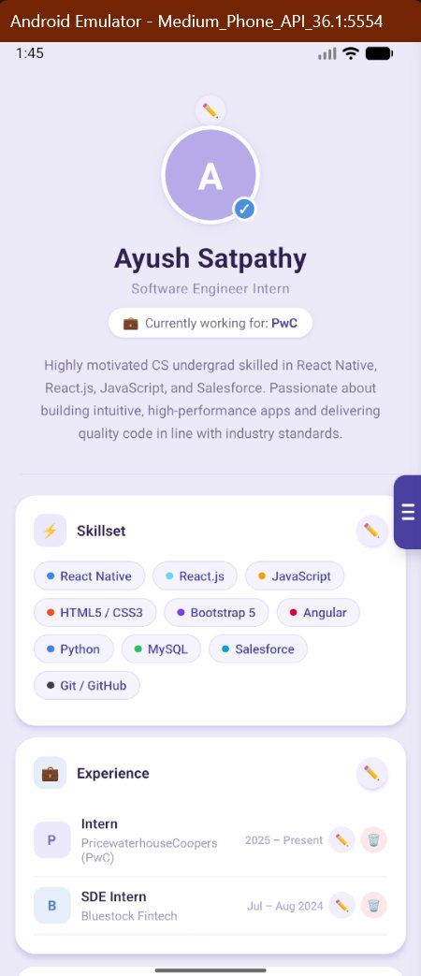
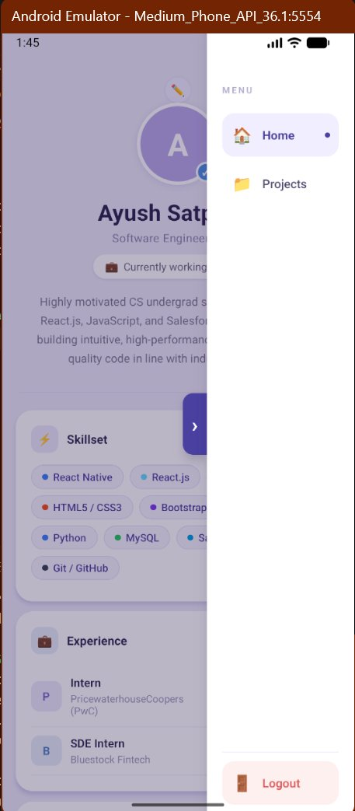
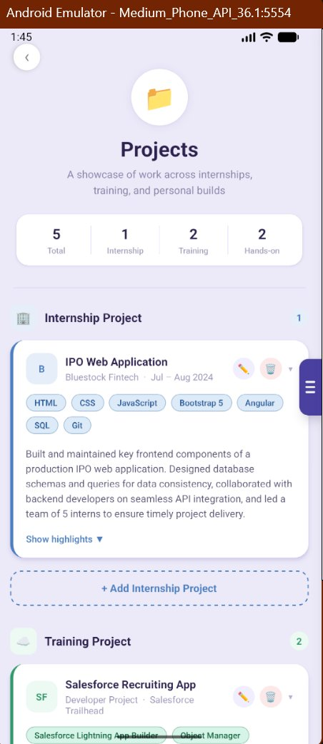
App Overview
Personal Portfolio Mobile App built with React Native — interactive, fully editable, and persistent.
Login Screen
Home Screen
Navigation
Projects Screen
Email + Password
Validation + Spinner
Profile · Skills
Experience · CRUD
Slide-in Nav Drawer
Home · Projects · Logout
3 Categories
Full CRUD per Project

Slide 4
App Screen Flow
index.js
App.tsx
▶
AppRegistry.registerComponent()
NavigationContainer · Stack.Navigator
▼
Login.js
HomeScreen.js
ProjectDetails.js
name="Login"
name="Home"
name="Project"
navigation.replace('Home')
navigate('Project') / replace('Login')
navigate('Home') / replace('Login')
File Structure: src/Screen/Login.js · src/Screen/Home.js · src/Screen/ProjectDetails.js · App.tsx · index.js

Slide 5
Component Architecture
HomeScreen.js · 7 Components
ProjectDetails.js · 6 Components
SideNavBar
Animated spring slide-in nav drawer with Logout
SideNavBar
Same pattern — consistent UX across screens
navigation, activeScreen
navigation, activeScreen
EditBtn
Reusable ✏️ pencil button used in hero + cards
TechTag
Coloured tech pill inside project cards
onPress
label, bg, color
SkillTag
Coloured skill pill with dot indicator
Bullet
Single highlight bullet row
label, dotColor
text
ExpItem
One experience row with logo initial
ProjectCardItem
Expandable card with ✏️ edit + 🗑️ delete
initial, role, company…
project, category, onEdit…
AchItem
One achievement entry with dot bullet
CategorySection
Category header + project cards group
title, subtitle
category
Card
Generic card wrapper — used 3 times
ProjectEditModal
Slide-up bottom sheet for Add / Edit project
iconBg, title, children
visible, draft, onSave…
Modals ×4
Profile · Skills · Experience · Achievements
visible, draft, onSave…

Slide 6
CRUD Flow
Section
CREATE
READ
UPDATE
DELETE
File
Profile
–
✓
✓
–
Home.js
Skills
✓
✓
–
✓
Home.js
Experience
✓
✓
✓
✓
Home.js
Achievements
✓
✓
–
✓
Home.js
Internship Proj
✓
✓
✓
✓
ProjectDetails.js
Training Proj
✓
✓
✓
✓
ProjectDetails.js
Hands-on Proj
✓
✓
✓
✓
ProjectDetails.js
Pattern: CREATE → [...prev, item] | UPDATE → prev.map(x => match ? newData : x) | DELETE → prev.filter(x => !match)

Slide 7
User Flow Diagram
Launch App
Login Screen
Valid?
Home Screen
▶
▶
▶
index.js boots
Enter credentials
No → Error shown
replace('Home')
Edit Profile
(Modal)
▶
▼
Edit Skills
(Add/Delete)
Edit Experience
(Full CRUD)
Edit Achievements
(Add/Delete)
▼
Side Nav Drawer → Home | Projects | Logout
▼
▼
💾 AsyncStorage
Auto-save on change
Projects Screen
Logout
◀
Full CRUD
replace('Login')

Slide 8
Future Potential
01
🌐
Real Backend Integration
04
🌍
Multi-Language Support
Connect to a REST API (Node.js / Firebase) to fetch and push portfolio data dynamically, enabling multi-device sync and real-time updates.
Implement i18n localisation so the portfolio can be presented in multiple languages — expanding reach beyond English.
02
🔐
Real Authentication
05
🌙
Dark Mode
Replace the simulated login with Firebase Auth or OAuth — email/password, Google Sign-In, or biometric login for secure access.
Add a theme toggle using React Context and conditional StyleSheet — persisted via AsyncStorage between sessions.
03
🖼️
Photo Upload & Media
06
📤
Export as PDF / Share Link
Add camera/gallery integration using react-native-image-picker to upload a real profile picture and project screenshots.
Generate a PDF version of the portfolio or a shareable web link using react-native-share and a hosted serverless function.

Slide 9
Thank you
React Native Mini Project — Portfolio App
© 2026 PwC. This presentation has been prepared for the React Native Mini Project Assignment during the PwC Internship Programme.

