Slide 1


Runway Reservation using activity scheduling algorithm
Prepared by:
SR NO. | NAME | ROLL NO. | ENROLLMENT NO. | BATCH | BRANCH
1. | PATEL TIRTH A. | 61 | 21002171210127 | S2 | C.S.E
2. | SHAH AYUSH K. | 222 | 21002170110167 | S8 | C.E
3. | PANCHAL AARJAV N. | 145 | 21002170110090 | S5 | C.E
4. | GUNA DARSHIL R. | 146 | 21002171210043 | S5 | C.S.E
5. | BORDA KUNJ V. | 205 | 21002170110010 | S7 | C.E

Slide 2

INTRODUCTION: WHAT IS ACTIVITY SCHEDULING ALGORITHM?
Let's consider that you have n activities with their start and finish times.
The objective is to find solution set having maximum number of non-conflicting activities that can be executed in a single time frame.
Assuming that only one person or machine is available for execution.
Greedy approach is used to find the solution since we want to maximize the count of activities that can be executed.

Slide 3
BASIC IDEA REGARDING RUNWAY RESERVATION
On the basis of information stored in information storage units, runway use time is assigned to each arriving aircraft and departing aircraft by a takeoff and landing assignment unit in accordance with Control System Standards.
Runway reservation information thus obtained is stored in a reservation information storage unit.
The information stored in the reservation information storage unit is displayed on a screen by a reservation display unit.
The information stored in the estimated time of takeoff and landing storage unit is suitably displayed on the screen by a flight situation display unit.

Slide 4
STEPS FOR ACTIVITY SCHEDULING PROBLEM
Step 1: Sort the given activities in ascending order according to their finishing time.
Step 2: Select the first activity from sorted array act[] and add it to sol[] array.
Step 3: Repeat steps 4 and 5 for the remaining activities in act[].
Step 4: If the start time of the currently selected activity is greater than or equal to the finish time of previously selected activity, then add it to the sol[] array.
Step 5: Select the next activity in act[] array.
Step 6: Print the sol[] array.

Slide 5
Time Complexity Analysis
Case 1: When a given set of activities are already sorted according to their finishing time, then there is no sorting mechanism involved, in such a case the complexity of the algorithm will be O(n)
Case 2: When a given set of activities is unsorted ,the time complexity of this method will be O(nlogn), which also defines complexity of the algorithm.
Applications:
Scheduling multiple competing events in a room, such that each event has its own start and end time.
Scheduling manufacturing of multiple products on the same machine, such that each product has its own production timelines.
Activity Selection is one of the most well-known generic problems used in Operations Research for dealing with real-life business problems.

Slide 6
HOW HAVE WE IMPLEMENTED THIS ALGORITHM IN OUR PROJECT?
We have created a program for activity scheduling algorithm using linked list nodes. These nodes represent entities like Aircrafts.
Each aircraft has its initial and final time near a specific airport with N runways where the program is used.
This code arranges planes in such order that no plane has to wait for landing on a specific on a runway.
If the timeline of one runway clashes with an aircraft then that aircraft is assigned to next runway and so on. In this manner N runways are assigned to all the available planes.
Each process in activity scheduling is referred as ‘Runways’ here.
It solves the problem of clashing time and ambiguity of events (here arrival of aircraft).

Slide 7
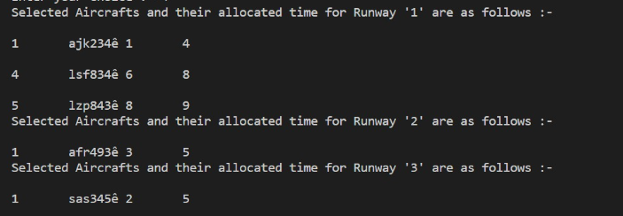
OUTPUT:

Slide 8
THANK YOU !

