Slide 1

E-Commerce: Your One One Stop Shop
Discover our innovative platform for online shopping and selling. Using HTML, CSS, Tailwind.js, React.js, Vite, Redux Toolkits, npm packages, and Firebase back-end, we provide a seamless and secure experience for users and admins alike with transaction gateway with security of user identity

Slide 2
Objectives
Empower Online Shopping
Support Online Selling
Secure Transactions
Enable business owners to sell their products with the ease and flexibility of an online store.
Ensure that all transactions are secure, from payment processing to data storage, to foster trust and reliability among customers and sellers.
Provide an easy-to-use platform for customers to browse and purchase products without the hassle of leaving their homes.

Slide 3
Problem Statement
Traditional shopping methods have limitations like location, time, and availability. Online shopping offers convenience, but the options are often limited and not trustworthy. Our project aims to bridge this gap and provide a secure platform that enables customers and sellers to thrive.

Slide 4
Literature Review
1
Amazon
Amazon revolutionized the e- commerce industry and set the benchmark with its extensive product range and proprietary fulfillment technology.
E-Bharat
2
E-Bharat is a e-commerce platform that offers creative sellers a platform to sell niche handmade or vintage items and connect with their customer base.
3
Shopify
Shopify offers website hosting and e- commerce tools to help businesses easily set up their online store. It has multiple features like inventory management, payment processing and point-of-sale solutions.

Slide 5

Methodology
Our project was developed using React, an open-source JavaScript library for building user interfaces. We used Tailwind CSS, a utility-first CSS framework along with Vite, a fast web development build tool. We also integrated Firebase, a mobile and web application development platform.

Slide 6
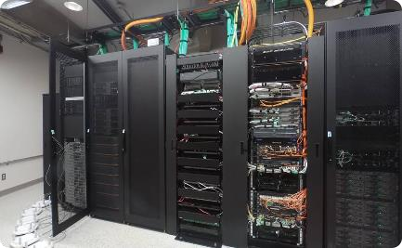

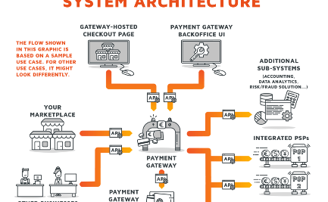
System Architecture
Server
Client-side
Payment Gateway
We use server resources to store and manage product details, user information and transaction history.
Our client-side system is built with React.js and Redux toolkits to provide a smooth, responsive and intuitive user interface.
We use Razorpay for secure and hassle-free payment processing.

Slide 7
Implementation
Our implementation process involved breaking down the project into smaller components, using reusable code wherever possible, writing clear documentation, and rigorous testing. The code was version controlled and deployed using best practices.

Slide 8
Features
1
Easy Navigation
User-friendly interface with categories, search tags, and filters to improve the browsing experience.
Safe and Secure
2
We ensure secure transactions with SSL encryption and Razorpay integration to provide options for
online payments.
3
Flexibility
Both sellers and customers can track order status, review order history, and contact each other using our messaging system.
Customizable
4
Sellers can personalize their storefronts
with their branding and product
images.

Slide 9

Results
E-commerce websites offer global market access, 24/7 availability, and cost efficiency, expanding businesses beyond physical constraints. With increased sales and revenue, they provide customer convenience through online browsing and informed decision- making. Personalization and data analytics enhance user experience, while streamlined transactions reduce time and effort for both businesses and consumers. E-commerce facilitates efficient inventory management, minimizing stock-related challenges.
Overall, these platforms revolutionize commerce, creating a dynamic and interconnected marketplace that benefits businesses and consumers alike.

Slide 10

Challenges Faced
1
Data Management
We faced challenges with optimal database queries and data structuring, eventual consistency, and scaling data architecture to cope with larger data volumes.
2
Security
Providing a secure transaction platform involves complex technical requirements and compliance regulations that we needed to address.
3
User Experience
Providing a seamless and intuitive user experience called for a lot of preliminary design and testing to get it just right.

Slide 11

Future Work
Customer Feedback
Collecting constant feedback is vital to providing an excellent user and seller experience. We continuously work on improving the feedback loop to achieve this.
Filter for better experience
E-commerce filtering streamlines product searches, aiding customers in finding desired items
quickly. Filters, such as price range or product attributes, enhance user experience, leading to more efficient and satisfying online shopping.
Order Tracking
We aim to provide better real-time order tracking to make the shopping experience more convenient for customers.

Slide 12

Conclusion
In conclusion, our e-commerce platform serves as a platform for both shoppers and sellers to interact efficiently with minimal transaction risk. Our innovative use of modern technologies has yielded excellent results that demonstrate high potential for future growth and improvement.

Slide 13
Acknowledgments
We would like to thank our professor - [Name], our classmates, and everyone else for their contributions,
feedback, and support during the project development. None of this would be possible without their help.

Slide 14


Q&A
We invite any questions or feedback from our esteemed audience.

Slide 15
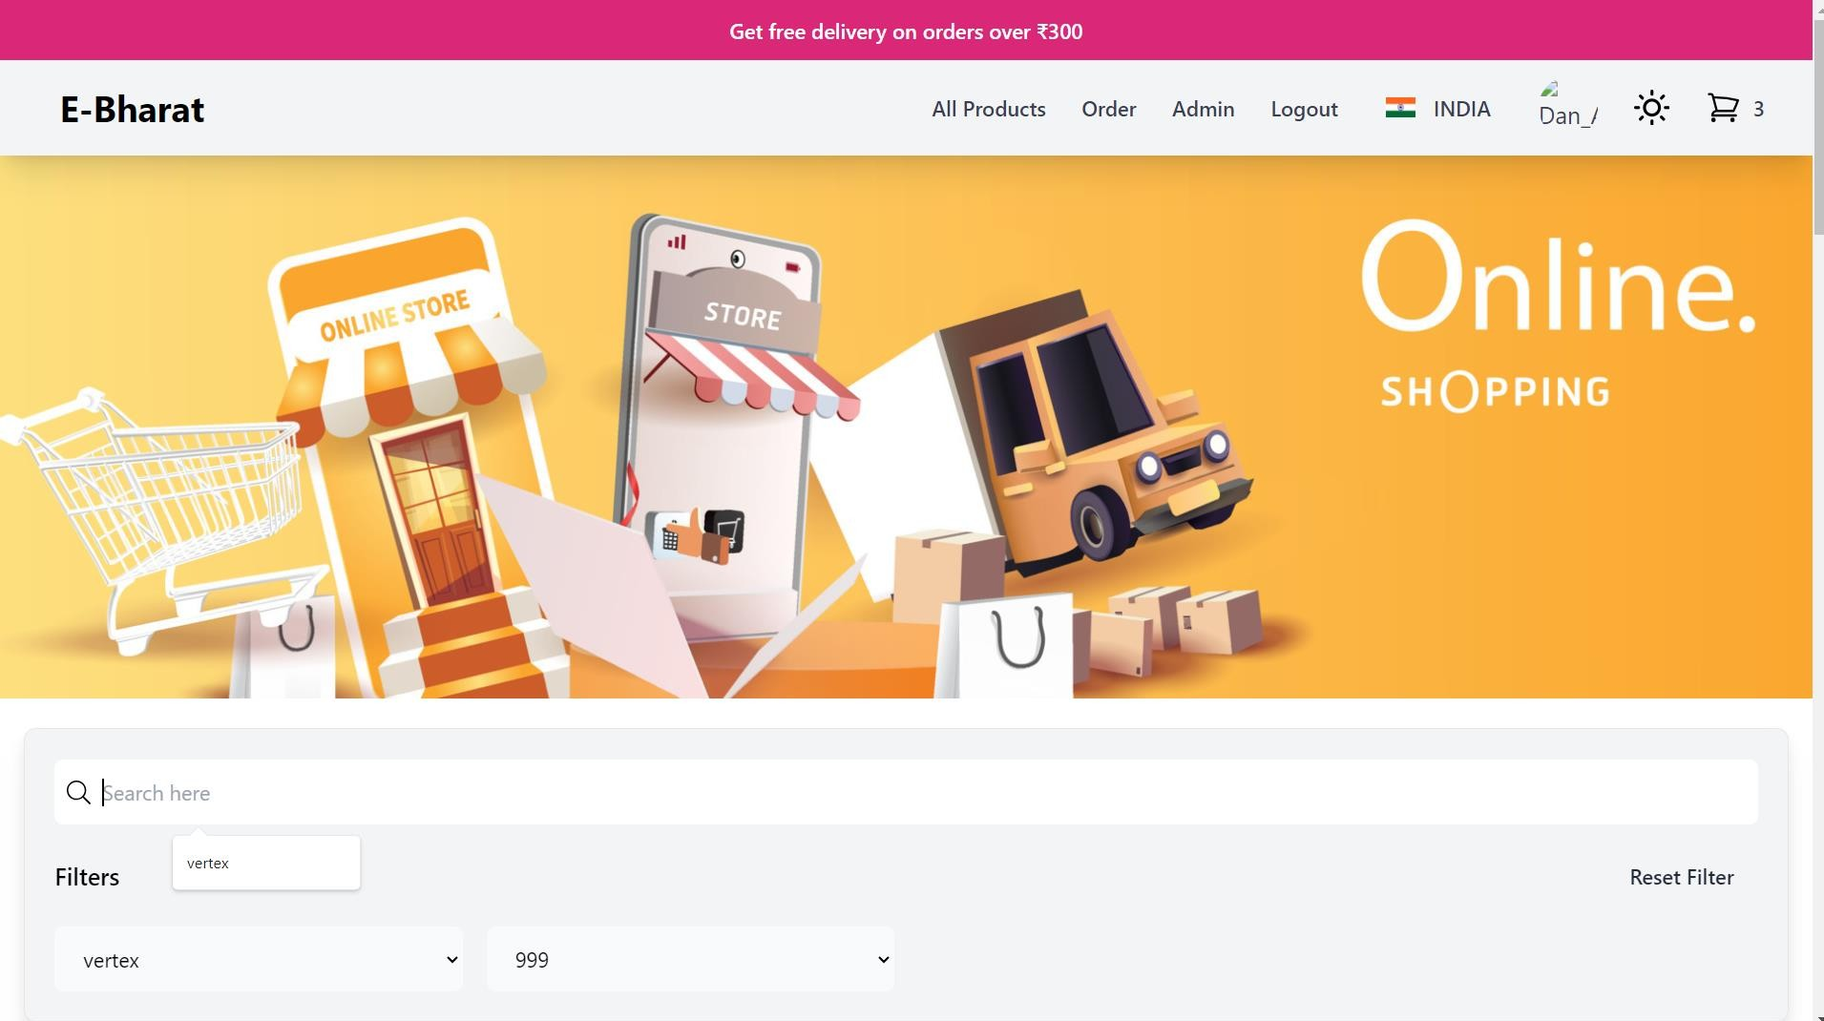

Slide 16
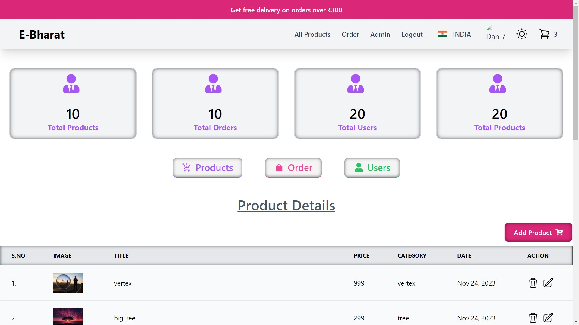

Slide 17
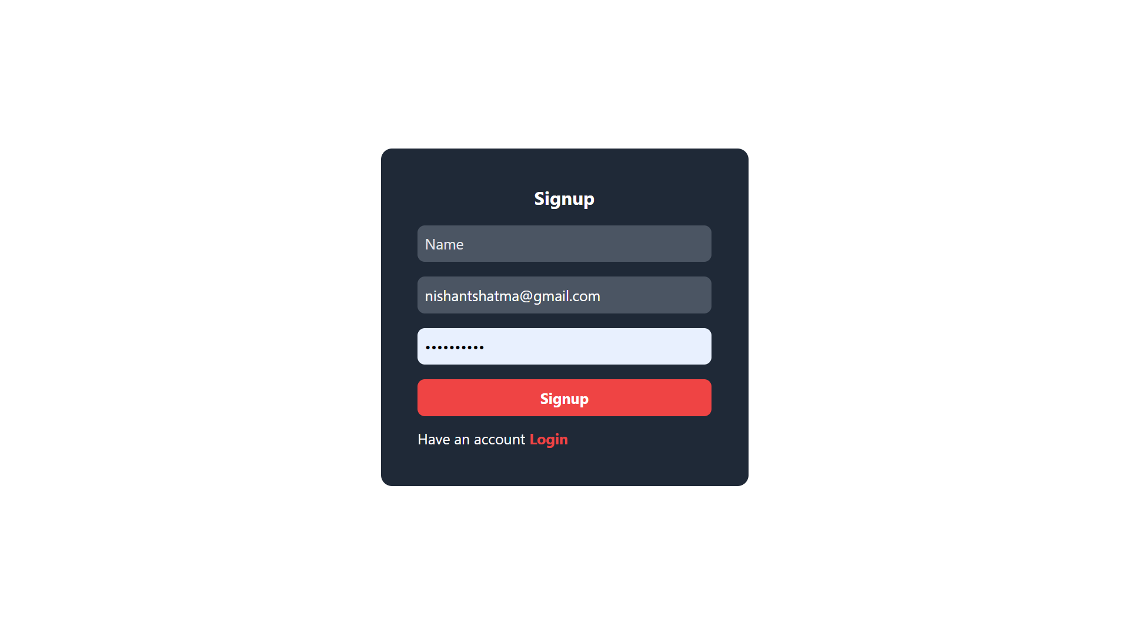
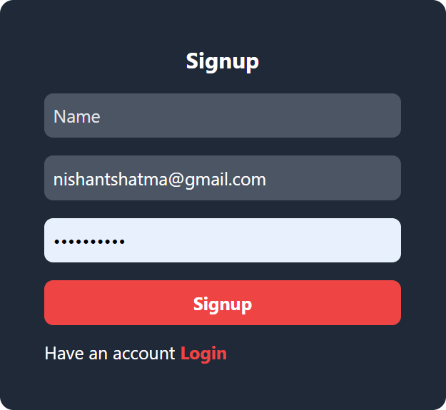

Slide 18
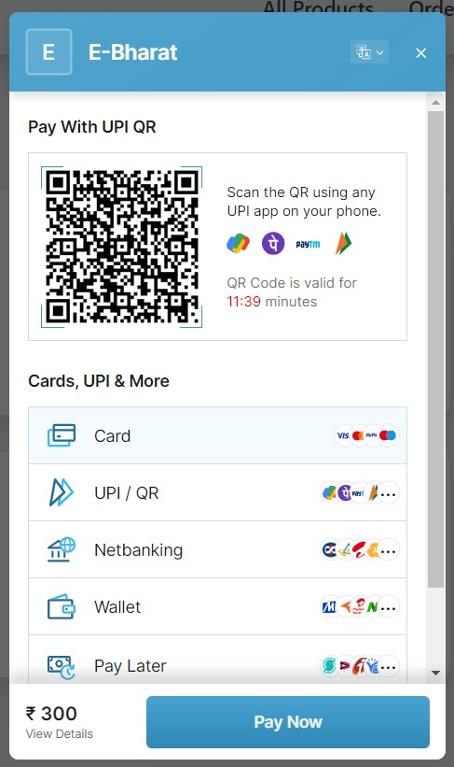

Slide 19
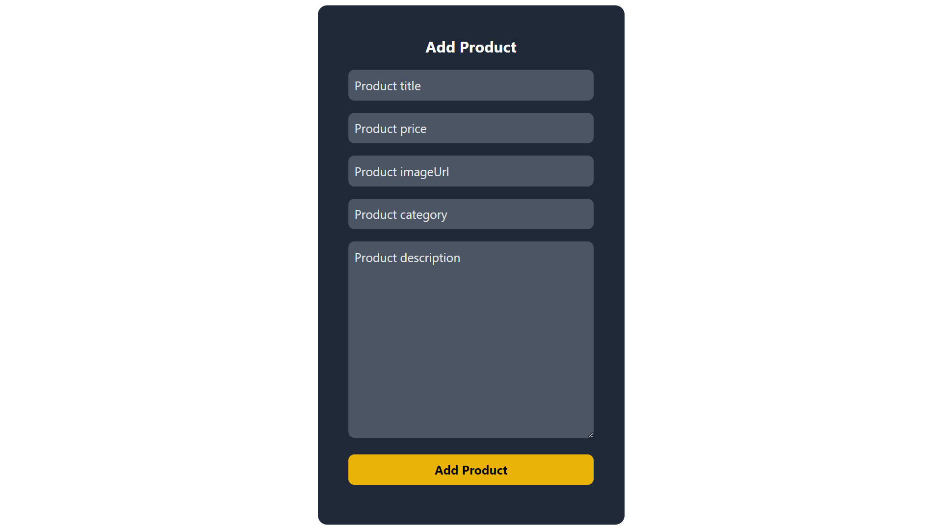

Slide 20
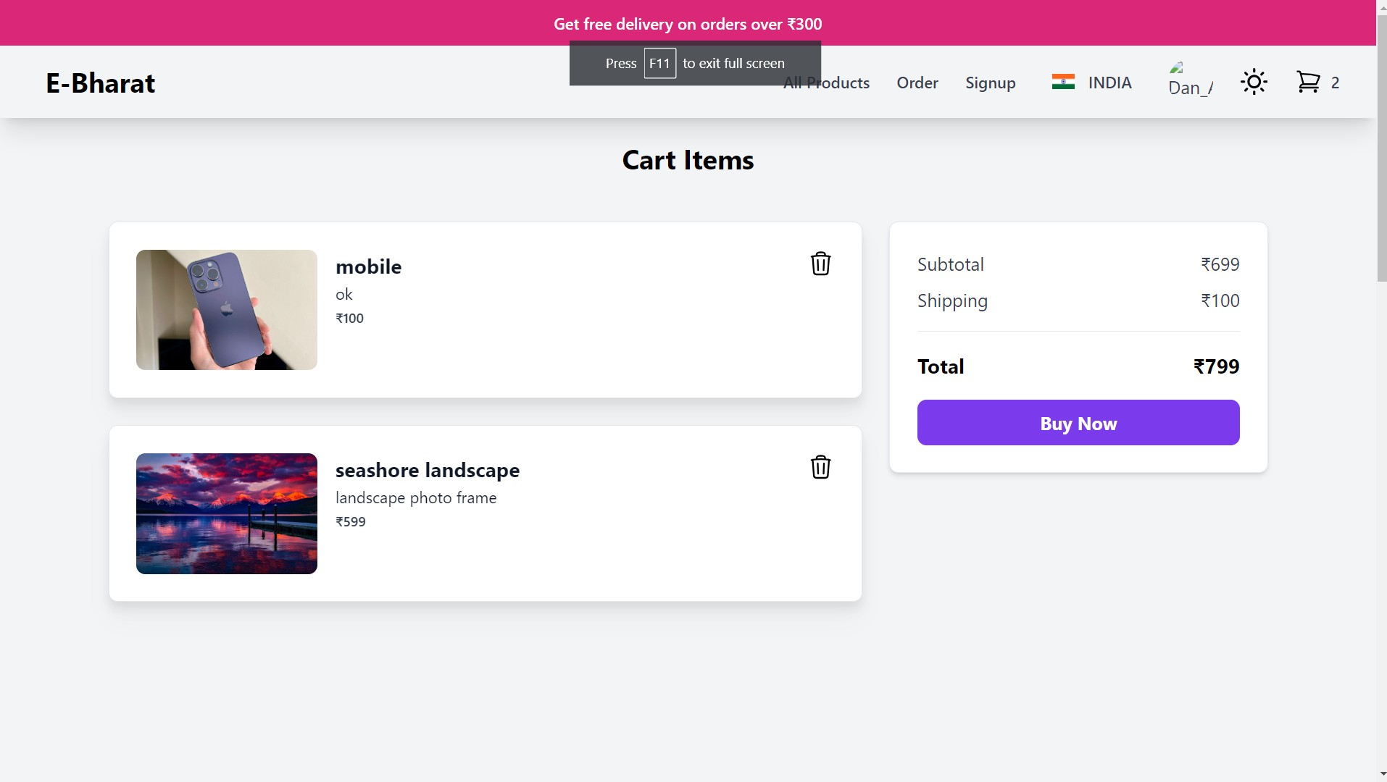

Slide 21
