Slide 1


SudoCode
Presented by:
Pranav Hindupur(1604-17-737-004)
Ayush Singh(1604-17-737-022)

Slide 2
INTRODUCTION
What is a pseudocode?
It is the code we are writing with no specific syntax or in no particular language (In English).
SudoCode:
It’s a web application and supreme tool, that converts a pseudocode to a program in either C or C++.
It’s a simplified way, where we write the pseudocode in a certain way (according to certain rules) and then convert it into a C or C++ code.

Slide 3
WHY WE NEED SUDOCODE?
It improves code readability and code quality.
It helps budding developers code, without even knowing the language.
No need to worry about syntax and errors. One can focus on developing the logic.
On a larger scale, in industries, it saves up important time, as the pseudocode is directly changed into C code, and its output is also given.
Easier to implement tougher programs.
Gives a superior code, with proper indentations/syntax.

Slide 4
FUNCTIONALITIES
All possible Functionalities that can be performed are:
For loop
While loop
Function definition
Function calling
Printing of statements and variables
Initializing variables
Basic increment and decrement statements
All the above mentioned functionalities can be written in the form of a pseudocode and will be converted to code by our program

Slide 5
RULES
Starting the Main body:
To start the code, we use the keyword start.
To initialize variables, we need to follow the following format(default:float):
Initialize <optional_name> <var_name>=<var_value>
To print, the following format is followed:
print <statement_or_variable to be printed>
EXAMPLE: (1) print hey there
(2) print inside loop now
(3) Let's assume there's a variable "temp" in the main body, then
print temp

Slide 6
RULES
For For loops the following format is followed:
for int <var_name>=<start_value> to <stop_value>
EXAMPLE: (1) for int i=0 to 10
-------
-------
endfor
(2) for int i=50 to 10
-------
-------
endfor

Slide 7
RULES
For While loops the following format is followed:
while <condition>
-----
-----
endwhile
EXAMPLE: (1) while i<=10
print i
i++
endwhile
(2) initialise int temp=110
while temp>=100
print temp
temp--
endwhile

Slide 8
RULES
For function definition the following syntax is followed:
function <func_name> returns <return_type> with args <var_type> <var_1>, <var_type> <var_2>,.....,<var_type> <var_n>
EXAMPLE: (1) function test returns int with args int a, float b, int c
(2) function test returns void with args int size, float array_size

Slide 9
HOW TO RUN?
The code is saved on github, and is run on an online shell, known as the google cloud platform.
Clone the source with git:
$ git clone https://github.com/Pranav24021/Project1
$ cd Project1
Running sudocode:
$ python3 main.py path/filename.txt
e.g. - $ python3 main.py testfiles/sudocode.txt

Slide 10
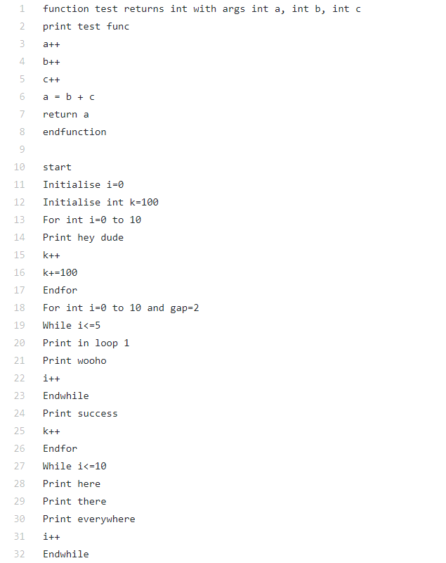
EXAMPLE
The following is the pseudocode:

Slide 11
The following are the converted C code, and the output of code.

Slide 12
CONCLUSION
It is a program used to help budding programmers, code, by focusing on logic, without even knowing the language.
In industries, it helps save time to a large extent and gives a code of superior quality and readability.
The pseudocode is written in a certain way, so as to convert the code to our desired language and output.
It is fairly simple and run on a shell.
Therefore, it’s a very useful tool, in todays world where time is essentially money.

Slide 13
THE END
THANK YOU

