Slide 1
Project : e9-246 Advanced Image Processing
Hateful Memes Identification with Multimodal Classifications
Ayush Singh (20910)
Preeti Sharma (20983)

Slide 2
Outline
Motivation
Introduction
Multimodal Classification & Data Overview
Data Fusion & Multimodal Representation
Baseline Model
VisualBERT Model
CLIP Fine Tuning
Experimentation Details and Results
Conclusions & Future Works
29th April, 2023

Slide 3

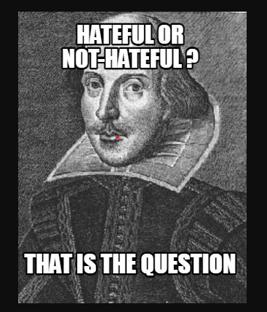
Motivation
Social media growth and communication changes.
Hateful expressions propagation on social media.
Progress in deep learning-based models to detect hate speech.
Different forms of hateful conduct require different modeling.
Memes as a unique form of hateful conduct on social media.
29th April, 2023

Slide 4
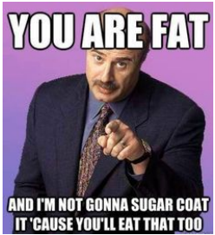
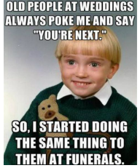
Introduction
Challenge of detecting and classifying hate memes due to coherence between image and text
Multimodal approach necessary to bridge CV and NLP
Project aims to build and train a model for hateful meme detection
Utilization of data from Facebook's Hateful Meme Challenge
Baseline model with independently pre-trained text and visual embeddings
VisualBERT standalone model
CLIP Fine Tuning
Hateful or Non Hateful Meme ?
Hateful or Non Hateful Meme ?
29th April, 2023

Slide 5
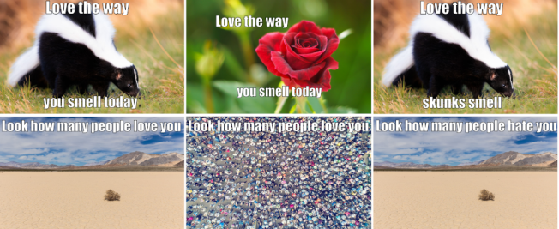
Multimodal Classification & Data Overview
Combines data representations from different modalities.
The Hateful Memes dataset was pre-processed by Facebook AI.
Within the hateful category, memes can be unimodal hate or multimodal hate, where the combination of the text and the visual makes them hateful.
The dataset contains 2,000 memes, with 14,00, 400 , and 2,00 memes used as train, dev, and test sets respectively.
Most of the models tested rely only on the raw pixel and text data, but VisualBERT also utilizes the R-CNN backbone for image processing.
Illustrative (not real) examples of multimodal hateful memes . While the memes on the left column are hateful, the ones in the middle are non-hateful image confounders, and those on the right are non-hateful text confounders.
29th April, 2023

Slide 6
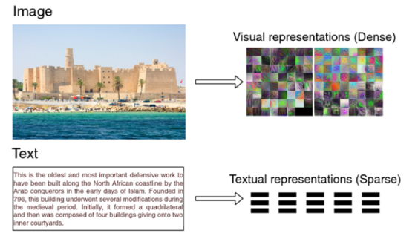
Data Fusion & Multimodal Representation
Multimodal data fusion is essential in creating a coherent joint representation of drastically different representations.
We focused on conventional fusion steps used in both baseline and VisualBERT models.
Fusion methods can be model-agnostic or model-based, with three commonly used approaches: early, late, and cross-modality fusion.
Another challenge in multimodal classification is how to represent data for computational purposes.
Introduced two categories of representations: joint and coordinated representations.
29th April, 2023

Slide 7
Baseline Model
The baseline model used two pre-trained models for text and vision that were fused and fine-tuned to our specific task of classifying hateful memes.
The converted image data was fed through the pre-trained Resnet152 model.
For the text data, S-BERT's sentence embedding was used, which pools each word-level embedding of the sentence into a single sentence-level embedding.
The fusion method was a simple concatenation of the embedding dimension.
The concatenated matrix was fed through a fully-connected linear and ReLU activation layer.
The matrix was then projected down for the softmax scoring.
A binary cross-entropy loss was used to backpropagate the errors.
29th April, 2023

Slide 8
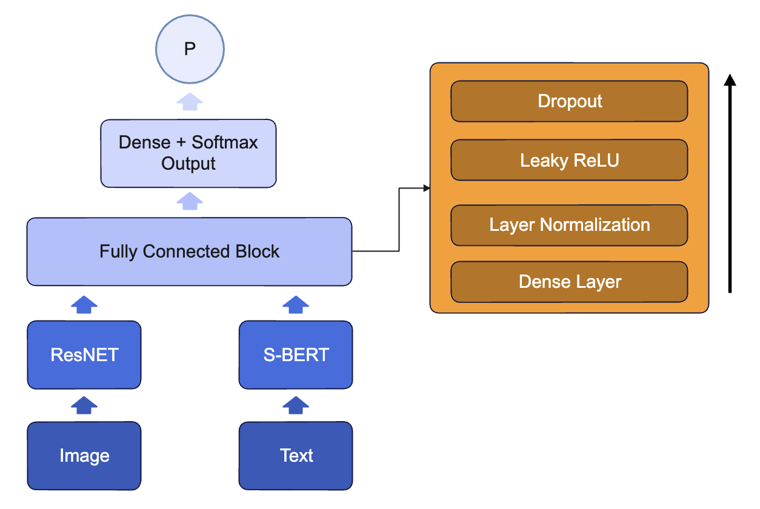
Baseline Architecture
29th April, 2023

Slide 9
VisualBERT Model
Pre-training step require both visual embeddings and tokenized text.
The text is fed through the BERT uncased tokenizer model.
The visual embedding inputs for VisualBERT are obtained from an R-CNN.
The raw pixels are initially fed through a RCNN model, using a Resnet101 model as the backbone
The R-CNN outputs will be the visual embeddings for VisualBERT.
The last hidden state of this pre-trained model, is flattened and then fed through fully-connected feed forward layers with LeakyReLU activations.
Layernorm and dropout regularization are applied before and after the activations respectively.
Finally, the matrices are projected down for softmax scoring in a binary cross-entropy loss function.
29th April, 2023

Slide 10
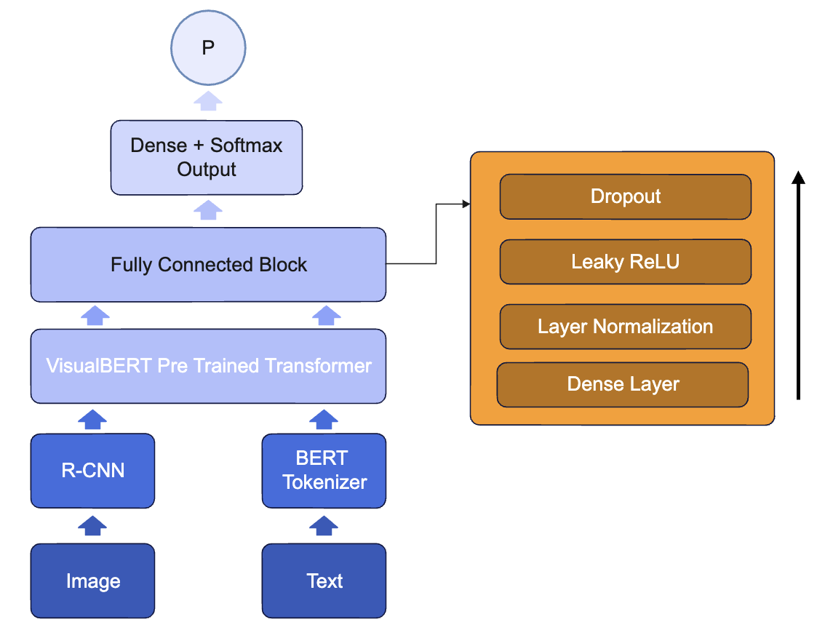
VisualBERT Architecture
29th April, 2023

Slide 11
Clip Fine Tuning
We propose the CLIP architecture for hate meme classification since CLIP is a state-of-the-art neural network model that can perform a wide range of tasks that involve understanding both text and images, such as image captioning, visual question answering, and object detection.
CLIP pre-trains an image encoder and a text encoder to predict which images were paired with which texts in a dataset.
It was found in literature that features of CLIP are more versatile and better suited for a multimodal domain.
We Fine tuned the CLIP model by freezing the backbone network till last second layer and we added the classification layer as the last layer.
We used Dropout Regularization and Leaky Relu activation functions for the fully connected layer.
29th April, 2023

Slide 12
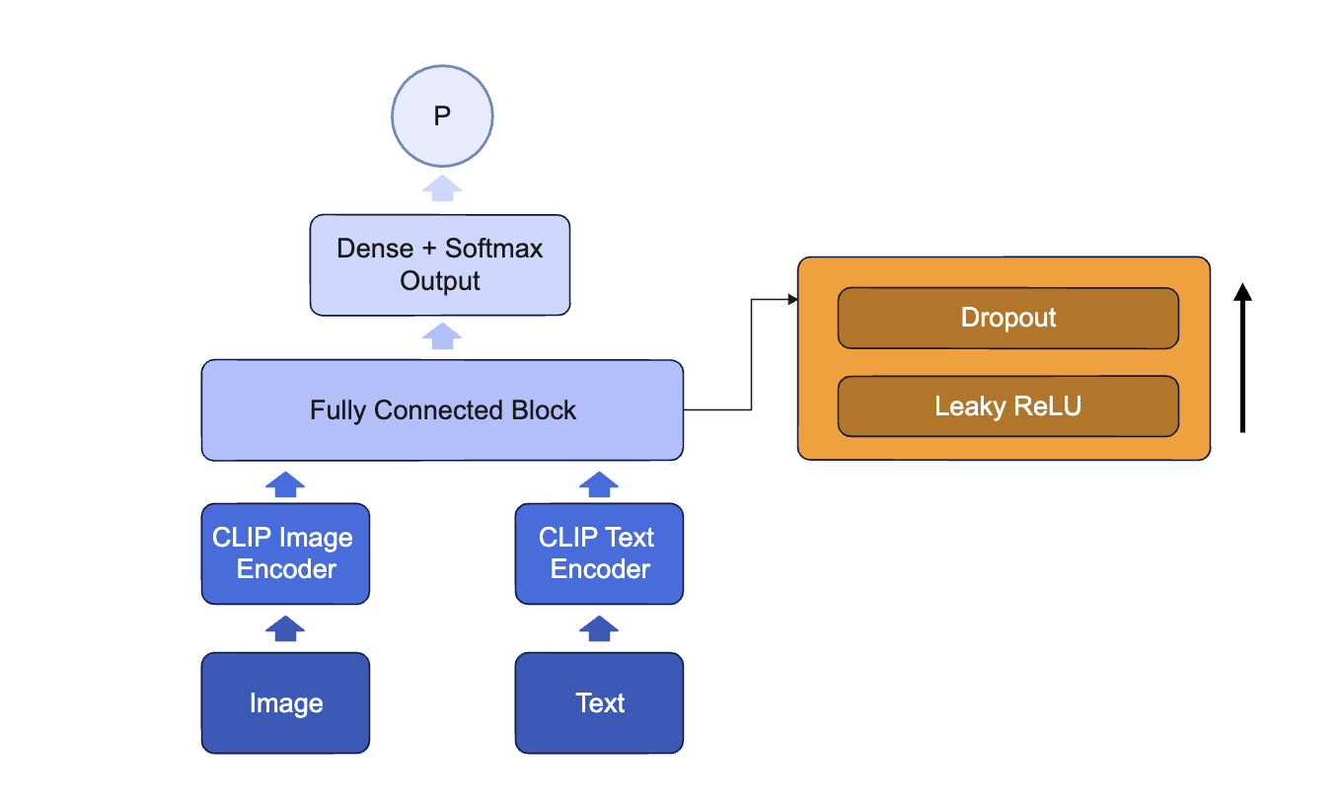
CLIP Architecture
29th April, 2023

Slide 13
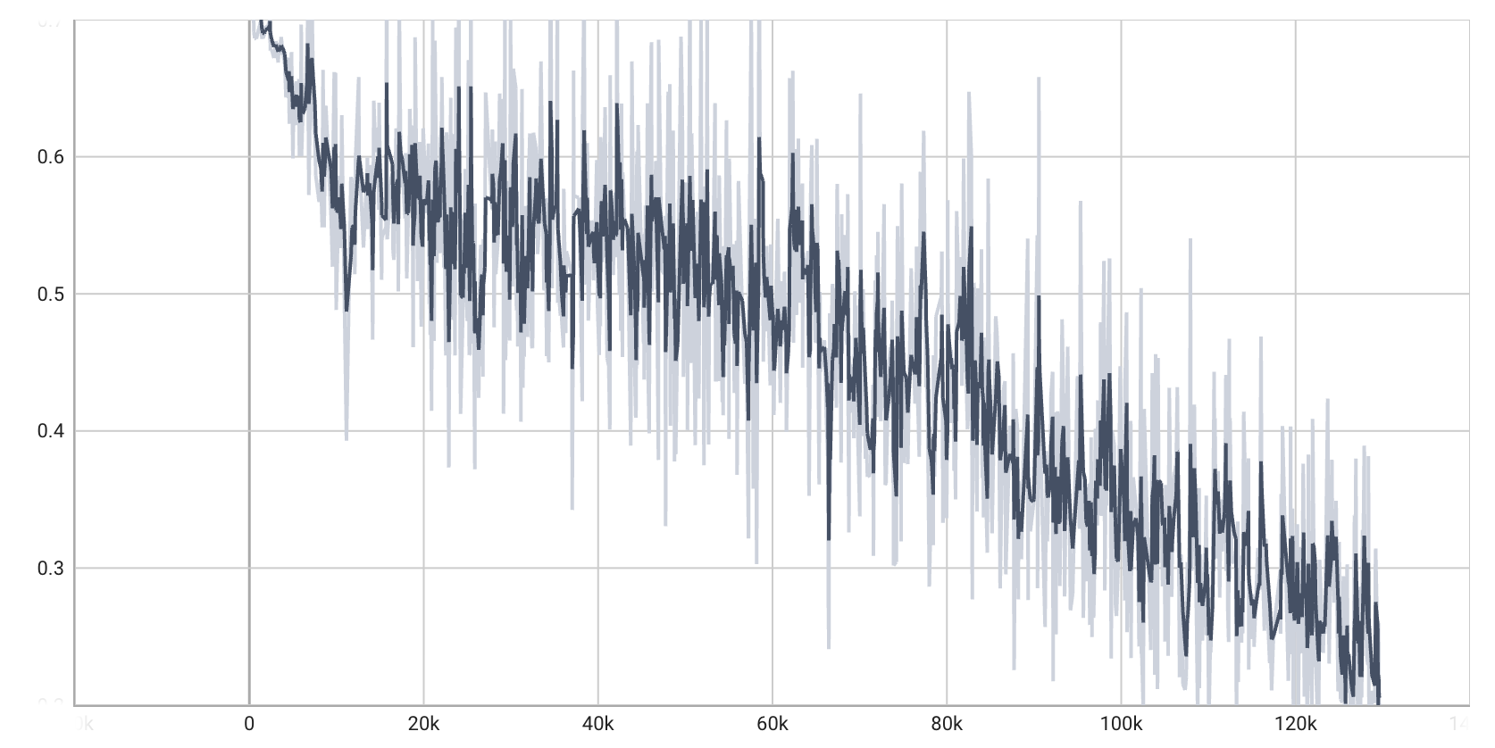
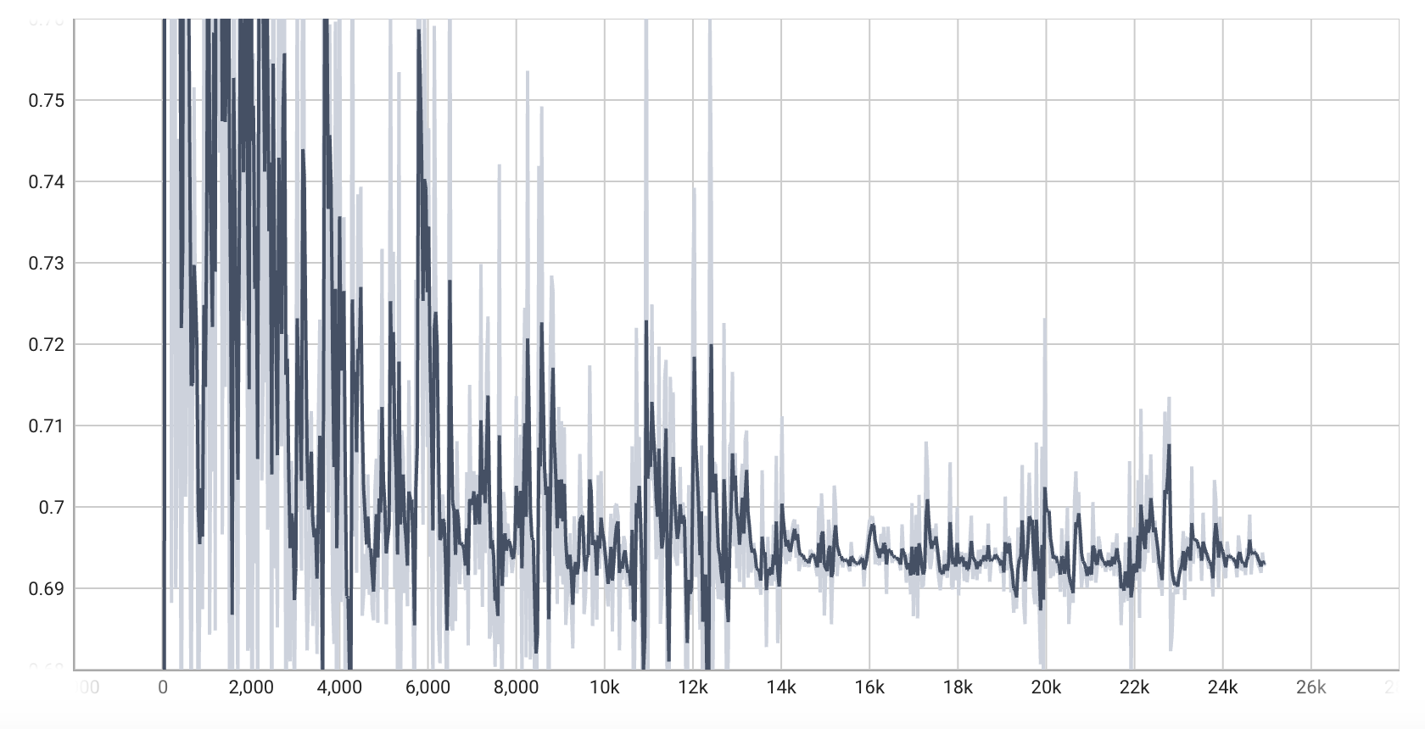
Results & Observations
Baseline Architecture
VisualBERT Architecture
Accuracy : 0.67
AUC : 0.54
Accuracy : 0.65
AUC : 0.52
Loss vs Number of steps
Loss vs Number of steps
29th April, 2023

Slide 14
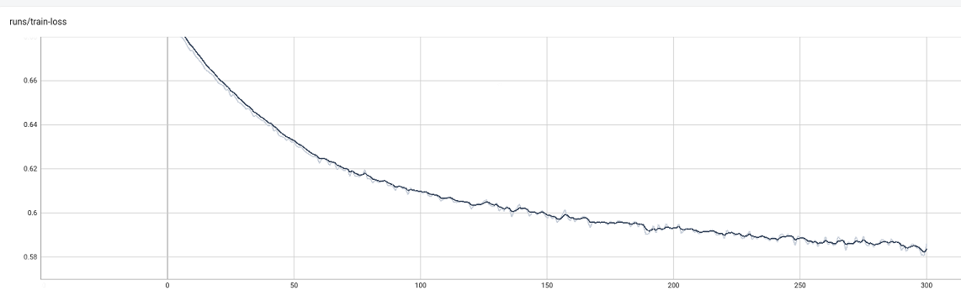
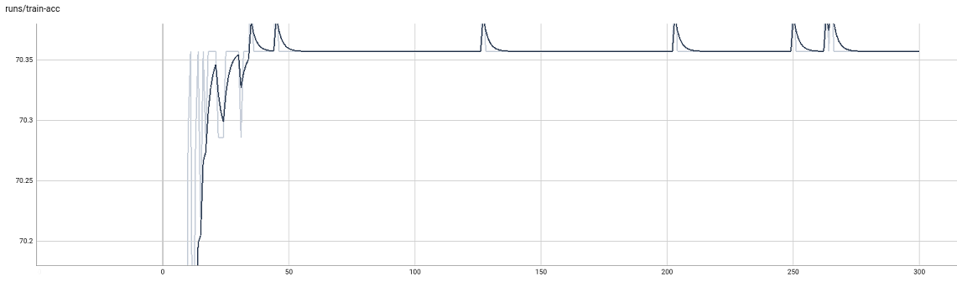
Results & Observations
CLIP Fine Tuning Architecture
Accuracy : 0.69
AUC : 0.66
Loss vs Number of epochs
Training Accuracy vs Number of epochs
29th April, 2023

Slide 15
Future Works
Due to time and computational limitations, there is still room for improvement. These include:
Train on more data if available
Improve the current model architecture to decrease probability of wrongly classifying memes as non-hateful
We can use better fusion techniques apart from concatenation
Conclusions
We worked on classifying hateful memes using three models: a baseline model, a VisualBERT model and a CLIP Fine Tuning Model.
The model with the highest accuracy is with the CLIP model, and a good AUC too.
The results of VisualBERT and baseline model were nearly equal (baseline performed somewhat better)
Given this result, if provided with more resource and time, we might consider adding other external features to further improve the accuracy and update the decision rule in our model to balance the false positive and false negative more.
29th April, 2023

Slide 16
Thank You!
29th April, 2023

