Slide 1
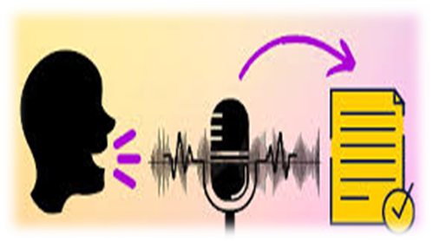
SIP ( E9-261 ) Course Project Presentation
Multi-Lingual Speaker Recognition
Presented by-
Neha Sharma – 21041
Ayush Singh - 20910

Slide 2
Outline
The problem we are addressing
Theory behind the approach to the problem
Experimental Setups and their Results and Observations
Conclusions
Future work
1st May, 2023

Slide 3
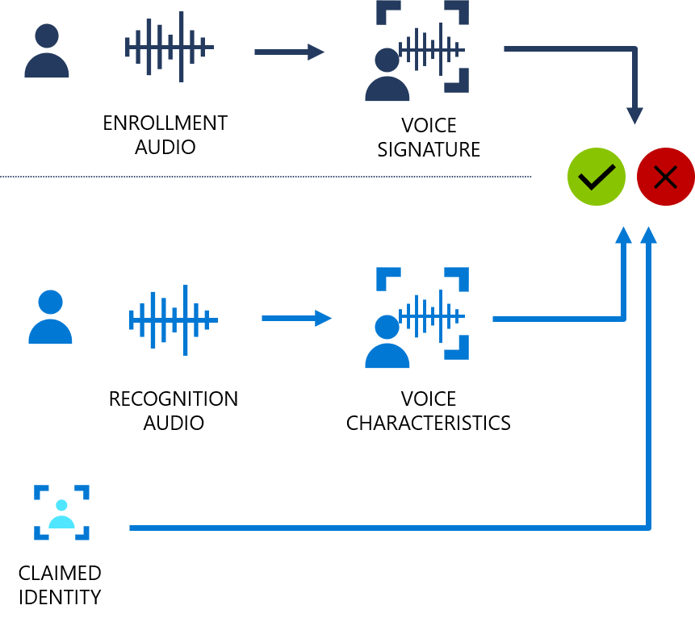
The problem we are addressing
The project addresses the problem of developing a multilingual speaker recognition and language identification system.
Neural network models and MFCC feature extraction are used to improve speaker recognition accuracy for two regional languages: Hindi and English.
We will determine the suitability of VCV or non-VCV sentences for speaker recognition task.
Is speaker recognition gender biased? This will be explored.
We will analyze how adding noise to audio data affects model performance in speaker recognition task.
Comparison of KNN, CNN, and LSTMs for speaker recognition task to determine which model performs better and why.
1st May, 2023

Slide 4
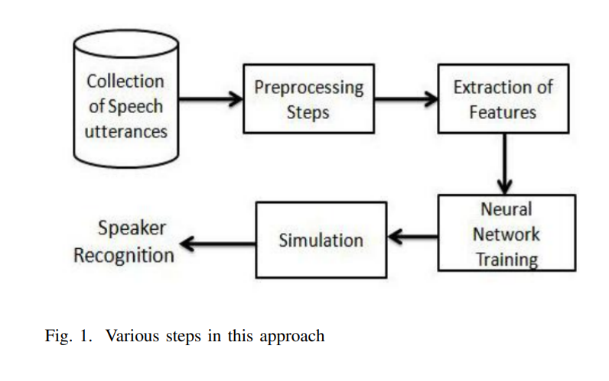
Theory behind the approach to the problem
15 VCV sentences recorded from 25 people in both English and Hindi (825 sentences in total).
Three models trained using extracted MFCC features: KNN, CNN, and LSTM
VCV sentences used because they have a similar sound pattern, making it easier to analyze and recognize speaker's unique characteristics
Addition of noise to audio datasets can affect speaker recognition accuracy by distorting spectral characteristics of voice
Multilingual speaker recognition is challenging due to phonetic structures and sound patterns unique to each language
Variation in phonetic patterns across different languages can affect acoustic characteristics of speaker's voice
Multilingual speakers may have different speaking styles or accents in different languages, further complicating speaker recognition task.
1st May, 2023

Slide 5
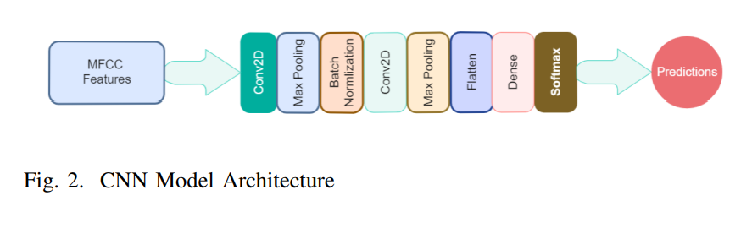
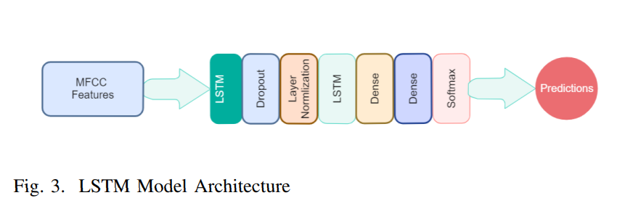
MODEL ARCHITECTURES
1st May, 2023

Slide 6
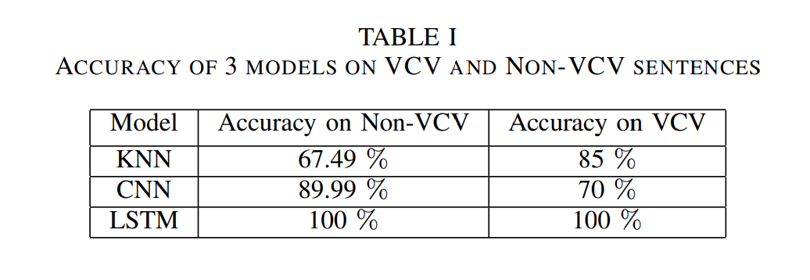
Experiment 1, Results and Observations-
In this experiment, 15 Non-VCV and VCV sentences were recorded from 5 speakers.
Speaker recognition was performed on both datasets individually to compare their suitability for the task.
The use of VCV (Vowel-Consonant-Vowel) sentences was found to be better for speaker recognition as they have a consistent phonetic structure.
VCV sentences are easy to control in terms of their length and content, and consist of a vowel sound, a consonant sound, and another vowel sound, ensuring a similar sound pattern for each sentence.
Non-VCV sentences can have a wide range of sound patterns, making it harder to analyze and recognize specific characteristics.
The consistency of VCV sentences makes them a more efficient and accurate dataset for speaker recognition systems
1st May, 2023

Slide 7
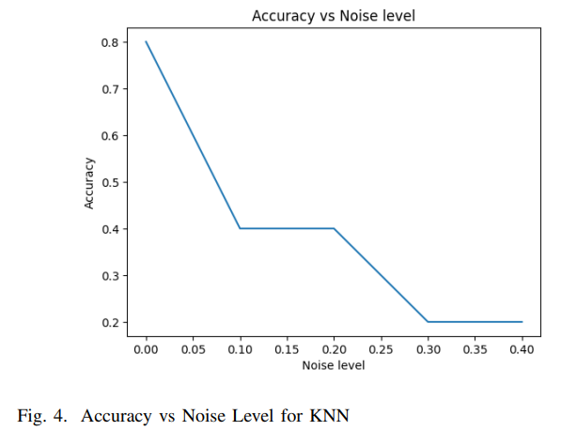
Experiment 2, Results and Observations-
This experiment involved adding noise to VCV sentences audio files and testing 3 models for speaker recognition tasks: CNN, KNN, and LSTM.
Results showed that noise affects all models' performance, but LSTM performed better in noisy environments than CNN and KNN.
MFCC features extracted from audio signals are commonly used as input to CNNs for speaker recognition tasks because they are robust to changes in the time domain caused by noise addition.
KNNs are generally not well-suited for handling noisy data because they are distance-based classifiers sensitive to noise in input features, which can lead to misclassifications.
The addition of noise to audio datasets can affect the accuracy of speaker recognition models since noise can distort the features necessary for speaker recognition.
An LSTM model is more robust to noise because it learns sequential patterns in an audio signal, such as the timing and duration of speech segments and the frequency characteristics of individual phonemes.
1st May, 2023

Slide 8
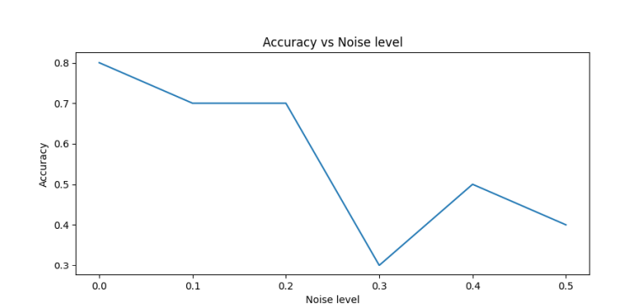
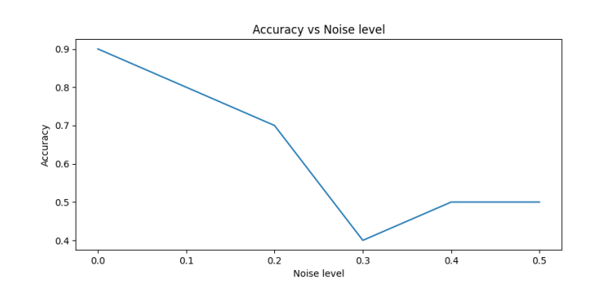
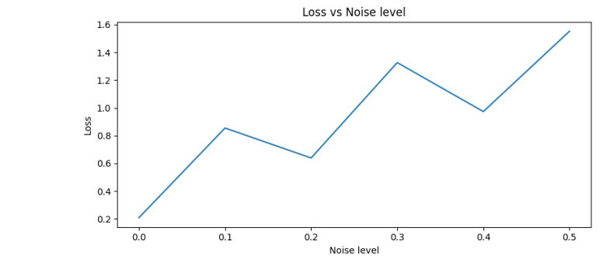
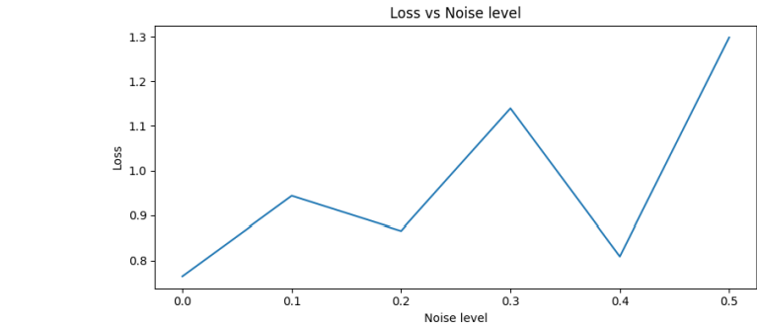
Experiment 2, Results and Observations-
LSTM
CNN
1st May, 2023

Slide 9
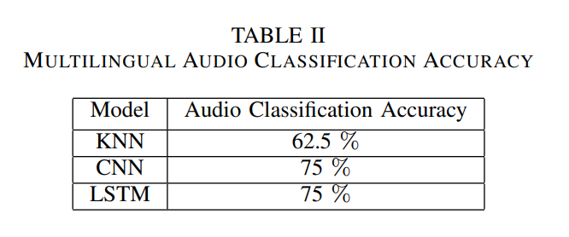
Experimental Setup
Experiment 3, Results and Observations-
This experiment segments and labels audio data by language for language identification
Speaker recognition aims to verify a speaker's identity across languages, which is challenging due to unique sound patterns
Experiment used existing models for multilingual audio classification on 10 individuals speaking Hindi and English
Variation in speech patterns and language models can make audio classification challenging
Classification algorithm needs to be robust to handle variability in speech patterns and languages
Results showed models were suitable for both speaker recognition and audio classification
1st May, 2023

Slide 10
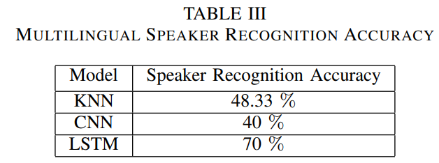
Experimental Setup
Experiment 4, Results and Observations-
In this experiment, we recorded 30 sentences (15 Hindi and 15 English) from 25 people for multilingual speaker recognition task.
Multilingual speaker recognition involves identifying speakers who speak multiple languages.
Proper labeling and annotation of the data is crucial to accurately reflect the speaker's identity across different languages.
LSTM networks perform significantly and consistently better in all the experiments, including multilingual speaker recognition.
LSTM networks can learn to extract relevant features from input signals and create a higher-level representation of the data that can be used to classify speakers across multiple languages.
LSTM networks perform better than other models because they can handle long-term dependencies in the input data and can remember previous input states, making them well-suited for tasks like speech recognition where the data is sequential and complex.
1st May, 2023

Slide 11
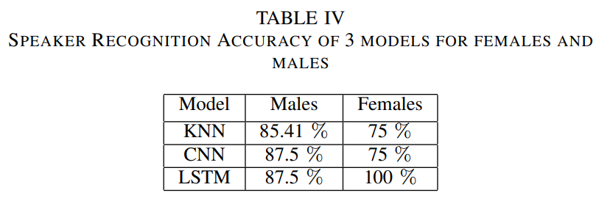
Experimental Setup
Experiment 5, Results and Observations-
Sample of 5 females and 5 males from dataset tested with 3 models for gender bias in speaker recognition
Models performed better on male group but premature to conclude gender bias
Male and female voices have different characteristics that can impact recognition accuracy
Good speaker recognition system should recognize voices regardless of gender
Both male and female voices can be used for speaker recognition, uniqueness of individual's voice is most important factor
Dataset for speaker recognition tasks should be diverse and include samples from a range of genders, ages, and ethnicities to avoid biases.
1st May, 2023

Slide 12
Conclusions -
We conclude that –
VCV sentences are preferred in speaker recognition tasks due to their consistent phonetic structure and ease of control regarding length and content.
Adding noise to audio datasets can negatively impact the accuracy of speaker recognition models, with KNN being the most affected due to its sensitivity to noisy data.
Using VCV sentences and LSTM models can improve the accuracy and efficiency of speaker recognition systems in noisy environments.
Experiment 3 showed that existing models are suitable not only for speaker recognition but also for multilingual audio classification.
Experiment 4 highlighted the challenges of multilingual speaker recognition, such as variation in phonetic patterns across different languages and the need for a diverse and representative dataset.
LSTM networks consistently outperformed other models in multilingual speaker recognition.
1st May, 2023

Slide 13
Conclusions -
We conclude that –
7. Experiment 5 found that although the models performed better on the male group, further investigation is needed to draw a more definitive conclusion on gender bias in speaker recognition.
8. Multilingual audio classification and speaker recognition require careful consideration of various factors, such as the phonetic patterns unique to each language, the availability of diverse and representative datasets, and potential biases in the system.
9. LSTM networks are effective in capturing the temporal information in speech signals, which is especially important in multilingual speaker recognition.
10. Diverse datasets and potential biases related to gender, age, and ethnicity should be taken into account to ensure the accuracy and fairness of speaker recognition systems.
1st May, 2023

Slide 14
Future Works -
As for future work, we suggest to continue investigating the following :
Are we overfitting the audio source? We used raw wav audio data from 25 people recorded on computers with moderate ambient noise. Testing the models on audio registered from various other sources will be interesting.
How can this algorithm be applied to real-time streaming? Currently, the algorithm is trained and tested on existing audio clips; what changes would we have to make to use it in a real-time scenario to identify speakers as they speak?
Other Feature Extraction technique should be explored ! We believe that LPC and LPC-derived features like Line spectral frequencies, linear prediction cepstral coefficients, log area ratios and arcus sine coefficients will perform better or equivalent to mfcc with LSTMs.
1st May, 2023

Slide 15
Thank You!

