Slide 1
THE JUNGLE BOOK
Presentation by: harshit keshari
Presented to: Siddharth sir

Slide 2
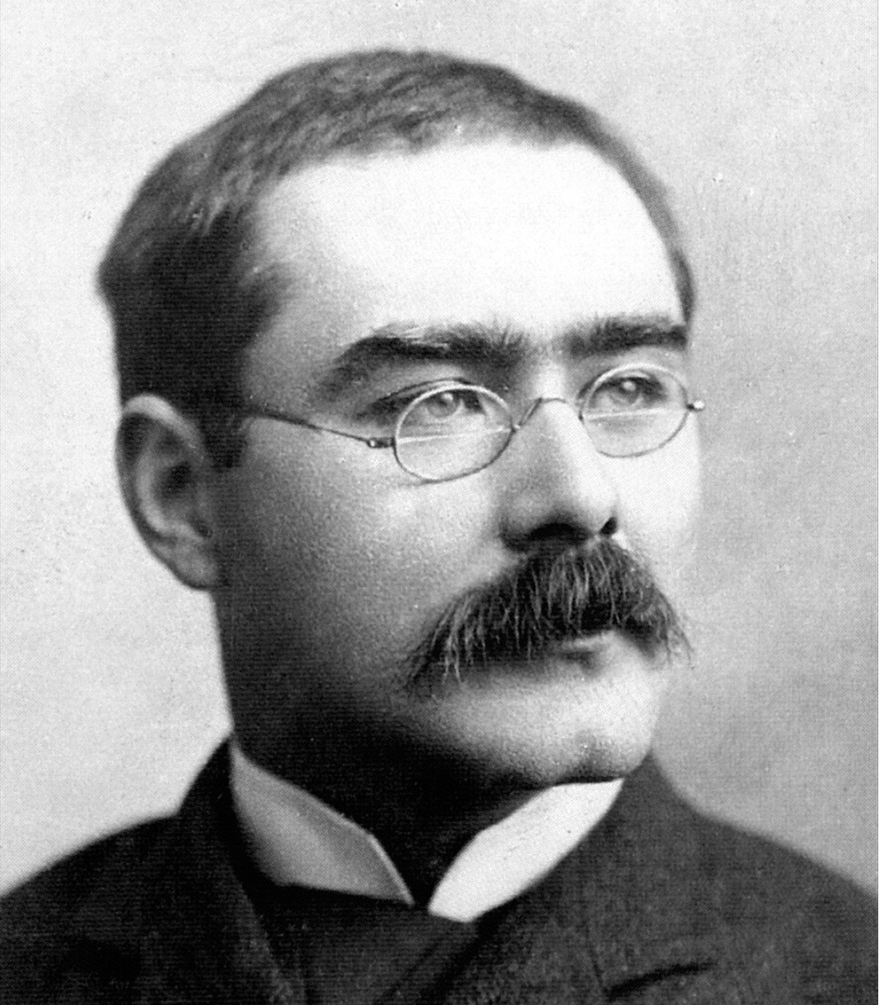
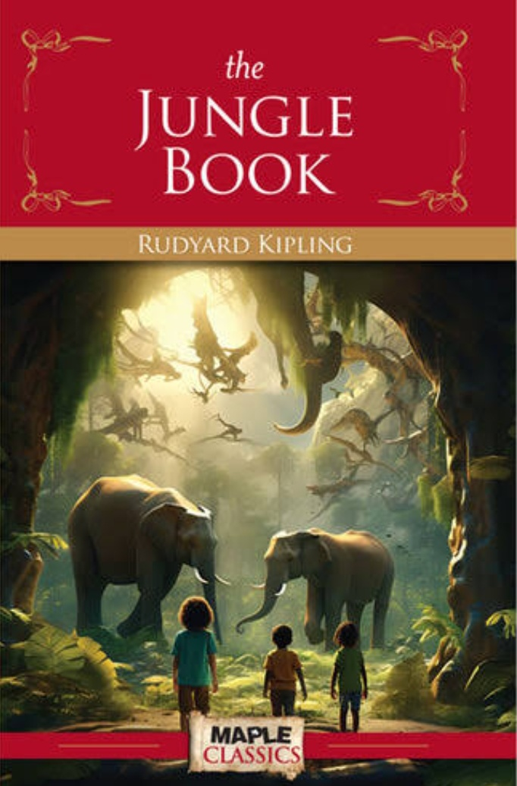
BOOK AND AUTHOR

Slide 3
ABOUT THE AUTHOR
A collection of short stories rather than one single story.• Combines animal fables, moral lessons, and adventure tales.· Main stories:o "Mowgli's Brothers"。“Kaa's Hunting"o "Tiger! Tiger!"o"The White Seal"o"Rikki-Tikki-Tavi"• Written originally for children but contains deep life lessons.
About the Author· Rudyard Kipling (1865-1936)· Born in Bombay, India; spent much of his life in England.· First English writer to receive the Nobel Prize in Literature(1907).· Famous works: The Jungle Book, Kim, Just So Stories.. Known for his storytelling rooted in colonialIndia, folklore, and moral lessons.

Slide 4
SETTINGS
· Location: Indian jungle (dense forests, rivers, caves).
Time Period: Late 19th century
Richly described natural environment full of danger, beauty, and wisdom.

Slide 5
SUMMARY
Baby Mowgli is lost in the jungle and raised by wolves.
Learns jungle laws from Baloo and Bagheera.
Faces danger from Shere Khan, the tiger.
Struggles between life in the jungle vs.human society.
Ultimately learns courage, wisdom, and his own identity.

Slide 6
MAIN CHARACTERS
Mowgli - Human boy raised by wolves.
Baloo – Gentle bear; teaches Mowgli “The Law of the Jungle.”
Bagheera - Wise black panther; Mowgli's protector.
Shere Khan - Cruel tiger who hates humans
Kaa - Enormous python, sometimes a friend to Mowgli
Akela - Leader of the wolf pack
Rikki-Tikki-Tavi -mongoose (hero ofa separate story).

Slide 7
MORAL MESSAGE
Respect and protect nature and animals
Unity and friendship make us stronger.
Courage and wisdom are keys to overcoming fear.
Everyone must find their true place in the world.

Slide 8
CONCLUSION
The Jungle Book is more than a children's story-it's a moral guide
Combines adventure, imagination, and life lessons.
Shows how humans and nature are connected.
Continues to inspirr าders, filmmakersand educators.

Slide 9
THANK YOU FOR YOUR ATTENTION

