Slide 1

YatraSetu AI
A safe-travel bridge for every pilgrim in Uttarakhand
Ayush Singh · B.Tech CSE (AI/ML), 4th Year · Roorkee Institute of Technology
Notes:
Introduce YatraSetu AI: setu means bridge. It bridges official information and millions of pilgrims, in their own language, at the moment they need it.

Slide 2
Record crowds in fragile mountains
6.03 cr
51 lakh
2.3×
56
visitors to Uttarakhand in 2025, highest ever
Char Dham pilgrims in 2025
Kedarnath peak day (30,154) vs. its recommended capacity (13,111)
pilgrim deaths in the first 28 days of the 2025 yatra
Sources: Uttarakhand Tourism data via ETV Bharat (2026); SDC Foundation via Counterview (2025); ETV Bharat (May 2025, May 2026)
Notes:
Tourism is a pillar of the state economy, but the Char Dham yatra concentrates huge numbers on narrow roads at high altitude. Peak days exceed safe capacity by more than two times, and health emergencies are frequent.

Slide 3





Pilgrims decide blind, officials warn too late
Scattered information
Unpredictable crowds
Registration, weather, roads, medical posts live in different apps, press notes and posts
No way to see in advance which days will be over capacity
Generic warnings
Unprepared at altitude
District-level alerts, not "your road tomorrow"; 2,500 tourists stranded in Mussoorie (Sept 2025)
Most deaths are cardiac, mostly pilgrims over 50
Language and network gaps
Pilgrims from every state; English-first apps; patchy coverage
Notes:
Five pain points come from one root cause: travellers lack timely, trustworthy, personalised information in their own language, and authorities lack forecasting and targeted broadcast tools.

Slide 4
Meet Sunita, 62, from Pune
Today
With YatraSetu
Picks the opening weekend: 2× over capacity
Learns of a landslide only at the debris
Skips health screening; no idea where help is
Searches in English on five different sites
Sees the week's crowd outlook and picks a lighter day
Gets a WhatsApp alert in Marathi or Hindi with a safe halt
Gets a readiness check and the screening point at Sonprayag
Asks one assistant in her language, with sources
Notes:
A persona makes the problem concrete. Every 'today' line maps to a documented problem; every 'with YatraSetu' line is a feature already working in the prototype (Marathi requires Bhashini credentials).

Slide 5




One assistant, five safety services
Ask in your language
Crowd forecast
Route-risk alerts
Health readiness
Officials' dashboard
Grounded answers with source and date; emergencies bypass AI
7-day outlook per shrine against carrying capacity
Your road, your dates: WhatsApp alert + safe halt
Self-check, screening reminder, medical posts
Publish once, reach every affected traveller
Works on WhatsApp, a lightweight web app and SMS: no new app to install

Slide 6
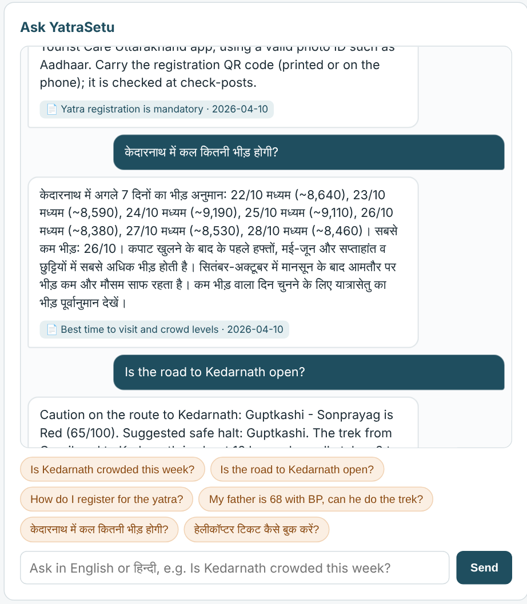
Trustworthy answers, in Hindi or English
1
Grounded
Every answer cites an official source and its last-updated date
2
Live
Crowd and route questions pull the forecast and risk services in real time
3
Safe
"Chest pain" or "stuck" triggers 112/108 instructions instantly, no AI model involved
4
Honest
Off-topic or unknown questions get a safe fallback instead of a guess

Slide 7
Spread the crowd before it forms
13.3%
forecast error (MAPE) on a held-out season
Every day is shown as Low, Moderate, High or Over capacity, with lighter dates and an alternative shrine suggested.
Gradient-boosted model; trained on a synthetic history calibrated to published totals

Slide 8
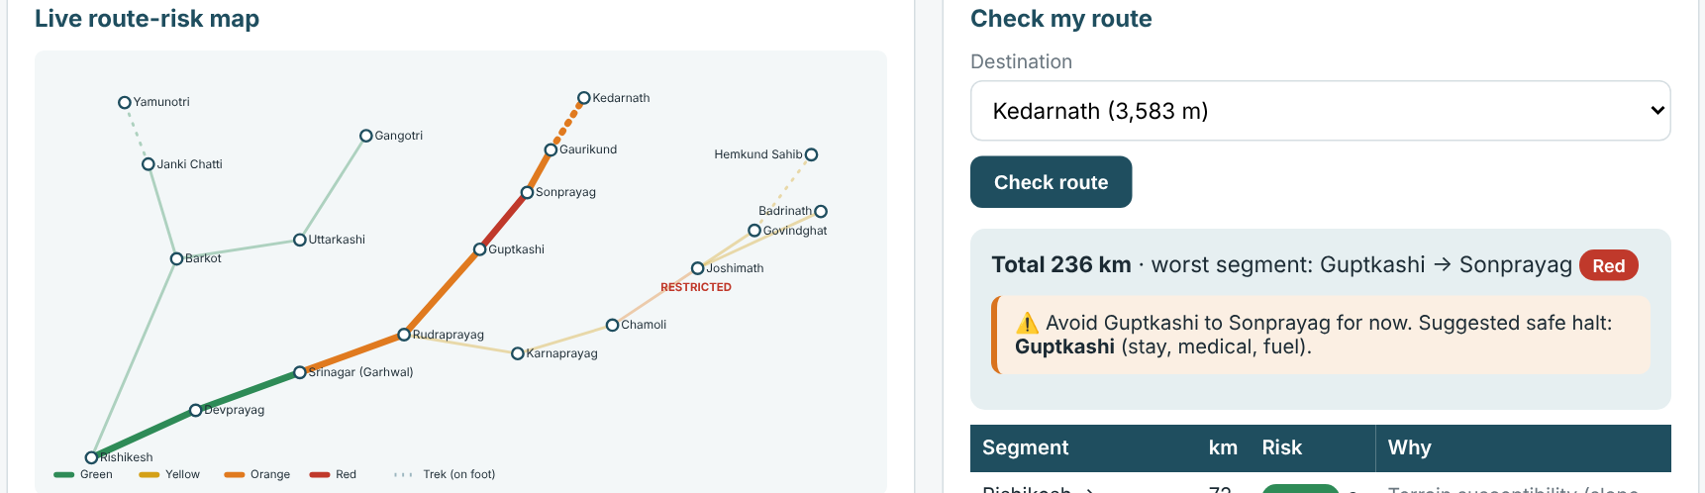


Warn the right travellers, on the right road
IMD alert or road closure
Segment risk scored 0–100
Official approves
WhatsApp / SMS + safe halt

Slide 9
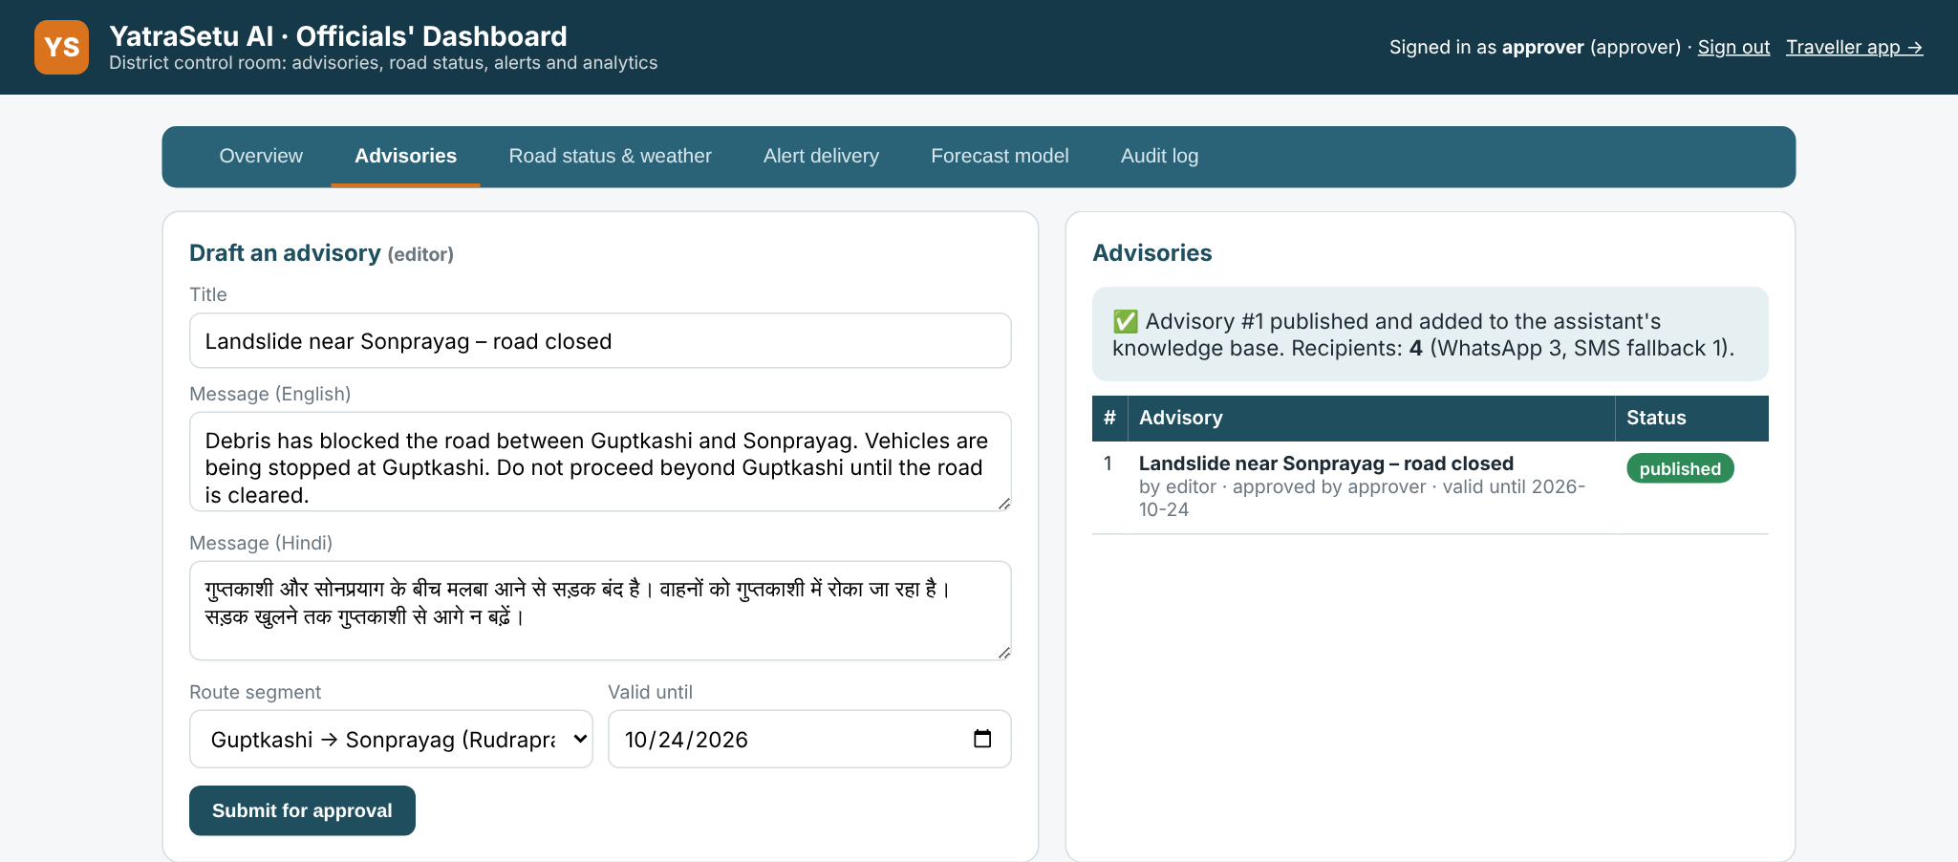
A control room for district officials
Four-eyes approval
The author can't publish their own advisory
Instant reach
Approved advisory updates the assistant and alerts every affected trip
Full audit trail
Every login, approval and road change is logged
Demo: advisory published to 4 subscribed trips: 3 by WhatsApp, 1 by SMS fallback
Live insight
What pilgrims ask, by topic and language

Slide 10

Built from proven, low-cost components
Channels
WhatsApp · Web app (PWA) · SMS · Officials' dashboard
AI engines
LangChain RAG on OpenRouter · Intent model · Gradient-boosted forecaster · Risk scoring · Bhashini for Indian languages
Platform
Python · FastAPI · scikit-learn · SQLite → PostgreSQL/PostGIS · runs offline on a laptop
No new hardware
Human approves every alert
Consent + hashed phone numbers (DPDP Act)
Graceful offline mode

Slide 11
The working prototype already performs
23 / 23
automated tests pass
~1.3 ms
to find an answer
40
bilingual test questions

Slide 12
What exists today vs. YatraSetu
Capability | Registration app | Disaster alert apps | Press notes / social | YatraSetu AI
Answers any yatra question | No | No | No | Yes
Your language (voice-friendly) | Partly | Partly | Partly | Yes
Crowd forecast vs. capacity | No | No | No | Yes
Route- and date-specific alerts | No | Partly | No | Yes
Health readiness + nearest help | No | No | No | Yes
Verified by officials, with audit | Yes | Yes | Partly | Yes

Slide 13


Costs less than one rupee per pilgrim
₹24.75 lakh
₹21 lakh / yr
₹0.41
one-time build (6 months, 4–5 people)
to run: cloud, AI, messages, support
per pilgrim per season
Who pays
Impact we will measure
Uttarakhand Tourism Development Board, state IT agency (ITDA), disaster-mitigation funds, CSR partners
Peak-day load cut by 10%+ · alerts in under 5 min · 1 lakh+ health checks · 5 lakh users in season one
Indicative estimates at typical market rates, not quotations

Slide 14
From prototype to the 2027 yatra
Done
Nov 2026 – Apr 2027
May – Jun 2027
2027 – 28
Working prototype
Pilot build
Pilot season
Scale
Assistant, forecast, route risk, health, SOS, dashboard; 18 tests
Data MoU, Bhashini voice, live WhatsApp/SMS, security audit
Rudraprayag and Chamoli districts (Kedarnath, Badrinath, Hemkund)
All 13 districts, Kanwar Yatra, other Himalayan states

Slide 15


Help us pilot it in the 2027 yatra
Four things will take YatraSetu from prototype to pilgrims' phones
Data-sharing MoU
Two pilot districts
Platform access
₹25 lakh budget
daily footfall + road status
Rudraprayag and Chamoli
WhatsApp Business, Bhashini, SMS
6-month pilot build
Ayush Singh · B.Tech CSE (AI/ML), Roorkee Institute of Technology
Notes:
Close with the ask. The prototype is done; what's needed is data access, two pilot districts, messaging/language platform access and a modest build budget.

