Slide 1
INTERNSHIP PRESENTATION
Artificial Intelligence
Internship
A one-month virtual internship at CodSoft, applying core AI and
machine-learning techniques across three hands-on projects.
Ayush Tiwari Roll No.: 25SCS1003001616 | Section: 1CSE13 IILM University, Knowledge Park 2, Greater Noida
INTERNSHIP DETAILS Domain: Artificial Intelligence • Organization: CodSoft

Slide 2
WHAT WE'LL COVER
Agenda
1
About the Organization
5
Task 1 — Chatbot with Rule-Based Responses
2
Internship Overview
6
Task 3 — Image Captioning
3
Tasks Completed
7
Task 4 — Recommendation System
4
Technology Used
8
What I Learned
CodSoft • Artificial Intelligence Internship

Slide 3
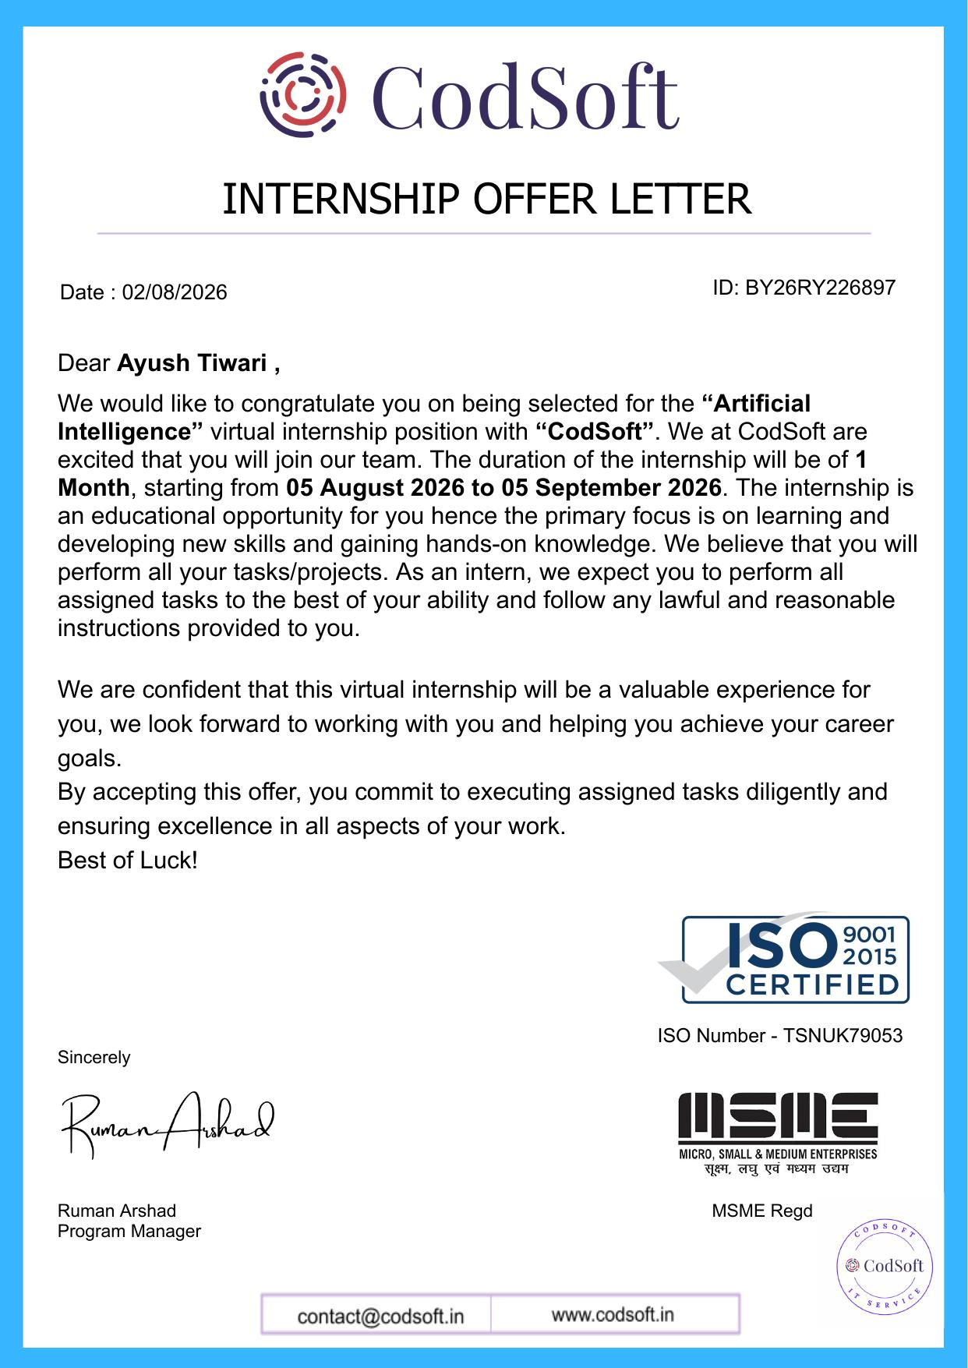
PROOF OF INTERNSHIP
Offer Letter
CodSoft • Artificial Intelligence Internship

Slide 4



ABOUT THE ORGANIZATION
About CodSoft
CodSoft is a tech education and software development platform that helps aspiring developers turn theoretical knowledge into practical, hands-on skills.
Virtual Internships
AI-Driven Career Tools
Project-Based Learning
Project-based internships across domains like AI, web development, and Java.
Resume builder, ATS checker, interview coach, and CodSoftAI mentor.
Curriculums built around real, buildable projects rather than theory alone.
CodSoft • Artificial Intelligence Internship

Slide 5







INTERNSHIP OVERVIEW
Internship Overview
Name
Ayush Tiwari
WHY THIS INTERNSHIP
Roll No. / Section
25SCS1003001616 • 1CSE13
It gives me hands-on practice in AI — building, training, and evaluating real models across three focused projects.
Company
CodSoft
Role
Artificial Intelligence Intern
Duration
1 Month (05 Aug 2026 – 05 Sept 2026)
Mode
Virtual / Remote
Program Manager
Ruman Arshad
CodSoft • Artificial Intelligence Internship

Slide 6



SCOPE OF WORK
Tasks Completed
TASK 1
TASK 3
TASK 4
Chatbot with Rule-Based Responses
Image Captioning
Recommendation System
A conversational agent that uses pattern matching to answer user queries.
Combines a CNN vision model with an RNN/transformer to generate captions for images.
Suggests movies to users using collaborative and content-based filtering.
CodSoft • Artificial Intelligence Internship

Slide 7






TECH STACK
Technology Used
Python
Pattern Matching
CNN (VGG16/ResNet)
Core language for all three projects.
Keyword & regex rules for the chatbot.
Extracts image features for captioning.
RNN / LSTM
Keras
scikit-learn
Generates captions word by word.
Builds and trains the neural network models.
Similarity metrics for recommendations.
CodSoft • Artificial Intelligence Internship

Slide 8
TASK 1 — GOAL
Objective
1
Build a chatbot that answers common user questions using rule-based logic.
2
Use pattern matching and keyword detection to identify user intent.
3
Handle greetings, small talk, and topic-specific queries with if-else rules.
4
Provide a graceful fallback response for unrecognized inputs.
5
Run an interactive command-line loop so the user can chat continuously.
CodSoft • Artificial Intelligence Internship

Slide 9
TASK 1 — HOW IT WAS BUILT
Approach & Tools
Python
String Matching
Response Rules
Core language used to write the rule engine and manage the conversation loop.
Keyword and regex-based pattern matching used to classify user intent before selecting a response.
A structured set of if-else / dictionary-based rules maps intents to friendly, context-aware replies.
CodSoft • Artificial Intelligence Internship

Slide 10

TASK 1 — HOW IT WORKS
Program Flow
1
2
3
4
User Input
Pattern Match
Rule Lookup
Response
User types a message
Keywords/regex scanned
Matching rule selected
Reply shown, loop continues
The pipeline runs start to finish for every new input, producing one result per pass.
CodSoft • Artificial Intelligence Internship

Slide 11
TASK 1 — DEMO
Sample Run
You: hello
Bot: Hi there! How can I help you today?
You: what is your name?
Bot: I'm CodBot, a simple rule-based assistant.
You: can you tell me a joke?
Bot: Why do programmers prefer dark mode? Because light attracts bugs!
You: bye
Bot: Goodbye! Have a great day.
CodSoft • Artificial Intelligence Internship

Slide 12
TASK 3 — GOAL
Objective
1
Combine computer vision and NLP to describe the content of an image in words.
2
Use a pre-trained CNN (VGG16 / ResNet) to extract visual feature vectors.
3
Feed those features into an RNN/LSTM (or transformer) to generate captions.
4
Train the decoder on an image–caption dataset so it learns natural phrasing.
5
Evaluate generated captions for relevance and fluency against sample images.
CodSoft • Artificial Intelligence Internship

Slide 13
TASK 3 — HOW IT WAS BUILT
Approach & Tools
CNN Encoder
RNN/LSTM Decoder
Keras & scikit-learn
A pre-trained VGG16/ResNet (Keras) extracts a feature vector representing the image's visual content.
The feature vector seeds a sequence model that generates the caption one word at a time.
Used for model building, tokenizing captions, and preparing the training/validation splits.
CodSoft • Artificial Intelligence Internship

Slide 14
TASK 3 — HOW IT WORKS
Program Flow
1
2
3
4
Input Image
CNN Encoder
RNN/LSTM Decoder
Caption
Photo is loaded
Extracts feature vector
Generates word sequence
Final sentence returned
The pipeline runs start to finish for every new input, producing one result per pass.
CodSoft • Artificial Intelligence Internship

Slide 15
TASK 3 — DEMO
Sample Output
Generated caption:
"a dog running through a grassy field"
Sample input image
CodSoft • Artificial Intelligence Internship

Slide 16


TASK 4 — GOAL & APPROACH
Recommendation System
Build a system that suggests movies to a user based on their past preferences, using similarity between users or between items.
Collaborative Filtering
Content-Based Filtering
scikit-learn
Finds users with similar rating patterns and recommends what they liked.
Recommends items similar in genre/features to ones the user already rated highly.
Cosine similarity and nearest-neighbor techniques rank candidate recommendations.
CodSoft • Artificial Intelligence Internship

Slide 17
TASK 4 — HOW IT WORKS
Program Flow
1
2
3
4
User Ratings
Similarity Calc
Ranking
Recommendation
Past preferences collected
Compare users/items
Score candidate titles
Top matches shown
The pipeline runs start to finish for every new input, producing one result per pass.
CodSoft • Artificial Intelligence Internship

Slide 18
TASK 4 — DEMO
Sample Recommendation
User rated highly: Inception, Interstellar, The Dark Knight
Generating recommendations...
1. Shutter Island (similarity: 0.91)
2. The Prestige (similarity: 0.88)
3. Memento (similarity: 0.85)
4. Tenet (similarity: 0.82)
Recommendations ready — based on genre & rating similarity.
CodSoft • Artificial Intelligence Internship

Slide 19
TAKEAWAYS
What I Learned
Strengthened fundamentals in rule-based logic, sequence models, and similarity-based recommenders.
Learned to combine computer vision and NLP components into a single working pipeline.
Practiced structuring an ML project end-to-end: data prep, modeling, and evaluation.
Gained confidence building and debugging three independent AI projects.
Thank you, CodSoft!
Ayush Tiwari | Artificial Intelligence Intern

